Slide 1

ESD COURSE PROJECT

Slide 2


Simulating Automatic door opener and closure using Raspberry pi
VISHWAKARMA INSTITUTE OF TECHNOLOGY, PUNE
Electronics and Telecommunication Engineering Department
Academic Year 2021-22
Under the Guidance of
Prof. SUNI TAYDE Sir

Slide 3











Group Details
D
Atharva Chaudhari
Roll No. 62
11910101
Shubham Damale
Roll No. 68
11910803
D
D
Division - ET-A
Batch 3
Group No. 3
Chinmay Deotale
Roll No. 71
11910759
Deven Nalawade
Roll No. 77
12020067
D
D

Slide 4

Contents
Project Objective and Introduction
Tools & Technology
Block Diagram
Pin Description
Schematic Capture
Output
Future Scope
Conclusion
References
Thank-you
D
D
D
D
D

Slide 5


D
Project Objective and Description
D
revolutionize the traditional methods of counting visitors
Count the
no. of visitors
D
D
Automatic Door
Opening
Alert using
LCD and LEDs
D

Slide 6

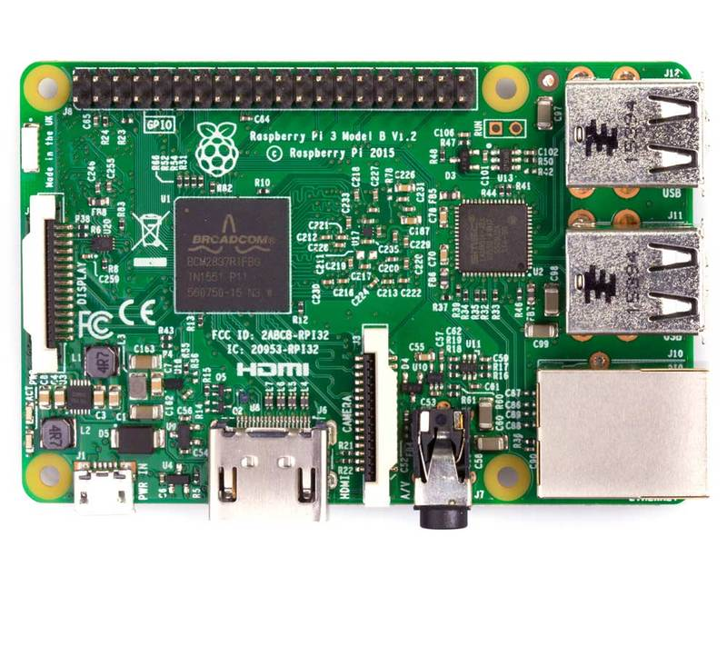
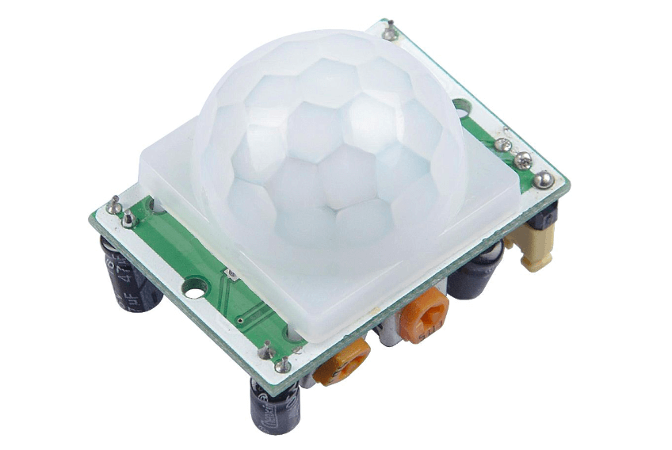
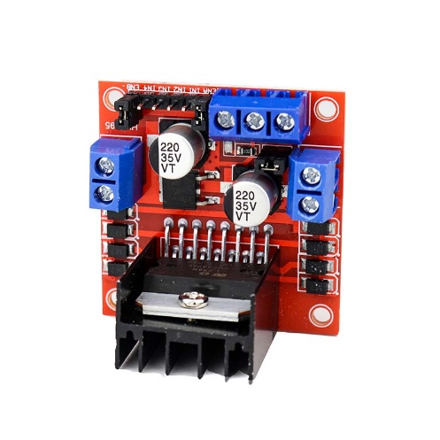

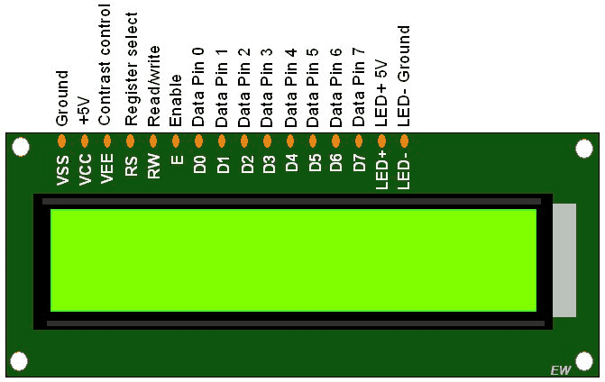

D
Tools & Technology
D
D
Proteus(8.9) Raspberry Pi 3 PIR Sensor
D
D
16*2 LCD L292D Motor DC Motor LEDS
Driver

Slide 7
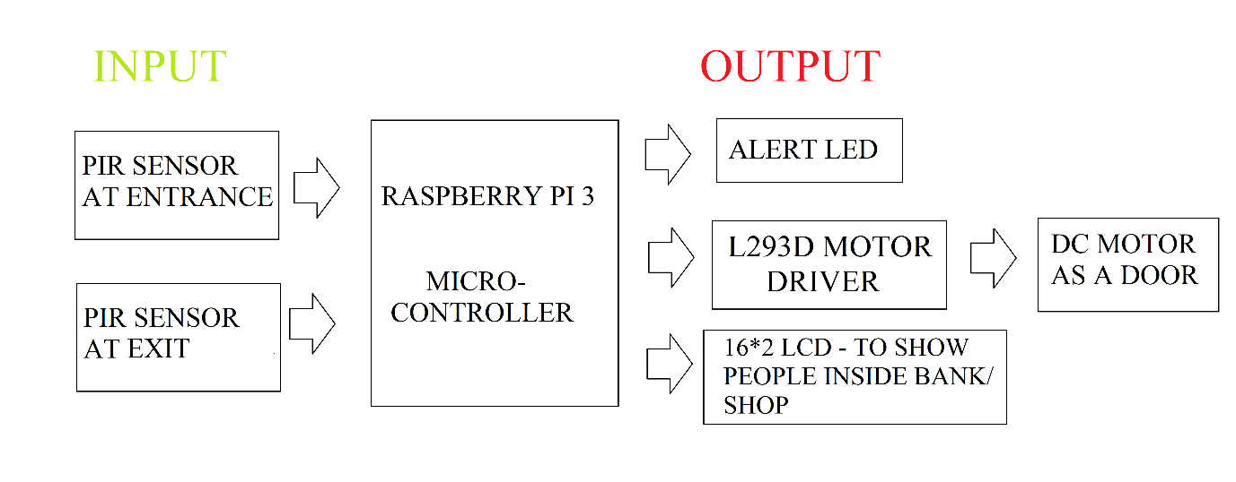
D
Block Diagram
D
D
D
D

Slide 8

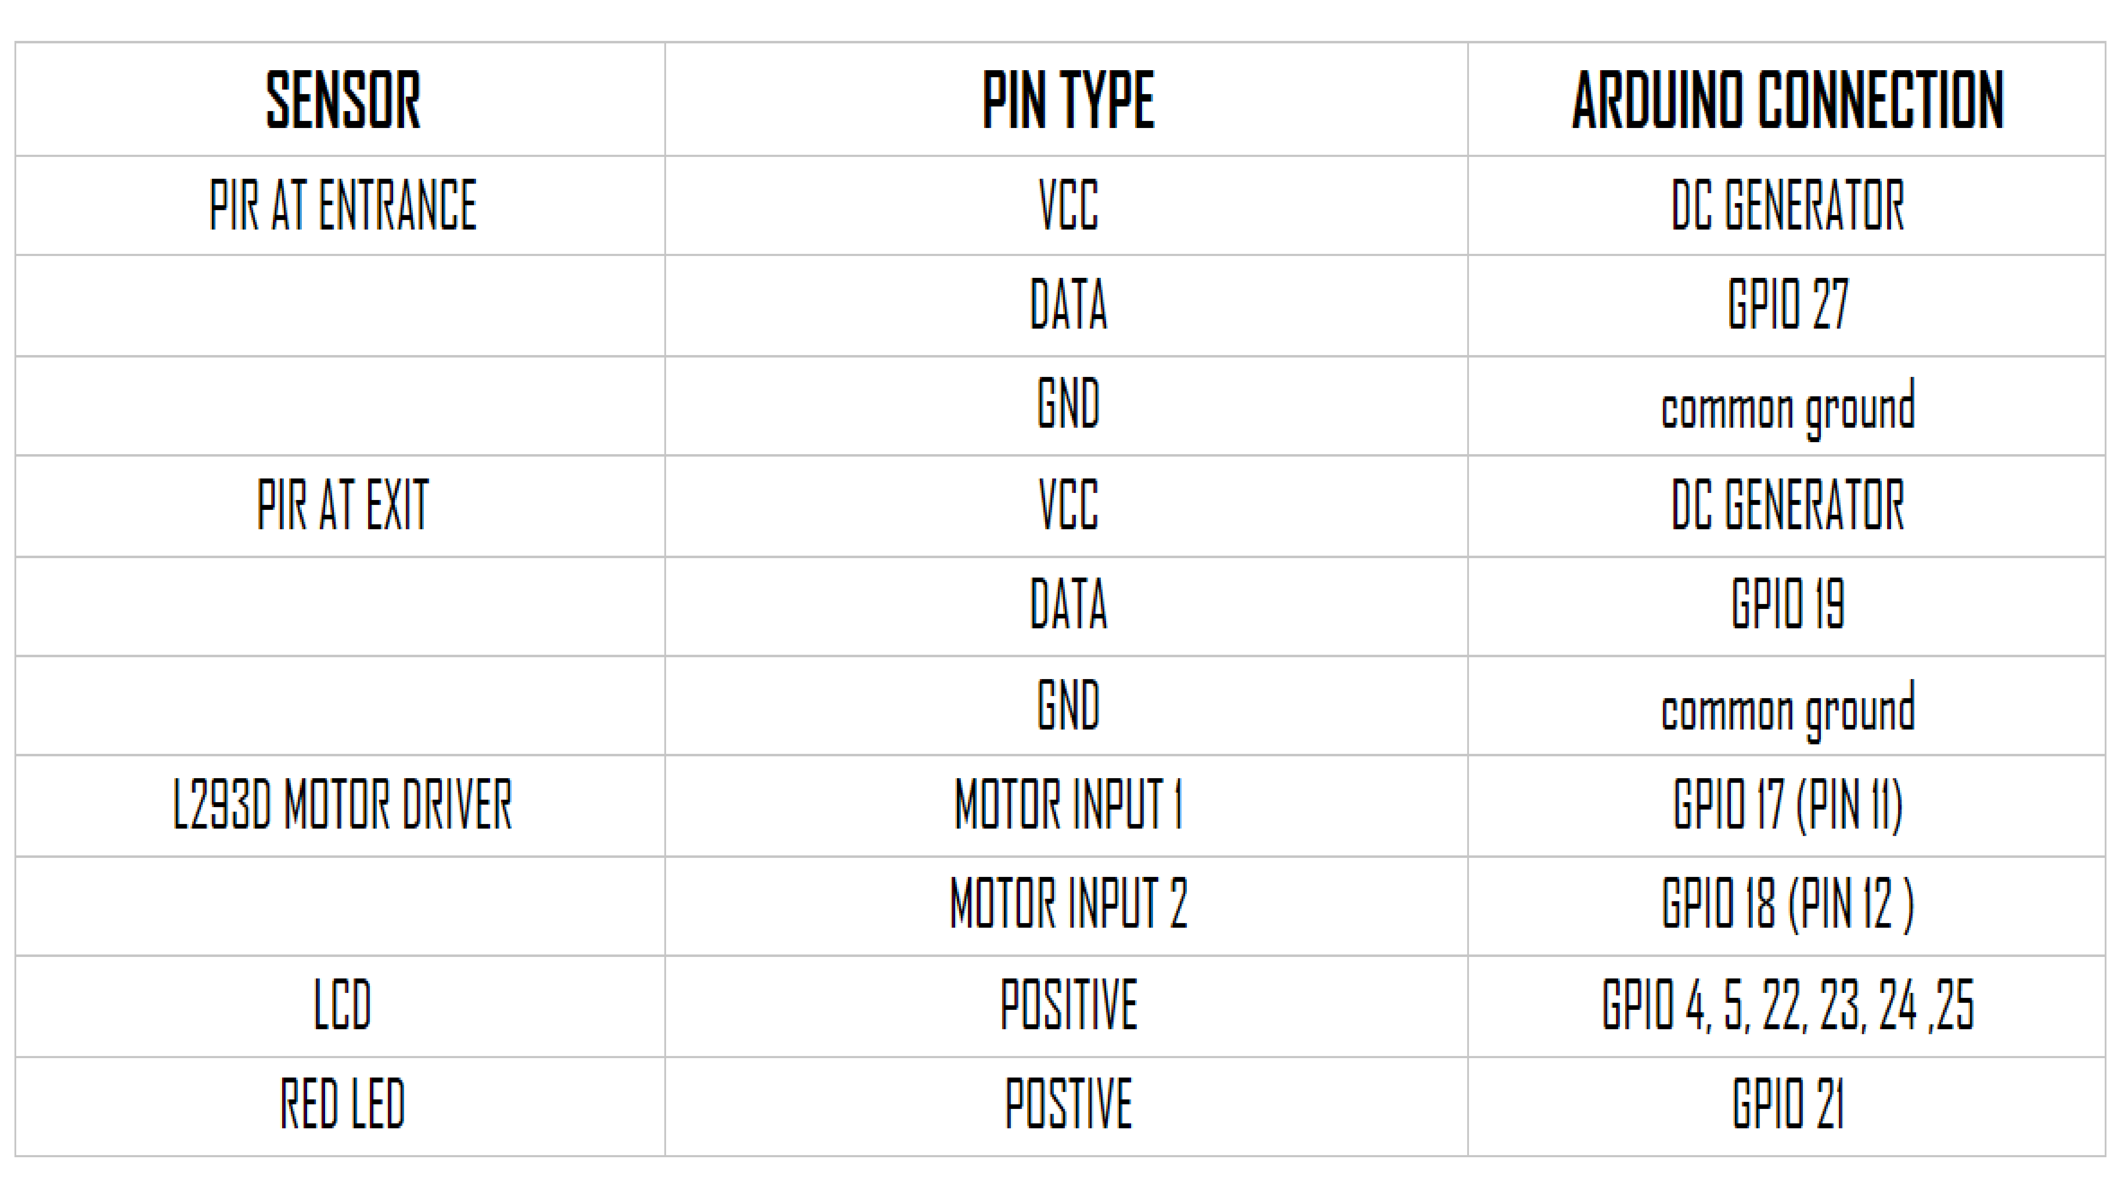
Pin Description

Slide 9
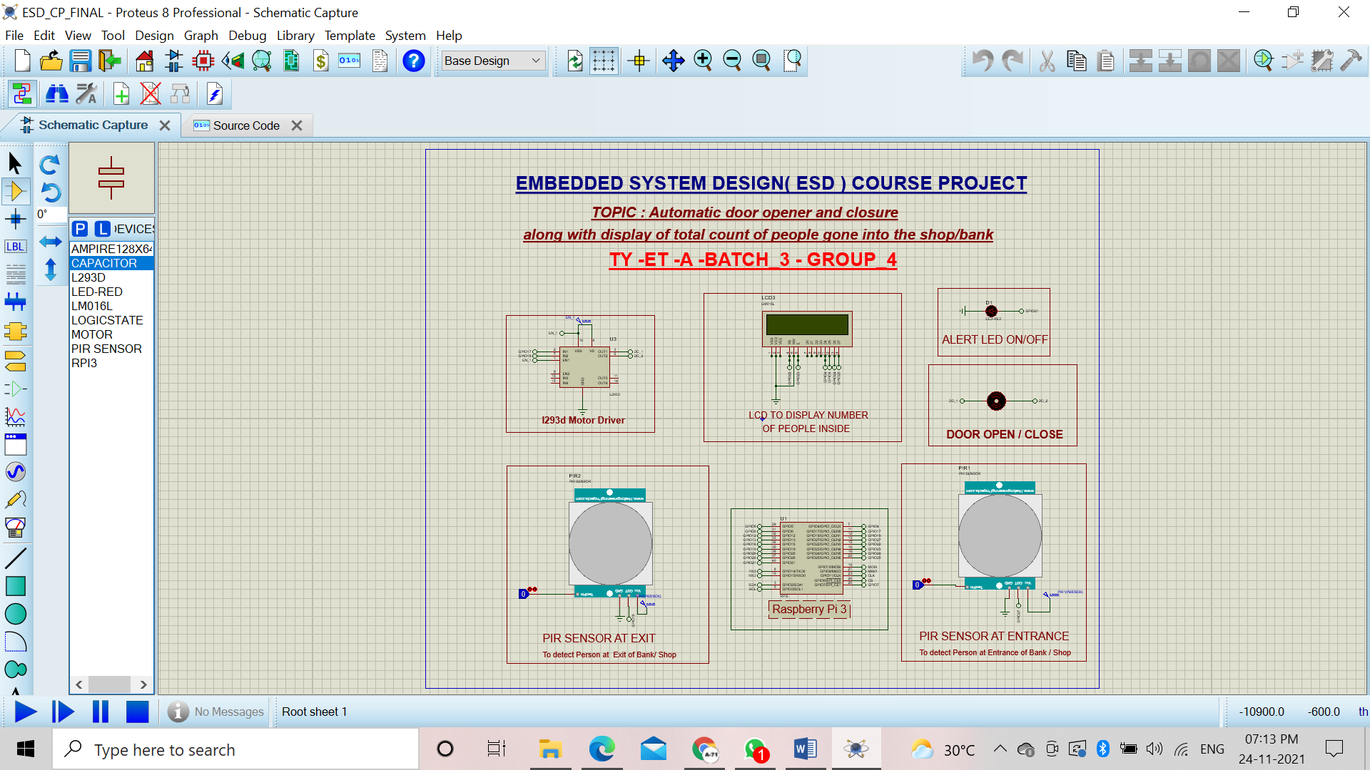
Schematic Capture

Slide 10
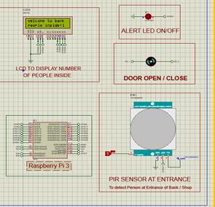
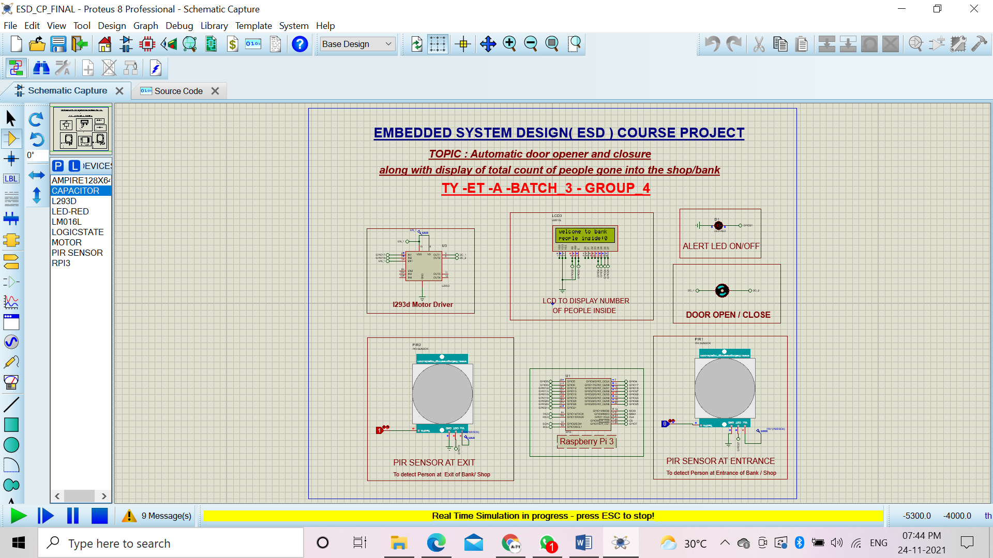
Output
As PIR Entrance detects person LED glows , Motor Rotates and Visitor count increments on LCD
As PIR Exit detects Person at Visitor count decrements on LCD

Slide 11

Conclusion
We were able to successfully Stimulate a system which would automatically open door(DC Motor) after sensing through PIR Sensor at entrance and Display the number of people inside the Bank / Shop .
The result will be shown by Alert Led glowing and Rotating DC Motor(showing opening of door)
Similarly if a person exits Bank / Shop PIR Sensor will detect the presence of that person and update the number inside number on display at Entrance by deducing one .

Slide 12

Future Scope
Adding MLX90614
Body Temperature detection
Mask Detection at Entrance
Mobile App
Hardware Implementation

Slide 13
References
A. Mathur, K. S. Nagl, "Microcontroller-based bidirectional visitor counter", Electronics for You, 78-81 (2007).
Gaurav Waradkar, Hitesh Ramina, Vinay Maitry, Tejasvi Ansurkar, Asha Rawat, Parth Das, "Automated room light controller with visitor counter", Imper. J. Interdisc. Res., 2(4): 777-780 (2016).
A. Dey, S. Chakraborty, S. Islam, M. Pramanik, Md. AH Malick, "Design of controllable bidirectional visitor counter", Int. J. Innov. Res. Elect Electro., Instru. Cont. Engg., 4(5): 133-136 (2016).
Mohanaprakash, Sathya, Dhanabal, "Modern multipurpose security and power management system", Int. J. Engg. Res. Gen. Sci., 3(2): (2015)
D

Slide 14


