Slide 1
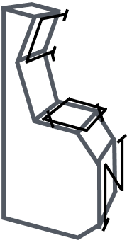

Brightcon 2023
Open source databases for MFA
Creative Workshop
Facilitated by
Sander van Nielen and Stewart McDowall
CML @ Leiden University
September 18-20
Luxembourg Institute of Science and Technology
Institute of Environmental Sciences, Leiden

Slide 2
Introduction
Databases exist for LCA and for EEIO, why not for MFA?
In this workshop we will:
Explain the context and motivation,
Dive into possible reasons for the lack of MFA databases,
Explore the organisational structure of an open MFA database, and
Discuss the technical structure of this hypothetical database.
AIM
Identify best practices for developing open databases – new and existing.

Slide 3



Workshop plan
Introduction: Motivation and context
Part One: Organisational structure
Presentation (10 min)
Breakout to small groups (20 min)
Plenary synthesis (10 min)
Part Two: Technical design
Presentation (10 min)
Breakout to small groups (20 min)
Plenary discussion (10 min)
Wrap up
DB
Notes:
This will be a collaborative brainstorming session with two sections (organisational and technical) consisting of:
Introduction
Breakout to small groups
Plenary discussion

Slide 4
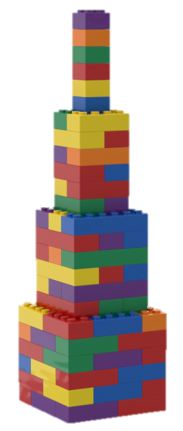
Context and background
Cumulative science:
Standing on the shoulders of giants - Newton
Data-intensive research benefits from databases
Accessible, reusable data can speed up research projects
Databases are part of research infrastructure

Slide 5
Data for MFA
Material Flow Analysis (MFA) quantifies stocks and flows of materials in society:
building materials,
metals in electronics,
hazardous substances,
and many more.
Data needs:
Production, construction
Trade
Composition
Lifespan
Waste flows, demolition

Slide 6

Part One: Organisational Structure
A database needs to be maintained and supported by (research) organizations or communities.
maintenance
DB
Data providers
Data users
management

Slide 7
What makes a successful database?
The data it contains must be wanted by a group of users.
The data must be up to date and complete. Also in the future.
The data must be presented in an attractive format to the user.
The technological expertise needed to use the system must be compatible with the users.
A mechanism of dialog is needed to deal with user inquiries and for identifying unmet user needs.
A database manager must commit to long-term support of the database.
maintenance
Porter et al. (2000)
6
3,4
DB
Data providers
2
1
Data users
5
management
Notes:
Discuss each, and identify pitfalls.

Slide 8
Part One: Organisational Structure
Need for a database
Why is the database needed?
Who will use the database?
What types of questions should the database be able to answer?
Who will provide data to the database?
Practical viability
What incentives stimulate data providers to provide data?
What quality checks are performed?
Who maintains the database? (incl. webhosting)
Who pays for the maintenance?

Slide 9
Questions on transparency
Should the database contain only open data or also license-protected data?
How to manage data with restrictive or unclear licensing?
Should the database collect company/product-specific data and show only averages?
What is a suitable level of data transparency?

Slide 10
Examples of existing databases
Name | Aim & content | Access | Entries
Ecoinvent | LCA – whole economy | Paid | 22,000
Exiobase | MRIO | Free | >10⁷ (data points)
GLAD (Global LCA Data network) | Gateway to LCI datasets | Mixed | 9,000 free 88,000 paid
HESTIA database | LCA – Agriculture | Free | ?
LCA Commons | LCA – Agriculture and forestry (USA) | Free | >10,000
NMD | LCA – Construction (NL) | Paid | 3000
ProSUM Urban Mine Platform | MFA – Waste streams (WEEE, ELV, batteries) | Free (but only figures) | >10,000
Material intensity database | Seed for building material intensity | Free | 608
Yale stocks and flows database (YSTAFDB) | MFA (data up to 2012) | Free | >100,000
BONSAI | LCA, EEIO | Free

Slide 11
Discussion: Organisational Structure
Think of a new MFA database and define its aim.
Pick one of the example databases and check the website.
Discuss the organizational structure: is it effective?
What does it mean for your new database?
Notes:
As a group, you can also decide to choose for an LCA or IO database.

Slide 12
Discussion: Organisational Structure
Guiding questions for discussion in groups
Questions | Existing example | New database
Why is the database needed? Who will use the database? What questions should the database answer?
Who will provide data to the database? What are the incentives for data providers? What quality checks are performed?
Who maintains the database? Who pays for the maintenance?
Desired level of data transparency?

Slide 13
Discussion Group X: Organisational Structure
(duplicate this slide for your group)
Questions | Existing example | New database
Why is the database needed? Who will use the database? What questions should the database answer?
Who will provide data to the database? What are the incentives for data providers? What quality checks are performed?
Who maintains the database? Who pays for the maintenance?
Desired level of data transparency?

Slide 14
Synthesis: Organisational Structure
What was the largest challenge for the example database? And for your case?
Demand by users
Data provision and updates
Required technological expertise
Maintenance and support of the database
Notes:
Optional:
Attractive data presentation format
Dialog with users
Data transparency

Slide 15
Part Two: Technical structure
Workshop on open databases for MFA

Slide 16
Part Two: Technical structure
What is a database?
Collection of information
Accessible by a database management system (DBMS)
Database types:
Relational databases: use SQL
Key-value databases: e.g. Redis
Document-oriented databases
Graph databases: e.g. Resource Description Framework

Slide 17
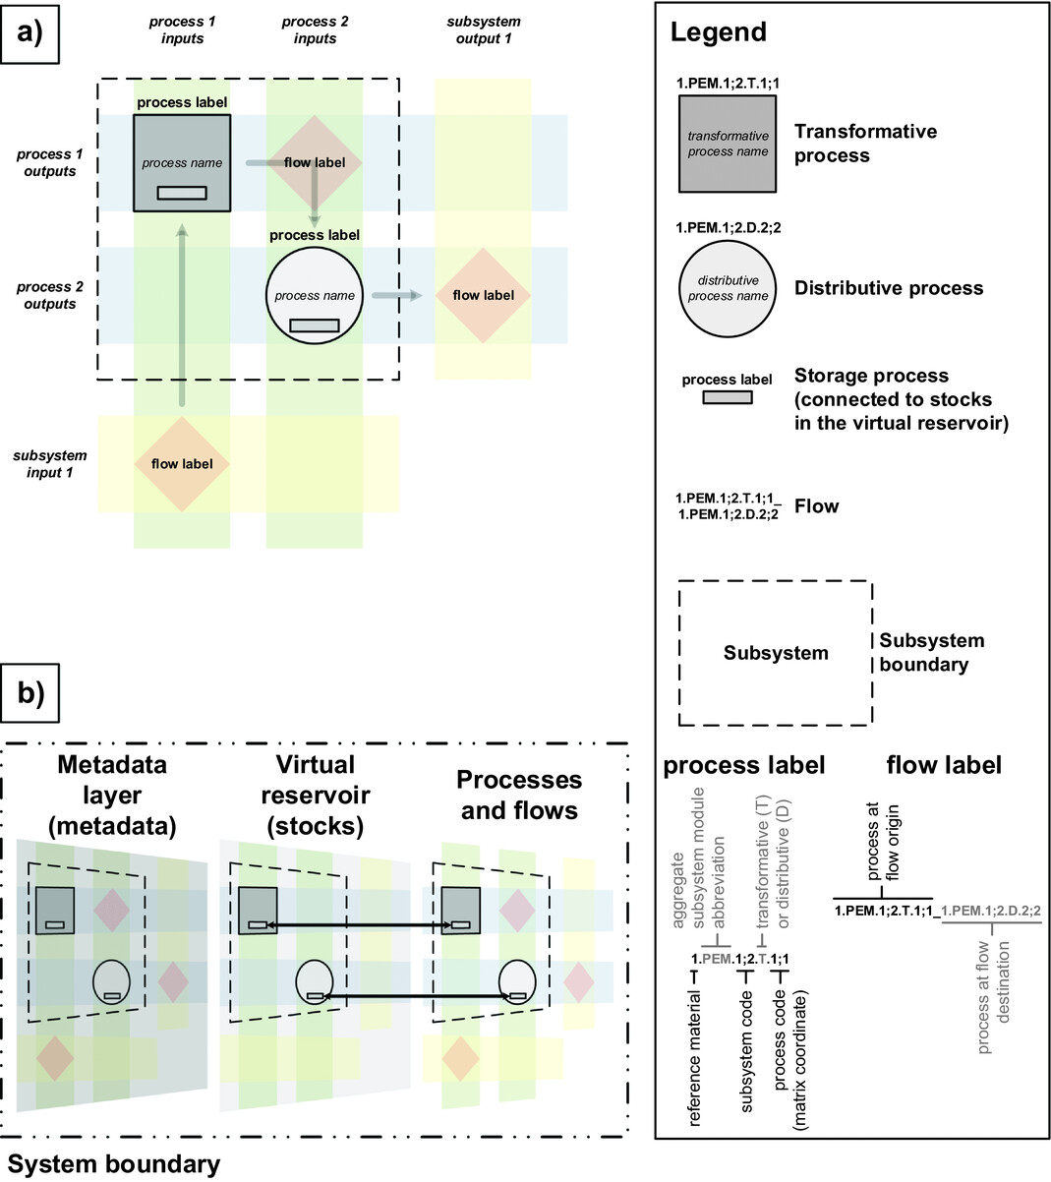
Example: Unified Material Info System
Myers et al. (2019)

Slide 18

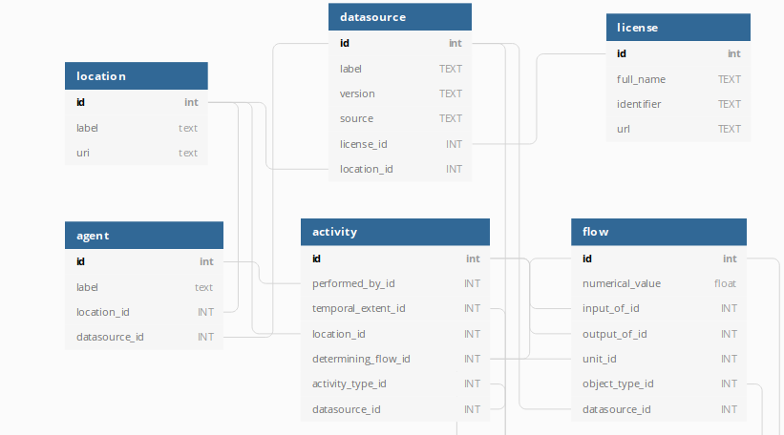
Example: BONSAI
Notes:
Tables and features

Slide 19
Part Two: Technical structure
Measures for reusable data
Use or expand existing data models
Consensus data models
Standardize classifications
Deliver formatted data
Convert data to linked open datasets
Database integration and interlinking
Create data templates and parsers
Pauliuk (2020)
Notes:
Data models: deciding in advance what properties are described in the database.

Slide 20
Part Two: Technical structure
Structure depends on the aim of the database
‘Deep’ databases | ‘Wide’ databases
Specialize on one or a few types of data. | Contain many different kinds of data.
Contain large amounts of observations on one (or a few) types of data. | Contain many different kinds of observation, but relatively few data of each type.
Provide sophisticated data query and analysis tools. | May provide tools for locating data, but typically do not have tools for analysis.
Tools operate primarily on data content. | Tools operate primarily on metadata content.
Porter et al. (2000)

Slide 21
Part Two: Technical structure
Data quality assurance:
Completeness
Metadata availability
Intact cross-links

Slide 22
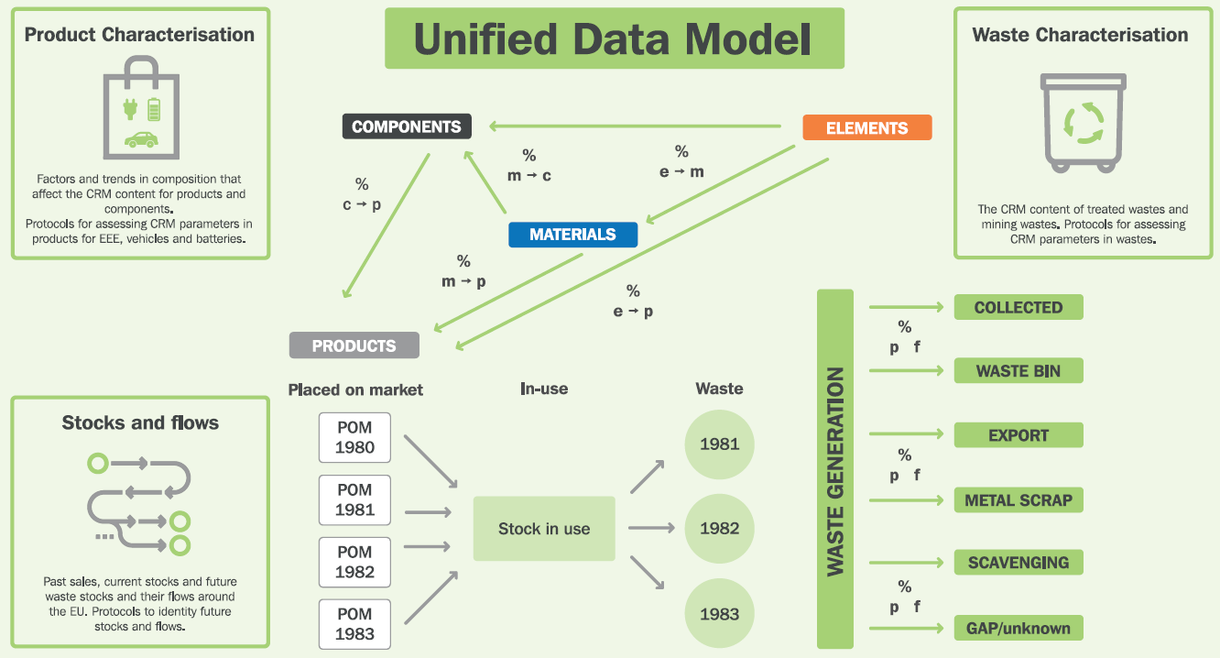
Example: Urban Mining Platform
ProSUM (2017)
→
→
→
Notes:
Data from measurements has to be inserted in the db format.
Links between all entities have to be established and corrected if needed.
Placed on market uses statistical codes that may change over time.

Slide 23
Discussion: Technical structure
Guiding questions for discussion in groups
Questions, technical aspects | Response
Data content & features
Database type
Accessibility
Optional: data quality assurance

Slide 24
Discussion Group X: Technical structure
(duplicate this slide for your group)
Questions, technical aspects | Response
Data content & features
Database type
Accessibility
Optional: data quality assurance

Slide 25
Synthesis: Technical Structure
Preference for certain technical specifications?
Is the choice different for use cases?
Data content & features
Database type
Accessibility
(Data quality assurance)

Slide 26
Bibliography
Huisman, J., Leroy, P., Tertre, F., Söderman, M. L., Chancerel, P., Cassard, D., Amund, N., Wäger, P. A., Kushnir, D., Rotter, V. S., Mählitz, P., Herreras, L., Emmerich, J., Hallberg, A., Habib, H., Wagner, M., & Downes, S. (2017). Prospecting Secondary Raw Materials in the Urban Mine and mining wastes (ProSUM) - Final Report.
ISIE-SEM section board (2021) Guidelines for Data Modeling and Data Integration for Material Flow Analysis and Socio-Metabolic Research. Freiburg. doi: 10.6094/UNIFR/217970.
Michener, W. K. and Brunt, J. W. (eds.) (2000) Ecological data: Design, management, and processing. Blackwell Science.
Myers, R. J. et al. (2019) ‘Unified Materials Information System (UMIS): An Integrated Material Stocks and Flows Data Structure’, Journal of Industrial Ecology 23(1), pp. 222–240. doi: 10.1111/jiec.12730.
Pauliuk, S. (2020) Making sustainability science a cumulative effort. Nature Sustainability 3, 2–4.
Porter, J., McCartney, P. and Vanderbilt, K. (2000) ‘2. Developing a Scientific Database’, in GTOS Central and Eastern European Terrestrial Data Management and Accessibility Workshop. Vácrátót, Hungary.

Slide 27
Stay in touch!
Stuart McDowall
s.c.mcdowall@cml.leidenuniv.nl
FutuRAM project
Sander van Nielen
s.s.van.nielen@cml.leidenuniv.nl
SUSMAGPRO project
Institute of Environmental Sciences (CML), Leiden

