Slide 1


Are the Provided Keywords on Open Data Portals Semantically Complete and Relevant? An Exploratory Study
Deperias Kerre, Christophe Debruyne
3rd NeXt-generation Data Governance workshop 2026 (NXDG 2026), co-located with SEMANTiCS 2026
Ghent, Belgium, September 15, 2026

Slide 2
Metadata as an Enabler of Dataset Discovery
Open data portals such as the European Open Data Portal contain increasingly large collections of datasets.
Data discovery usually through metadata and based on the quality of the metadata that describes it [1].
Keywords support metadata search yet the quality of keywords in relation to the descriptive metadata is unexplored.
1. J. Attard, F. Orlandi, S. Scerri, S. Auer, A systematic review of open government data initiatives, Government Information Quarterly 32 (2015) 399–418. doi:10.1016/j.giq.2015.07.006.

Slide 3
Why Keywords?
Metadata-driven dataset discovery in open data portals: Datasets typically discovered through metadata rather than direct access to their contents.
Keywords as Thematic Descriptors: “documents are linked thematically with each other when they have been indexed with the same tags” [2].
2. I. Peters, W. G. Stock, Folksonomy and information retrieval, Proceedings of the American Society for Information Science and Technology 44 (2007) 1–28. doi:10.1002/meet.1450440226.

Slide 4
The Problem: A Semantic Gap in Keyword Quality Assessment
Existing Metadata Quality Metrics [3]
✓ Completeness
✓ Accuracy
✓ Consistency
✓ Accessibility
✓ Interoperability
?
Do keywords adequately
represent the metadata?
BUT
Our focus: keyword annotations as a component of metadata quality and the evaluation of the semantic quality of keywords relative to titles and descriptions.
3. J. Martinez-Gil, Framework to automatically determine the quality of open data catalogs, Expert Systems with Applications 289 (2025) 128379. doi:10.1016/j.eswa.2025.128379.

Slide 5
Research Questions and Contributions
RQ1: How can established metadata quality dimensions be operationalized for analysing keyword annotations in open data portals?
RQ2: Do the keyword annotations on open data portals adequately semantically represent the
concepts expressed in descriptive metadata?
Contributions
Operationalizing Semantic Keyword Quality (SKQ): Semantic Relevance and Semantic Completeness.
Analysis of Semantic Keyword Quality: using sample data from the European Open Data Portal.

Slide 6
Introducing Semantic Keyword Quality
Semantic Relevance
Based on metadata accuracy and measures the degree to which keyword annotations semantically align with associated descriptive metadata (titles and descriptions).
Aggregated relevance: keyword set → metadata; captures collective semantic alignment.
Average keyword-level relevance: individual keyword → metadata; captures alignment of individual keywords.

Slide 7
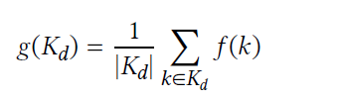
Introducing Semantic Keyword Quality
Semantic Relevance: Aggregated Semantic Relevance
Measures the overall semantic alignment between the entire keyword set and a descriptive metadata field associated with a dataset.
Let 𝐾_{𝑑} = {𝑘₁, … , 𝑘_{𝑛}} be the set of keywords assigned to dataset 𝑑, and 𝑀_{𝑑} ∈ {𝑡_{𝑑}, 𝑑𝑒𝑠𝑐_{𝑑}} represent the associated descriptive metadata, where 𝑀𝑑 consist of the dataset title or description.
Let 𝑓 (⋅) denote the embedding function, and 𝑔(⋅) denote an aggregation function combining the semantic representations of all keywords into a collective representation.
The aggregated relevance is defined as:
Cos (.,.) , cosine similarity
𝑅𝑒𝑙_{agg}(𝐾_{𝑑}, 𝑀_{𝑑}) = cos (𝑔({𝑓 (𝑘₁), … , 𝑓 (𝑘_{𝑛})}), 𝑓 (𝑀_{𝑑}))

Slide 8
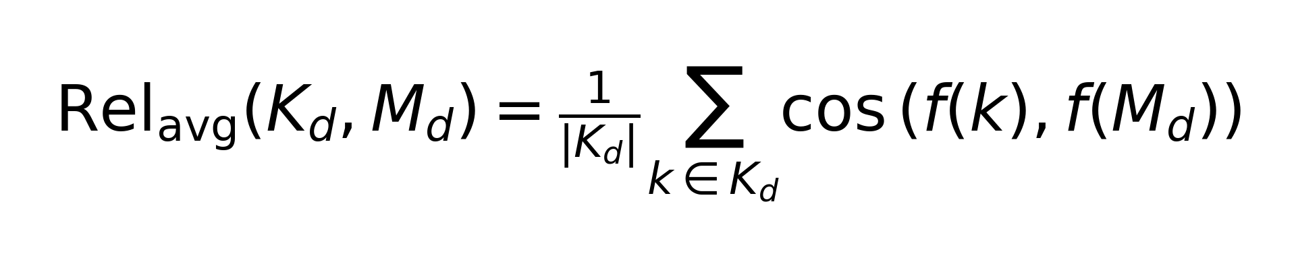
Introducing Semantic Keyword Quality
Semantic Relevance: Average Keyword-Level Relevance
Measures the average semantic alignment of individual keywords with a metadata field.
Let 𝑑 ∈ 𝐷 denote a dataset, 𝐾_{𝑑} = {𝑘₁, … , 𝑘_{𝑛}} the set of keywords assigned to 𝑑, and |𝐾_{𝑑}| the number of keywords.
Each 𝑘 ∈ 𝐾_{𝑑} represents an individual keyword, and 𝑀_{𝑑} ∈ {𝑡_{𝑑}, 𝑑𝑒𝑠𝑐_{𝑑}} denotes the dataset metadata, where 𝑀_{𝑑} is either the dataset title or description.
The formal definition of average keyword relevance is as given:

Slide 9
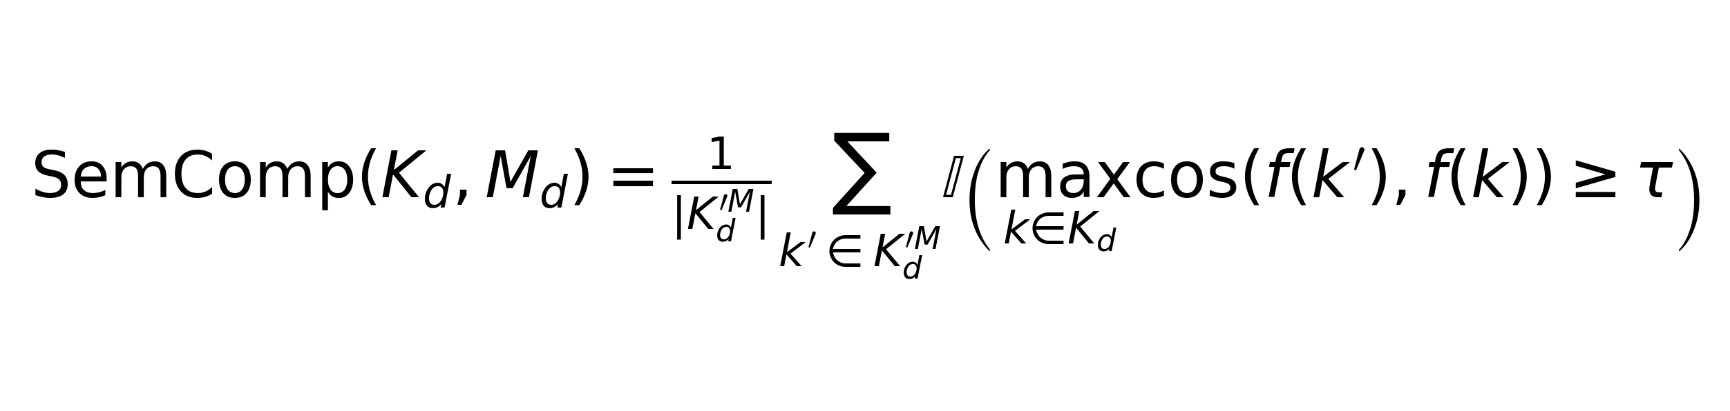
Introducing Semantic Keyword Quality
Semantic Completeness
Based on metadata completeness and measures degree to which keyword annotations semantically represent the concepts expressed in a metadata field.
Let 𝑑 ∈ 𝐷 denote a dataset and 𝑀_{𝑑} ∈ {𝑡_{𝑑}, 𝑑𝑒𝑠𝑐_{𝑑}} represent the associated descriptive metadata, where 𝑀_{𝑑} is either the dataset title or description.
Let 𝐶_{𝑑} = {𝑐₁, … , 𝑐_{𝑚}} denote the set of concepts expressed in metadata field 𝑀_{𝑑}, and 𝐾_{𝑑} = {𝑘₁, … , 𝑘_{𝑛}} denote the set of assigned keywords.
Concepts not directly observable at scale, operationalized using a set of metadata-derived keywords 𝐾′_{𝑀𝑑} = {𝑘′₁, … , 𝑘′_{𝑚} } extracted from 𝑀_{𝑑}
Semantic Completeness therefore defined as:

Slide 10
Analysing Semantic Keyword Quality
Experimental Set up
Data Source: European Open Data Portal used as a case study. 23,777 datasets from the data.gov.uk collection extracted from the metadata dump⁴. Randomly sampled 10,000 datasets (dataset ID, title, description, and keywords).
Keywords Baseline: metadata concepts approximated using KeyBERT; robustness checked using YAKE.
Sensitivity Analysis: Sensitivity: completeness thresholds τ ∈ {0.6, 0.7, 0.8}; alternative embedding model all-mpnet-base-v2.
4. https://data.europa.eu/en/download-datasets, accessed on 16 April 2026.

Slide 11
Analysing Semantic Keyword Quality
Experimental Results: Semantic Relevance
Summary statistics of semantic relevance
Metric | Agg Title | Agg Description | Avg Title | Avg Description
Mean | 0.44 | 0.41 | 0.30 | 0.28
Median | 0.44 | 0.42 | 0.28 | 0.27
Agg = Aggregated keyword relevance; Avg = Average keyword relevance.
Keyword sets are generally semantically related to the metadata, but alignment is low-to-moderate.
Individual keywords are less aligned than keyword sets collectively.

Slide 12
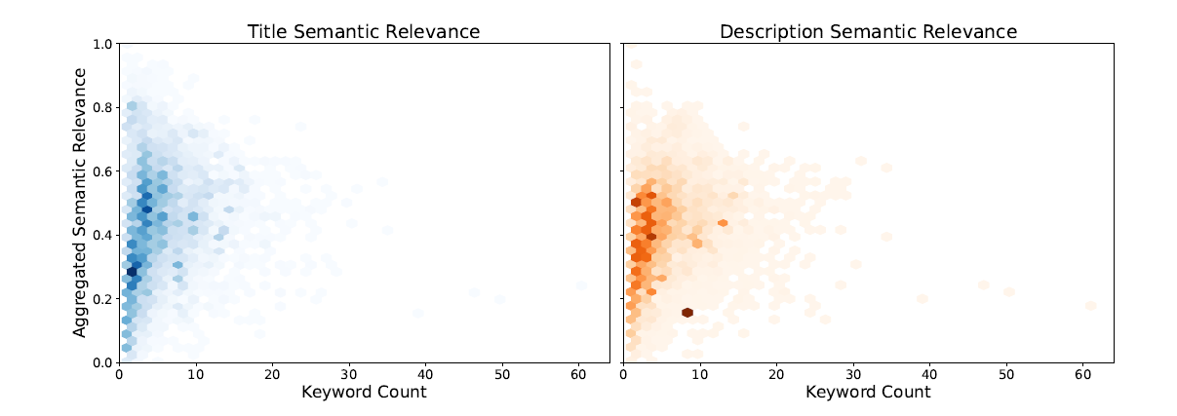
Analysing Semantic Keyword Quality
Experimental Results: Semantic Relevance
Relationship between the number of assigned keywords and aggregated semantic relevance
More keywords do not necessarily mean better aggregated semantic relevance.

Slide 13
Analysing Semantic Keyword Quality
Experimental Results: Semantic Completeness
Summary statistics of semantic completeness.
Metric | Title | Description
Mean | 0.325 | 0.278
Median | 0.200 | 0.200
Keyword annotations cover only a limited portion of the concepts expressed in descriptive metadata.

Slide 14
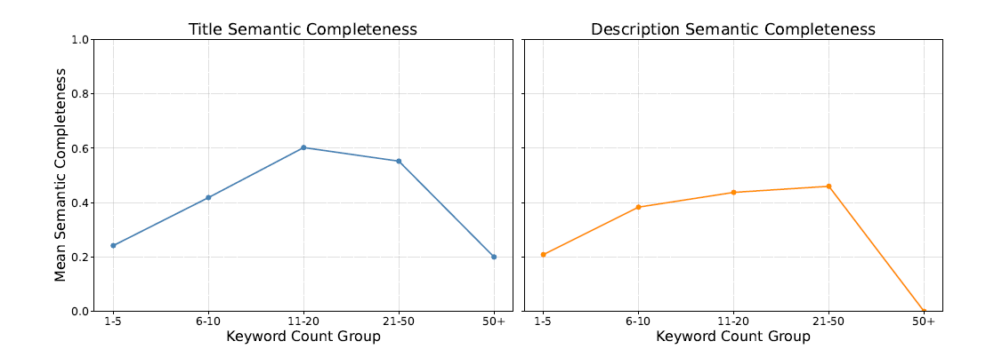
Analysing Semantic Keyword Quality
Experimental Results: Semantic Completeness
Relationship between the number of assigned keywords and semantic Completeness
More keywords do not necessarily mean better semantic completeness.

Slide 15
Analysing Semantic Keyword Quality
Experimental Results: Semantic Completeness versus Semantic Completeness
Semantic relevance exhibits low alignment (mean aggregated relevance of 0.44 and 0.41 for titles and descriptions, respectively), semantic completeness remains substantially lower (title mean = 0.33; description mean = 0.28).
Data governance perspective: current metadata curation practices within open data portals need to consider both aspects of semantic keyword quality.
Data annotation guidelines to consider not only: “Are keywords present?”, but also: “Do keywords accurately and comprehensively represent the semantic content of the metadata?”

Slide 16
Conclusion and Future Works
We operationalize existing metadata quality metrics to analyse semantic keyword quality in terms of semantic relevance and semantic completeness.
Keywords are generally semantically related to metadata, but keyword coverage of metadata concepts is limited. Semantic relevance and semantic completeness capture different aspects of keyword quality.
Current Limitation: Semantic completeness currently relies on automatically extracted metadata concepts rather than human-validated concepts.
Next steps: develop a human-annotated reference dataset, validate computational SKQ against human judgments, and investigate whether higher SKQ improves dataset discoverability and retrieval.

Slide 17


Acknowledgements and Availability of Resources
Acknowledgements
This work was supported by the Fonds de la Recherche Scientifique – FNRS under Grant n° MIS F.4016.24.
Availability of Resources
GitHub
Zenodo
Link: https://github.com/DeperiasKerre/keyword_quality_eval
https://doi.org/10.5281/zenodo.22108459

Slide 18
Thanks for your attention. Q & A.

