Slide 1

Tutorial of week 3
Dong Taotao
220019128@link.cuhk.edu.cn

Slide 2
Review
Structure of Relational Databases
Database Schema
Keys
Schema Diagrams
Relational Query Languages
The Relational Algebra

Slide 3
Review
Design Process
The Entity-Relationship Model
Complex Attributes
Mapping Cardinalities
Primary Key
Removing Redundant Attributes in Entity Sets

Slide 4
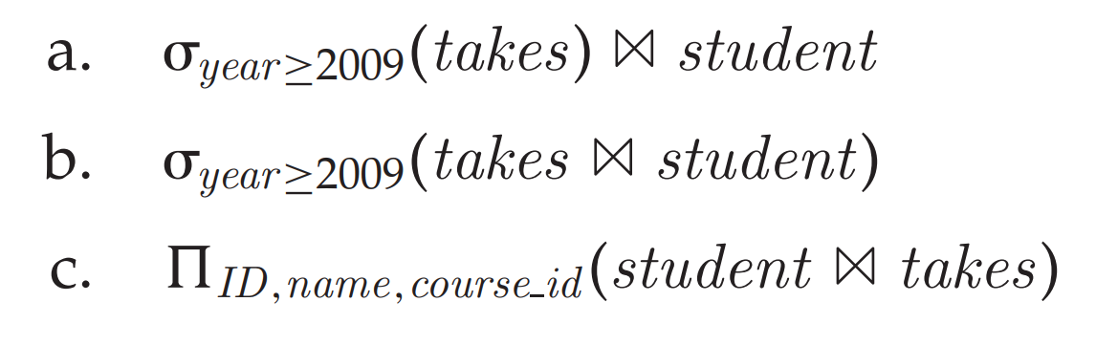
Exercise 1
Consider the following expressions, which use the result of a relational algebra operation as the input to another operation. For each expression, explain in words what the expression does.

Slide 5
Exercise 1
a. For each student who takes at least one course in 2009, display
the students information along with the information about what
courses the student took. The attributes in the result are:
ID, name, dept name, tot cred, course id, section id, semester, year, grade
b. Same as (a); selection can be done before the join operation.
c. Provide a list of consisting of ID, name, course id of all students who took any course in the university.

Slide 6
Exercise 2
Construct an E-R diagram for a car insurance company whose customers own one or more cars each. Each car has associated with it zero to any number of recorded accidents. Each insurance policy covers one or more cars and has one or more premium payments associated with it. Each payment is for a particular period of time, and has an associated due date, and the date when the payment was received.

Slide 7
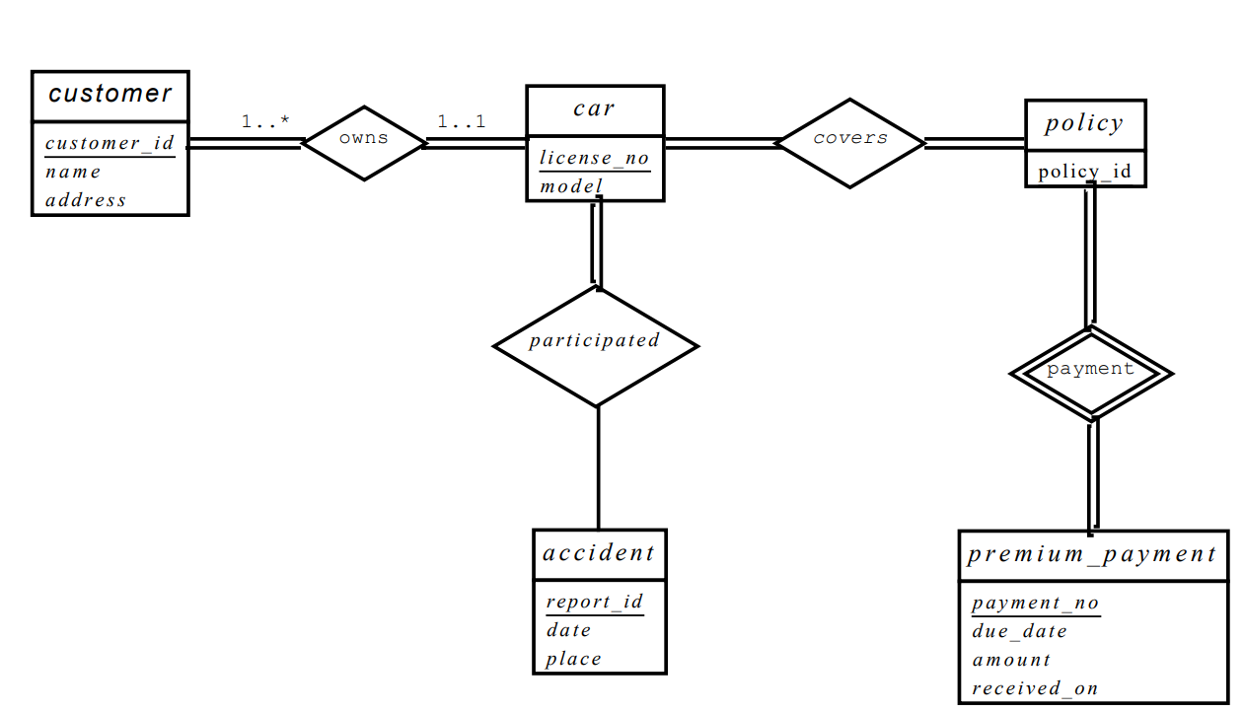
Exercise 2
Notes:
Payments are modeled as weak entities since they are related to a specific policy. Note that the participation of accident in the relationship participated is not total, since it is possible that there is an accident report where the participating car is unknown.

Slide 8
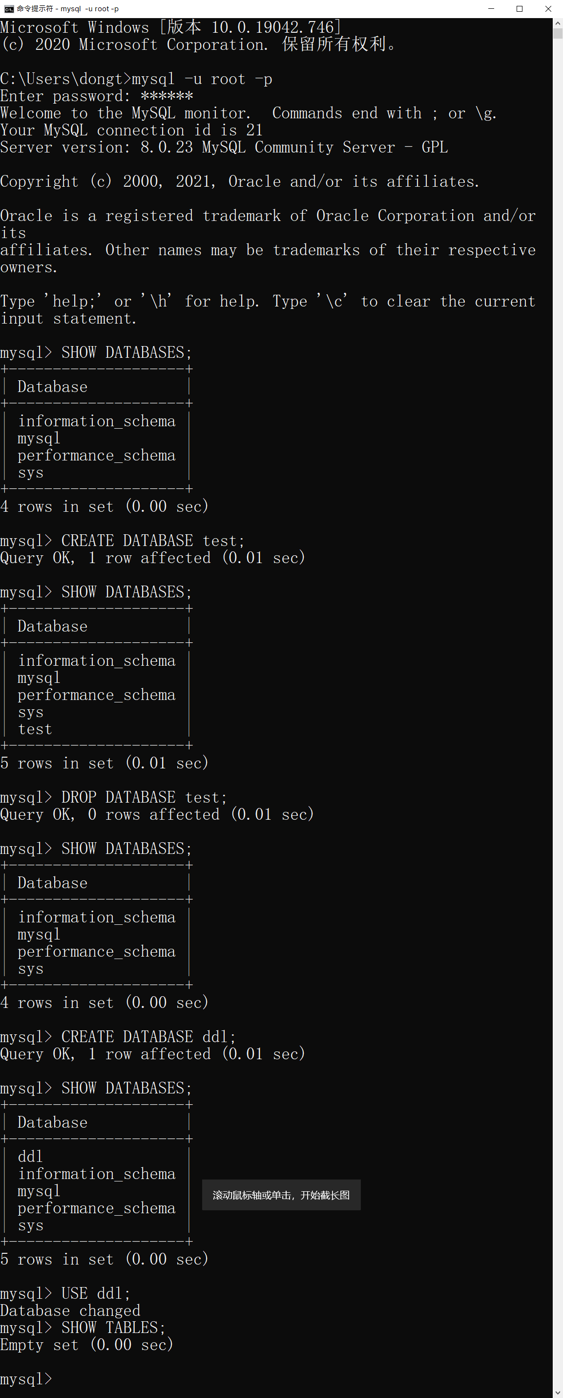

Slide 9
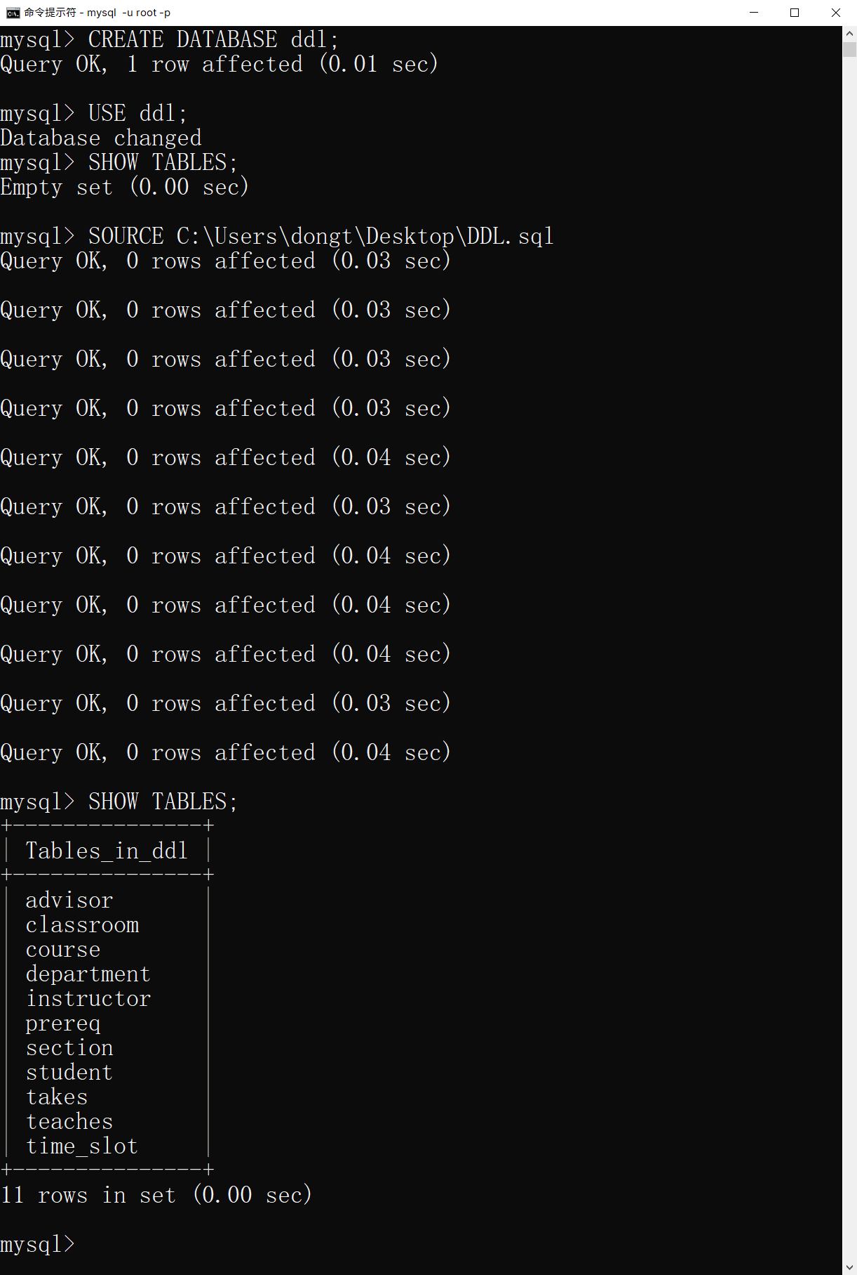
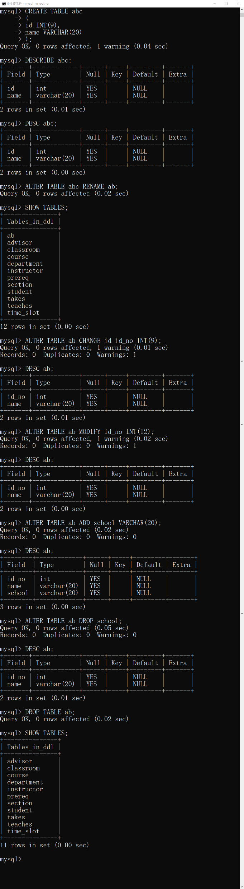

Slide 11
