Slide 1
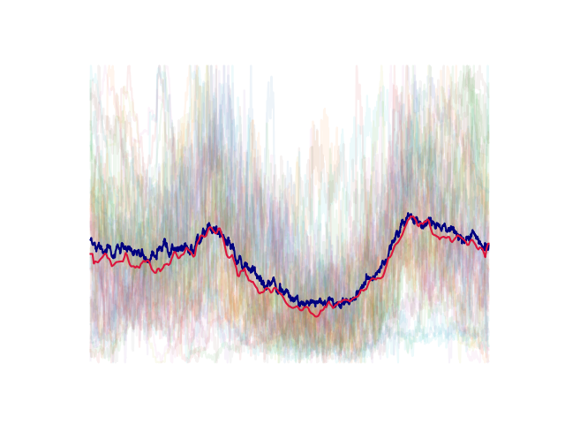
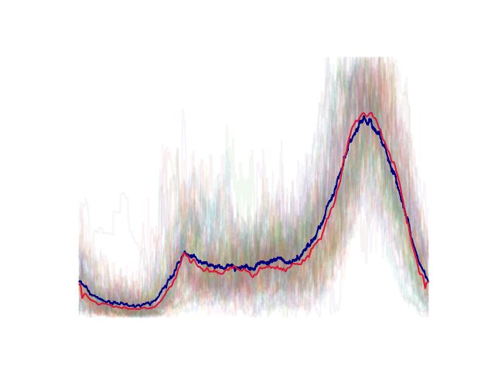
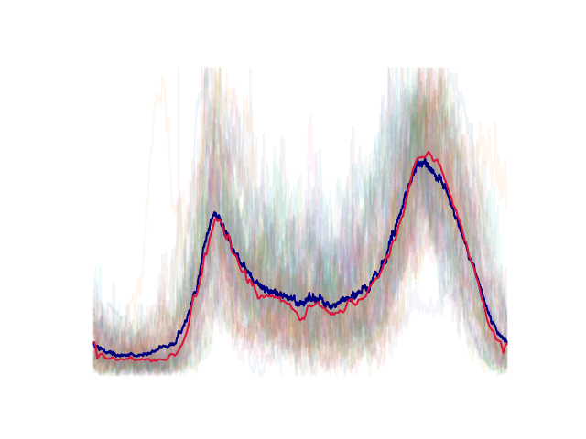
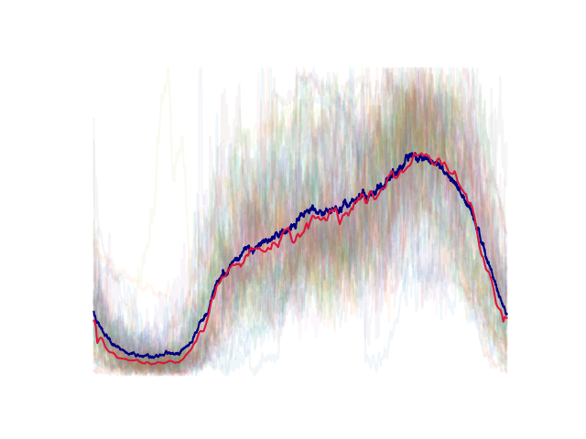
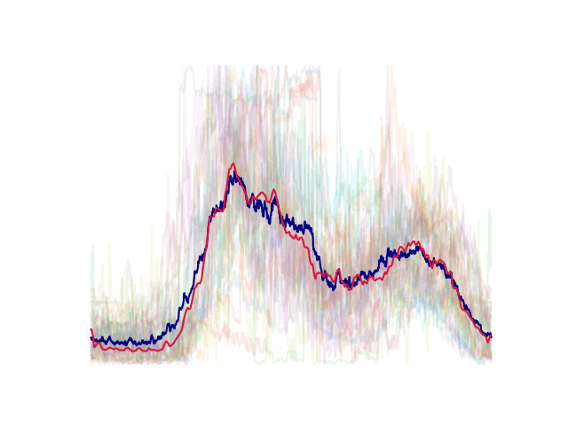
Exploring daily load clustering
with Convolutional Autoencoders
Members : Chen Ang
Fu Quanzhi

Slide 2
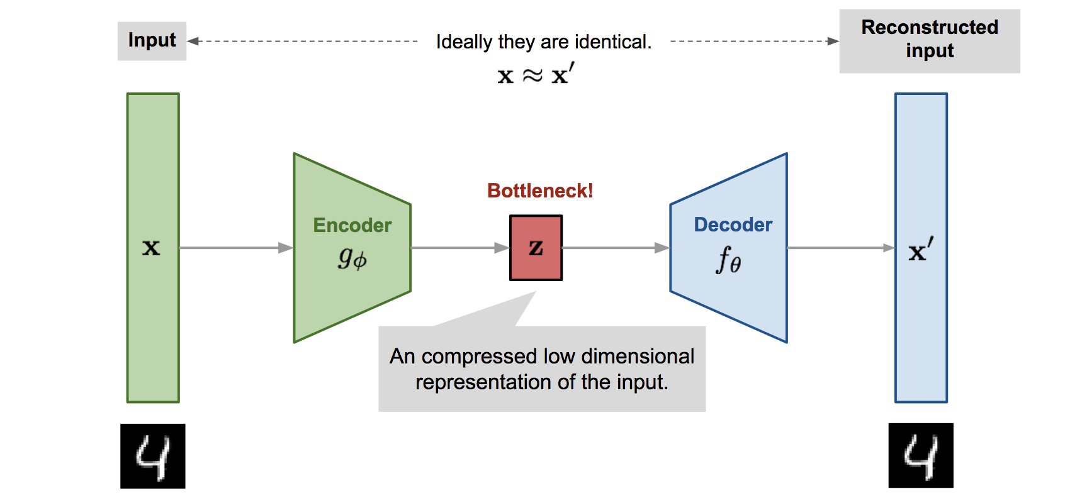

Background & Motivation
low dimensional latent variable.
A generic autoencoder

Slide 3
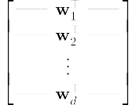

PCA is a linear autoencoder
first principal components

Slide 4
Can we train an autoencoder on a set of electrical load data to cluster similar load patterns extracted?

Slide 5
Problem Formulation
Can we train an autoencoder on a set of electrical load data to cluster similar load patterns?

