Slide 1
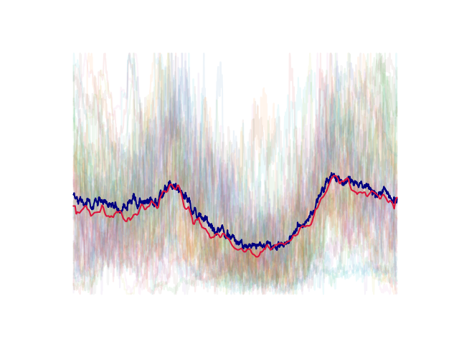
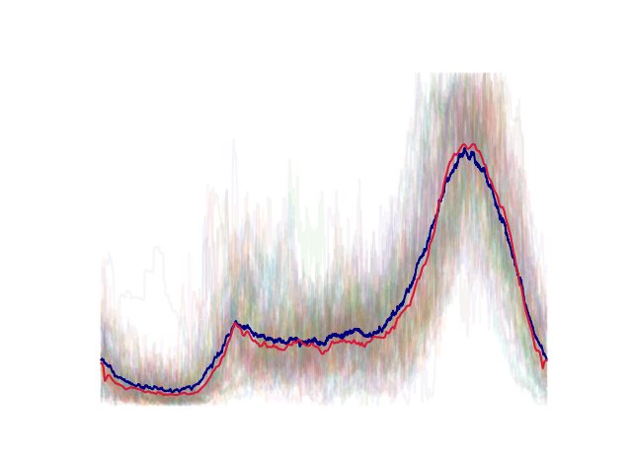
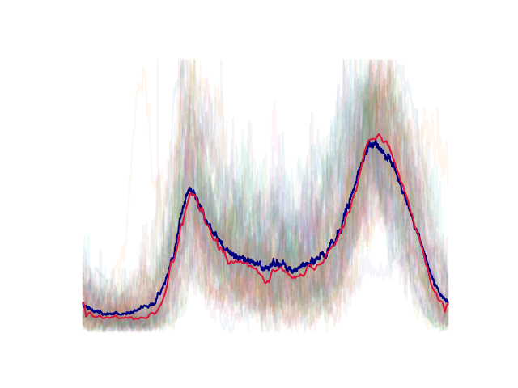
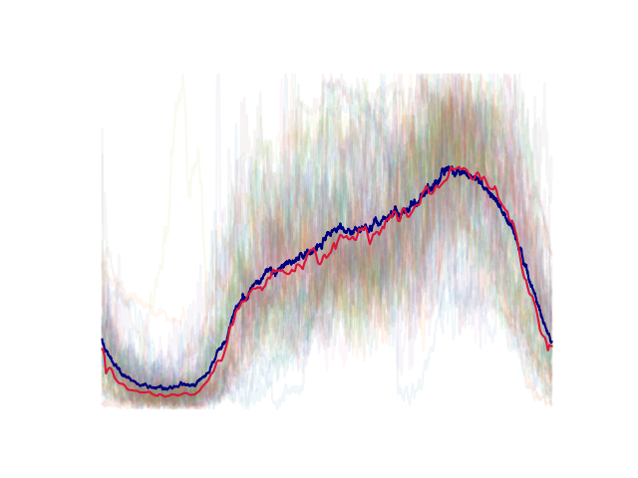
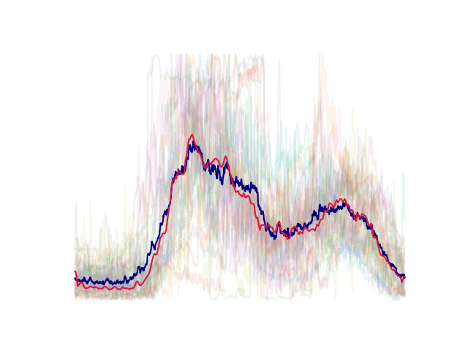
Exploring daily load profile clustering
with Convolutional Autoencoders
Members : Chen Ang
Fu Quanzhi

Slide 2
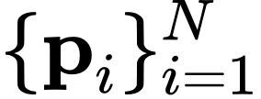
Problem formulation
Given: Average daily load profiles of $N=460$ residents, all normalized to [0, 1].
TODO: Put some profiles here

Slide 3
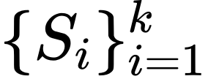
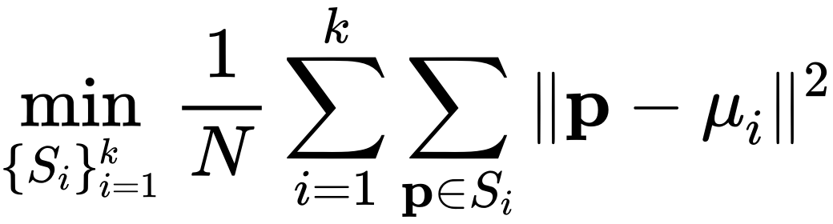
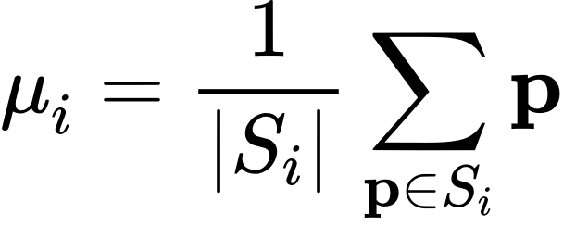
Problem formulation
Given: Average daily load profiles of $N=460$ residents, all normalized to [0, 1].
Goal: Find a k-partition of the profiles such that similar profiles are clustered into the same set.
How to measure similarity?
K-means algorithm?

Slide 4
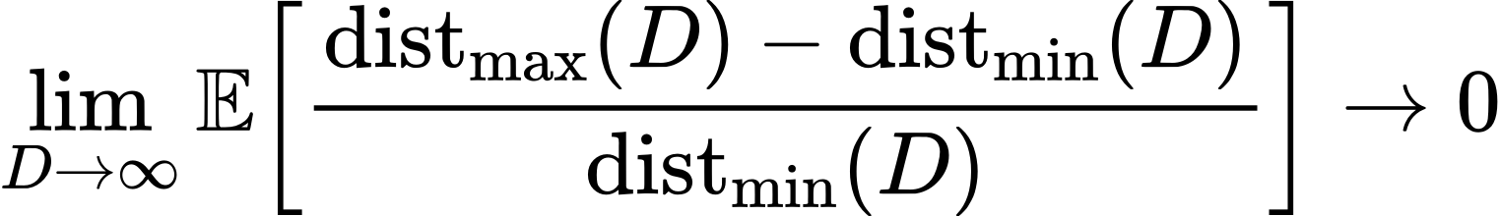
Curse of dimensionality

Slide 5

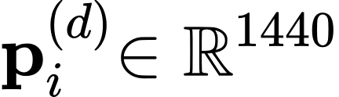
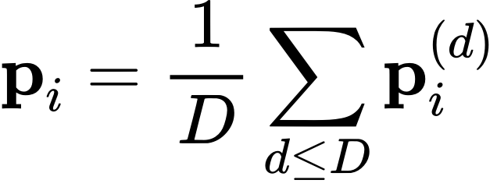
Data Preprocessing
1. Divide load data of each resident by days:
(days containing missing data are discarded)
2. Compute average daily profile in $D$ days:
3. We are interested in the relative distribution of electrical load across a day. Therefore $L_i$ is further normalized to lie within $[0, 1]$.
TODO: Put some profiles here

Slide 6
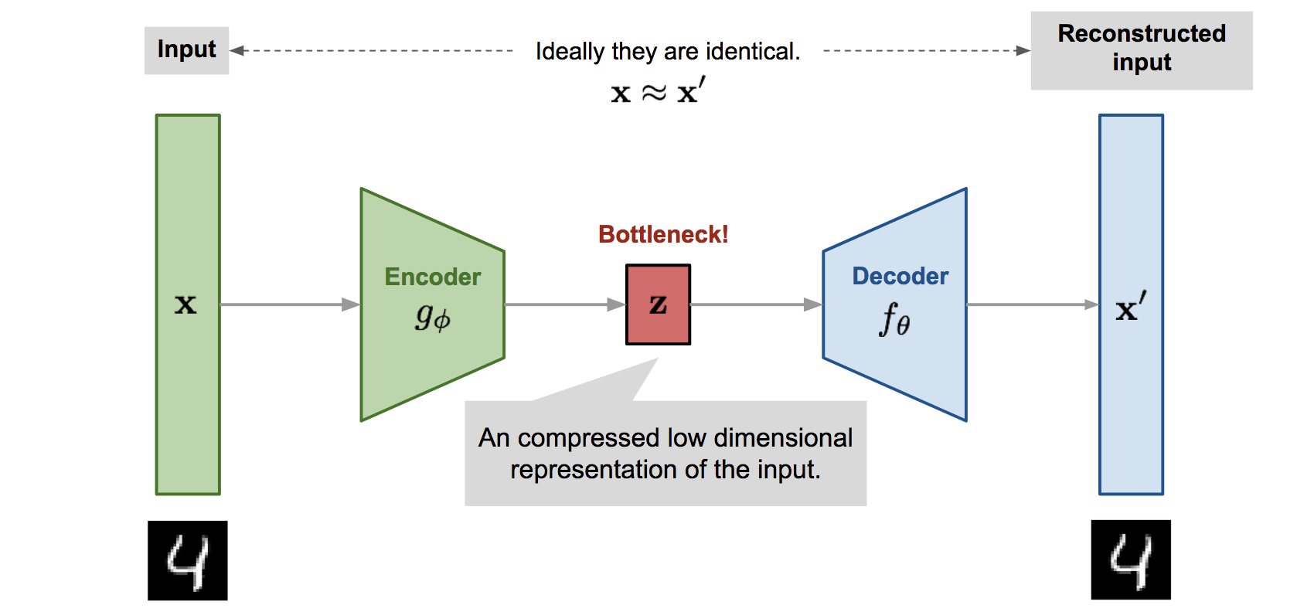

Background & Motivation
low dimensional latent variable.
A generic autoencoder

Slide 7
Background & Motivation
low dimensional latent variable.
A generic autoencoder

Slide 8
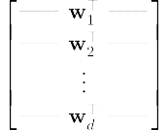

PCA is a linear autoencoder
first principal components

Slide 9
TODO: Application of AE in image classification

Slide 10
Can autoencoders be used to cluster similar electrical load profiles?

Slide 11
Data Preprocessing
1. Divide load data of each resident by days:
(days containing missing data are discarded)
2. Compute average daily profile in $D$ days:
3. We are interested in the relative distribution of electrical load across a day. Therefore $L_i$ is further normalized to lie within $[0, 1]$.
TODO: Put some profiles here

Slide 12
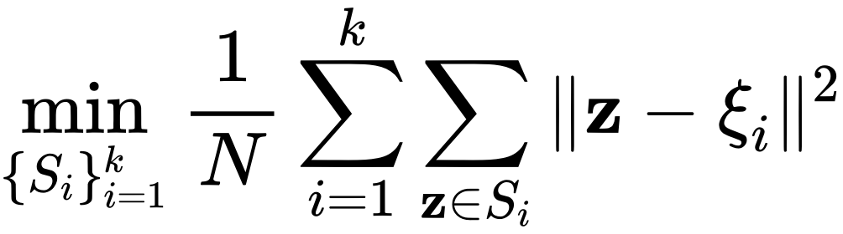

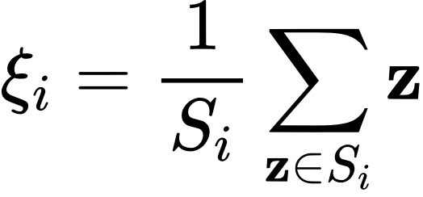
Problem Formulation (Cont'd)
Naive K-means
*Latent-space K-means

