Slide 2

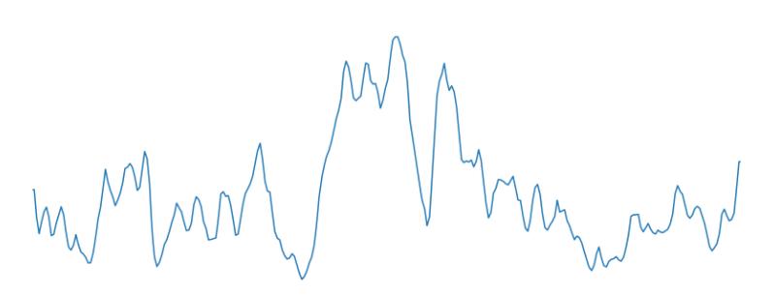
up sampling
up sampling
flatten
reshape

Slide 3
Dense
Dense
Input
Conv
+ Maxpool
Conv
+
Maxpool
Conv
+
Maxpool
Conv
+
Maxpool
···
···
reshape
flatten
Up
sampling
Up
sampling
Encoder
Decoder

