Slide 1
Seller-End E-commerce Iteractive Querying System
Chen Ang (118010009)
xxx

Slide 2



System Pipeline
E-commerce
Database
Graphical User
Interface
Querying Agent

Slide 3
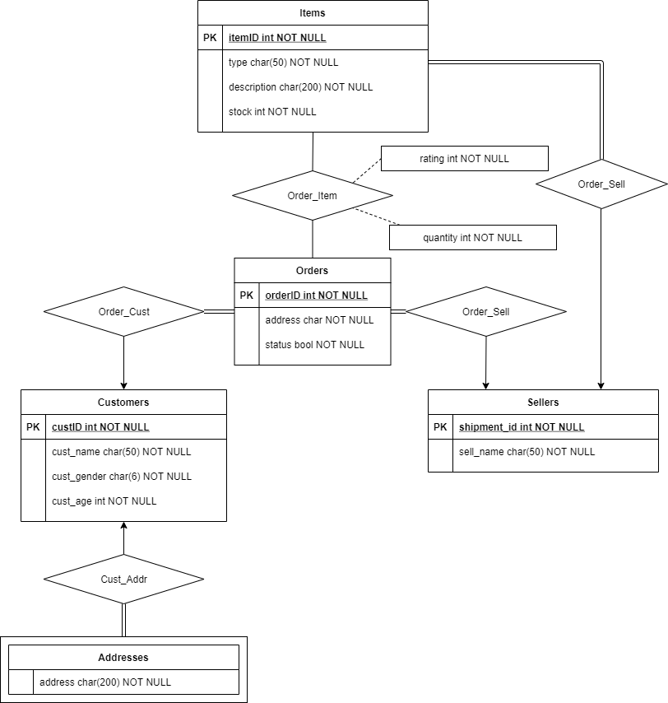
ER Diagram

Slide 4
Relational Schemas
orders(orderID, custID, sellerID, time, address, status)
order_item(orderID, itemID, quantity, rating)
items(itemID, sellerID, type, description, stock)
sellers(sellerID, seller_name)
customers(custID, cust_name, cust_gender, cust_age)
addresses(custID, address)

Slide 5
System Functionalities

Slide 6
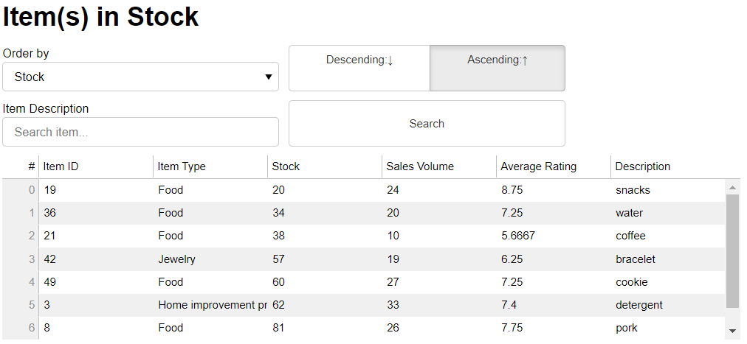
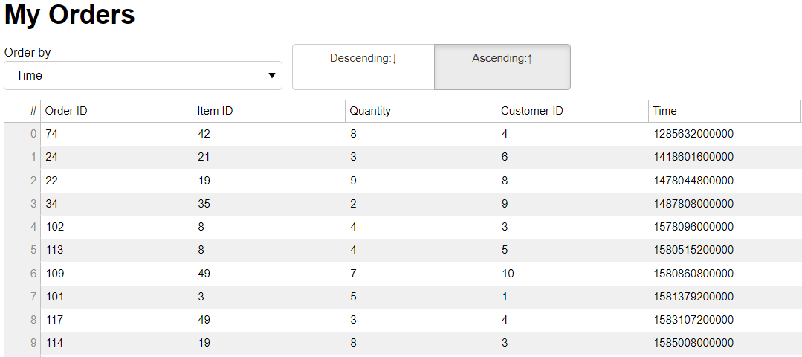
Shop Information
Items on Sale
Orders Info

Slide 7
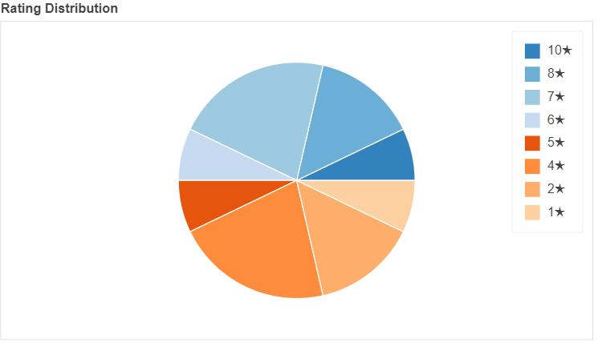
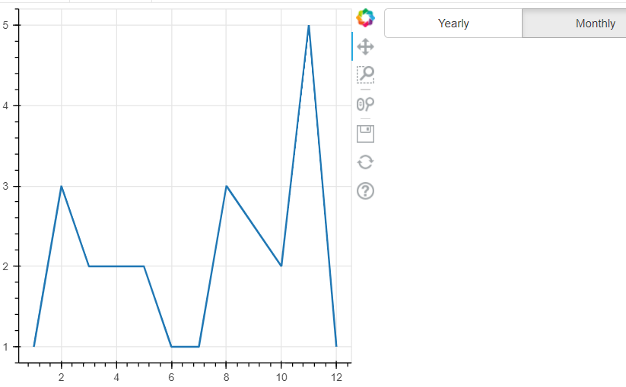
Visual Analytics (Orders)
Rating Distribution
Sales Trend

Slide 8
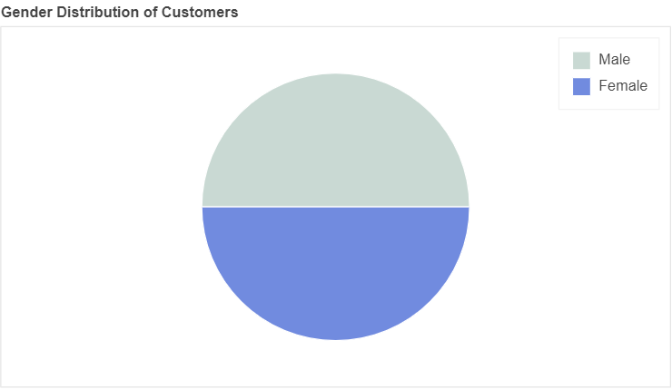
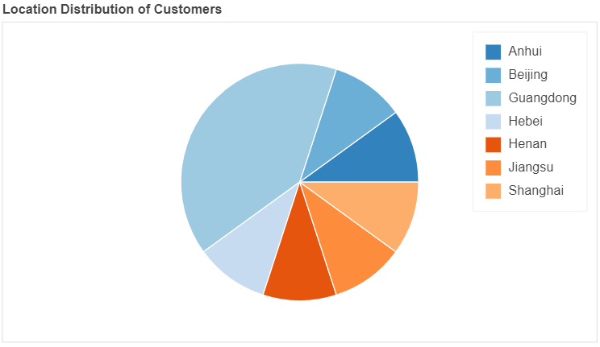
Visual Analytics (Customers)
Gender Distribution
Location Distribution

Slide 9
Members' Contribution

Slide 10
Chen Ang
(Querying Agent)

Slide 11
Developed the querying agent that
Establishes linkage to the database (MySQL Connector/Python)
Performs MySQL queries to fetch database records
Encapsulates all routines in a class to aid GUI development
SELECT time, COUNT(orderID)
FROM orders
WHERE sellerID = 1
GROUP BY UNIX_TIMESTAMP(time)
DIV 31556952
ORDER BY time
encapsulate
sales_trend(timespan='yearly')
Object methods
MySQL queries

Slide 12
Developed the querying agent that
Establishes linkage to the database (MySQL Connector/Python)
Performs MySQL queries to fetch database records
Encapsulates all routines in a class to aid GUI development
SELECT time, COUNT(orderID)
FROM orders
WHERE sellerID = 1
GROUP BY UNIX_TIMESTAMP(time)
DIV 31556952
ORDER BY time
class SellerAnalytics:
login()
...
my_selling_items()
my_orders()
sales_trend()
encapsulate
MySQL queries
Analytics class

