Slide 1
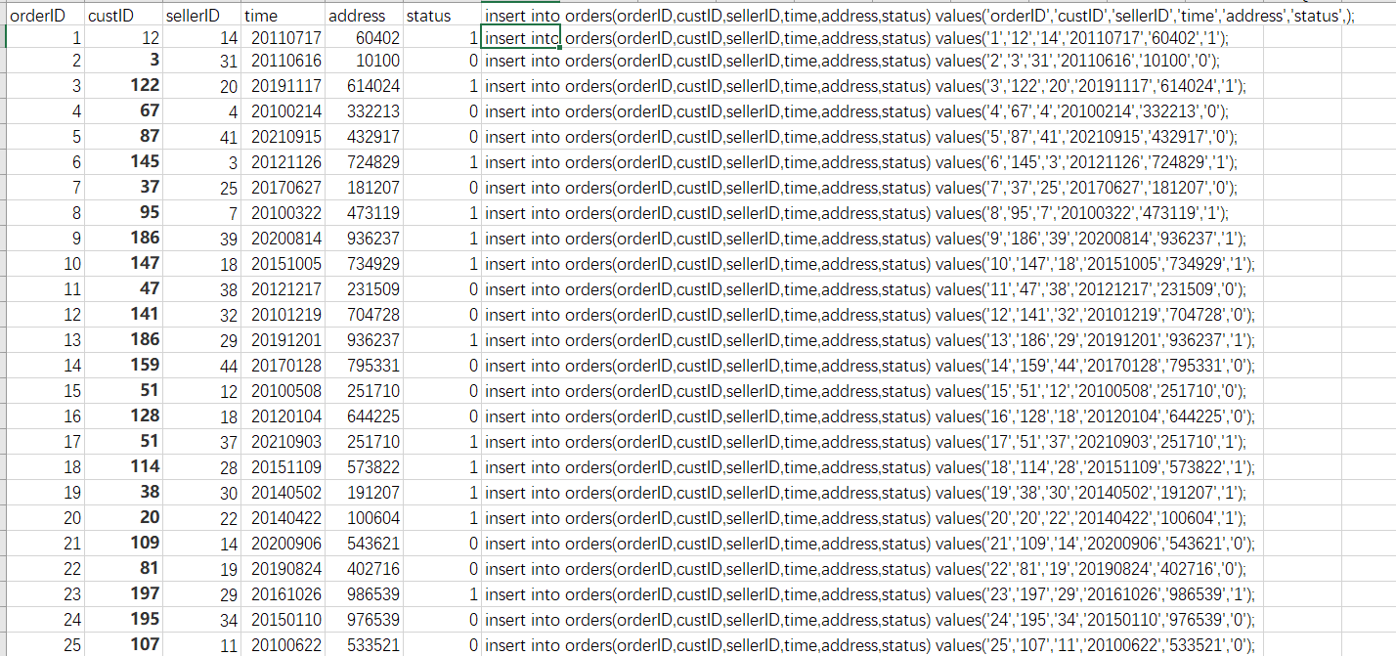
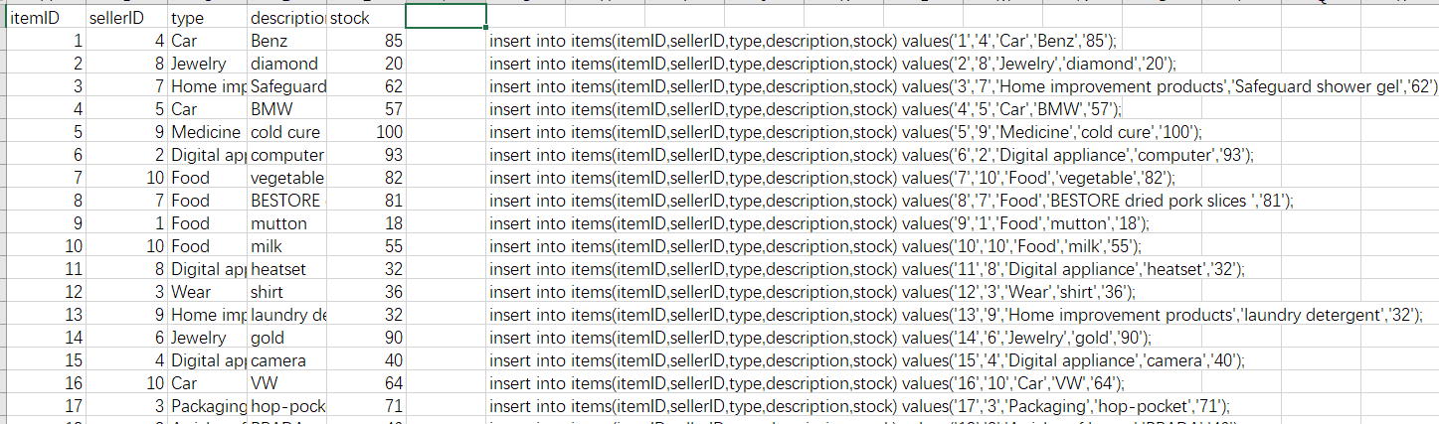
Use C to avoid data inconsistencies in the table

Slide 2
Use excel function to let me change and debug more easily, after changing data I only need to insert all function into the database

