Slide 1
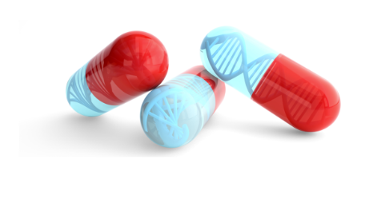


Certificate of Advanced Studies (CAS)
In Personalized Molecular Oncology
Module 3 – Clinical bioinformatics
Day 3 – Emerging technologies
2025.04.11 15h15 – 17h15 | ASAP Introduction Automated Single-cell Analysis Portal
Vincent Gardeux
Laboratory of Systems Biology and Genetics (Bart Deplancke)
École Polytechnique Fédérale de Lausanne (EPFL)

Slide 2


ASAP - Automated Single-cell Analysis Portal
ASAP in short:
User-friendly automated single-cell analysis web tool
No coding required. Interactive analysis 100% online.
Very fast to obtain reproducible results (using Docker containers)
Part of the scFAIR initiative for standardizing single-cell genomics data
Technical aspects:
Web page accessible from any computer/tablet with any browser
Common interface designed for reproducible and interactive analysis of data
Centralized computational resources: Ruby-on-Rails server + versioned Python/R/Java code
Job queuing management on server for dispatching client jobs and mitigating computing load

Slide 3
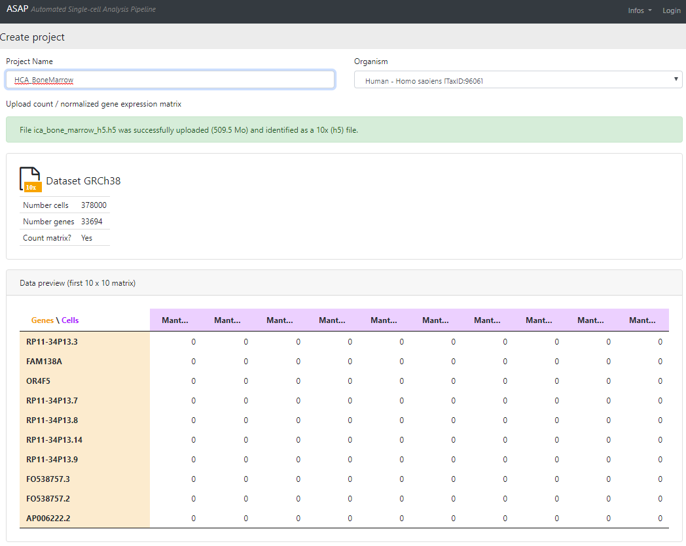
How to use ASAP – 1. Uploading data
Import your own data or load a public project (shared by users or publicly shared such asHCA / FCA)
Handling of TXT, 10x files (output of CellRanger), H5AD, and Loom Format
Can handle ~300 species
Single-cell and bulk RNA-seq pipelines
Automatic transformation in loom/h5ad files
You can also load a pre-analyzed dataset (Seurat / scanpy / …) with all its metadata (for sharing / visualization / crowd annotation)
Limitations:
No spatial transcriptomics (yet)
No scATAC-seq or multiomics (yet)
Integration tool in development

Slide 4
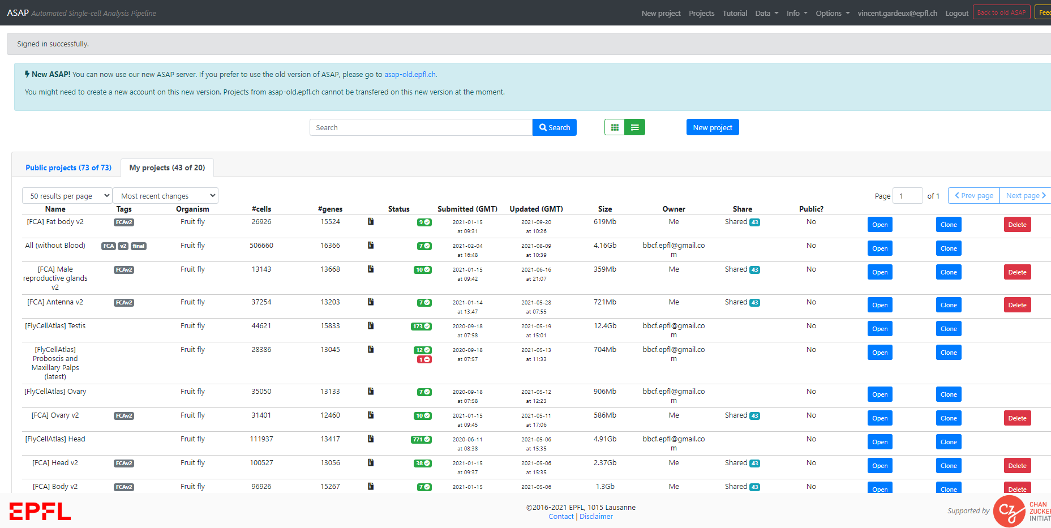
How to use ASAP – 2. Handling ASAP projects
Store and share analyses of single-cell RNA-seq projects
All data is kept fully private by default, but can be set as a public project with a unique permalink URL (for publication)
If not logged in: one sandbox project per session, deleted after 48h
Store all your SC projects in one place
List of publicly available projects
Clone an existing project to perform your own or modify an existing analysis
Sharing feature

Slide 5
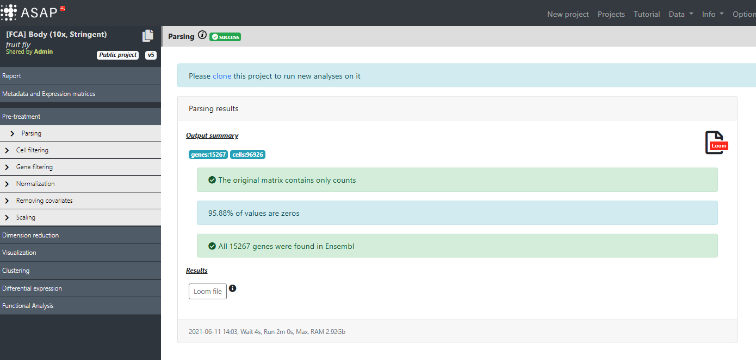
How to use ASAP – 3. Pipeline and visualization tools
Once a project is loaded/cloned, you can run any step of the pipeline
View global project infos, export as loom/h5ad
Check or add new metadata
Steps of the pipeline to check/run (if run within ASAP)
Visualize UMAPs/t-SNEs/PCA… and annotate cell-types

Slide 6
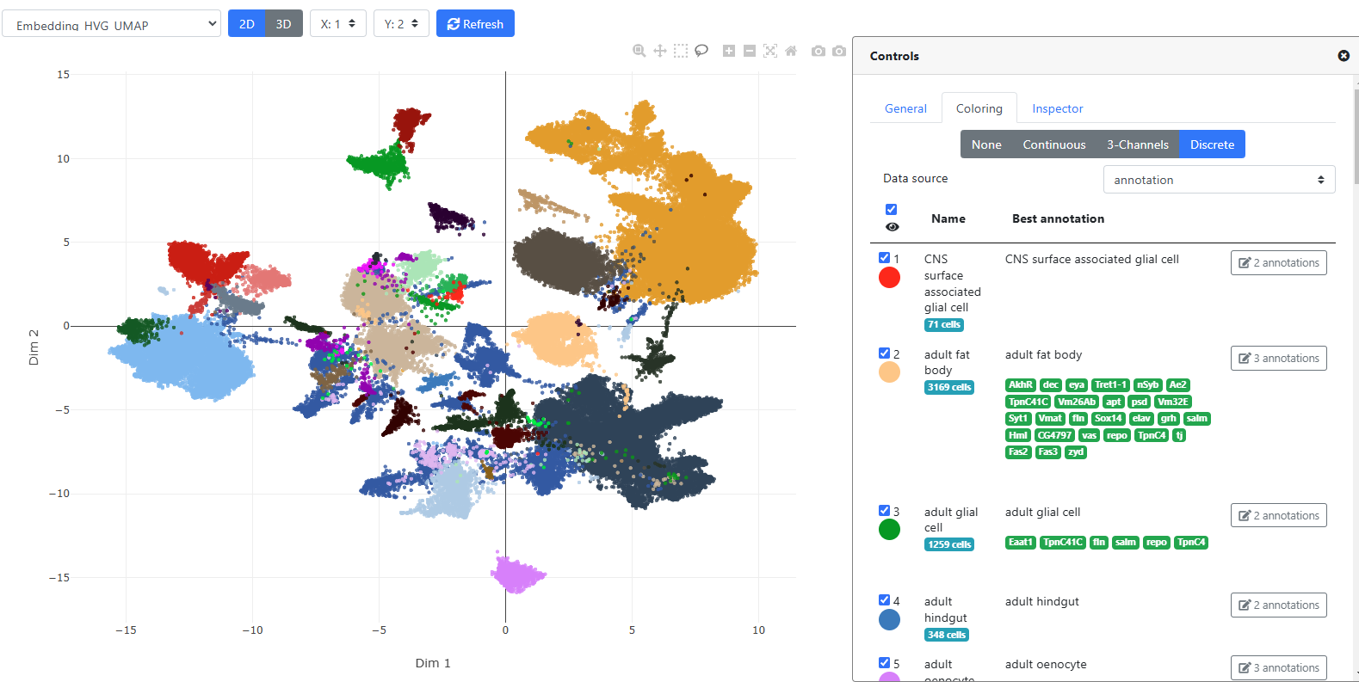
How to use ASAP – 4. Interactive visualization and annotation
Choose embedding to display
Change plot parameters (dot size, …)
Color by continuous metadata (gene expression, depth, %mito, …)
Color by discrete metadata (clustering, annotation, …)
Interactive plot
Annotate clusters / any discrete metadata or upvote/downvote existing annotation
Supporting marker genes for annotation (selected by curator)

Slide 7
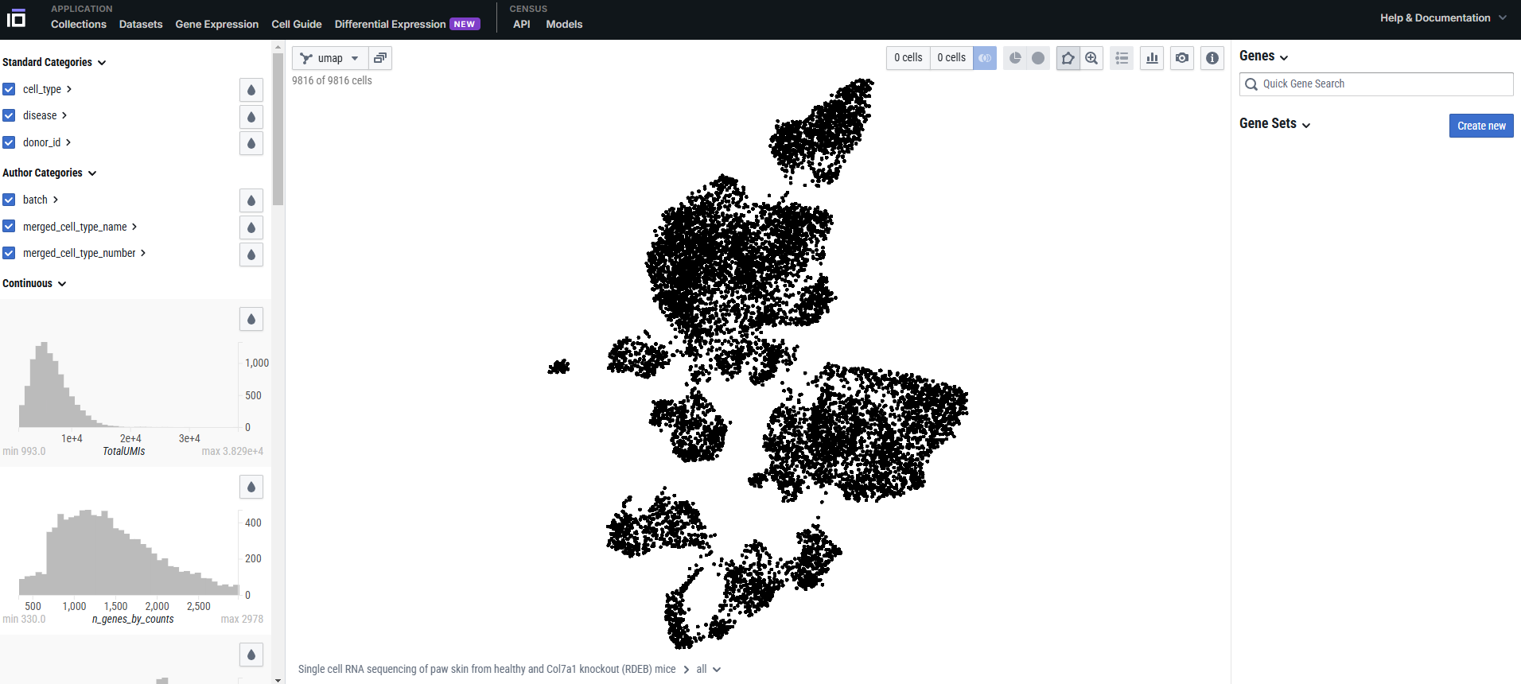
Other visualization-only portals
CELLxGENE (from Chan Zuckerberg Initiative, CZI)
https://cellxgene.cziscience.com/

Slide 8
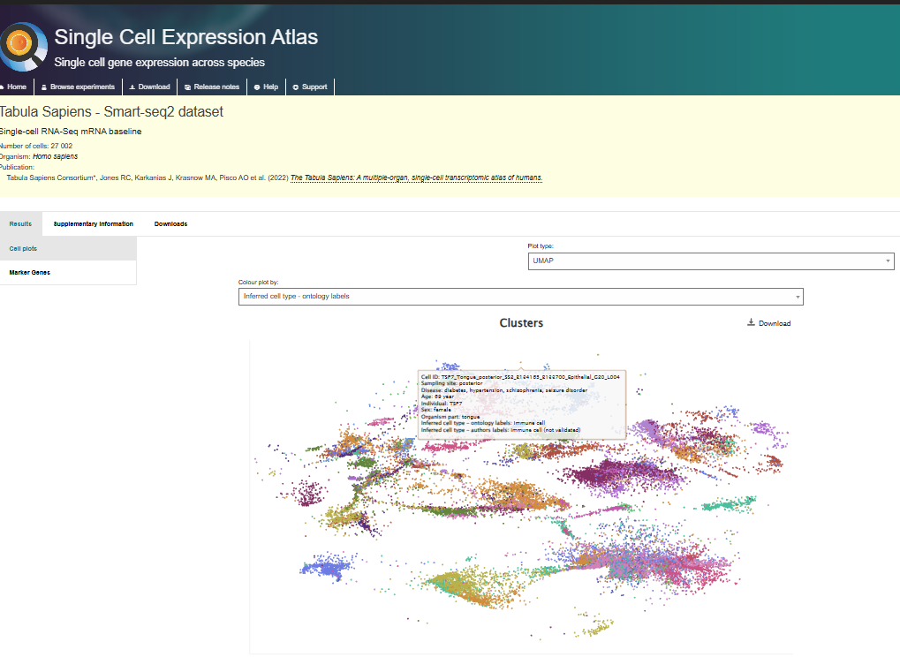
Other visualization-only portals
CELLxGENE (from CZI)
Single-cell Expression Atlas (from EBI)
https://www.ebi.ac.uk/gxa/home

Slide 9
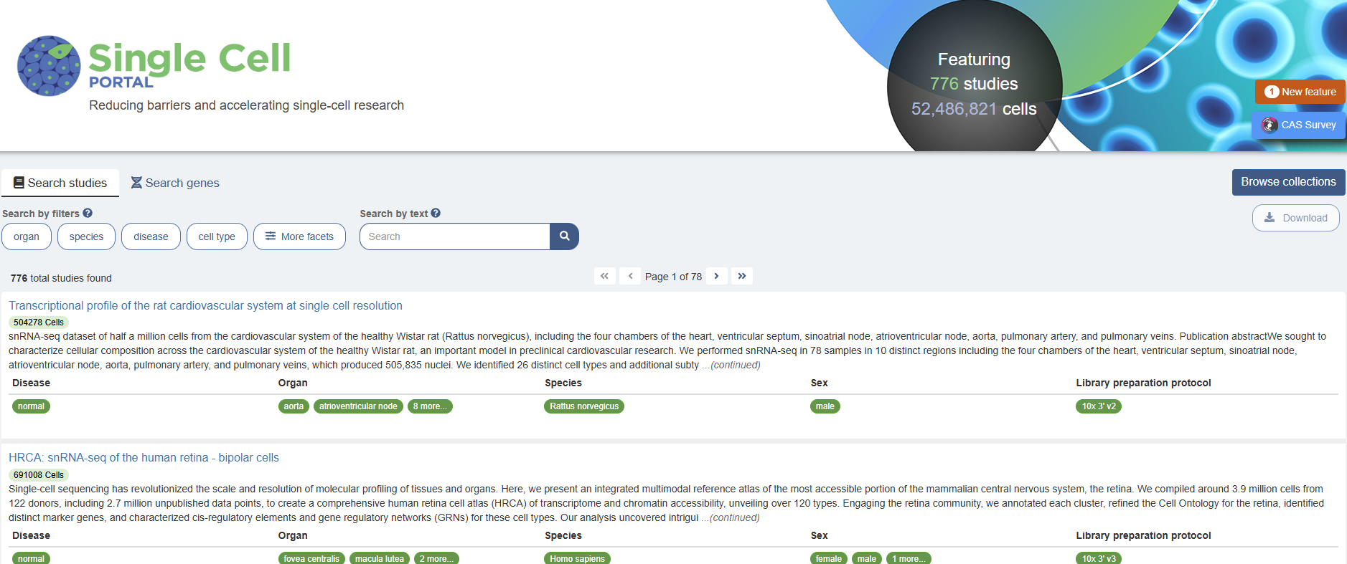
Other visualization-only portals
CELLxGENE (from CZI)
Single Cell Expression Atlas (from EBI)
Single Cell PORTAL (from Broad Instit.)
Bgee (from UNIL)
https://www.ebi.ac.uk/gxa/home
https://singlecell.broadinstitute.org/single_cell
https://www.bgee.org/

