Slide 1

Bioinformatics III Short introduction to
ENHPATHY Event IV - Bioinformatics and Technologies
Vincent Gardeux
Deplancke’s Laboratory of Systems Biology and Genetics

Slide 2
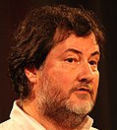



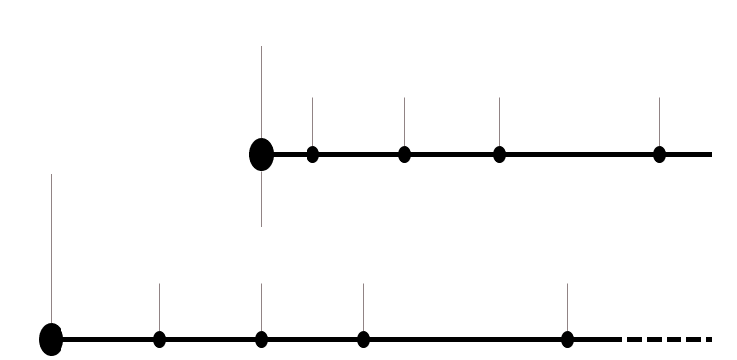

A bit of history
Ross Ihaka
John M. Chambers
R initial development as a mix between S and Scheme
S programming language developed for data analysis
Robert C. Gentleman
v1.0
v2.0
v3.0
v4.0
v. 4.1.1 (Kick Things)
1995
2000
2004
2013
2020
August 2021
(latest)
S2
“S-plus”
Sold to
Insightful corporation
S3
S4
1976
1988
1992
1998
2008

Slide 3

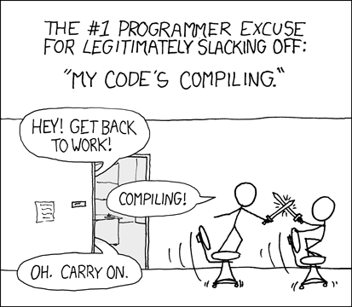
Why learning R?
Contrary to SAS or SPSS, it is not only a statistical environment but a complete language
It is not compiled such as C/C++ but interpreted (typically command-line interpreter)
18th language at TIOBE index
Open source
Advanced statistical language
High quality graphical tools
Large collection of packages

Slide 4

Where to find R resources?
R WEBSITES
www.r-project.org
Main project page & news
cran.r-project.org
Download area for the R software itself, but also for extension packages
www.bioconductor.org
An extended series of packages, acting as an alternate of CRAN for bioinformatics tools ( for analysis and comprehension of high-throughput genomic data)
The Comprehensive R Archive Network

Slide 5
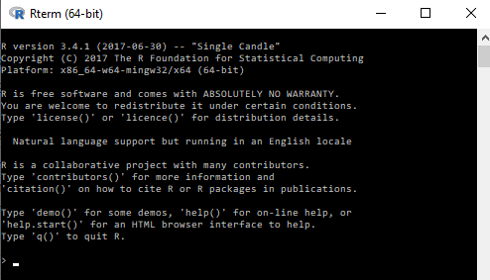
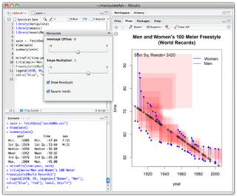

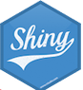
How to set up your working environment?
R INTERFACE & IDE
Default R interface
Directly available when installing R
Text editor + Rscript
Use your favorite text editor (Notepad++, emacs, etc…) and run it with ‘Rscript’ tool (directly available when installing R)
Advanced IDEs (Rstudio, …)
www.rstudio.org
Rstudio developed Shiny for web-based interactive visualization of data

Slide 6
Getting started
Start by installing the last version of R for your machine (64 bits) from cran.r-project.org
Install Rstudio Desktop (free version, 64 bits) from www.rstudio.com
Run Rstudio and write directly in the terminal a simple command to check that both programs are correctly linked
Check if you can install and load a package from CRAN (e.g. by installing the ‘ggplot2’ package)
> 2 + 2
[1] 4
> install.packages("ggplot2")
> require(ggplot2)

