Slide 1
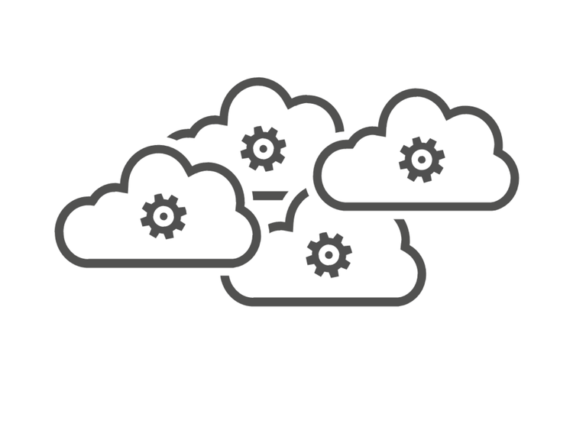

Online Store Company – ‘Global’ Domain
Hipster Store Domain
Purchase Processing Domain
Product Catalog microservices
Sub-Domain
Ad microservices
Sub-Domain
Cart microservices
Sub-Domain
Front End microservices
Sub-Domain
Hipster Application with Components
Payment microservices
Sub-Domain
Shipping microservices
Sub-Domain
Shipping
microservices
AD
microservices
Front End
microservices
Check-out
microservices
Product Catalog
microservices
Cart
microservices
Currency microservices
Sub-Domain
Check-out microservices
Sub-Domain
Hipster Environments
Dev Environment
System Test Environment
Test Environment
Prod Environment

