Slide 1
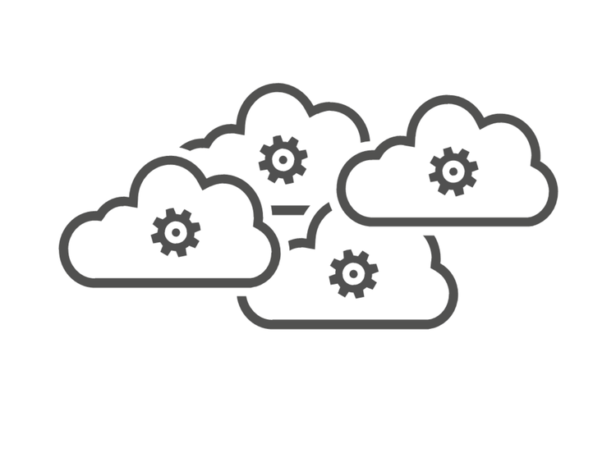

Online Store Company – ‘Global’ Domain
Purchase Processing Domain
Hipster Store Domain
Payment microservices
Sub-Domain
Shipping microservices
Sub-Domain
Front End microservices
Hipster Application with Components
Currency microservices
Sub-Domain
Check-out microservices
Sub-Domain
Shipping
microservices
Payment
microservices
Ad
microservices
Store Services Domain
Front End
microservices
Check-out
microservices
Product Catalog
microservices
Cart
microservices
Product Catalog
Sub-Domain
Ad Services
Sub-Domain
Hipster Environments
Dev Environment
System Test Environment
Cart Services
Sub-Domain
Email
Sub-Domain
Test Environment
Prod Environment

Slide 2
‘Global’ Domain
Error Services
Security Services
Login Services
Branding Websites
Domain
Santa Fe Software Domain
Online Stores Domain
Store Services Domain
Purchase Processing Domain
WordPress Integration
Services
Product Catalog
Sub-Domain
Ad Services
Sub-Domain
Payment microservices
Sub-Domain
Shipping microservices
Sub-Domain
Cart Services
Sub-Domain
Email
Sub-Domain
Currency microservices
Sub-Domain
Check-out microservices
Sub-Domain

