Slide 1
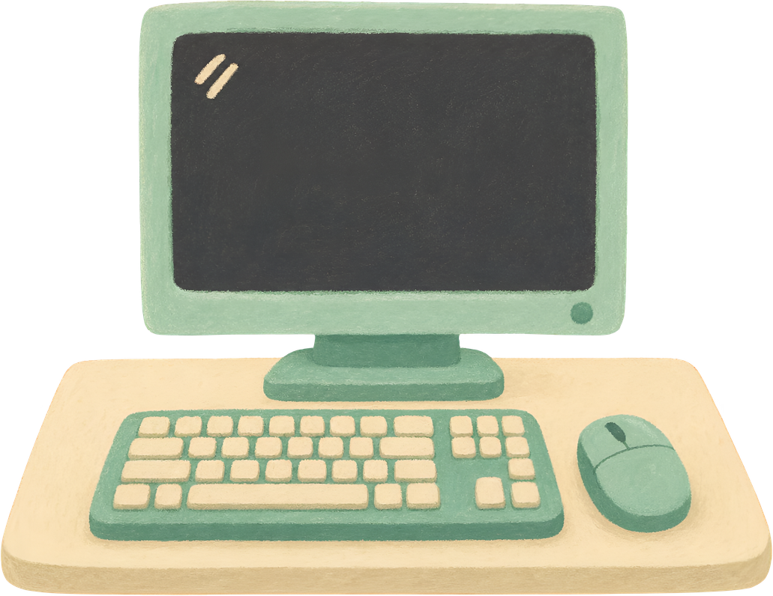
Page 01
CSS
FUNDAMENTALS
<CSS>
Skill Lab Module 1: CSS, Selectors & The CSS Box Model

Slide 2
WHAT IS CSS?
Page 02
CSS (Cascading Style Sheets) defines how HTML content is presented, sized, spaced, and aligned.
Anatomy of a CSS Rule
1. Selector: Points to the HTML element(s) you want to style (e.g., h1, .card, #main).
2. Declaration Block { }: Surrounded by curly braces; contains one or more styling rules.
3. Property: The visual feature you want to change (e.g., color, font-size, padding).
4. Value: The setting assigned to the property (e.g., blue, 24px), ending with a semicolon (;).
📄 CSS Rule Syntax
/* General Syntax */
selector {
property: value;
}
/* Real Example */
h1 {
color: blue;
font-size: 36px;
text-align: center;
}

Slide 3
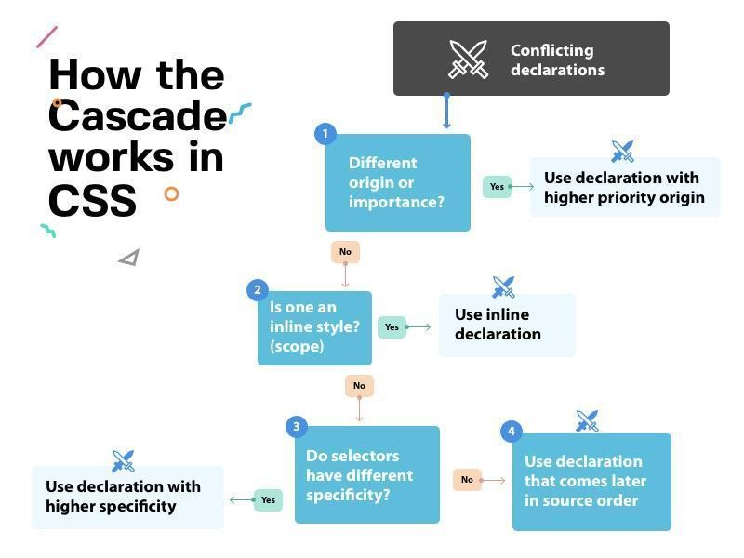
HOW THE CASCADE WORKS
Page 03
Why is it called 'Cascading'? When multiple rules target the same element, how does the browser pick a winner?
4 Tie-Breaking Rules (Demo: 8.cascading_specificity.html)
1. Origin & Importance: Author stylesheets override browser defaults (!important beats all).
2. Inline Styles: style='...' directly on an HTML tag beats <style> and external .css rules.
3. Specificity Hierarchy: More specific selectors always win:
ID (#id) > Class (.class) > Element (p, h1)
4. Source Order: If two rules have the exact same specificity, the rule written LATER in the CSS file wins!

Slide 4
6.1 APPLYING CSS
Page 04
Three methods to attach CSS to HTML (Demos in CSS/Methods_of_using_CSS/):
Method | Mechanism | Suitable Use
Inline | style attribute directly on an HTML element | Small demonstrations & quick testing
Internal | <style> block inside the <head> of the HTML file | Single-page prototypes
External | Separate .css file linked using <link> in <head> | Maintainable, multi-page applications (Preferred!)
📄 inline.html
<h1 style="color: blue;">
Hello World!
</h1>
📄 internal.html
<head>
<style>
h1 { color: blue; }
</style>
</head>
📄 external.html + external.css
<head>
<link rel="stylesheet"
href="external.css">
</head>

Slide 5
6.2 ESSENTIAL CSS SELECTORS
Page 05
Selectors tell CSS exactly WHICH HTML elements to style (Demos in CSS/Essential_Selectors/):
Selector Type | Example | Purpose | Isolated Demo File
Element | p | Targets all elements of that tag type | 1.element_selector.html
Class | .card | Targets reusable components (starts with .) | 2.class_selector.html
ID | #main | Targets a single element with a unique ID (starts with #) | 3.id_selector.html
Descendant | .card p | Targets matching descendants anywhere inside .card | 4.descendant_selector.html
Child | .card > p | Targets ONLY direct children of .card | 5.child_selector.html
Attribute | input[type='email'] | Targets elements by their HTML attribute value | 6.attribute_selector.html
Pseudo-class | button:hover | Targets a special state or condition (mouse hover) | 7.pseudoclass_selector.html

Slide 6
ELEMENT, CLASS & ID SELECTORS
Page 06
Comparing the 3 foundational selectors one by one:
📄 1. Element Selector (p)
/* Targets ALL <p> tags */
p {
color: blue;
}
<p>Styled paragraph 1</p>
<p>Styled paragraph 2</p>
📄 2. Class Selector (.card)
/* Reusable! Starts with dot (.) */
.card {
border: 2px solid red;
}
<div class="card">Card 1</div>
<div class="card">Card 2</div>
📄 3. ID Selector (#main)
/* Unique! Starts with hash (#) */
#main {
background: lightgreen;
}
<!-- Use only ONCE per page -->
<div id="main">Main Box</div>

Slide 7
COMBINATORS, ATTRIBUTE & HOVER
Page 07
📄 4 & 5. Descendant (space) vs Child (>)
/* Descendant: ANY <p> inside .card */
.card p { color: darkblue; }
/* Child: ONLY direct <p> child of .card */
.card > p { font-weight: bold; }
<div class="card">
<p>Direct Child (Both apply!)</p>
<div>
<p>Grandchild (Only .card p applies!)</p>
</div>
</div>
📄 6. Attribute Selector ([type='email'])
/* Targets ONLY email inputs, ignores text inputs */
input[type='email'] {
border: 2px solid blue;
}
<input type="text"> <!-- Ignored -->
<input type="email"> <!-- Styled! -->
📄 7. Pseudo-class Selector (button:hover)
/* Triggers when user hovers mouse over button */
button:hover {
background-color: green;
color: white;
}
<button>Hover Over Me!</button>

Slide 8
7. THE CSS BOX MODEL
Page 08
Every rendered HTML element occupies a rectangular box consisting of Content, Padding, Border, and Margin.
Component | Meaning | Typical Properties
1. Content | Actual text, image, or child content at the center | width, height
2. Padding | Internal spacing between the content and the border | padding (padding-top, etc.)
3. Border | Visible boundary line around the padding and content | border (e.g., 4px solid blue)
4. Margin | External transparent space outside the border (pushes neighbors away) | margin (e.g., margin: 20px)
MARGIN (External Space)
BORDER (Boundary Line)
PADDING (Internal Space)
CONTENT
(Text / Image)
width × height

Slide 9
7.1 BOX SIZING & DIMENSIONS
Page 09
content-box vs border-box (Demo: CSS/Box_Model/)
1. content-box (Browser Default): Padding and border are ADDED outside the declared width.
Example: width: 300px + padding: 30px (×2) + border: 10px (×2) = 380px actual width!
2. border-box (Recommended Best Practice): Declared width INCLUDES content, padding, and border.
Example: width: 300px with padding & border stays strictly 300px total!
3. Responsive Container & Image: Use percentage width (92%) with a max-width cap (1200px) and max-width: 100% on images so nothing overflows on mobile phones.
📄 3.responsive_container_and_img.html
/* 1. Universal border-box reset */
*, *::before, *::after {
box-sizing: border-box;
}
/* 2. Flexible centered container */
.container {
width: 92%;
max-width: 1200px;
margin: 0 auto;
}
/* 3. Responsive image rule */
img {
max-width: 100%;
height: auto;
}

