Slide 1

Page 01
HTML
FUNDAMENTALS
<HTML>

Slide 2
Page 02
WHAT IS HTML?
HyperText Markup Language
Now, what is HyperText and Markup?
Hypertext - Hypertext refers to text that contains hyperlinks (a digital reference in a document or webpage that lets users jump to another location, file, or website with a click or tap), allowing users to click and instantly jump to other connected web pages or resources.
Markup - Languages used to control the structure, presentation or description of data.

Slide 3

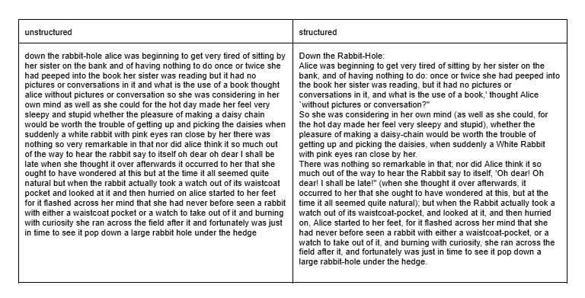
Ex:
Page 03

Slide 4

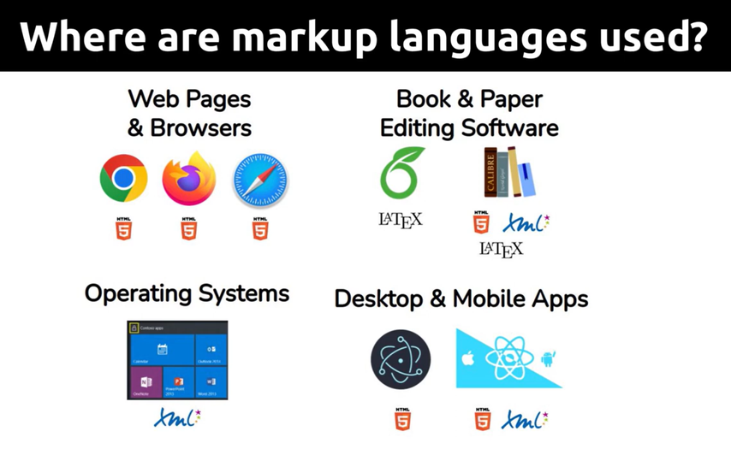
Page 04
WHAT IS HTML?
HTML is the markup language used to structure webpage content.
All the webpages, websites and everything that you see on the Internet has employed HTML as its skeleton.

Slide 5
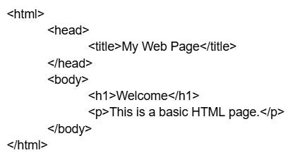
Page 05
HTML STRUCTURE

Slide 6
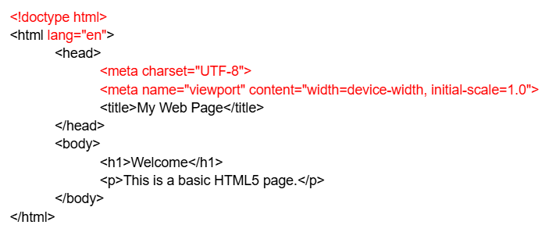
Page 06
HTML STRUCTURE

Slide 7
Page 07
HTML STRUCTURE
What do these mean?
  <!doctype html> - tells the browser to render the page in "Standards Mode."
  <html lang=”en”> - lang="en" attribute inside the <html> tag declares English as the default language for all the text on that web page.
  <meta charset="UTF-8"> - UTF-8 (Unicode Transformation Format – 8-bit) is a variable-width character encoding standard that translates all Unicode code points into binary data using one to four 8-bit bytes.
  <meta name="viewport" content="width=device-width, initial-scale=1.0"> - tells mobile browsers to scale and size a webpage to match the physical screen width of the device at a normal 1:1 zoom level.

Slide 8
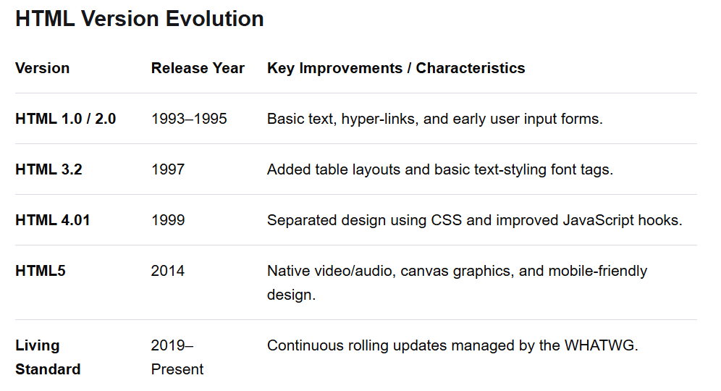
Page 08
HTML VERSION EVOLUTION

Slide 9
Page 09
HTML TAGS
  heading tag <h1>, <h2>, <h3>, <h4>, <h5>, <h6>
  Paragraph tag <p>
  Anchor tag <a>
  Image tag <img>
  List tags <ol>, <ul>, <li>
  Table tag <table>, <tr>, <th>, <td>
  Form tag <form>
  Container tags <div>, <span>

Slide 10
Page 10
FORM TAG
Forms collect user input using controls such as text fields, email fields, radio buttons, checkboxes, select lists and buttons. Labels should be associated with controls, and HTML5 validation attributes such as required, min, max and pattern may be used.

Slide 11
Page 11
FORM TAG
  action: Specifies the destination URL where the form data is sent when the user clicks submit.
  method: Defines how the data is sent; "get" appends the data visibly to the end of the URL, while "post" sends it securely in the background.
  for: Links a label to its corresponding input field, meaning if a user clicks the label text, the input box automatically focuses.
  type: Determines the behavior and appearance of the input field, such as a basic text box ("text"), an email field with built-in validation ("email"), or a clickable button ("submit").
  id: A unique identifier for the HTML element, used primarily to connect it with labels, CSS styling, or JavaScript.
  name: The variable name that the server uses to identify the specific piece of data being submitted (e.g., name="email" means the server receives email=student@rvce.edu).
  required: A built-in validation rule that prevents the form from submitting until the user fills out that specific field.

Slide 12
Page 12
SEMANTIC HTML
Semantic HTML is the use of markup that clearly describes the meaning and role of its content to both browsers and developers, rather than just how it looks
  <header>: Holds introductory content at the top of a page, such as a logo, website title, or search bar.
  <footer>: Sits at the very bottom of a page or section, typically containing copyright notices, social links, or contact info.
  <nav>: Wraps the major navigation links used to click around and explore the website.
  <main>: Contains the primary, unique core content of the webpage, excluding repeated elements like sidebars or top menus.
  <section>: Groups a block of related content together under a specific theme or heading (like a "Projects" or "Contact" section).
  <article>: Holds an independent, self-contained piece of content that could be shared on its own, like a blog post, news story, or specific product card.

Slide 13
Page 13
EXERCISE
Create a single-page Student Profile / Course Information webpage using semantic HTML5. Create index.html using the standard HTML5 document structure. Add a header containing the page title and a navigation section with internal links. Create sections containing headings, paragraphs, a list, an image with meaningful alt text, and a small table. Add a simple form containing name, email, course selection and a submit button. Use labels and appropriate HTML5 input types. Open the page in a browser, verify links and form controls, and inspect the document using browser developer tools.

