Slide 1
Page 01
WEB DEVELOPMENT
FUNDAMENTALS
WEB DEV INTRO
Skill Lab Module 1: Full-Stack Architecture, Client-Server Cycle & Developer Tools

Slide 2
AIM & LEARNING OBJECTIVES
Page 02
Aim: Develop a strong foundation in front-end web development (HTML, CSS, Responsive Design & Git).
Web Application Basics: Explain how web apps work and the roles of HTML, CSS, and JavaScript.
HTML5 Structure: Create structured webpages using semantic HTML5 elements, tables, and forms.
CSS3 Styling: Apply CSS using selectors, the Box Model, and reusable external stylesheets.
Responsive Layouts: Build flexible layouts using Flexbox and adapt them across screen sizes with Media Queries.
Browser Developer Tools: Use Inspect & Network tabs to debug HTML, CSS, and server requests.
Version Control: Apply basic Git operations for repository creation, staging, commits, and branches.

Slide 3
WHAT IS WEB DEVELOPMENT?
Page 03
Web development is the process of creating applications that are accessed through a web browser.
1. The Client (Web Browser)
• Runs on the user's device (Laptop, Phone, Tablet).
• Requests a webpage or resource from a remote server.
• Renders HTML, CSS, and JavaScript onto the screen.
• Examples: Google Chrome, Microsoft Edge, Firefox.
2. The Web Server
• A powerful computer connected to the Internet 24/7.
• Listens for incoming requests from browsers.
• Processes application logic & queries the database.
• Returns the required HTML, CSS, JS, or JSON data.
💡 Live Demo: Open WebDevIntro/1.fullstack_layers.html

Slide 4
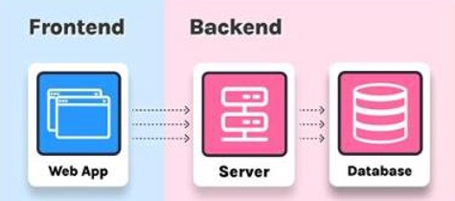
FULL-STACK APPLICATION LAYERS
Page 04
A full-stack application contains three layers: Front End, Back End, and Database.
Layer | Role in the Application | Typical Technologies
Front end | User interface displayed in the browser (What the user sees & clicks) | HTML5, CSS3, JavaScript
Back end | Application logic, user authentication, and APIs (Behind the scenes) | Node.js, Python, Java, Express
Database | Permanently stores and retrieves application data | Relational (MySQL) or NoSQL (MongoDB)
🍽️ Restaurant Analogy: Front End = Dining Table & Menu | Back End = Kitchen & Chef | Database = Pantry/Fridge

Slide 5
FRONT-END TRIO: HTML, CSS & JS
Page 05
Why do we need three separate languages inside the Front-End browser layer?
1. HTML5 (Structure)
Role: The Skeleton
• Defines raw page content and meaning.
• Adds headings, paragraphs, images, tables & forms.
• Without HTML, there is no content on the page.
2. CSS3 (Presentation)
Role: The Clothing / Style
• Controls colors, fonts, spacing & alignment.
• Arranges layouts using Box Model, Flexbox & Grid.
• Adapts pages to mobile & desktop screens.
3. JavaScript (Behavior)
Role: The Muscles & Brain
• Makes the webpage interactive and dynamic.
• Responds to button clicks & validates input.
• Fetches live data from the server without reloading.

Slide 6
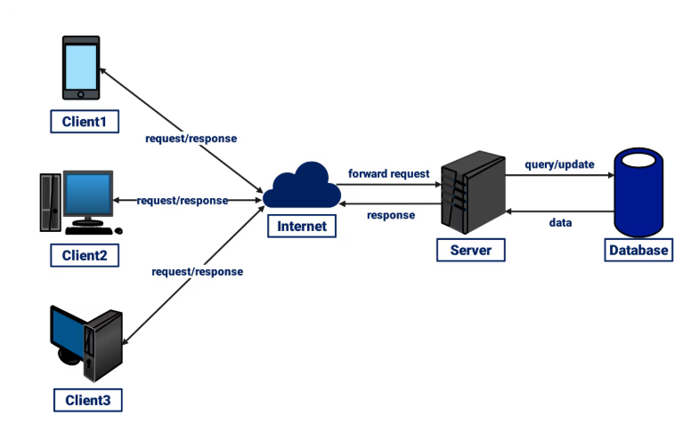
CLIENT-SERVER ARCHITECTURE
Page 06
In a client-server architecture, clients request services/resources and the server returns responses.
How Communication Works
Multiple Clients: Phones, laptops, and desktops (Client 1, Client 2, Client 3) all connect via the Internet.
HTTP Request: The client sends an HTTP/HTTPS request asking for a webpage or data.
Database Query: The Server queries or updates the Database when data is needed.
HTTP Response: The Server sends back the requested HTML, CSS, JS, or image files.

Slide 7
REQUEST-RESPONSE CYCLE
Page 07
What happens in the 500 milliseconds after you press Enter on a website URL?
Step 1: The browser generates an HTTP request for the target URL.
Step 2: The request is sent across the Internet to the web server.
Step 3: The web server receives and processes the request.
Step 4: The server may access a database to read or store information.
Step 5: The server generates an HTTP response (with status code like 200 OK).
Step 6: The response is returned to the client browser.
Step 7: The browser renders the received HTML, CSS, and images onto the screen.

Slide 8
LAB TASK: NETWORK & DEVTOOLS
Page 08
Hands-on Activity (Open WebDevIntro/2.client_server_network_demo.html & press F12):
1. Open Developer Tools: Right-click anywhere on the webpage -> Click Inspect -> Select the Network tab.
2. Reload the Webpage: Press Ctrl + R (or F5) to record all incoming network traffic live.
3. Select HTML Request: Click the main HTML document request at the top of the list.
4. Inspect Key Fields: Identify Request URL, Request Method (GET/POST), Status Code (200 OK), and Response.
5. Identify Asset Requests: Spot separate requests made for HTML, CSS, JavaScript, and Images.
6. Verify Communication: Explain the exact sequence of communication between browser and server.

Slide 9
TOOLS & SOFTWARE REQUIRED
Page 09
Our Web Development Toolkit for Skill Lab Module 1:
Sl. No | Tool / Software | Purpose in Web Development
1 | Visual Studio Code | Web development and code editing (writing .html and .css files)
2 | Git | Version control (tracking project history, commits, and branches)
3 | Node.js | JavaScript runtime environment (used from Module 3 onwards)
4 | Web Browser | Running and testing web pages (Chrome / Edge / Firefox)
5 | Browser Developer Tools | Inspecting & debugging HTML, CSS, JS, and network requests (F12)
6 | HTML5 | Standard markup language for web page structure
7 | CSS3 | Stylesheet language for presentation, layout, and styling

