Slide 1
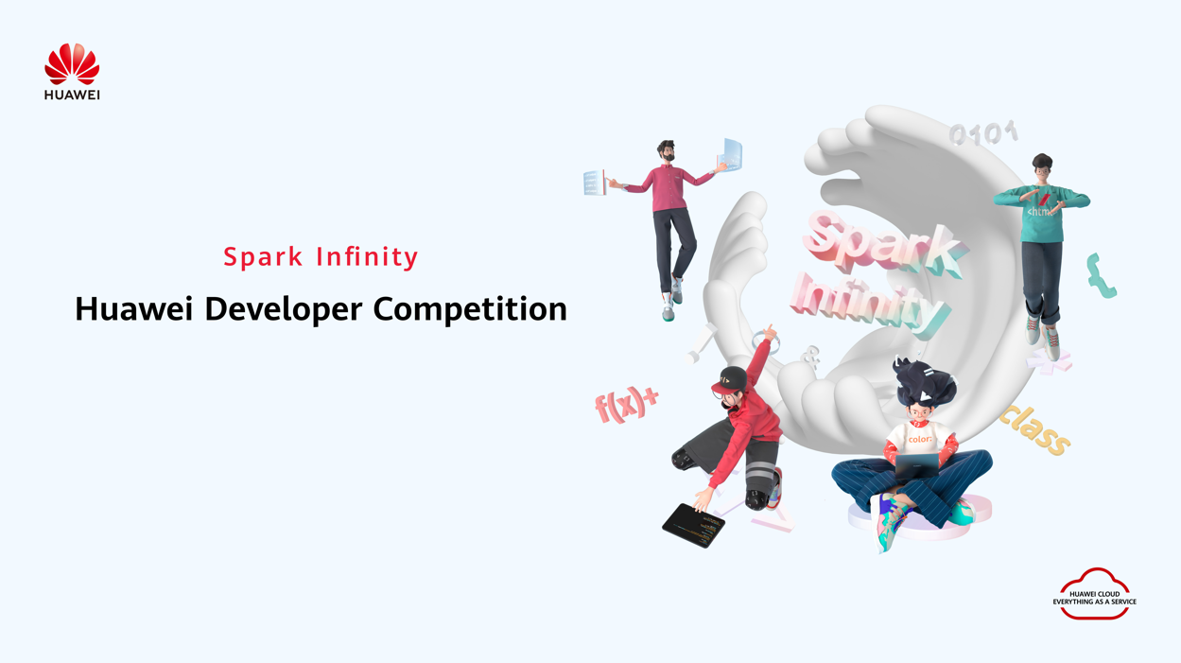
Challenge Name: Huawei Developer competition Northen Africa
Project Name: Depression detection using NLP
Team Name: Depresso
Organization:
Email/Phone: elamirmansour@outlook.com

Slide 2
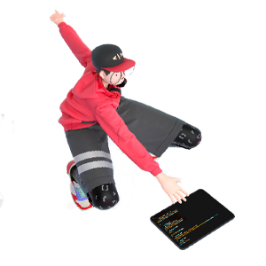

Project Overview
Overview
Project Name | Depression Detection using NLP (Depresso)
Team Name | Depresso
Contacts | elamirmansour@outlook.com
Technical Field | EI (Artificial Intelligence / NLP) + PaaS (Huawei Cloud Integration)
Technologies | Specify the key technologies you used.
Keywords | Depression , detection , Natural language processing
Applicable Fields | Mental Health, Digital Healthcare, and AI-driven Wellness Platforms
Description (in 200 words) | Our project introduces an AI-powered platform designed to detect and monitor depression through Natural Language Processing (NLP). The solution allows users to engage in daily journaling via a mobile application where written entries are analyzed using advanced deep learning models such as DeepSeek. By interpreting linguistic patterns, emotional tone, and writing behavior, the system classifies the user’s depression severity level (e.g., mild, moderate, or severe). If elevated risk is detected, the app recommends nearby certified therapists using location services, ensuring immediate professional support. In addition, a built-in community feature offers safe peer interaction and emotional support, promoting early intervention and social connection. The platform leverages Huawei’s EI (Enterprise Intelligence) capabilities and PaaS infrastructure for scalable AI processing, cloud storage, and secure data management. Ultimately, this project aims to empower users to monitor their mental health, reduce stigma around depression, and support healthcare professionals through AI-driven insights and real-time analysis.

Slide 3

Contents
1
Team Introduction
2
Project Introduction
3
Technical Architecture
4
Functions
5
Innovations
6
Business Value
7
Demo & Follow-up Plan

Slide 4





Team Introduction
Maryam Osman Hussien
ElAmir Mahmoud Mansour
Nourhan Alaa Mohamed
Roaa Osama Elsheikh
Edu: Zagazig University
Role: Team leader , cloud
Experience：DevOps, cloud
Edu: Mansoura University
Role: Development
Experience：iOS and Backend Developer
Edu: Mansoura University
Role: AI
Experience：AI model development
Edu: Cairo University
Role: AI
Experience：AI model,cloud development

Slide 5
Project Introduction
Project Background
Depression is one of the leading causes of disability worldwide, affecting over 300 million people, according to the World Health Organization (WHO, 2023). Recent studies show that one in every five adults will experience depression at some point in their lives, yet more than 60% of those affected never receive proper diagnosis or treatment due to social stigma, high costs, and limited access to mental health professionals—particularly in low- and middle-income countries.
At the same time, research indicates that language use and writing patterns can serve as reliable indicators of mental state. For instance, studies in Nature Human Behaviour (2022) and Frontiers in Psychology (2023) demonstrate that Natural Language Processing (NLP) models can detect depressive tendencies with accuracy rates exceeding 85%.
Despite these advances, most solutions remain confined to academic settings or lack practical implementation for end-users. There is a critical need for accessible, AI-driven tools that can monitor emotional health in real time while ensuring data privacy and user engagement.
Our project addresses this gap by developing an AI-powered mental health platform that leverages Huawei’s EI and PaaS technologies to analyze text-based journaling, assess depression severity, and connect users to professional or community support.

Slide 6
Project Introduction
Project Features
1- AI-Powered Text Analysis:
Utilizes DeepSeek NLP models to analyze the written journal entries submitted by users.
Examines linguistic patterns such as word choice, sentence structure, emotional tone, and sentiment polarity to identify depressive tendencies.
Classifies the user’s mental state into severity levels (mild, moderate, or severe) based solely on textual content.
Continuously refines accuracy through machine learning on anonymized text data.
2- Therapist Recommendation System:
Enables quick access to professional help by using location services when high-risk patterns are detected.

Slide 7
Project Introduction
Project Features
3- Community Support Hub:
Provides a safe, anonymous community for users to share experiences, encouragement, and recovery stories.
4- Huawei Cloud & EI Integration :
Deployed on Huawei PaaS for scalability, reliability, and secure data storage.
Utilizes Huawei EI (Enterprise Intelligence) to power NLP inference and predictive analytics.

Slide 8
Project Introduction
Application Scenarios
1. Mental Health Monitoring
Individuals can use the platform for daily journaling to monitor emotional trends and detect early signs of depression. The AI model analyzes text entries to provide real-time emotional feedback and progress tracking over time.
2. University and Student Wellness Programs
Universities and schools can adopt the system to support student mental wellbeing. With proper privacy controls, the platform can help identify students who may need counseling or additional psychological support.
3.Teletherapy and e-Health Platforms
Therapists and digital health providers can use the platform as a screening and monitoring tool to complement online counseling, helping track patient mood evolution through written communication.

Slide 9
Project Introduction
Problems Solved
1. Lack of Early Detection
Most people with depression remain undiagnosed until symptoms become severe. Our platform provides early, AI-driven screening based on users’ written text, enabling timely awareness and intervention.
2. Limited Access to Mental Health Services
In many regions, professional psychological support is scarce or expensive. The app bridges this gap by offering AI-based self-assessment and therapist recommendations.
3. Social Stigma and Fear of Judgment
Many individuals hesitate to seek help. The platform allows private journaling and automated analysis.
4. Lack of Continuous Monitoring
Traditional therapy often lacks between-session follow-up. Our system enables continuous emotional tracking through text analysis, helping both users and professionals observe progress over time.

Slide 10
Project Introduction
Project Features
Our primary target users are students and young adults in their 20s, a group that is highly connected, tech-oriented, and increasingly affected by mental health challenges.
University and College Students: Often face high levels of stress, anxiety, and self-pressure due to academic, social, and financial challenges. The platform provides a private, judgment-free space for journaling and self-reflection, helping them recognize early signs of depression.
Young Adults in Early Careers (20–29 years): This group experiences significant lifestyle changes, career stress, and emotional instability. The platform helps them track their emotional wellbeing and connect with professional therapists when necessary.
Our design and interaction style are tailored to young users’ digital habits, focusing on simplicity, privacy, and engagement, encouraging consistent use and reducing the stigma around mental health discussions.

Slide 11
Technical Architecture
Overview
Key technologies you selected and their collaboration with other functional modules
Roles of the Huawei Cloud technologies you used in the project
Implementation principles
Solution deployment architecture diagram (including service flows)
Technology maturity assessment, such as whether the technical roadmap is clear and tools are mature and reliable

Slide 12
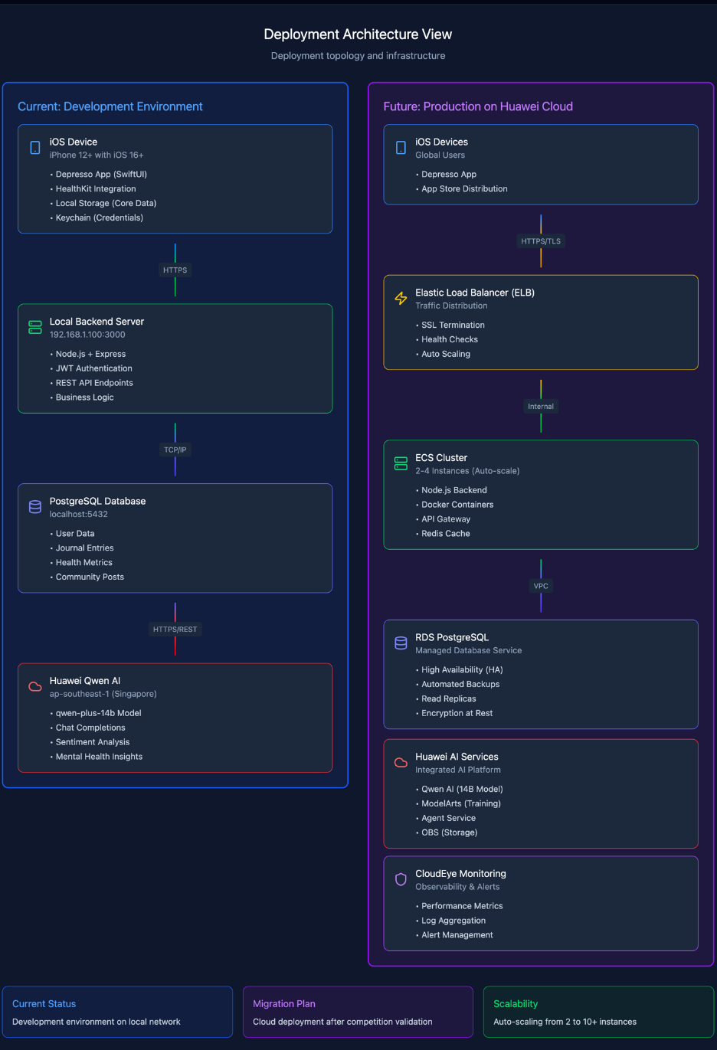
Technical Architecture : Solution Overview
Solution deployment architecture diagram
Depresso - Architecture Overview
Depresso is an AI-powered mental health companion app integrating real-time health metrics and personalized insights. It combines iOS frontend, Node.js backend, and Huawei Cloud AI to deliver proactive mental wellness support.
Key Components:
iOS App (SwiftUI + TCA): Tracks health (HealthKit), journals moods, sets goals, and enables community support.
Backend (Node.js + Express): Manages user data, authentication (JWT), API endpoints, and communicates with AI services.
Huawei Cloud (Qwen AI, 14B): Provides AI chat support, sentiment analysis, depression risk detection, and personalized recommendations.
Architecture Highlights:
Secure data flow with HTTPS/TLS, JWT, and Keychain storage.
Scalable cloud deployment using ECS, RDS, Redis, ELB.
AI-driven insights integrated with health metrics for early detection and personalized interventions.
Current Status: Local development; planned migration to Huawei Cloud for production with global reach.
Impact: Combines physical and mental health data, 24/7 AI support, and community engagement, demonstrating an innovative, scalable, and secure mental health solution.

Slide 13
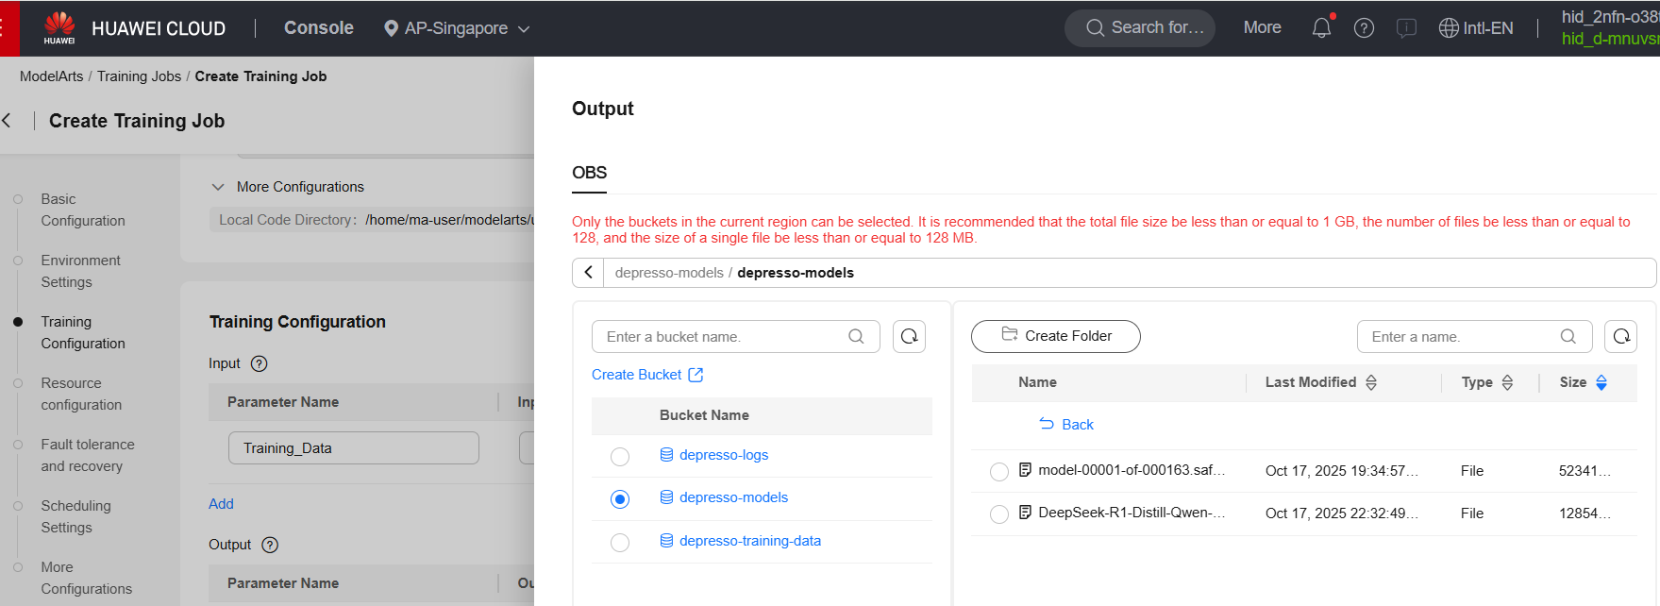
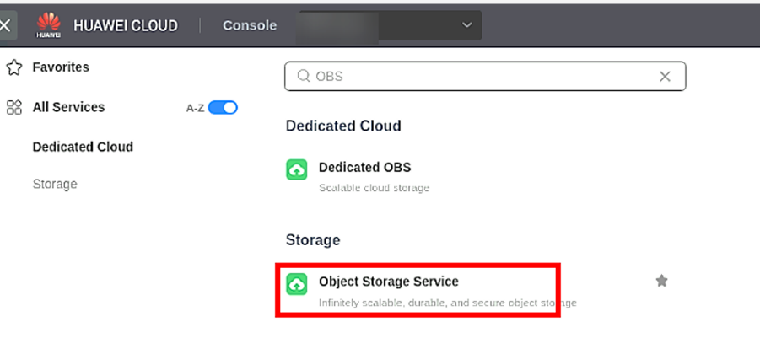
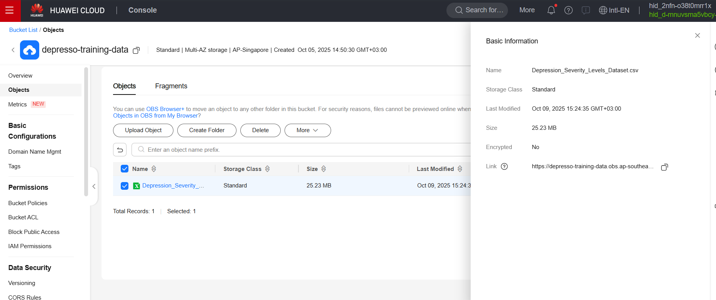
Technical Architecture : Huawei Cloud Service Dashboard
Creating an OBS Bucket and upload data

Slide 14
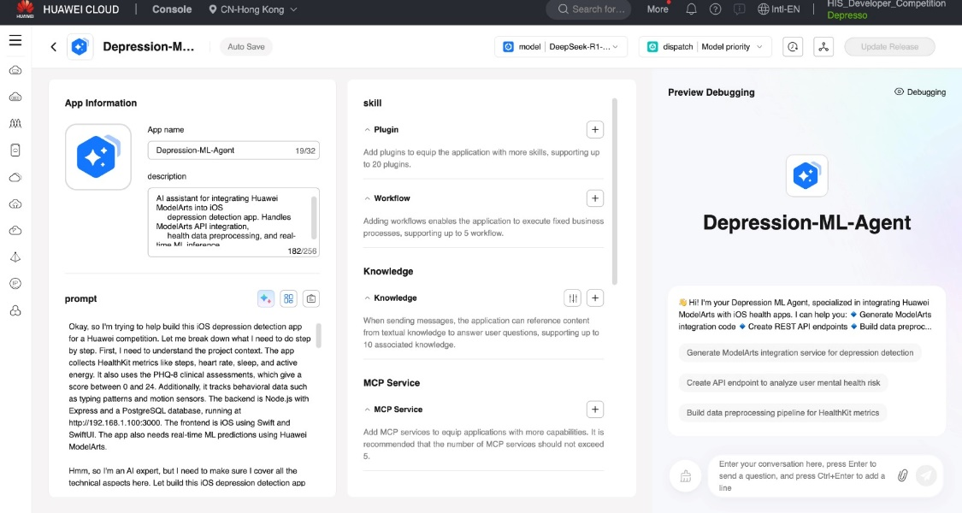
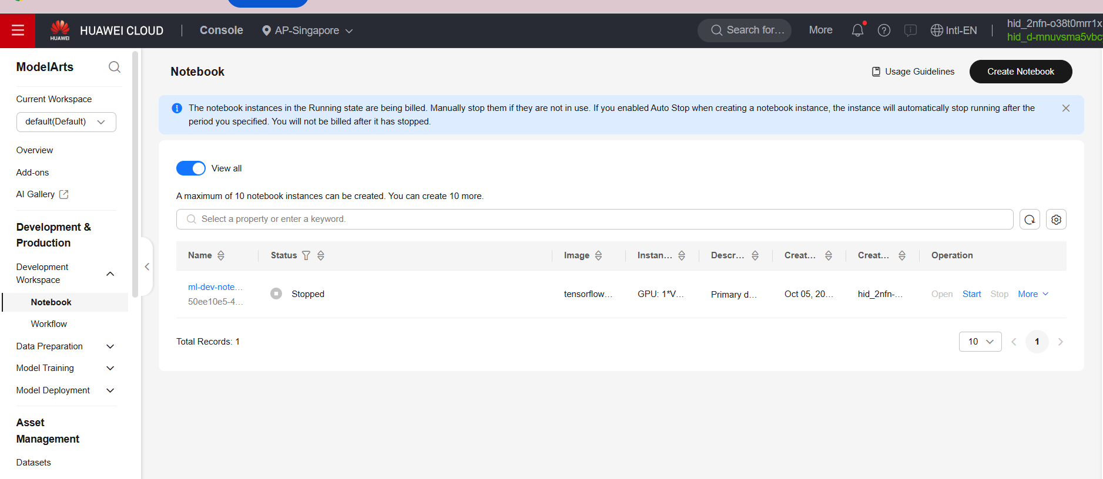
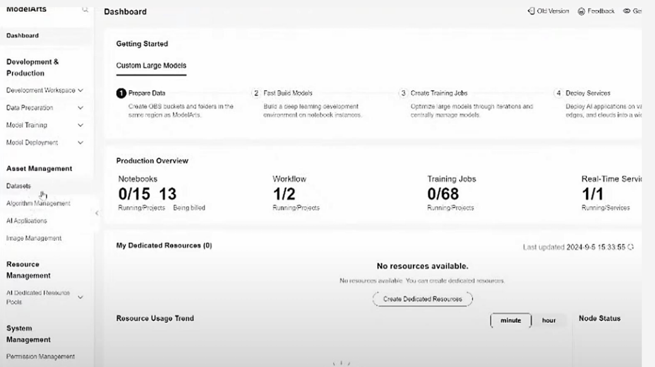
Technical Architecture : Huawei Cloud Service Dashboard
Depression ML Agent
Using Huawei Cloud ModelArt for AI training

Slide 15
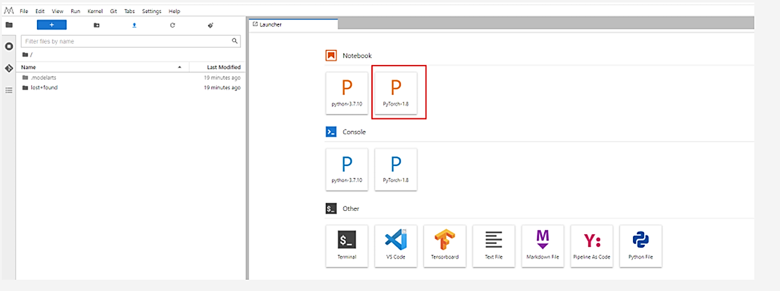
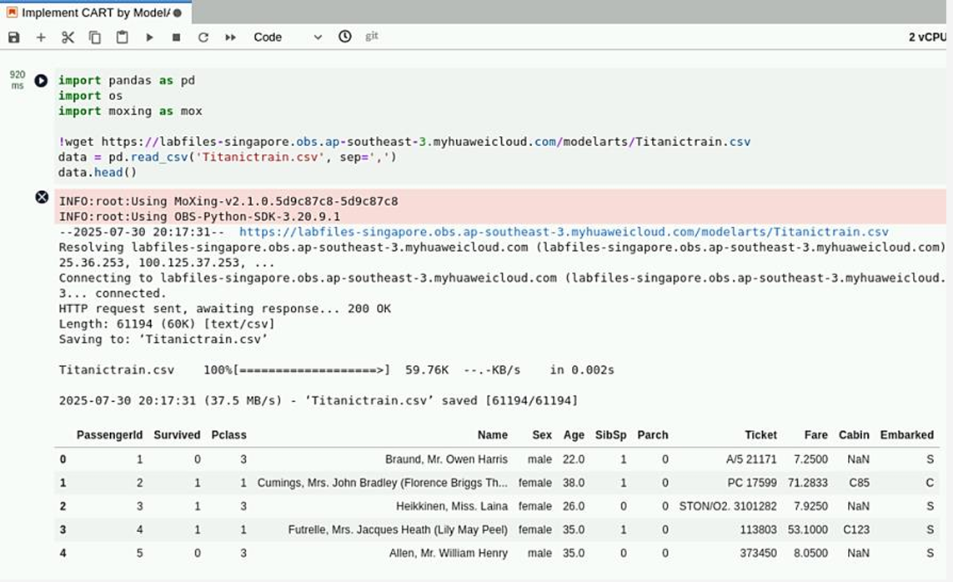
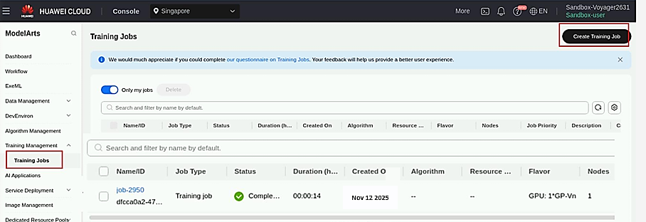
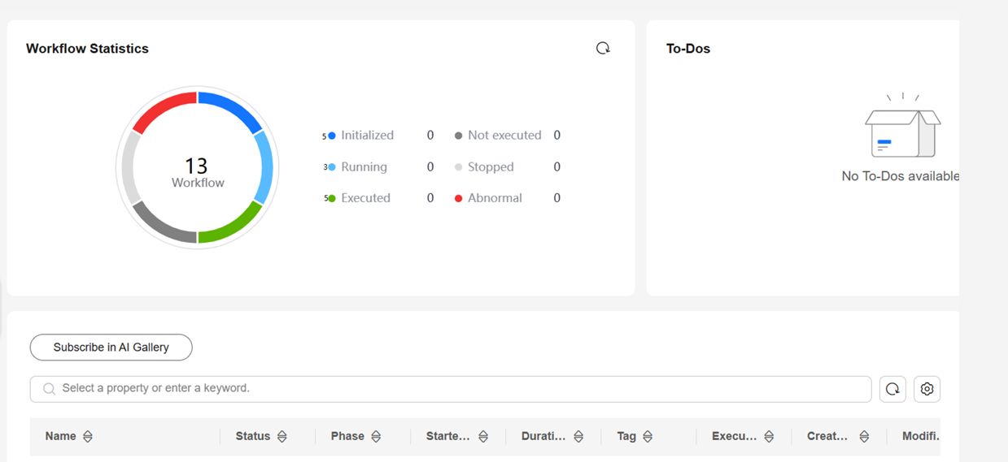
Technical Architecture : Huawei Cloud Service Dashboard
Create Notebook
Model Training and Training Jobs

Slide 16
Functions
Overview
The platform is a text-based depression detection system that allows users to write daily journals through a mobile or web interface. The written text is analyzed using DeepSeek NLP models to identify emotional patterns, linguistic cues, and potential signs of depression.
Based on the analysis, the system provides personalized feedback, severity classification, and, if necessary, recommendations for nearby therapists.
The platform integrates Huawei services to ensure accurate AI processing, cloud scalability, and secure data handling. It aims to make mental health tracking simple, private, and accessible, especially for students and young adults.
Uniqueness:
Unlike traditional wellness or journaling applications, Depresso emphasizes youth-centered design and proactive emotional monitoring, delivering a scientifically informed yet relatable user experience. Its adaptive AI framework ensures continuous learning from user interactions, resulting in more accurate emotional understanding and intervention over time.

Slide 17
Functions
Core Functions and Advantages:
AI-Based Mood Recognition: Utilizes natural language processing and sentiment analysis to detect emotional states from text input, enabling early identification of stress, anxiety, and depressive tendencies.
Personalized Intervention Plans: Generates adaptive coping strategies, mindfulness activities, and daily recommendations based on the user’s behavioral trends and emotional history.
Anonymous Peer Support Network: Facilitates secure and confidential communication among users, promoting empathy and social connectedness.
Crisis Management Module: Provides immediate access to verified professional resources and helplines when high-risk behaviors are detected.

Slide 18
Innovations
Technical Innovations & Prospects
Deep Language Understanding: Utilizes advanced transformer-based models such as DeepSeek fine-tuned for emotional nuance, capable of recognizing subtle linguistic cues linked to depressive tendencies.
Adaptive Severity Classification: Introduces a customized depression-level classifier trained on diverse psychological datasets, enhancing cultural and linguistic relevance for North African users.
Smart Integration with Huawei Ecosystem: Leverages Huawei’s PaaS and EI services for scalable cloud deployment, enabling efficient data processing, and privacy-preserving storage.

Slide 19
Innovations
Originality & Breakthroughs
Youth-Focused Mental Health AI: Specifically designed for students and young adults, addressing a demographic often underserved by traditional therapy platforms.
Hybrid Wellness Ecosystem: Combines AI-driven analysis, peer community engagement, and therapist connection — creating a seamless bridge between self-help and professional care.
Ethical AI & Data Privacy: Implements responsible AI principles with anonymized emotional data to ensure user trust and confidentiality.
Business & Service Innovation
Depresso introduces a freemium model, offering basic journaling and AI feedback for free while providing premium features — such as therapist matching and advanced emotional analytics — through subscription. This model supports both accessibility and sustainable scalability across regions.

Slide 20
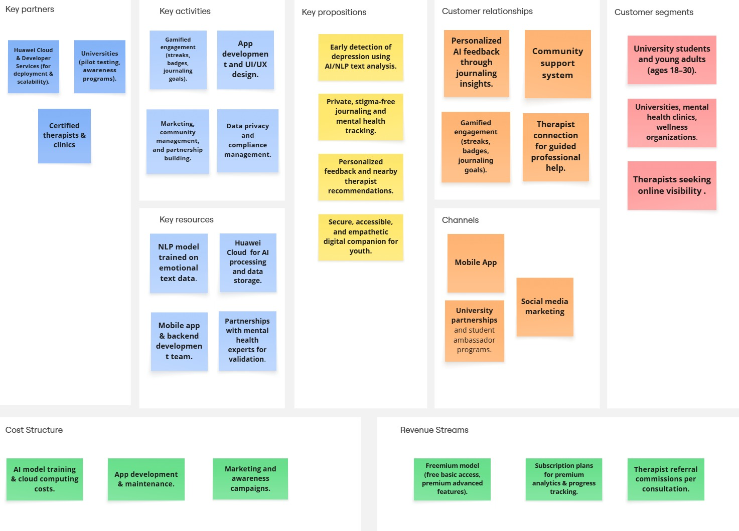
Business Value

Slide 21
Business Value
Social Value:
Depression affects more than 280 million people globally (WHO, 2024), yet over 60% receive no adequate treatment, especially in developing regions. In North Africa, studies show that 1 in 4 university students report symptoms of depression or severe stress. Depresso addresses this gap by offering early, accessible, and stigma-free detection through AI-powered journaling. By promoting mental health awareness and connecting users to professional therapists, the platform contributes to improved emotional well-being and reduced societal burden.
Business Value:
The global mental health app market was valued at USD 6.2 billion in 2023 and is projected to reach USD 17.5 billion by 2030 .Youth and student populations represent one of the fastest-growing user segments for digital wellness solutions. Depresso’s freemium model and therapist referral partnerships position it strategically for sustainable revenue.

Slide 22
Business Value
Profitability:
The global mental health app market is projected to reach USD 17.5 billion by 2030, with annual growth over 15% (Grand View Research, 2024). With an estimated 10,000 active users in the first year and a 5% conversion to premium, Depresso expects early revenue generation through subscription and referral commissions. Low infrastructure cost via Huawei Cloud EI and PaaS ensures high margins and scalability.
Prospect:
Depresso aims to become the leading AI-powered emotional wellness platform for youth in North Africa, with future expansion to the Middle East and Sub-Saharan Africa. Planned updates include voice emotion recognition, multilingual support (Arabic–French–English), and integration with Huawei Health Kit, creating a complete digital ecosystem for preventive mental health care.

Slide 23
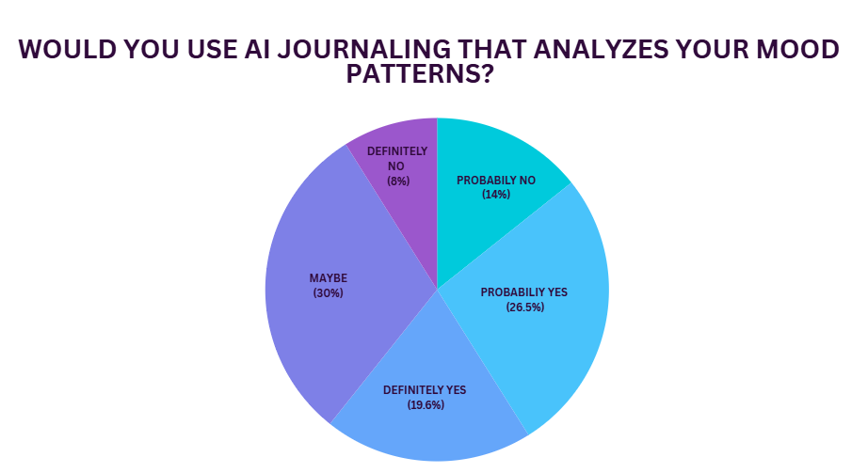
(Optional) Verification
Figure: Responses to “Would you use a journaling app?”
Based on our survey
The pie chart illustrates participants’ willingness to use a journaling application. The majority of respondents answered “Yes”, indicating a strong interest and openness toward adopting such an app. A portion selected “Maybe”, showing some curiosity but potential hesitation, while only a few respondents answered “No”, suggesting limited resistance. Overall, the results reflect positive user receptiveness, supporting the potential demand for a journaling app.

Slide 24
Demo & Follow-up Plan
Demo
https://drive.google.com/drive/folders/1EE6fb8OCwlJcN9zERt80QYxaEEg3qe-S?usp=sharing

Slide 25
Demo & Follow-up Plan
Follow-Up Plan
Overall Objective:
To develop, validate, and scale Depresso into a regionally recognized AI-powered depression detection and support platform for students and young adults across North Africa and the Middle East.
Phase 1 – Prototype Development (0–6 months)
Objectives:
Build MVP (mobile app + backend NLP model using DeepSeek and Huawei EI).
Conduct pilot testing with 100–200 university students.
Challenges:
Ensuring dataset relevance and balanced language diversity.
Solutions:
Use locally sourced, anonymized journaling data; collaborate with university psychology departments.

Slide 26
Demo & Follow-up Plan
Phase 2 – Beta Testing & Market Validation (6–12 months)
Objectives:
Conduct large-scale user testing with students and young professionals.
Measure accuracy, user engagement, and satisfaction metrics.
Challenges:
User retention and trust in AI emotional assessment.
Solutions:
Introduce gamified journaling rewards, anonymous community spaces, and verified professional endorsements.

Slide 27
Demo & Follow-up Plan
Phase 3 – Product Launch & Monetization (12–24 months)
Objectives:
Launch officially on Huawei AppGallery and App Store.
Roll out premium subscription services and therapist referral network.
Challenges:
Balancing ethical AI use with data privacy and scalability.
Solutions:
Implement strict data anonymization, secure Huawei Cloud storage, and transparent consent policies.

Slide 28
THANK YOU

