Slide 1

COMPUTER SECURITY AND NETWORKING

Slide 2
INTRO
MODULE CODE:DFITT 04206
MODULE NAME: COMPUTER SECURITY AND NETWORKING
TWO TESTS EACH WITH 20 MARKS
TWO ASSIGNMENTS
REGULAR CLASS QUIZ
WEEKLY PRESENTATIONS

Slide 3

Lecture 1 contents
Meaning of Network
Characteristics of a Network
Types of Networks
Components of a Network

Slide 4

What is a Network
A network is a collection of interconnected nodes or entities that are linked together to enable communication, sharing of resources, or exchange of information.
These nodes can be computers, servers, routers, switches, or any other devices capable of sending, receiving, or forwarding data
Networks facilitate the exchange of data, information, and resources among connected devices, enabling collaboration and efficient operations.

Slide 5
Aspect used to setup a network
There are two aspects of setting up a network:
The hardware - used to connect the systems, and
The software - installed on the computers to allow them to communicate.
This lecture is designed to give you an understanding of the hardware used to build a network.
The network comprises two key elements: ENTITIES, which seek to share information or resources, and MEDIUM facilitating communication, such as cables or wireless connections.

Slide 6
Definition of key terminologies
Server refers to a specialized computer or software application that provides services or resources to other devices on the network, known as clients.
Workstations/Client, is a basic computer running a client operating system such as Windows XP or Linux. These users typically store their files on a central server so that they can share the files with other users on the network.
Host refers to any computer or device that is connected to a network and sends or receives information on that network. A host can be a server, a workstation, a printer with its network card, or a device such as a router.
NOTE: Generally any system or device that is connected to the network is known as a host.

Slide 7

Characteristics of a Network
Connectivity
Scalability
Security
Reliability
Performance
Standards and Protocols
Management and Administration

Slide 8
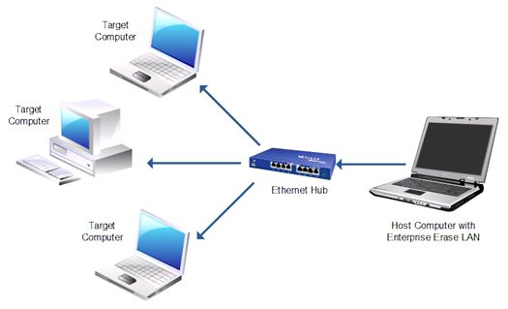
1. Connectivity
The primary purpose of a computer network is to enable devices to communicate with each other.
Connectivity is established through a variety of wired and wireless technologies, such as Ethernet cables, Wi-Fi, and Bluetooth.

Slide 9
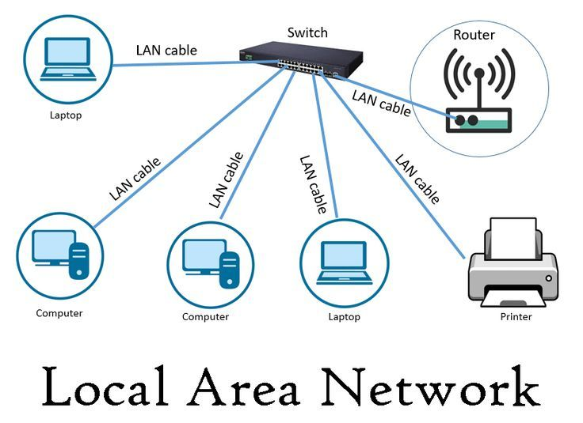
2. Scalability
Computer networks must be scalable to accommodate growth and changing needs.
As the number of devices and users on the network increases, the network must be able to handle the additional traffic and data.

Slide 10
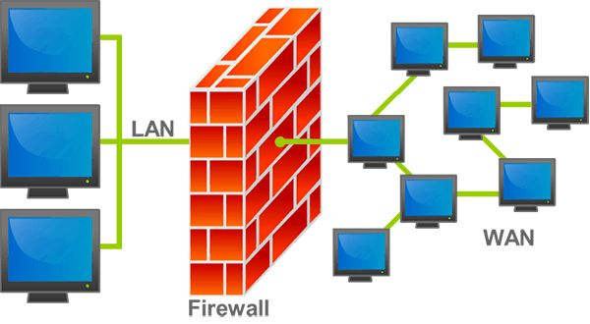
3. Security
Computer networks are vulnerable to security threats such as hacking, viruses, and data breaches.
Security measures such as firewalls, encryption, and user authentication are essential to protect network resources and data.

Slide 11
4. Reliability
Computer networks must be reliable to ensure that data and resources are always available when needed.
Redundancy and backup systems can help to ensure that the network remains operational in the event of a failure.

Slide 12
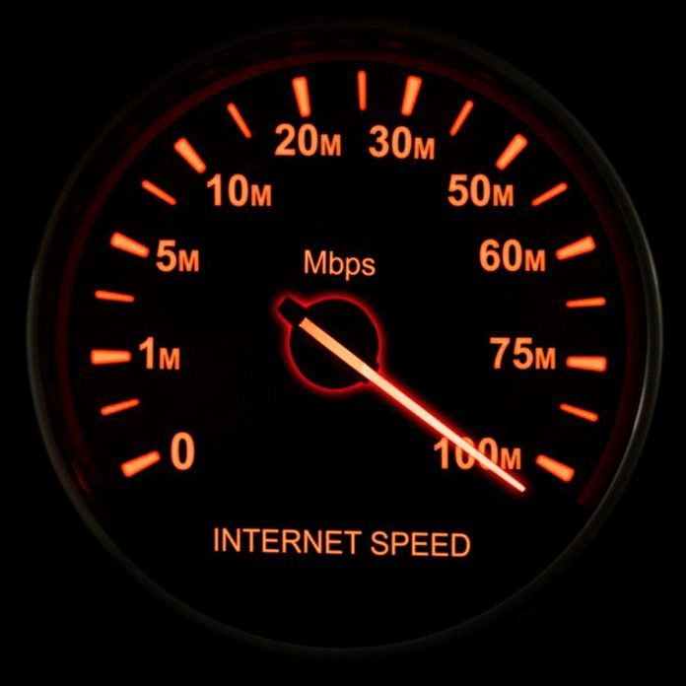
5. Performance
Network Performance refers to the efficiency, speed, and overall effectiveness of data transmission and communication within a computer network.
The performance of a computer network is determined by factors such as bandwidth, latency, and throughput. These factors affect the speed and responsiveness of the network and can impact the user experience.
Bandwidth: refers to the maximum amount of data that can be transmitted over a network in a given period, typically measured in bits per second (bps) or its multiples (Mbps, Gbps).
Latency: also known as delay, is the time it takes for data packets to travel from the source to the destination across the network.
Throughput: measures the actual amount of data transmitted over a network within a specified timeframe. It reflects the network's capacity to deliver data efficiently and is influenced by factors such as bandwidth, latency, packet loss, and network congestion.
Higher throughput indicates better network performance and faster data transfer rates.
Packet Loss: Packet loss occurs when data packets transmitted across the network fail to reach their destination due to network congestion, errors, or hardware failures

Slide 13
6. Standards and protocols
Computer standards are guidelines dictating how hardware, software, and systems must function or communicate to ensure they are compatible and can work together seamlessly. e.g. TCP/IP and Ethernet
Protocols are formal rules, conventions, or procedures that govern the format, timing, sequencing, and error handling of communication between devices or systems. e.g. HTTP and SMTP
Protocols define specific steps and data structures required for devices to initiate, establish, maintain, and terminate communication sessions, ensuring reliable and efficient data exchange.
NOTE: Computer networks rely on standards and protocols to ensure that devices can communicate with each other.

Slide 14
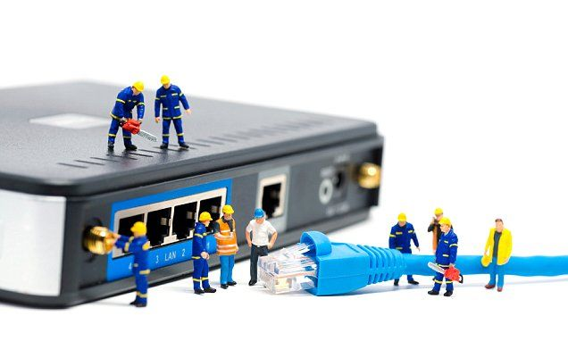
7. Management And Administration
Computer networks require ongoing management and administration to ensure that they continue to function properly.
This includes tasks such as monitoring network performance, configuring devices, and troubleshooting issues

Slide 15
TYPES OF NETWORKS
Network Hardware
In this section, we'll talk about different types of networks.

Slide 16
CLASSIFICATION OF NETWORK
There is no generally accepted taxonomy into which all computer networks fit, but two dimensions stand out as important: transmission technology and scale.
two types of transmission technology are in widespread use: broadcast links and point-to-point links.
Point-to-point links connect individual pairs of machines.
Often multiple routes, of different lengths, are possible, so finding good ones is important in point-to-point networks. Point-to-point transmission with exactly one sender and exactly one receiver is sometimes called unicasting.
In broadcast network, the communication channel is shared by all the machines on the network; packets sent by any machine are received by all the others.

Slide 17
Cont…
An address field within each packet specifies the intended recipient. Upon receiving a packet, a machine checks the address field. If the packet is intended for the receiving machine, that machine processes the packet; if the packet is intended for some other machine, it is just ignored
A wireless network is a common example of a broadcast link, with communication shared over a coverage region that depends on the wireless channel and the transmitting machine.
As an analogy, consider someone standing in a meeting room and shouting “Micah, come here. I want you”. Although the packet may be received (heard) by many people, only Micah will respond; the others just ignore it

Slide 18
CLASSIFICATION OF NETWORKS BY SCALE
An alternative criterion for classifying networks is by scale. Distance is important as a classification metric because different technologies are used at different scales.
According to scale networks can be classified into the following types:
Personal Area Network (PAN)
Local Area Network (LAN)
Metropolitan Area Networks(MAN)
Wide Area Networks(WAN)
Internetworks.

Slide 19

1.Personal Area Network
PANs let devices communicate over the range of a person. A common example is a wireless network that connects a computer with its peripherals.
Almost every computer has an attached monitor, keyboard, mouse, and printer. Without using wireless, this connection must be done with cables.
To help these users, some companies got together to design a short-range wireless network called Bluetooth to connect these components without wires.
The idea is that if your devices have Bluetooth, then you need no cables. You just put them down, turn them on, and they work together. For many people, this ease of operation is a big plus.

Slide 20
2.Local area network
A LAN is a privately owned network that operates within and nearby a single building like a home, office or factory.
LANs are widely used to connect personal computers and consumer electronics to let them share resources (e.g., printers) and exchange information. When LANs are used by companies, they are called enterprise networks.
Wireless LANs are very popular these days, especially in homes, older office buildings, cafeterias, and other places where it is too much trouble to install cables
In most cases, each computer talks to a device in the ceiling. This device, called an AP (Access Point), wireless router, or base station, relays packets between the wireless computers and also between them and the Internet.
There is a standard for wireless LANs called IEEE 802.11, popularly known as Wi-Fi, which has become very widespread.

Slide 21
3.Metropolitan area network
A MAN covers a city. The best-known examples of MANs are the cable television networks available in many cities.
These systems grew from earlier community antenna systems used in areas with poor over-the-air television reception.
In those early systems, a large antenna was placed on top of a nearby hill and a signal was then piped to the subscribers’ houses.
When the Internet began attracting a mass audience, the cable TV network operators began to realize that with some changes to the system, they could provide two-way Internet service in unused parts of the spectrum.

Slide 22
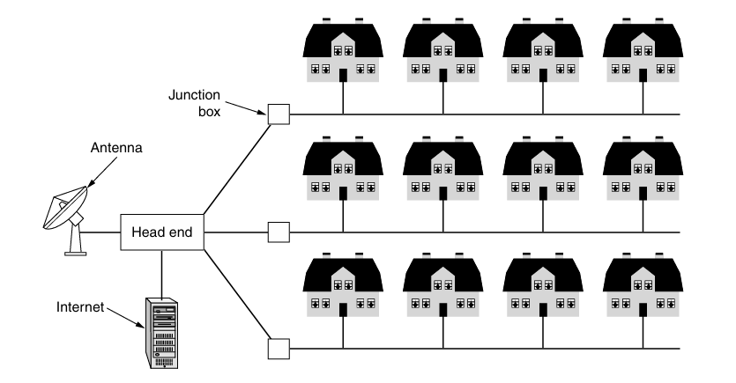
Cont…
A metropolitan area network based on cable TV

Slide 23
4. WIDE AREA NETWORK(WAN)
A WAN (Wide Area Network) spans a large geographical area, often a country or continent.
A wide area network (WAN) is typically made up of multiple LANs.

Slide 24
5.Internetwork
A collection of interconnected networks is called an internetwork or internet.

Slide 25
COMPONENTS OF A NETWORK
The path that a message takes from its source to destination can be as simple as a single cable connecting one computer to another, or as complex as a network that spans the globe.
This network infrastructure is the platform that supports the network. It provides a stable and reliable channel over which our communications can occur.
The network infrastructure contains three categories of hardware components, as shown in the figure:
End devices
Intermediate devices
Network media

Slide 26
CONT…
Computer network components are the major parts that are needed to install the software.
Some important network components are NIC, switch, cable, hub, router, and modem
Depending on the type of network that we need to install, some network components can also be removed. For example, the wireless network does not require a cable.
The following are the network components explained in detail:

Slide 27
1. network interface Cards
The network interface card (NIC), or network card, is a device installed on the system that is responsible for sending and receiving data onto the network.
The network card is responsible for preparing data from the system to be transported on the wire by converting the outbound data from a parallel format to electrical signals that will travel along the network media.
On the receiving end, the network card is responsible for receiving the electrical signal and converting it to data that is understood by the system.

Slide 28
Cont…
There are two types of NIC:
Wired NIC
Wireless NIC
The Wired NIC is present inside the motherboard. Cables and connectors are used with wired NIC to transfer data.
The wireless NIC contains the antenna to obtain the connection over the wireless network. For example, a laptop computer contains a wireless NIC.
The MAC address or physical address is encoded on the network card chip which is assigned by the IEEE to identify a network card uniquely.
The MAC address is stored in the PROM (Programmable read-only memory).

Slide 29
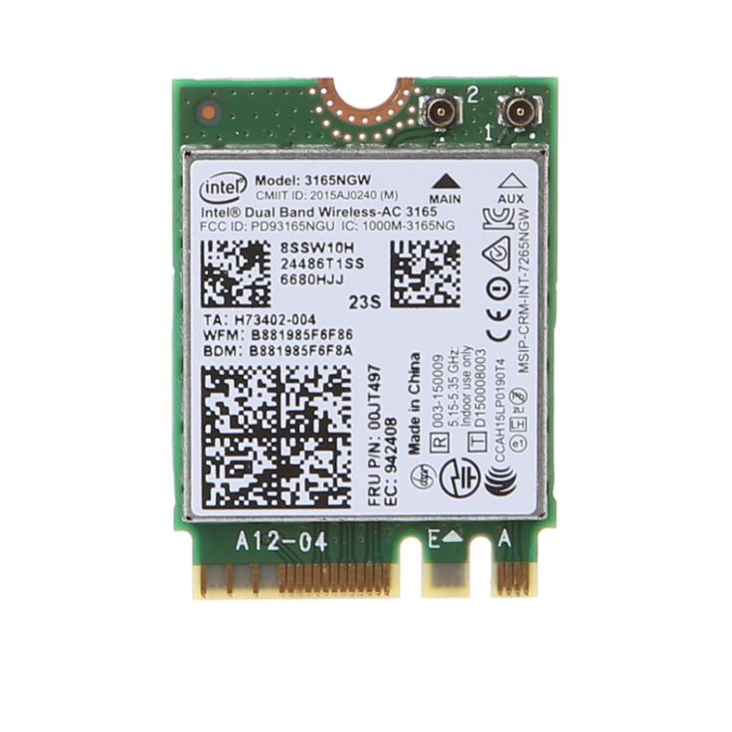
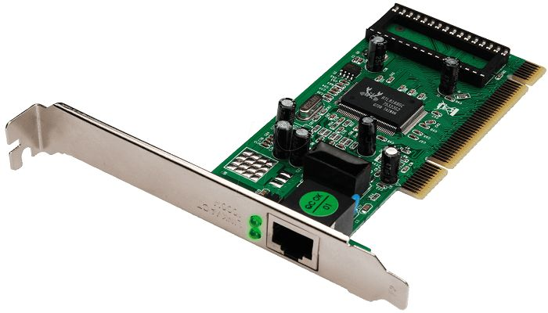
network interface Cards

Slide 30
2. HUB
A Hub is a hardware device that divides the network connection among multiple devices.
When a computer requests for some information from a network, it first sends the request to the Hub through cable.
Hub will broadcast this request to the entire network. All the devices will check whether the request belongs to them or not. If not, the request will be dropped.
The process used by the Hub consumes more bandwidth and limits the amount of communication.

Slide 31
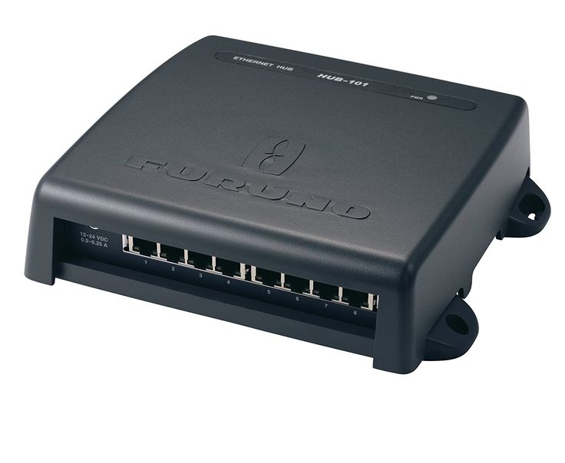
HUB
Nowadays, the use of hub is obsolete, and it is replaced by more advanced computer network components such as Switches and routers.

Slide 32
2. INTERMEDIATE DEVICES

Slide 33
3. SWITCH
A switch is a hardware device that connects multiple devices on a computer network.
The Switch contains the updated table that decides where the data is transmitted or not.
The switch delivers the message to the correct destination based on the physical address present in the incoming message.

Slide 34
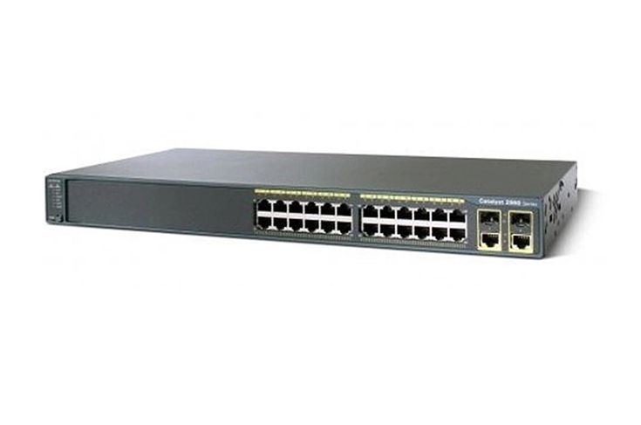
SWITCH
One advantage of a Switch is that it does not broadcast the message to the entire network like a Hub. Instead, it determines the specific device to which the message is to be transmitted.
Therefore, we can say that the switch provides a direct connection between the source and destination. It increases the speed of the network.

Slide 35
4. ROUTER
A router is a hardware device that is used to connect a LAN with an internet connection. It is used to receive, analyze, and forward the incoming packets to another network.
A router works in Layer 3 (Network layer) of the OSI Reference model.
A router forwards the packet based on the information available in the routing table.
It determines the best path from the available paths for the transmission of the packet.

Slide 36
ADVANTAGES OF A ROUTER
Security
Reliability
Performance

Slide 37

5. Modem
A modem is a hardware device that allows the computer to connect to the internet over the existing telephone line.
A modem is not integrated with the motherboard rather it is installed on the PCI slot found on the motherboard.
It stands for Modulator/Demodulator. It converts the digital data into an analog signal over the telephone lines.

Slide 38
6. Cables and connectors
Cable is a transmission media used for transmitting a signal.
There are three types of cables used in transmission
Twisted pair cable
Coaxial cable
Fibre-optic cable

Slide 39
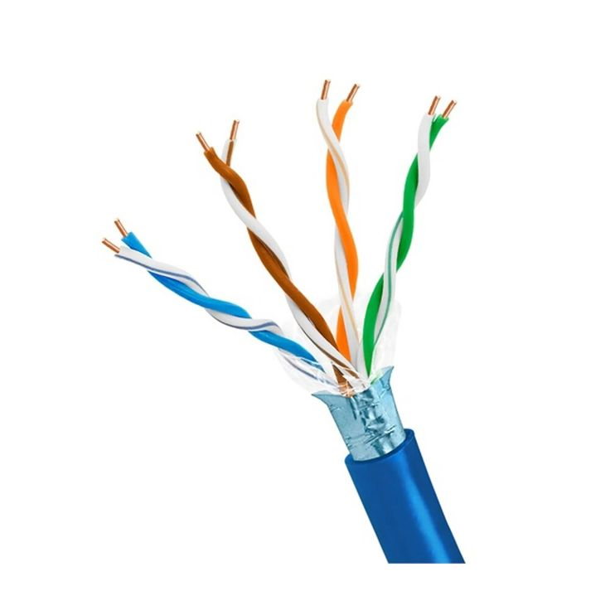
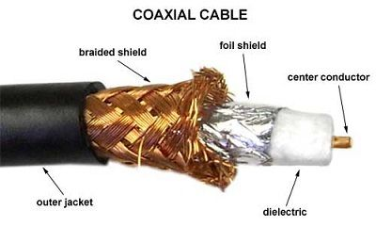
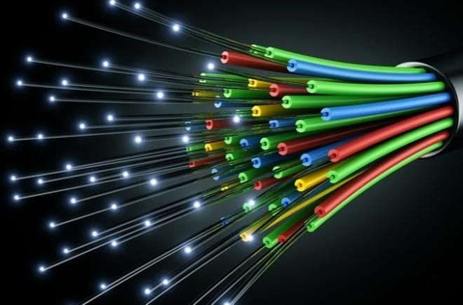
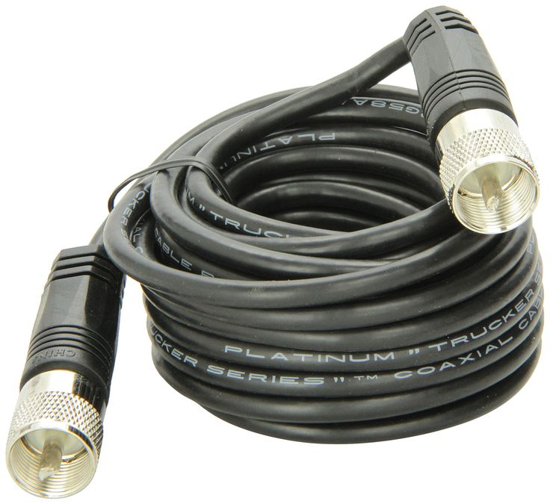
TYPES OF CABLES

Slide 40


