Slide 1

COMPUTER SECURITY AND NETWORKING

Slide 2
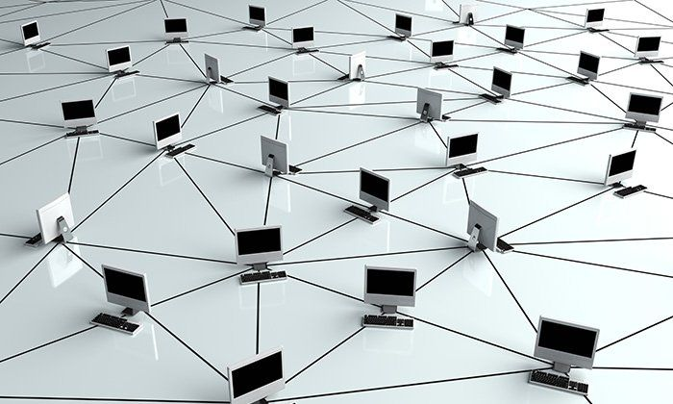
NETWORK TOPOLOGIES
A network topology refers to the layout or arrangement of interconnected devices or nodes within a computer network. It describes how these devices are connected and how data flows between them.
OR

Slide 3
CONT…
The arrangement of a network that comprises nodes and connecting lines via sender and receiver.
The various network topologies are:

Slide 4
CONT…
Point to Point Topology
Mesh Topology
Star Topology
Bus Topology
Ring Topology
Tree Topology
Hybrid Topology

Slide 5
1. Point to Point Topology
Is a type of topology that works on the functionality of the sender and receiver. It is the simplest communication between two nodes, in which one is the sender and the other one is the receiver. Point-to-Point provides high bandwidth.

Slide 6
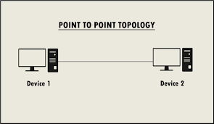
CONT…

Slide 7
2. MESH TOPOLOGY
In a mesh topology, every device is connected to another device via a particular channel. In Mesh Topology, the protocol used is DHCP (Dynamic Host Configuration Protocol).
Every device is connected to another via dedicated channels. These channels are known as links.

Slide 8
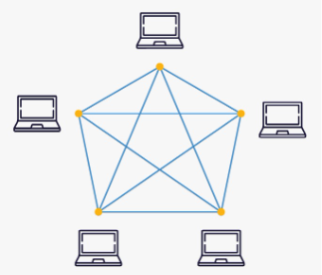
CONT…

Slide 9
CONT…
Suppose, the N number of devices are connected in a mesh topology, the total number of ports that are required by each device is N-1. In the Figure above, there are 5 devices connected, hence the total number of ports required by each device is 4. The total number of ports required = N * (N-1).

Slide 10
CONT…
Suppose, N number of devices are connected in a mesh topology, then the total number of dedicated links required to connect them is N(N-1)/2. In the Figure above, there are 5 devices connected, hence the total number of links required is 5*4/2 = 10.

Slide 11
Advantages of Mesh Topology
Communication is very fast between the nodes.
Mesh Topology is robust.
The fault is diagnosed easily. Data is reliable because data is transferred among the devices through dedicated channels or links.
Provides security and privacy.

Slide 12
Drawbacks of Mesh Topology
Installation and configuration are difficult.
The cost of cables is high as bulk wiring is required, hence suitable for less number of devices.
The cost of maintenance is high.

Slide 13
STAR TOPOLOGY
In Star Topology, all the devices are connected to a single hub through a cable.
This hub is the central node and all other nodes are connected to the central node.
Coaxial cables or RJ-45 cables are used to connect the computers.

Slide 14
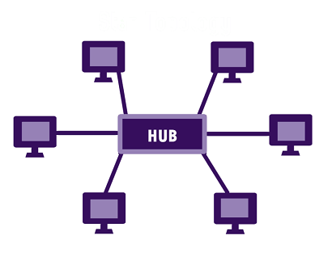
CONT…

Slide 15
Advantages of Star Topology
If N devices are connected in a star topology, then the number of cables required to connect them is N. So, it is easy to set up.
Each device requires only 1 port i.e. to connect to the hub, therefore the total number of ports required is N.
It is Robust. If one link fails only that link will affect and not other than that.

Slide 16
CONT…
Easy to fault identification and fault isolation.
Star topology is cost-effective as it uses inexpensive coaxial cable.

Slide 17
Drawbacks of Star Topology
If the concentrator (hub) on which the whole topology relies fails, the whole system will crash down.
The cost of installation is high.
Performance is based on the single concentrator i.e. hub.

Slide 18
BUS TOPOLOGY
Bus Topology is a network type in which every computer and network device is connected to a single cable. It is bi-directional.
It is a multi-point connection and a non-robust topology because if the backbone fails the topology crashes.
In Bus Topology, various MAC (Media Access Control) protocols are followed by LAN ethernet connections like TDMA, Pure Aloha, CDMA, Slotted Aloha, etc.

Slide 19
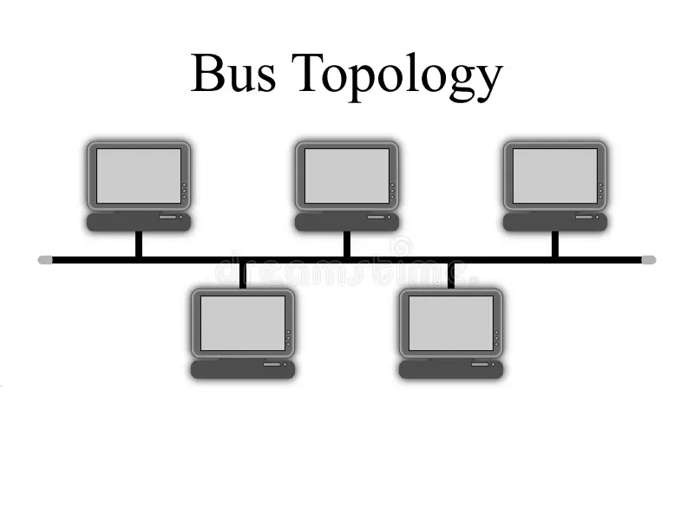
CONT…

Slide 20
ADVANTAGES OF BUS TOPOLOGY
If N devices are connected in a bus topology, then the number of cables required to connect them is 1, known as backbone cable, and N drop lines are required.
Coaxial or twisted pair cables are mainly used in bus-based networks.

Slide 21
CONT…
The cost of the cable is less compared to other topologies, but it is used to build small networks.

Slide 22
DRAWBACKS OF BUS TOPOLOGY
A bus topology is quite simple, but still, it requires a lot of cabling.
If the common cable fails, then the whole system will crash down.
If the network traffic is heavy, it increases collisions in the network. To avoid this, various protocols are used in the MAC layer known as Pure Aloha, Slotted Aloha, CSMA/CD, etc.

Slide 23
CONT…
Adding new devices to the network would slow down networks.
Security is very low.

Slide 24
RING TOPOLOGY
In a Ring Topology, forms a ring connecting devices with exactly two neighboring devices.
Several repeaters are used for Ring topology with a large number of nodes, because if someone wants to send some data to the last node in the ring topology with 100 nodes, then the data will have to pass through 99 nodes to reach the 100th node.
Hence to prevent data loss repeaters are used in the network.

Slide 25
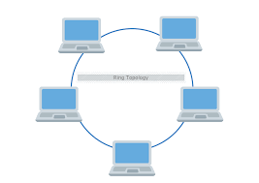
CONT…

Slide 26
CONT…
The data flows in one direction, i.e. it is unidirectional, but it can be made bidirectional by having 2 connections between each Network Node, it is called Dual Ring Topology.
In-ring topology, the Token Ring Passing protocol is used by the workstations to transmit the data.

Slide 27
ADVANTAGES OF RING TOPOLOGY
The data transmission is high-speed.
The possibility of collision is minimal in this type of topology.
Cheap to install and expand.
It is less costly than a star topology.

Slide 28
Drawbacks of Ring Topology
The failure of a single node in the network can cause the entire network to fail.
Troubleshooting is difficult in this topology.
The addition of stations in between or the removal of stations can disturb the whole topology.
Less secure.

Slide 29
Hybrid Topology
This topological technology is the combination of all the various types of topologies we have studied above.
Hybrid Topology is used when the nodes are free to take any form. It means these can be individuals such as Ring or Star topology or can be a combination of various types of topologies. Each topology uses the protocol that has been discussed earlier.

Slide 30
Advantages of Hybrid Topology
This topology is very flexible.
The size of the network can be easily expanded by adding new devices.

Slide 31
Drawbacks of Hybrid Topology
It is challenging to design the architecture of the Hybrid Network.
Hubs used in this topology are very expensive.
The infrastructure cost is very high as a hybrid network requires a lot of cabling and network devices.

Slide 32


