Slide 1
Logical Operations in Computer
DFITT 05209
Lecture04

Slide 2
Defn intro
Logical operations are fundamental to computing and are used in decision-making, comparisons, and bitwise operations.
These operations use Boolean algebra and are performed by the Arithmetic Logic Unit (ALU) of a CPU

Slide 3
Basic Logical Operations
i) AND Operation ( ∧ )
Symbol: && (in programming) or ∧ (mathematical notation)
Rule: Returns 1 only if both inputs are 1, otherwise 0.

Slide 4
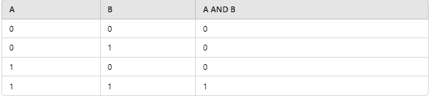
Basic Logical Operations…
Truth Table:

Slide 5
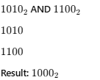
Basic Logical Operations…

Slide 6
Basic Logical Operations…
ii) OR Operation ( ∨ )
Symbol: || (in programming) or ∨ (mathematical notation)
Rule: Returns 1 if at least one input is 1.

Slide 7
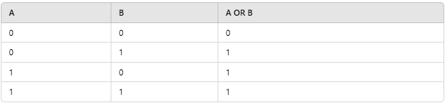
Basic Logical Operations…
Truth Table

Slide 8

Basic Logical Operations…
Example

Slide 9
Basic Logical Operations…
iii) NOT Operation ( ¬ )
Symbol: ! (in programming) or ¬ (mathematical notation)
Rule: Inverts the input (0 becomes 1, and 1 becomes 0)

Slide 10

Basic Logical Operations…
Truth Table

Slide 11
Basic Logical Operations…
Example:
NOT (1010) → 0101

Slide 12
Basic Logical Operations…
iv) XOR (Exclusive OR) Operation ( ⊕ )
Symbol: ⊕Rule: Returns 1 only if inputs are different (one is 1 and the other is 0)

Slide 13
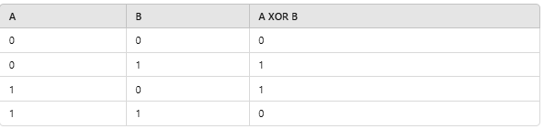
Basic Logical Operations…
Truth Table

Slide 14

Basic Logical Operations… XOR example..

Slide 15
Assignment Two-a Group Tasks ( 10 Marks)
Presentation Questions
1. Describe memory addressing
Presentations Date
31 March 2025

Slide 16
Assignment Two-a Group Tasks
Question 2. Describe Memory capacity
Question 3. Describe Memory Addressing Decoder

Slide 17
Assignment 03a ( 5 Marks)
What CPU operations occur when Mr. Xiexie requests to print a document from a shared printer, using concepts from computer architecture?
Submission Date is 14 April 2025

Slide 18
Lecture Five
BOOLEAN ALGEBRA AND DIGITAL LOGIC

Slide 19
BOOLEAN ALGEBRA
Boolean algebra is an algebra for the manipulation of objects that can take on only two values, typically true and false.
In formal logic, these values are “true” and “false.”
In digital systems, these values are “on” and “off,” 1 and 0, or “high” and “low.”

Slide 20
Boolean Expression
Boolean algebra also has operations that can be performed on these objects, or variables.
Combining the variables and operators yields to Boolean expressions.
A Boolean function typically has one or more input values and yields a result, based on these input values, in the range {0,1}.

Slide 21
Three common Boolean operators are AND, OR, and NOT.
A Boolean operator can be completely described using a table that lists the inputs, all possible values for these inputs, and the resulting values of the operation for all possible combinations of these inputs.
This table is called a truth table.
A truth table shows the relationship, in tabular form, between the input values and the result of a specific Boolean operator or function on the input variables.

Slide 22
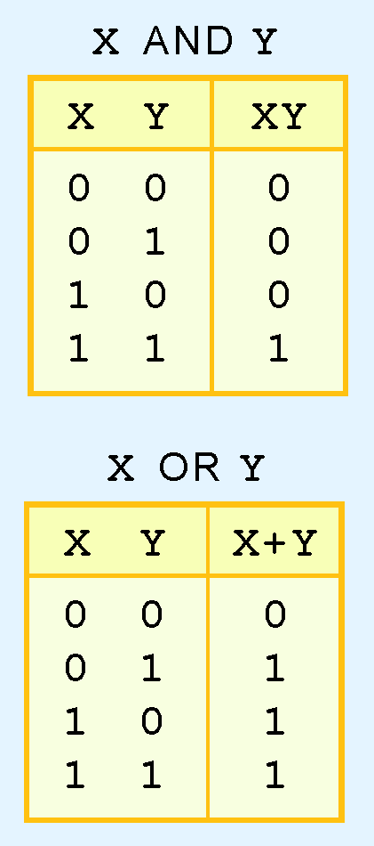
The truth table for the Boolean operators AND and OR are shown at the right.
The AND operator is also known as a Boolean product.
The OR operator is the Boolean sum.

Slide 23
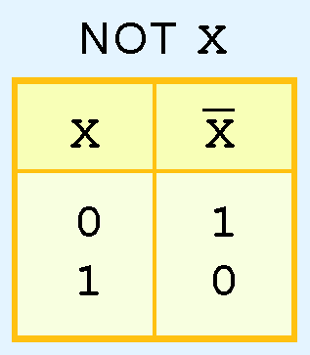
The truth table for the Boolean NOT operator is shown at the right.
The NOT operation is most often designated by an overbar.
It is sometimes indicated by a prime mark ( ‘ ) or an “elbow” (¬).

Slide 24
We now understand that Boolean algebra deals with binary variables and logical operations on those variables.
Combining these two concepts, we can examine Boolean expressions composed of Boolean variables and multiple logic operators.

Slide 25
As with common arithmetic, Boolean operations have rules of precedence.
The NOT operator has highest priority, followed by AND and then OR.
This is how we chose the (shaded) function subparts in our table.

Slide 26
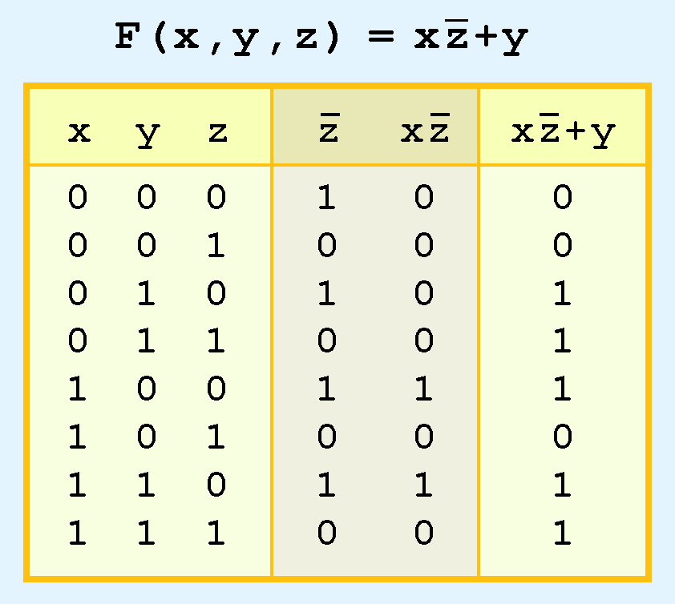
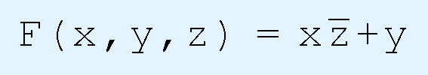
The truth table for the Boolean function:

Slide 27
Boolean Identities
Digital computers contain circuits that implement Boolean functions.
The simpler that we can make a Boolean function, the smaller the circuit that will result.
Simpler circuits are cheaper to build, consume less power, and run faster than complex circuits.
Boolean expressions can also be simplified, but we need new identities, or laws, that apply to Boolean algebra instead of regular algebra.

Slide 28
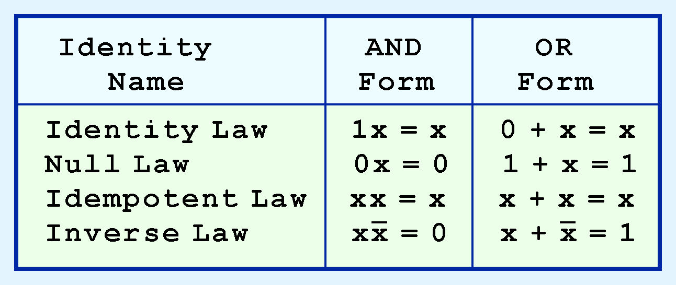
Most Boolean identities have an AND (product) form as well as an OR (sum) form. We give our identities using both forms. Our first group is rather intuitive:

Slide 29
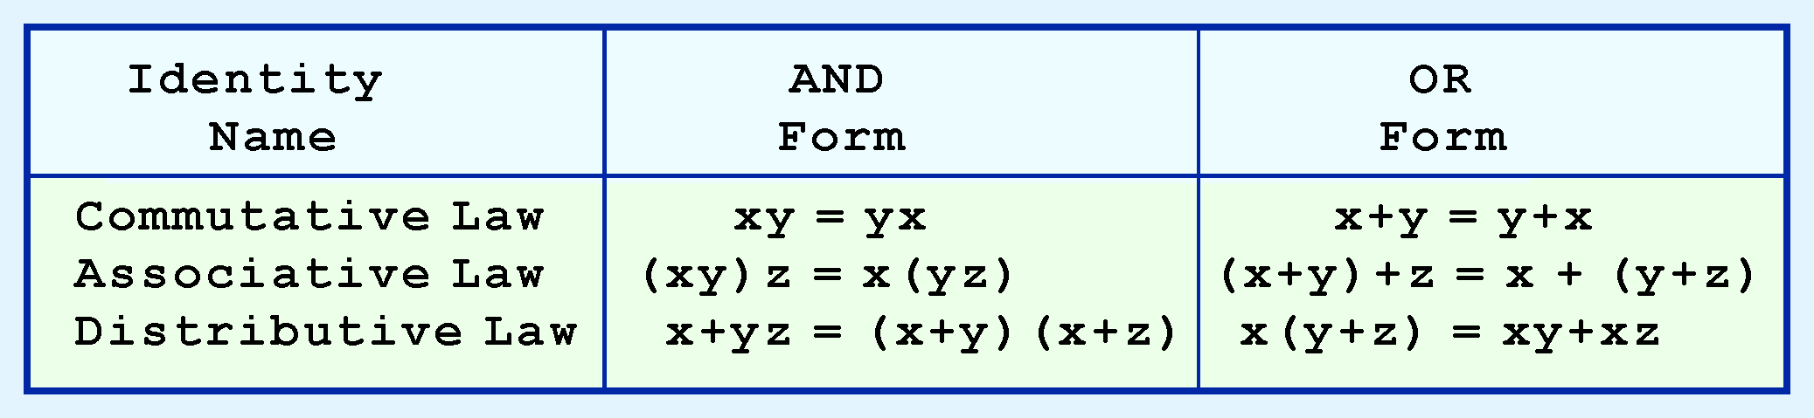
Our second group of Boolean identities should be familiar to you from your study of algebra:

Slide 30
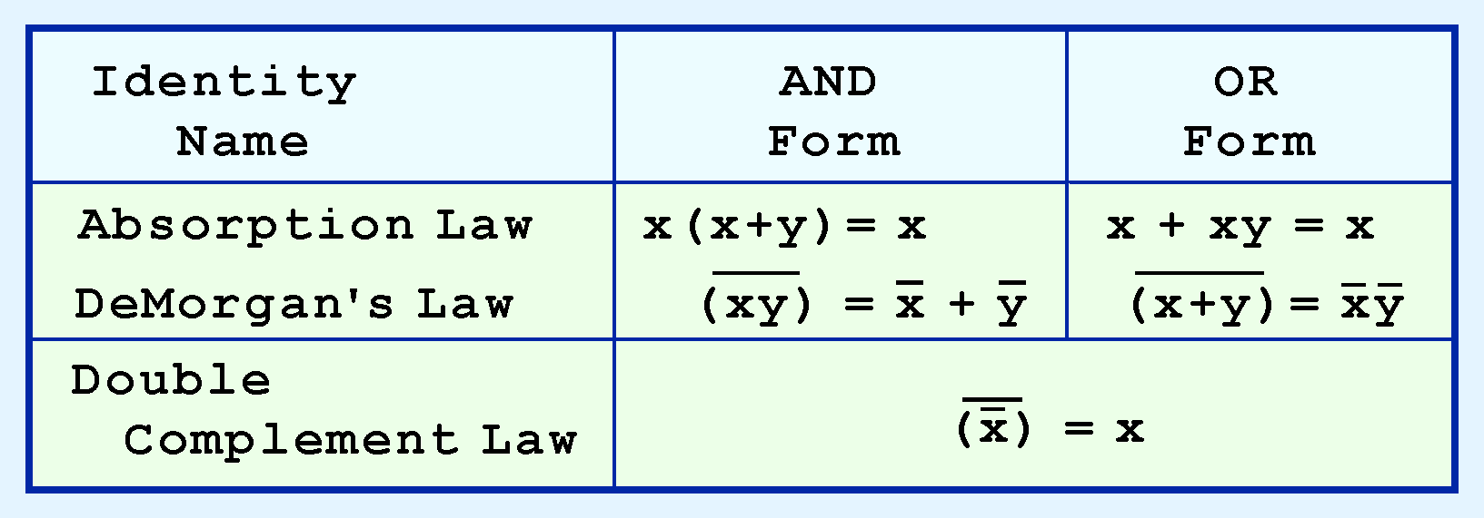
Our last group of Boolean identities are perhaps the most useful.

Slide 31
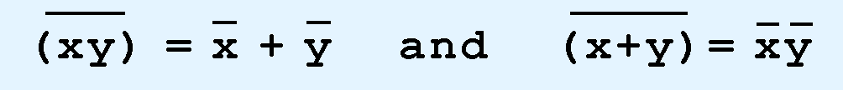
Complements
Sometimes it is more economical to build a circuit using the complement of a function (and complementing its result) than it is to implement the function directly.
DeMorgan’s law provides an easy way of finding the complement of a Boolean function.
Recall DeMorgan’s law states:

Slide 32
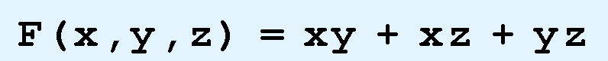
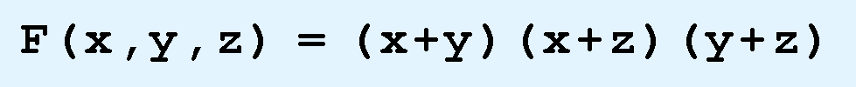
There are two canonical forms for Boolean expressions: sum-of-products and product-of-sums.
Recall the Boolean product is the AND operation and the Boolean sum is the OR operation.
In the sum-of-products form, ANDed variables are ORed together.
For example:
In the product-of-sums form, ORed variables are ANDed together:
For example:

Slide 33
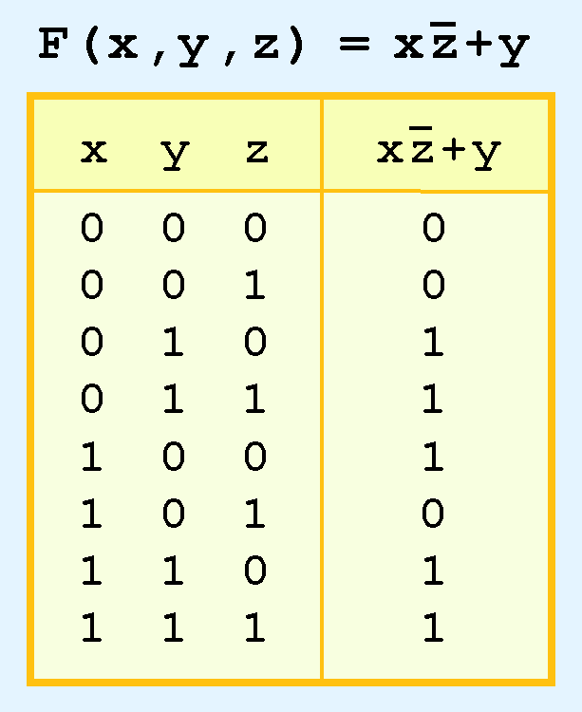
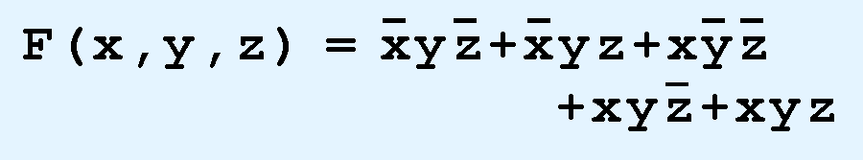
The sum-of-products form for our function is:

Slide 34
To generate a sum-of-products expression using the truth table for any Boolean expression, you must generate a product term of the input variables corresponding to each row where the value of the output variable in that row is 1.
In each product term, you must then complement any variables that are 0 for that row.
The product-of-sums form is often preferred when the Boolean expression evaluates true in more cases than it evaluates false.

Slide 35
LOGIC GATES
The logical operators AND, OR, and NOT that we have discussed have been represented using truth tables and Boolean expressions.
The actual physical components, or digital circuits, such as those that perform arithmetic operations or make choices in a computer, are constructed from a number of primitive elements called gates.

Slide 36
These gates are the basic building blocks for digital design.
Formally, a gate is a small, electronic device that computes various functions of two-valued signals.
To physically implement each gate requires from one to six or more transistors, depending on the technology being used.

Slide 37
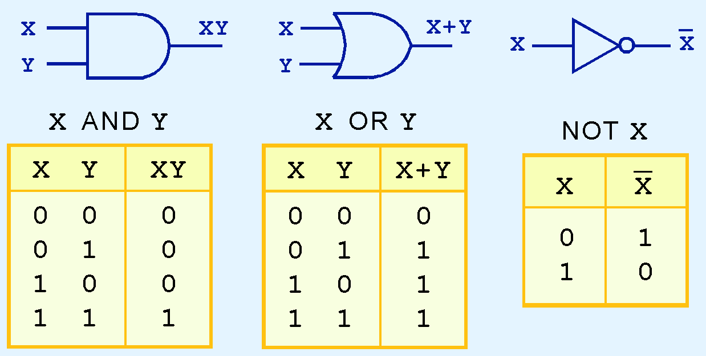
Symbols for Logic Gates
The three simplest gates are the AND, OR, and NOT gates.

Slide 38
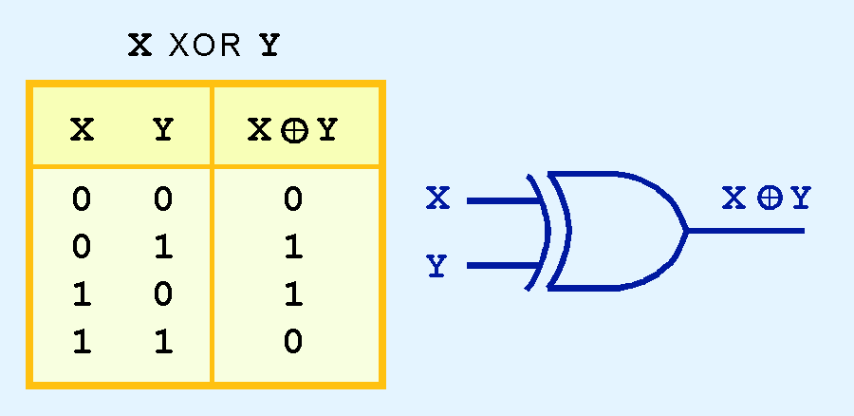
Another common gate is the exclusive-OR (XOR) gate. XOR is false if both of the input values are equal and true otherwise.

Slide 39
Universal Gates
Two other common gates are NAND and NOR, which produce complementary output to AND and OR, respectively.
Each gate has two different logic symbols that can be used for gate representation.

Slide 40
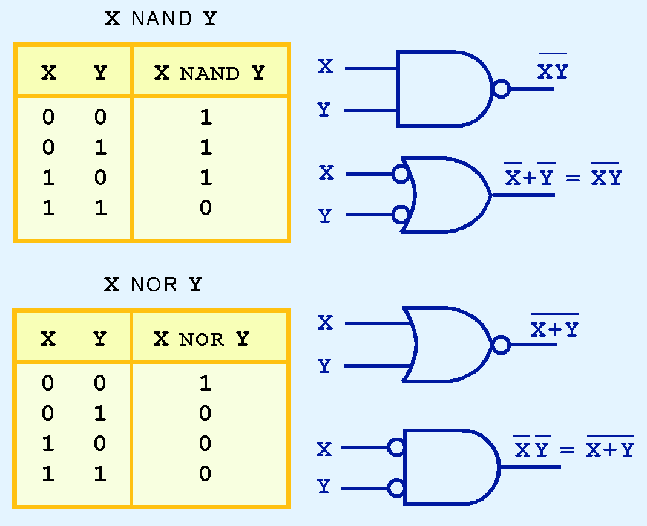

Slide 41
The NAND gate is commonly referred to as a universal gate, because any electronic circuit can be constructed using only NAND gates.
To prove this, an AND gate, an OR gate, and a NOT gate are constructed using only NAND gates in the next slide.

Slide 42
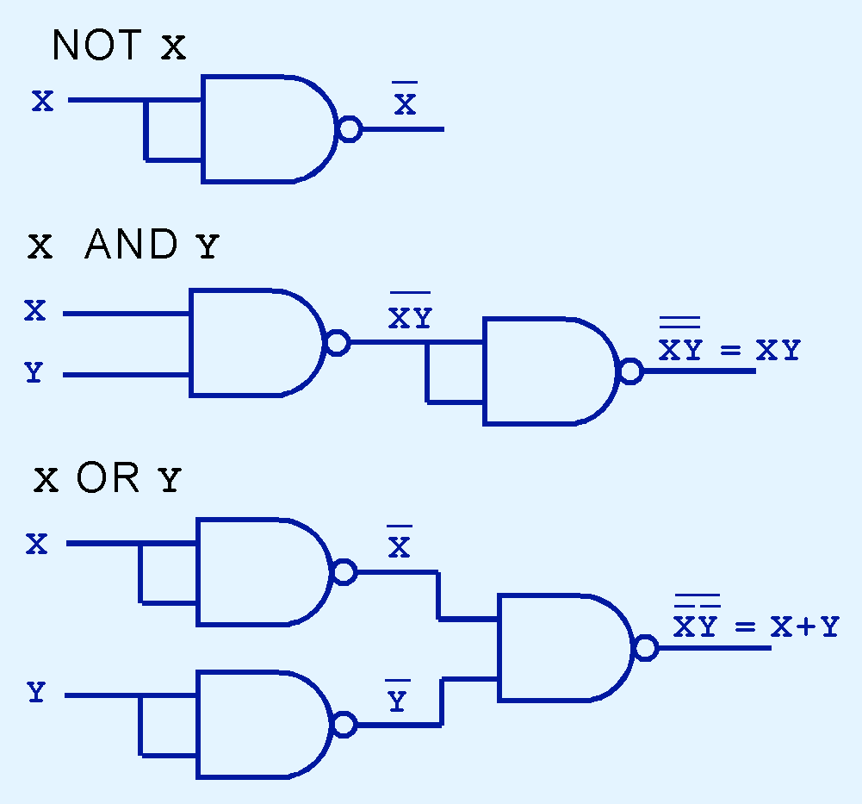

Slide 43
Why using NAND gates?
First, NAND gates are cheaper to build than the other gates.
Second, complex integrated circuits are often much easier to build using the same building block (i.e., several NAND gates) rather than a collection of the basic building blocks (i.e., a combination of AND, OR, and NOT gates).

Slide 44
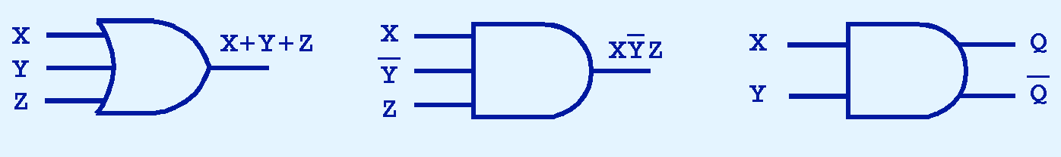
Multiple Input Gates
Gates can have multiple inputs and more than one output.

Slide 45

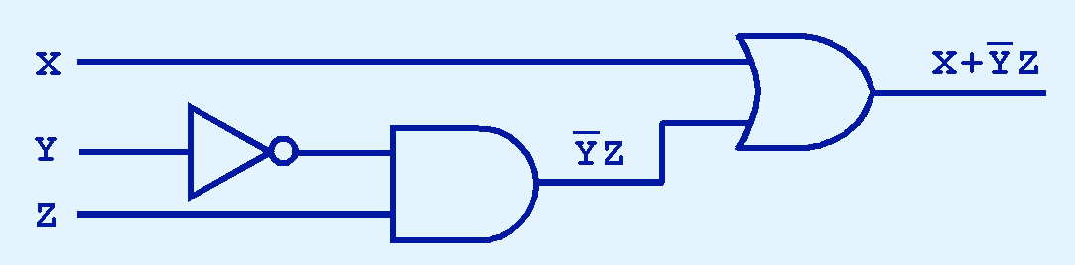
DIGITAL COMPONENTS
The main thing to remember is that combinations of gates implement Boolean functions.
The circuit below implements the Boolean function:

Slide 46
COMBINATIONAL CIRCUITS
Digital logic chips are combined to give us useful circuits.
These logic circuits can be categorized as either combinational logic or sequential logic.
Combinational logic is used to build circuits that contain basic Boolean operators, inputs, and outputs.

Slide 47
The key concept in recognizing a combinational circuit is that an output is always based entirely on the given inputs.
Thus, the output of a combinational circuit is a function of its inputs, and the output is uniquely determined by the values of the inputs at any given moment.

Slide 48
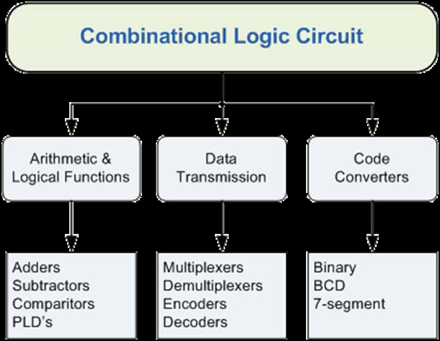
Classification of Combinational Logic

Slide 49
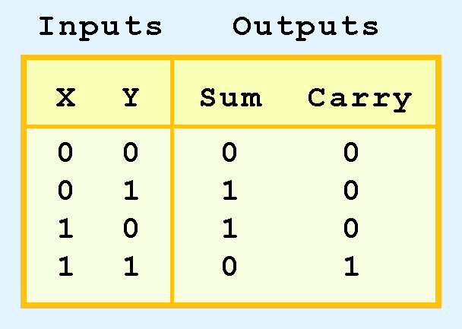
1.HALF ADDER
Half adder is the simple combinational circuit.
There are only three things to remember:
0 + 0 = 0, 0 + 1 = 1 + 0 = 1, and 1 + 1 = 10.
Its truth table is:

Slide 50
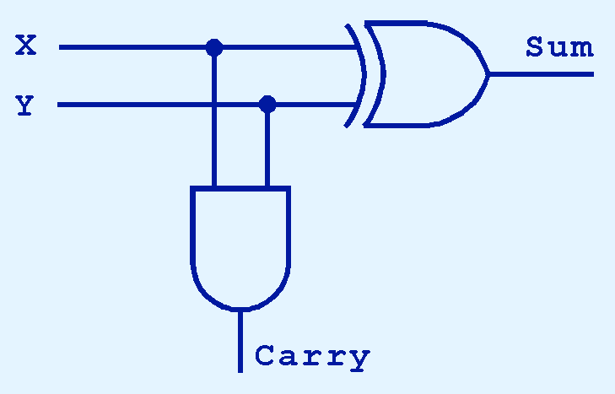
As we see, the sum can be found using the XOR operation and the carry using the AND operation.

Slide 51
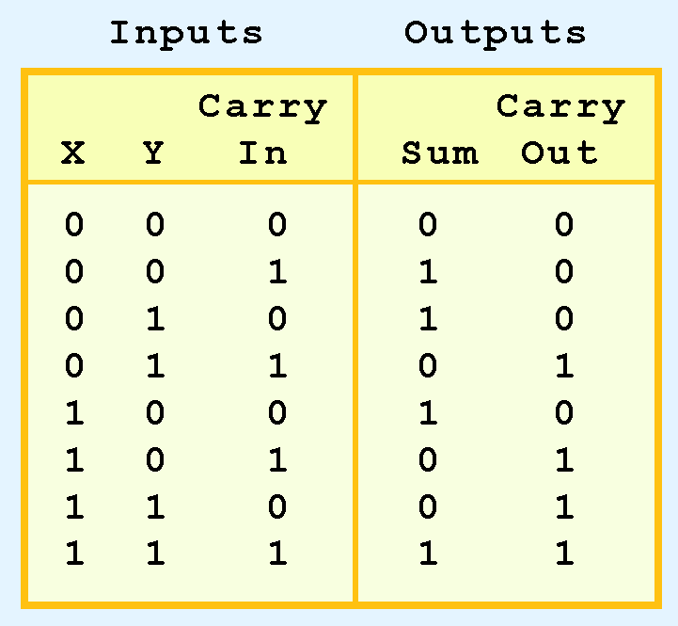
2. FULL ADDER
Is circuit that allows three inputs (x, y, and Carry In), and gives two outputs (Sum and Carry Out).
Its truth table is:

Slide 52
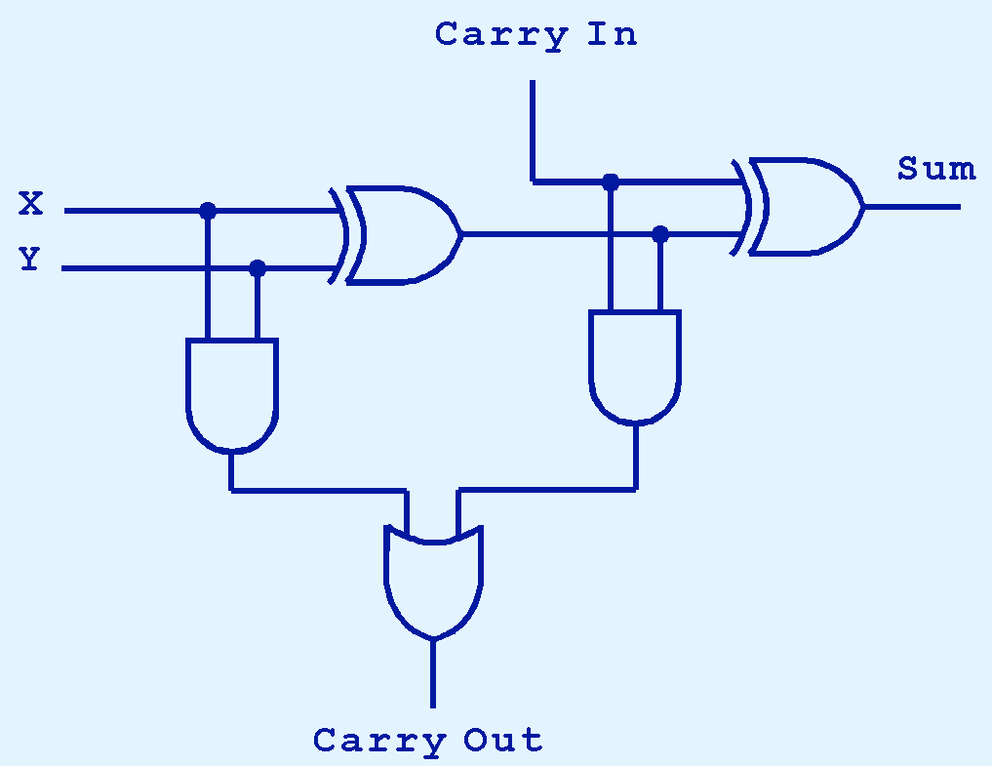
The full adder circuit

Slide 53

Note that this full-adder is composed of two half-adders and an OR gate.
Just as we combined half adders to make a full adder, full adders can be connected in series.
The carry bit “ripples” from one adder to the next; hence, this configuration is called a ripple-carry adder.

Slide 54
3.Decoders
Decoders are another important type of combinational circuit.
Among other things, they are useful in selecting a memory location according to a binary value placed on the address lines of a memory bus.
Address decoders with n inputs can select any of 2^{n} locations.

Slide 55
A 2-to-4 decoder operates according to the following truth table.
The 2-bit input is called S1S0, and the four outputs are Q0-Q3.
If the input is the binary number i, then output Qi is uniquely true.

Slide 56
S1 | S0 | Q0 | Q1 | Q2 | Q3
0 | 0 | 1 | 0 | 0 | 0
0 | 1 | 0 | 1 | 0 | 0
1 | 0 | 0 | 0 | 1 | 0
1 | 1 | 0 | 0 | 0 | 1

Slide 57
For instance, if the input S1 S0 = 10 (decimal 2), then output Q2 is true, and Q0, Q1, Q3 are all false.
This circuit “decodes” a binary number into a “one-of-four” code.

Slide 58
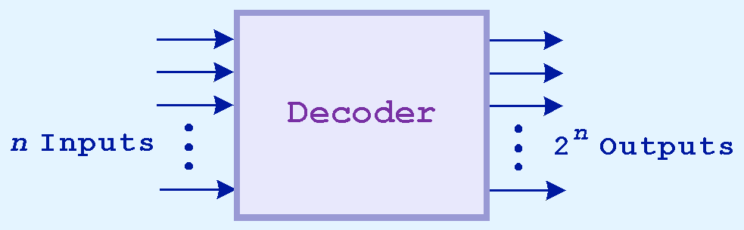
Decoders are normally defined by the number of inputs and the number of outputs.
For example, a decoder that has 3 inputs and 8 outputs is called a
3-to-8 decoder.

Slide 59
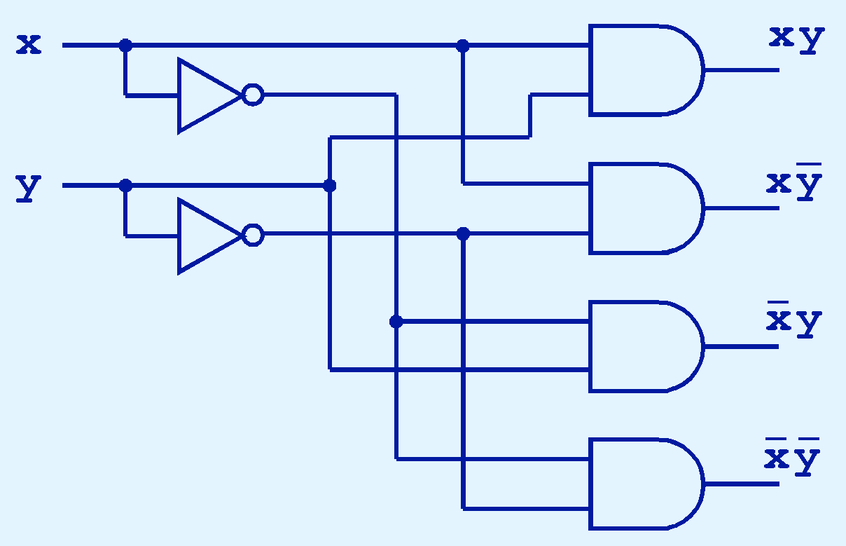
This is what a 2-to-4 decoder looks like on the inside.

Slide 60
4. Multiplexer
Another common combinational circuit is a multiplexer.
A multiplexer or mux is a device that selects one of several analog or digital input signals and forwards the selected input into a single line.
A multiplexer of 2^{n} inputs has n select lines, which are used to select which input line to send to the output.

Slide 61
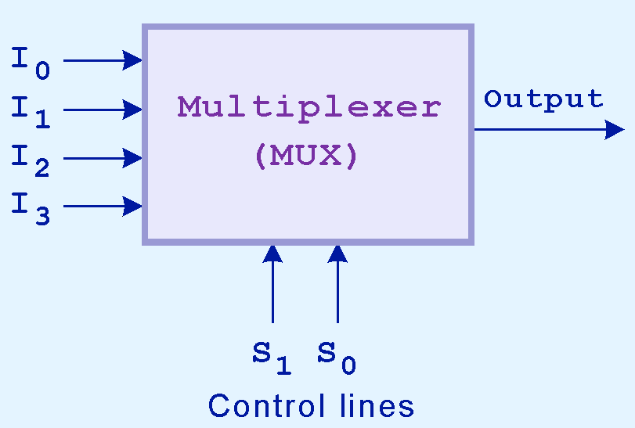

Slide 62
At any given time, only one input (the one selected) is routed through the circuit to the output line.
All other inputs are “cut off.”
If the values on the control lines change, the input actually routed through changes as well.

Slide 63
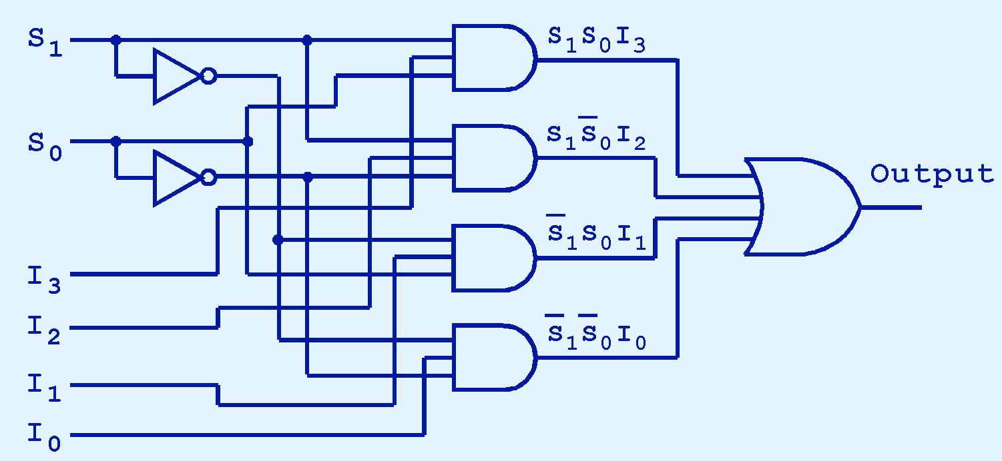

Slide 64
Reading assignment
Read about sequential circuits

