Slide 1

COMPUTER SECURITY AND NETWORKING

Slide 2

NETWORKING PROTOCOLS
A network protocol is a language that is used by systems that wish to communicate with one another.
OR
Network Protocols are a set of rules governing the exchange of information in an easy, reliable, and secure way.
If two systems wish to communicate (or talk) with one another, they need to speak the same language (or protocol).

Slide 3
CONT…
Before delving into protocols, it's essential to grasp the logical organization or design of a network.
The most popular model used to establish open communication between two systems is the Open Systems Interface (OSI) model proposed by ISO.

Slide 4
OSI Model
The OSI model is not a network architecture because it does not specify the exact services and protocols for each layer.
It simply tells what each layer should do by defining its input and output data. It is up to network architects to implement the layers according to their needs and the resources available.

Slide 5
CONT…
The OSI model was developed by the International Organization for Standardization (ISO) in the late 1970s.
It was intended to be a comprehensive standard for networking protocols, allowing different systems to communicate regardless of their underlying architecture.

Slide 6
CONT…
These are the seven layers of the OSI model:
Physical layer
Data Link Layer
Network Layer
Transport Layer
Session Layer
Presentation Layer
Application Layer

Slide 7
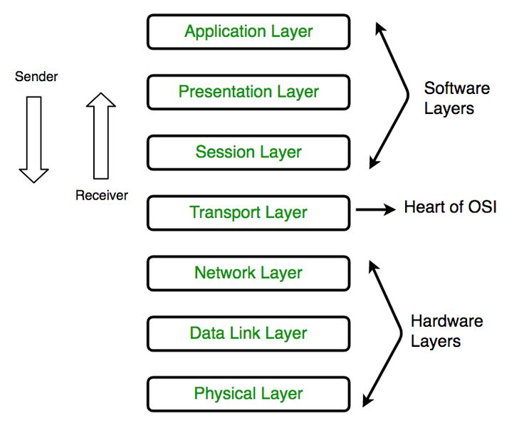
OSI MODEL

Slide 8
1. PHYSICAL LAYER
It is the first layer that physically connects the two systems that need to communicate.
It transmits data in bits and manages simplex or duplex transmission by modem.
It also manages the Network Interface Card’s hardware interface to the network, like cabling, cable terminators, topography, voltage levels, etc.

Slide 9
2. Data link layer
The main task of the data link layer is to transform a raw transmission facility into a line that appears free of undetected transmission errors.
It does so by masking the real errors so the network layer does not see them. It accomplishes this task by having the sender break up the input data into data frames (typically a few hundred or a few thousand bytes) and transmit the frames sequentially.

Slide 10
CONT…
If the service is reliable, the receiver confirms correct receipt of each frame by sending back an acknowledgement frame

Slide 11
CONT…
The Data Link Layer is responsible for establishing, maintaining, and terminating connections between devices.
It ensures error-free transmission of data frames between nodes on the same network segment.

Slide 12
CONT…
It handles issues such as framing, flow control, error detection, and MAC (Media Access Control) addressing.
Examples include Ethernet switches, bridges, repeaters, and wireless Access Points(WAP).

Slide 13
3. NETWORK LAYER
It is concerned with routing, switching, and controlling the flow of information between the workstations.
It also breaks down transport layer datagrams into smaller datagrams
The Network Layer facilitates routing and forwarding of data packets between different networks.

Slide 14
CONT…
It determines the optimal path for data packets to reach their destination using routing algorithms.
IP (Internet Protocol) operates at this layer, providing logical addressing and packet forwarding.
Routers, Firewalls, and layer 3 switches operate at the Network Layer.

Slide 15
4. Transport layer
The basic function of the transport layer is to accept data from above it, split it up into smaller units if need be, pass these to the network layer, and ensure that the pieces all arrive correctly at the other end.
The Transport Layer ensures reliable end-to-end communication between devices.

Slide 16
CONT…
It is responsible for segmenting, reassembling, and error-checking data.
TCP (Transmission Control Protocol) and UDP (User Datagram Protocol) are common Transport Layer protocols.

Slide 17
5. SESSION LAYER
The Session Layer manages and synchronizes communication sessions between devices.
It establishes, maintains, and terminates connections, allowing for data exchange between applications.
This layer handles session establishment, maintenance, and termination, as well as synchronization and checkpointing.

Slide 18
6. PRESENTATION LAYER
The Presentation Layer is responsible for data translation, encryption, compression, and formatting.
It ensures that data exchanged between applications is in a format that the receiving application can understand.
This layer handles tasks such as data encryption, decryption, data compression, and character encoding conversion

Slide 19
7. APPLICATION LAYER
The Application Layer provides network services directly to end-users and applications.
It enables communication between applications and facilitates user interactions with the network.

Slide 20
CONT…
Protocols like HTTP, FTP, SMTP, and DNS operate at this layer.
Application Layer protocols define the rules and conventions for communication between software applications

Slide 21
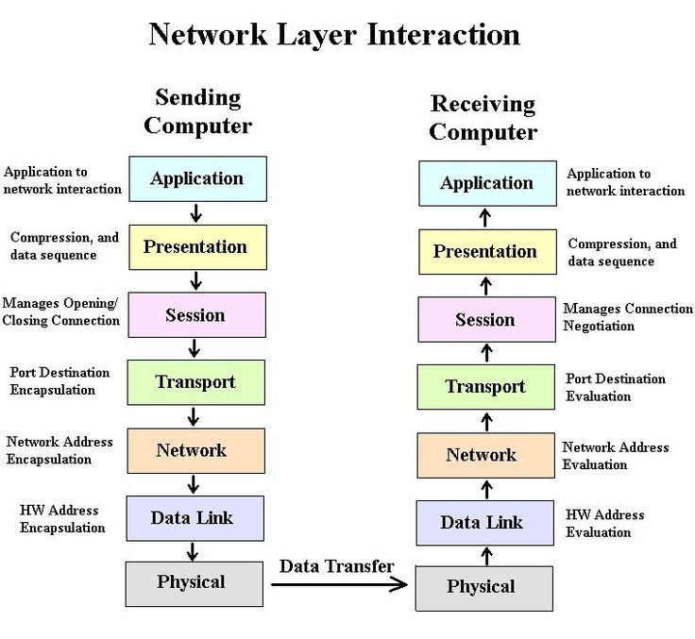
CONT…

Slide 22
TCP/IP
TCP/IP stands for Transmission Control Protocol/Internet Protocol.
The TCP/IP model evolved from ARPANET, the precursor to the modern Internet.

Slide 23
CONT…
It was developed by the U.S. Department of Defense and is based on the protocols used in the ARPANET.
TCP/IP is a set of layered protocols used for communication over the Internet.

Slide 24
CONT…
TCP/IP is used on small, medium, and large networks and has been adopted as the protocol of the Internet.
TCP/IP is a protocol suite—meaning that there are multiple protocols within the TCP/IP.
You will be required to know a number of these protocols

Slide 25
CONT…
The communication model of this suite is a client-server model. A computer that sends a request is the client and a computer to which the request is sent is the server.
TCP/IP has four layers:
Network Interface Layer
Internet Layer
Transport Layer
Application Layer

Slide 26
CONT…
The four layers of the TCP/IP model map out to the seven layers of the OSI, but you may find that one layer of the TCP/IP model combines multiple layers of the OSI model.
Several protocols direct how computers connect and communicate using TCP/IP within the TCP/ IP protocol suite, and each protocol runs on different layers of the Internet model

Slide 27
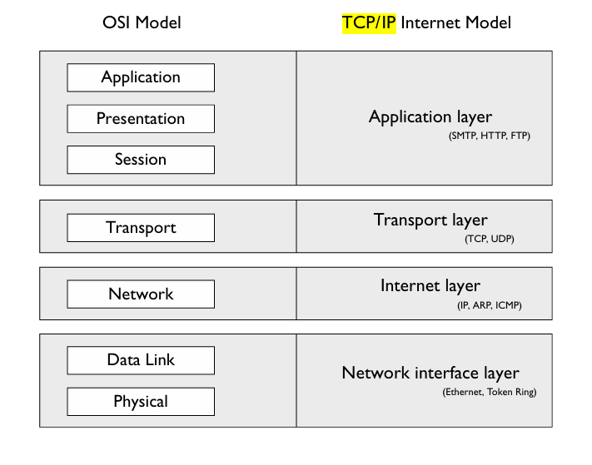
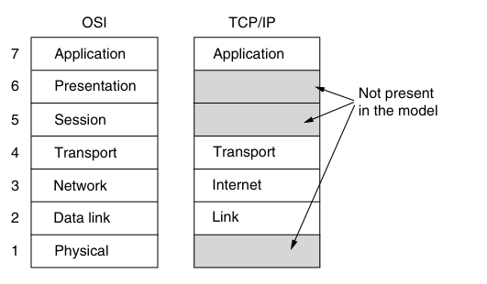
CONT…

Slide 28
1. NETWORK INTERFACE LAYER
Actual data transmission in bits occurs at the data link layer using the destination address provided by the network layer.
It is not a layer at all, in the normal sense of the term, but rather an interface between hosts and transmission links.

Slide 29
CONT…
Protocols found in the Network Interface Layer include Ethernet, Wi-Fi, Point-to-Point Protocol (PPP), High-Level Data Link Control (HDLC), Frame Relay, Asynchronous Transfer Mode (ATM), and Token Ring.
The above protocols will be introduced and covered in subsequent levels of your networking career.

Slide 30
2. Internet layer
After a transport protocol has been selected, which boils down to whether the communication should be connection-oriented or connectionless.
The information is passed to the Internet layer to determine who is responsible for the delivery of the information. There are a few protocols that run at the Internet layer; IP, ICMP, and ARP are examples.

Slide 31
CONT…
Every machine connected to the Internet is assigned an IP address by the IP protocol to easily identify source and destination machines.

Slide 32
Internet Protocol (IP)
The Internet Protocol (IP) provides packet delivery for protocols higher in the model. It is a connectionless delivery system that makes a “best-effort” attempt to deliver the packets to the correct destination.
IP does not guarantee delivery of the packets—that is the responsibility of transport protocols; IP simply sends the data.

Slide 33
CONT…
The IP protocol is also responsible for the logical addressing and routing of TCP/ IP and therefore is considered a layer-3 protocol (of the OSI model).
The IP protocol on the router is responsible for decrementing (usually by a value of 1) the TTL (time to live) of the packet to prevent it from running around in a “network loop.”

Slide 34

Internet Control Message Protocol (ICMP)
The Internet Control Message Protocol (ICMP) enables systems on a TCP/IP network to share status and error information. You can use the status information to detect network trouble.
Two programs that use ICMP messages are Ping and Tracert.
Ping is used to send ICMP echo requests to an IP address and wait for ICMP echo responses. Ping reports the time interval between sending the request and receiving the response.
NOTE:
With Ping, you can determine whether a particular IP system on your network is functioning correctly. You can use many different options with the Ping utility.

Slide 35
CONT…
Tracert traces the path taken to a particular host. This utility can be very useful in troubleshooting internetworks.
Tracert sends ICMP echo requests to an IP address while it increments the TTL field in the IP header by a count of 1 after starting at 1 and then analyzing the ICMP errors that are returned.

Slide 36
Address Resolution Protocol (ARP)
The Address Resolution Protocol (ARP) provides IP address–to–physical address resolution on a TCP/IP network.
To accomplish this feat, ARP sends out a broadcast message with an ARP request packet that contains the IP address of the system it is trying to find.

Slide 37
CONT…
All systems on the local network see the message, and the system that owns the IP address for which ARP is looking replies by sending its physical address to the originating system in an ARP reply packet.
The physical/IP address combo is then stored in the ARP cache of the originating system for future use.

Slide 38
3. TRANSPORT LAYER
The next layer under the application layer is the transport layer.
The transport layer is responsible for both connection-oriented communication (a session is established) and connectionless communication (a session is not established).
When the request comes down from the higher (application) layer, a transport protocol is then chosen. The two transport protocols in TCP/IP are the Transmission Control Protocol (TCP) and the User Datagram Protocol (UDP).

Slide 39
CONT…
Data is transmitted in the form of datagrams using the Transmission Control Protocol (TCP).
TCP is responsible for breaking up data on the client side and then reassembling it on the server side.

Slide 40
transmission Control Protocol(TCP)
Transmission Control Protocol The Transmission Control Protocol (TCP) is responsible for providing connection-oriented communication and ensuring delivery of the data.
TCP will make sure that the data reaches its destination by retransmitting any data that is lost or corrupt.

Slide 41
CONT…
TCP is used by applications that require a reliable transport, but this transport has more overhead than a connectionless protocol because of the construction of the session and monitoring and retransmission of any data across that session

Slide 42
CONT…
Another factor to remember about TCP is that the protocol requires that the recipient acknowledge the successful receipt of data.
All the acknowledgments, known as ACKs, generate additional traffic on the network, which causes a reduction in the amount of data that can be passed within a given time frame.

Slide 43
User Datagram Protocol (UDP)
The User Datagram Protocol (UDP) offers a connectionless datagram service that is an unreliable “best-effort” delivery.
UDP does not guarantee the arrival of datagrams, nor does it promise that the delivered packets are in the correct sequence.
Applications that don’t require an acknowledgment of data receipt use UDP. Because of the lack of overhead involved in UDP conversations, it is more efficient than TCP.

Slide 44
4. APPLICATION LAYER
The application layer is responsible for making the network request (sending computer) or servicing the request (receiving computer).
For example, when a user submits a request from a web browser, the web browser is responsible for the submission of the request and is running at this layer.
When that web request reaches the web server, the web server, running at the application layer, accepts that request

Slide 45
CONT…
The following are popular application-layer protocols:
Hypertext Transfer Protocol (HTTP)
Simple Mail Transfer Protocol (SMTP)
File Transfer Protocol (FTP)

Slide 46
Hypertext Transfer Protocol (HTTP)
The Hypertext Transfer Protocol (HTTP) is the protocol used on the Internet to allow clients to request web pages from web servers and to allow client interaction with those web servers.
HTTP is a stateless protocol, meaning that the web servers are not aware of what a client has or has not requested and cannot track users who have requested specific content.

Slide 47
CONT…
This system does not allow for good interaction with the web server but does allow for retrieving the HTML pages stored on websites.
To aid in tracking client requests, we use cookies—small files stored on the client’s computer that allow the web server to store data on the client that the client will send back with each request to the server.

Slide 48
Hypertext Transfer Protocol, Secure (HTTPS)
The Hypertext Transfer Protocol, Secure (HTTPS) allows you to connect to a website and receive and send content in an encrypted format using the Secure Sockets Layer (SSL).
HTTPS is most commonly used on e-commerce sites to allow you to send personal information without worrying that an Internet hacker is viewing this information, especially credit card numbers and other confidential data.

Slide 49
CONT…
You can determine when HTTPS is being used because the address of the website starts with https:// and not http://, which marks the regular HTTP protocol

Slide 50
Network Time Protocol (NTP)
The Network Time Protocol (NTP) is used to synchronize the clocks of PCs on a network or the Internet.
This is accomplished by configuring a server to be the time server, which then is the server from which all other PCs on the network synchronize their time.

Slide 51
Simple Mail Transfer Protocol (SMTP)
The Simple Mail Transfer Protocol (SMTP) is used to send or route mail over a TCP/IP network such as the Internet. Most e-mail server products support SMTP to send e-mail out of the corporation and onto the Internet.

Slide 52
Post Office Protocol (POP3)
The Post Office Protocol, version 3 (POP3) is the Internet protocol used to retrieve e-mail from a mail server down to the POP3 client.
The e-mail is “popped” or downloaded to the client after the client has been authenticated to its mailbox.

Slide 53
CONT…
POP3 has limited capabilities as far as folder support is concerned. A POP3 client supports only an inbox, an outbox, sent items, and deleted items. If additional folder support is required, you would need to use an IMAP4 client

Slide 54
File Transfer Protocol (FTP)
The File Transfer Protocol (FTP) is a TCP/IP protocol that exists to upload and download files between FTP servers and clients.
Like Telnet and Ping, FTP can establish a connection to a remote computer using either the hostname or the IP address and must resolve hostnames to IP addresses to establish communication with the remote computer.

Slide 55
Telnet
Telnet is a terminal emulation protocol that allows a client to run or emulate the program running on the server.
Several devices allow you to telnet into the device and perform remote administration of the network device using the command set available to the Telnet session.

Slide 56
Secure Shell (SSH)
The Secure Shell (SSH) is a program used to create a shell, or session, with a remote system.
Once the remote session is established, the client can execute commands within this shell and copy files to the local system.
SSH has a major purpose in life, and that is to support remote shells with support for secure authentication and encrypted communication.

Slide 57


Slide 58
QUIZ

