Slide 1
Stochastic Reserving in General Insurance
Peter England, PhD
EMB
GIRO 2002

Slide 2
Aims
To provide an overview of stochastic reserving models, using England and Verrall (2002, BAJ) as a basis.
To demonstrate some of the models in practice, and discuss practical issues

Slide 3
Why Stochastic Reserving?
Computer power and statistical methodology make it possible
Provides measures of variability as well as location (changes emphasis on best estimate)
Can provide a predictive distribution
Allows diagnostic checks (residual plots etc)
Useful in DFA analysis
Useful in satisfying FSA Financial Strength proposals

Slide 4
Actuarial Certification
An actuary is required to sign that the reserves are “at least as large as those implied by a ‘best estimate’ basis without precautionary margins”
The term ‘best estimate’ is intended to represent “the expected value of the distribution of possible outcomes of the unpaid liabilities”

Slide 5
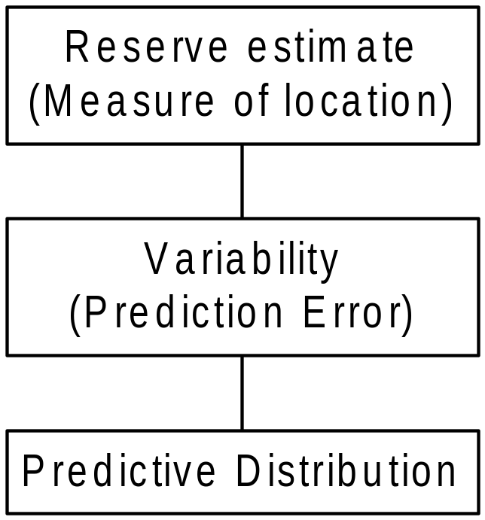
Conceptual Framework

Slide 6
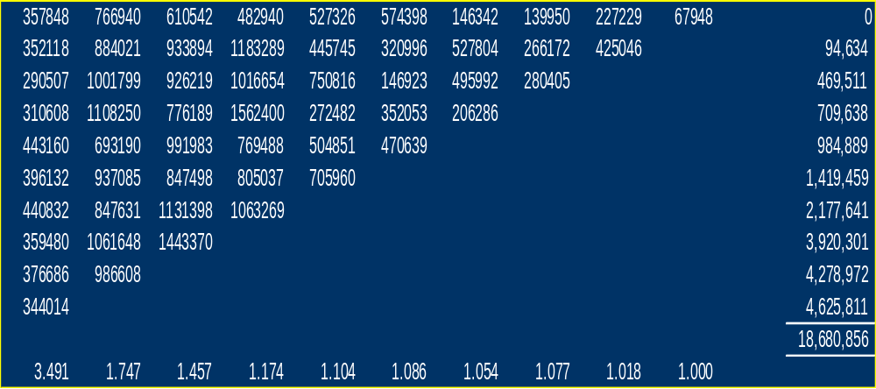
Example

Slide 7
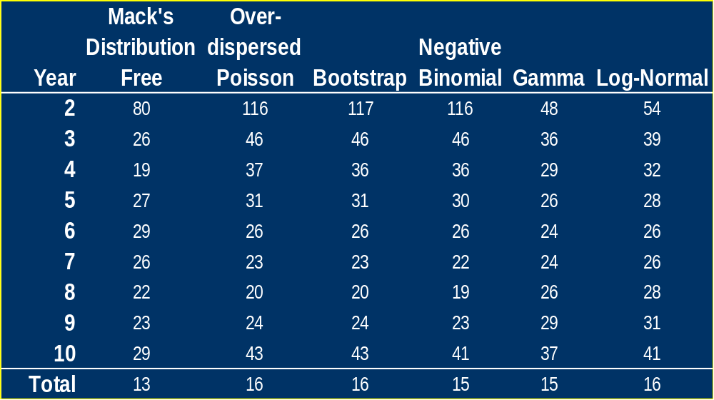
Prediction Errors

Slide 8
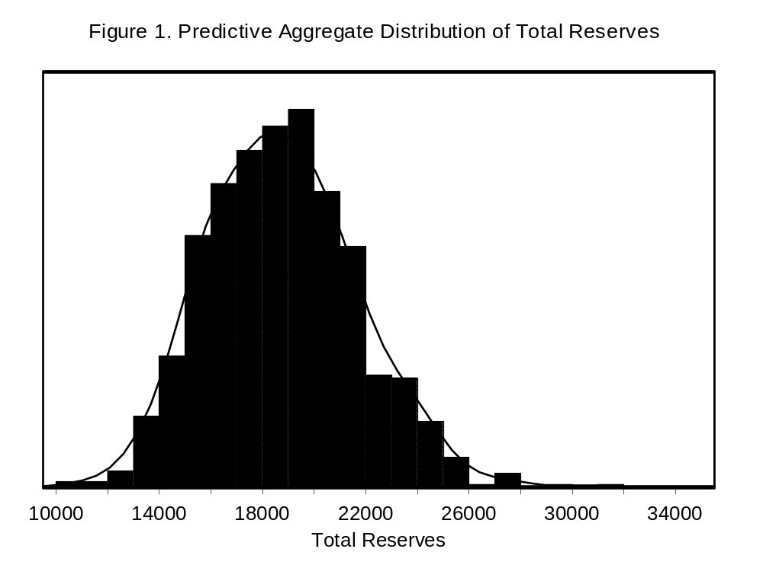

Slide 9
Stochastic Reserving Model Types
“Non-recursive”
  Over-dispersed Poisson
  Log-normal
  Gamma
“Recursive”
  Negative Binomial
  Normal approximation to Negative Binomial
  Mack’s model

Slide 10
Stochastic Reserving Model Types
Chain ladder “type”
  Models which reproduce the chain ladder results exactly
  Models which have a similar structure, but do not give exactly the same results
Extensions to the chain ladder
  Extrapolation into the tail
  Smoothing
  Calendar year/inflation effects
Models which reproduce chain ladder results are a good place to start

Slide 11
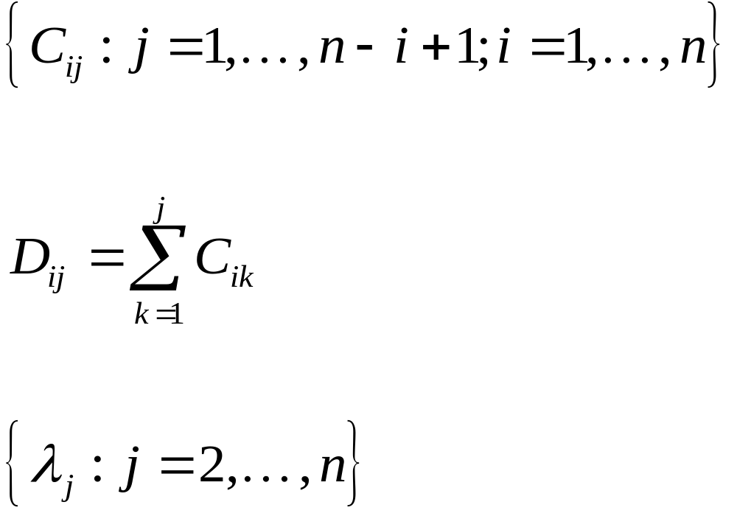
Definitions
Assume that the data consist of a triangle of incremental claims:
The cumulative claims are defined by:
and the development factors of the chain-ladder technique are denoted by

Slide 12
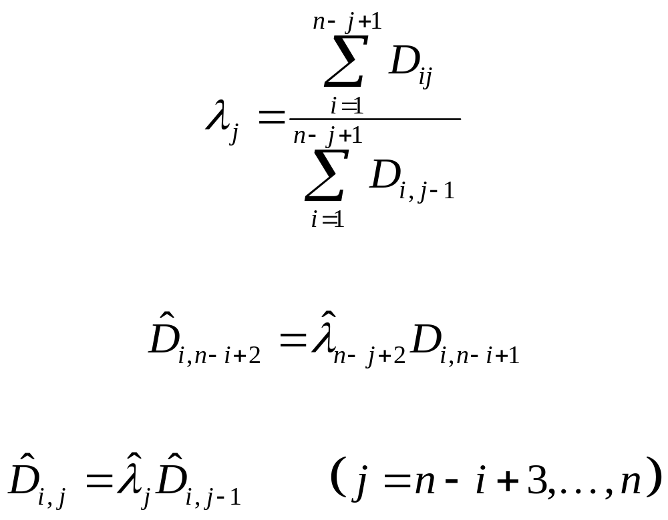
Basic Chain-ladder

Slide 13
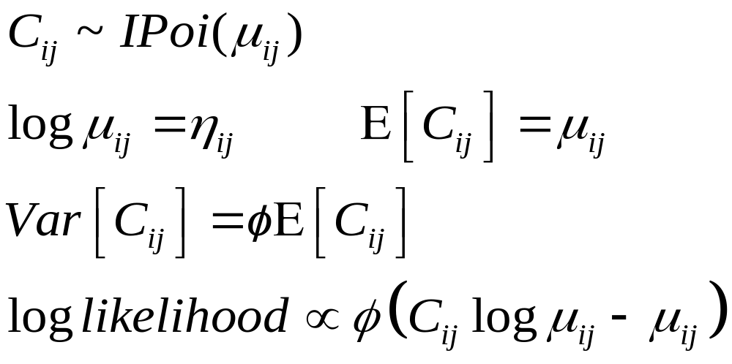
Over-Dispersed Poisson

Slide 14
What does Over-Dispersed Poisson mean?
Relax strict assumption that variance=mean
Key assumption is variance is proportional to the mean
Data do not have to be positive integers
Quasi-likelihood has same form as Poisson likelihood up to multiplicative constant

Slide 15
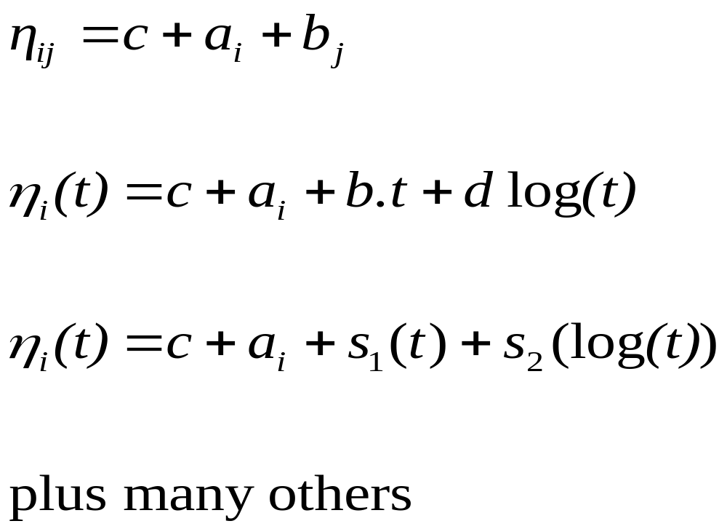
Predictor Structures
(Chain ladder type)
(Hoerl curve)
(Smoother)

Slide 16
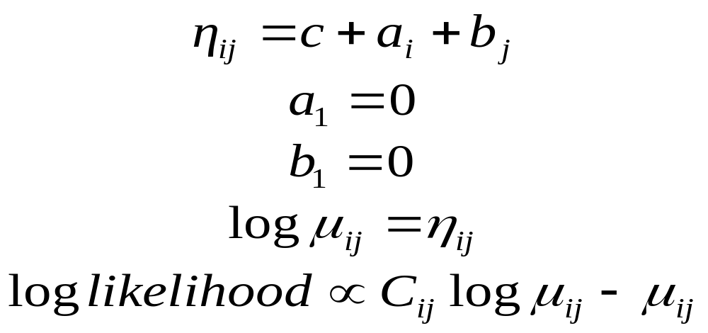
Chain-ladder
Other constraints are possible, but this is usually the easiest.
This model gives exactly the same reserve estimates as the chain ladder technique.

Slide 17
Excel
Input data
Create parameters with initial values
Calculate Linear Predictor
Calculate mean
Calculate log-likelihood for each point in the triangle
Add up to get log-likelihood
Maximise using Solver Add-in

Slide 18
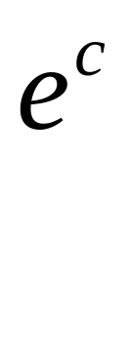
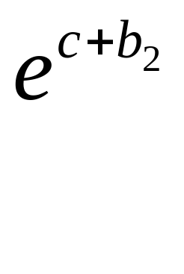


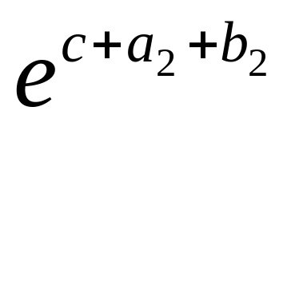
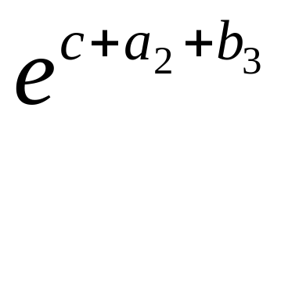
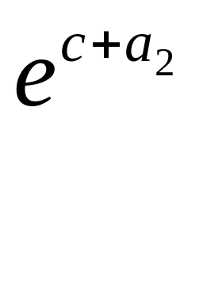
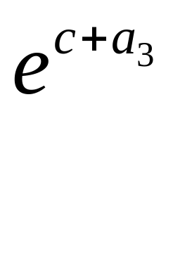


Recovering the link ratios
Incrementals

Slide 19
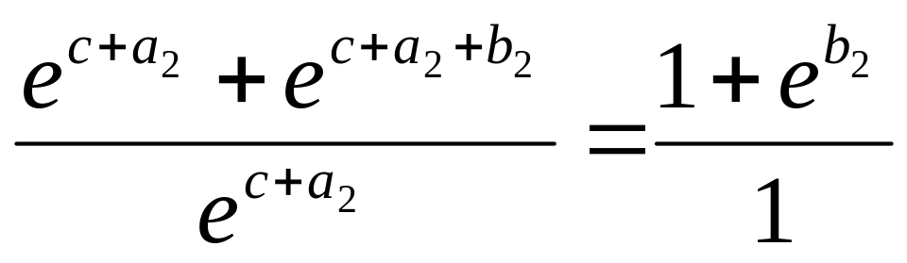
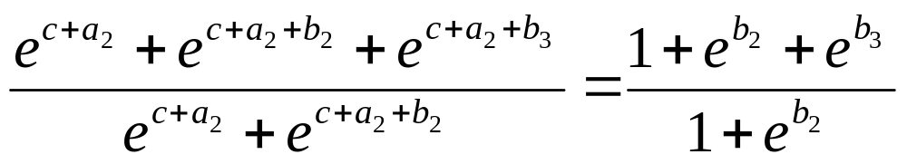
Recovering the link ratios
Calculate ratios of cumulatives, which are the same for each row. Eg row 2:
Column 2 to Column 1:
Column 3 to Column 2:

Slide 20
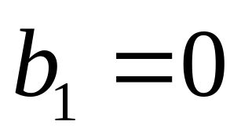
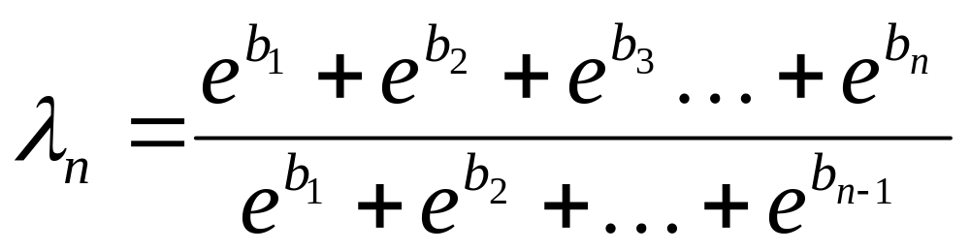
Recovering the link ratios
In general, remembering that

Slide 21
Variability in Claims Reserves
Variability of a forecast
Includes estimation variance and process variance
Problem reduces to estimating the two components

Slide 22
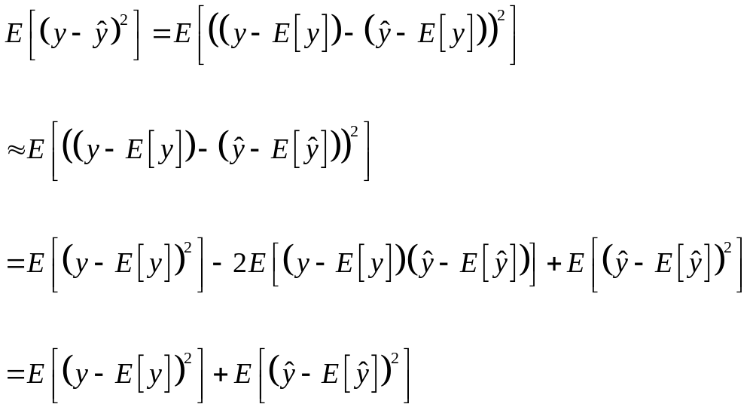
Prediction Variance
Prediction variance=process variance + estimation variance

Slide 23
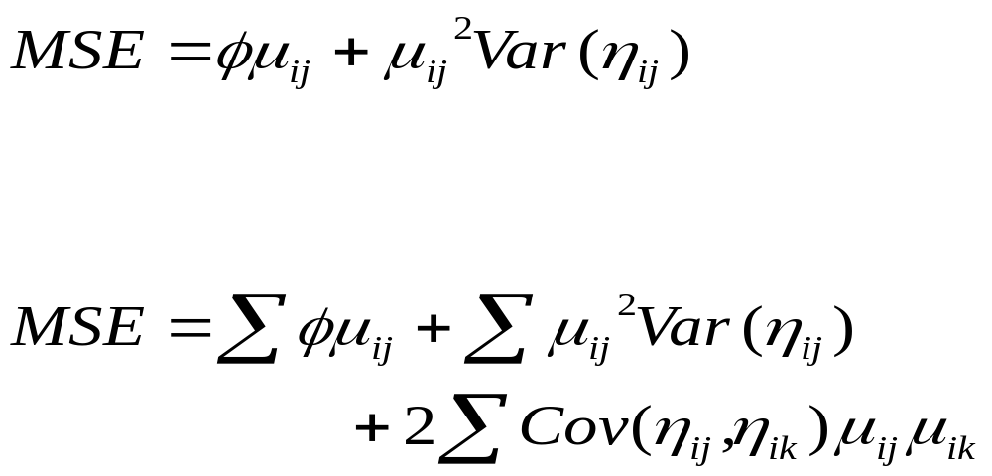
Prediction Variance (ODP)
Individual cell
Row/Overall total

Slide 24
Bootstrapping
Used where standard errors are difficult to obtain analytically
Can be implemented in a spreadsheet
England & Verrall (BAJ, 2002) method gives results analogous to ODP
When supplemented by simulating process variance, gives full distribution

Slide 25
Bootstrapping - Method
Re-sampling (with replacement) from data to create new sample
Calculate measure of interest
Repeat a large number of times
Take standard deviation of results
Common to bootstrap residuals in regression type models

Slide 26
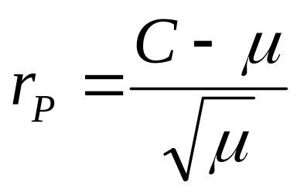
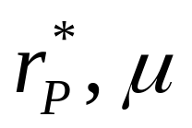
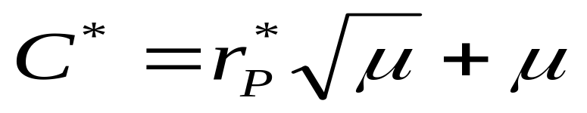
Bootstrapping the Chain Ladder
(simplified)
Fit chain ladder model
Obtain Pearson residuals
Resample residuals
Obtain pseudo data, given
Use chain ladder to re-fit model, and estimate future incremental payments

Slide 27
Bootstrapping the Chain Ladder
Simulate observation from process distribution assuming mean is incremental value obtained at Step 5
Repeat many times, storing the reserve estimates, giving a predictive distribution
Prediction error is then standard deviation of results

Slide 28
Log Normal Models
Log the incremental claims and use a normal distribution
Easy to do, as long as incrementals are positive
Deriving fitted values, predictions, etc is not as straightforward as ODP

Slide 29
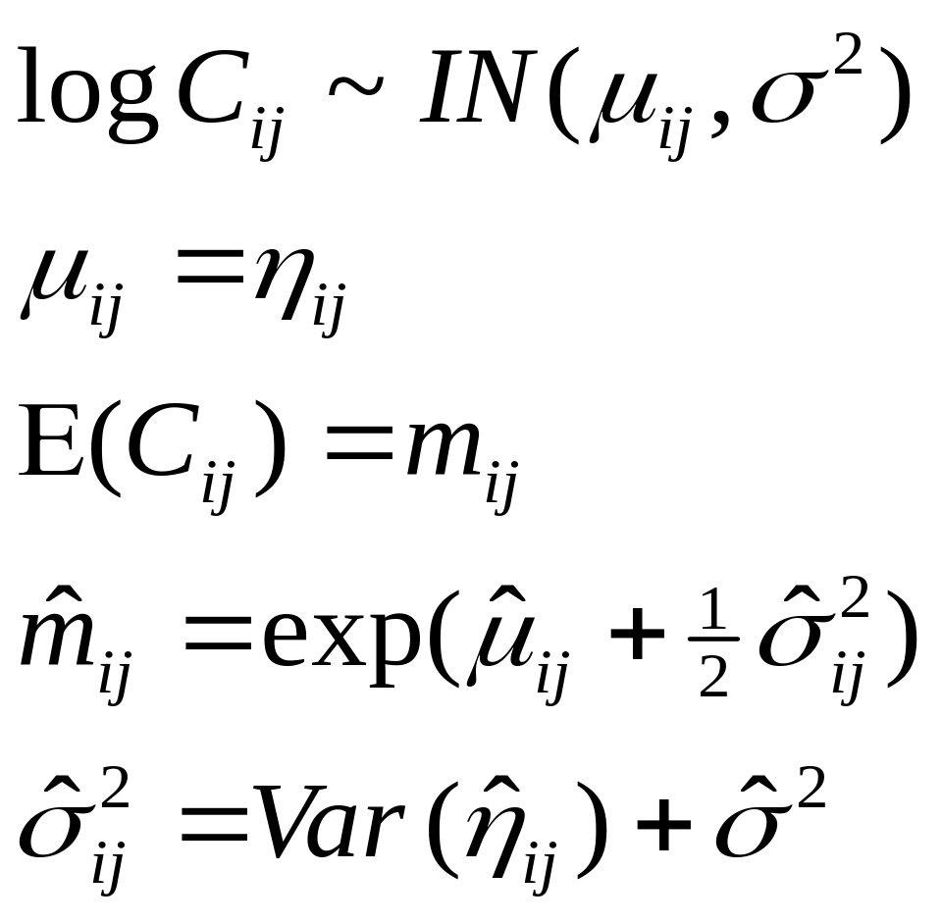
Log Normal Models

Slide 30
Log Normal Models
Same range of predictor structures available as before
Note component of variance in the mean on the untransformed scale
Can be generalised to include non-constant process variances

Slide 31
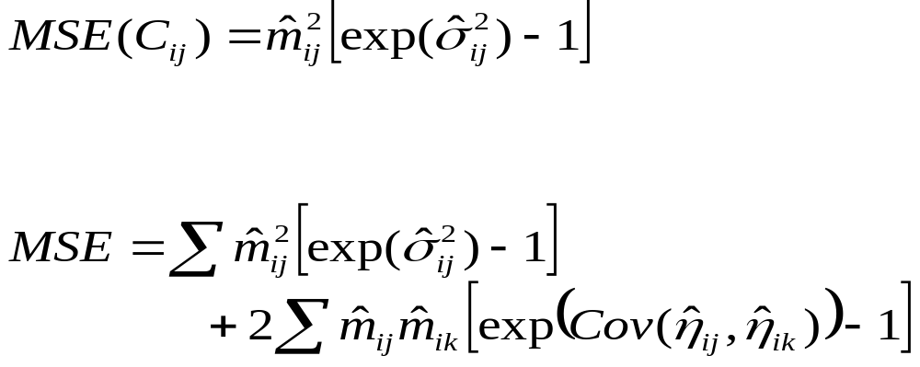
Prediction Variance
Individual cell
Row/Overall total

Slide 32
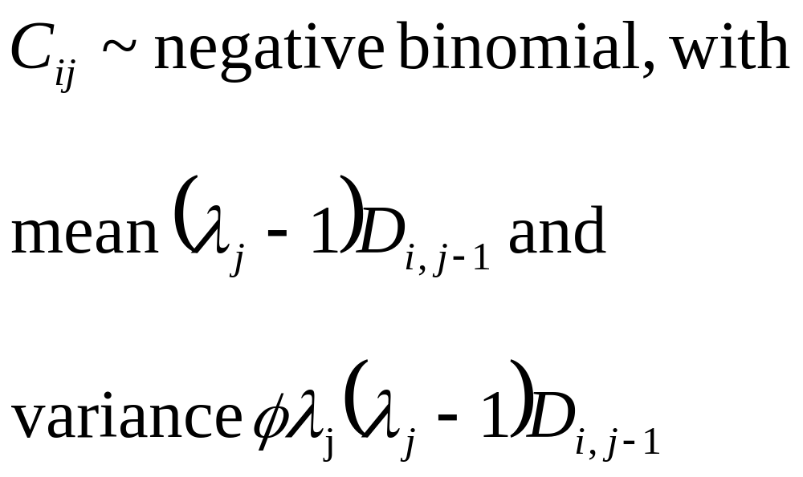
Over-Dispersed Negative Binomial

Slide 33
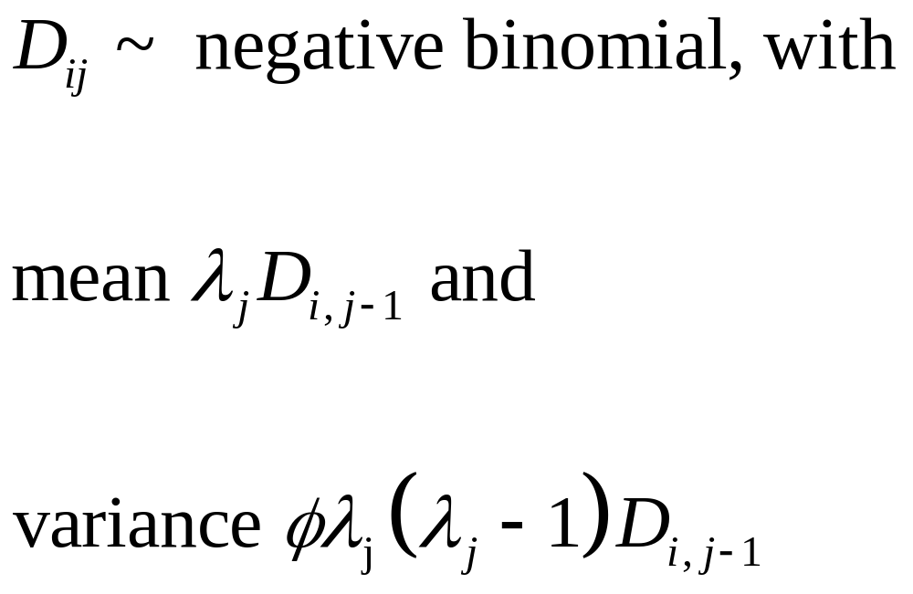
Over-Dispersed Negative Binomial

Slide 34
Derivation of Negative Binomial Model from ODP
See Verrall (IME, 2000)
Estimate Row Parameters first
Reformulate the ODP model, allowing for fact that Row Parameters have been estimated
This gives the Negative Binomial model, where the Row Parameters no longer appear

Slide 35
Prediction Errors
Prediction variance = process variance +
estimation variance
Estimation variance is larger for ODP than NB
but
Process variance is larger for NB than ODP
End result is the same

Slide 36
Estimation variance and process variance
This is now formulated as a recursive model
We require recursive procedures to obtain the estimation variance and process variance
See Appendices 1&2 of England and Verrall (BAJ, 2002) for details

Slide 37
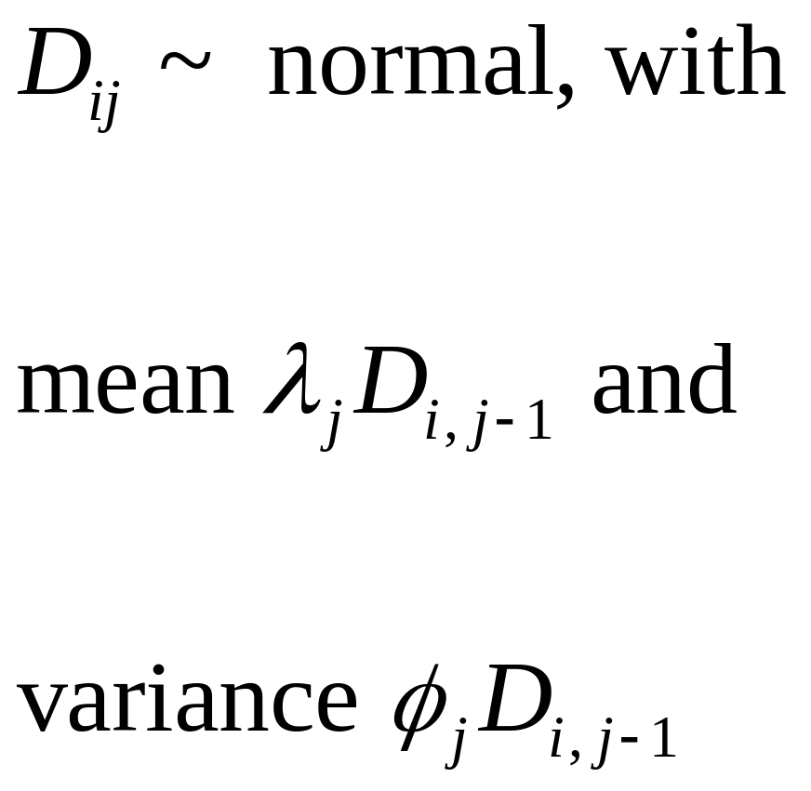
Normal Approximation to Negative Binomial

Slide 38
Joint modelling
Fit 1st stage model to the mean, using arbitrary scale parameters (e.g. =1)
Calculate (Pearson) residuals
Use squared residuals as the response in a 2nd stage model
Update scale parameters in 1st stage model, using fitted values from stage 3, and refit
(Iterate for non-Normal error distributions)

Slide 39
Estimation variance and process variance
This is also formulated as a recursive method
We require recursive procedures to obtain the estimation variance and process variance
See Appendices 1&2 of England and Verrall (BAJ, 2002) for details

Slide 40
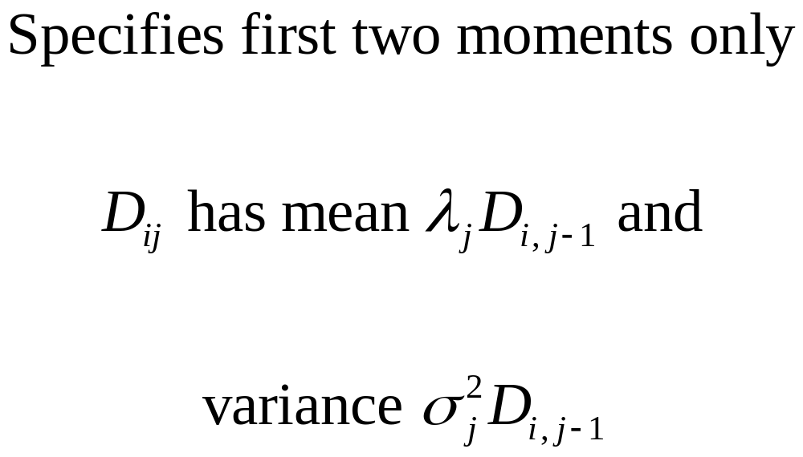
Mack’s Model

Slide 41
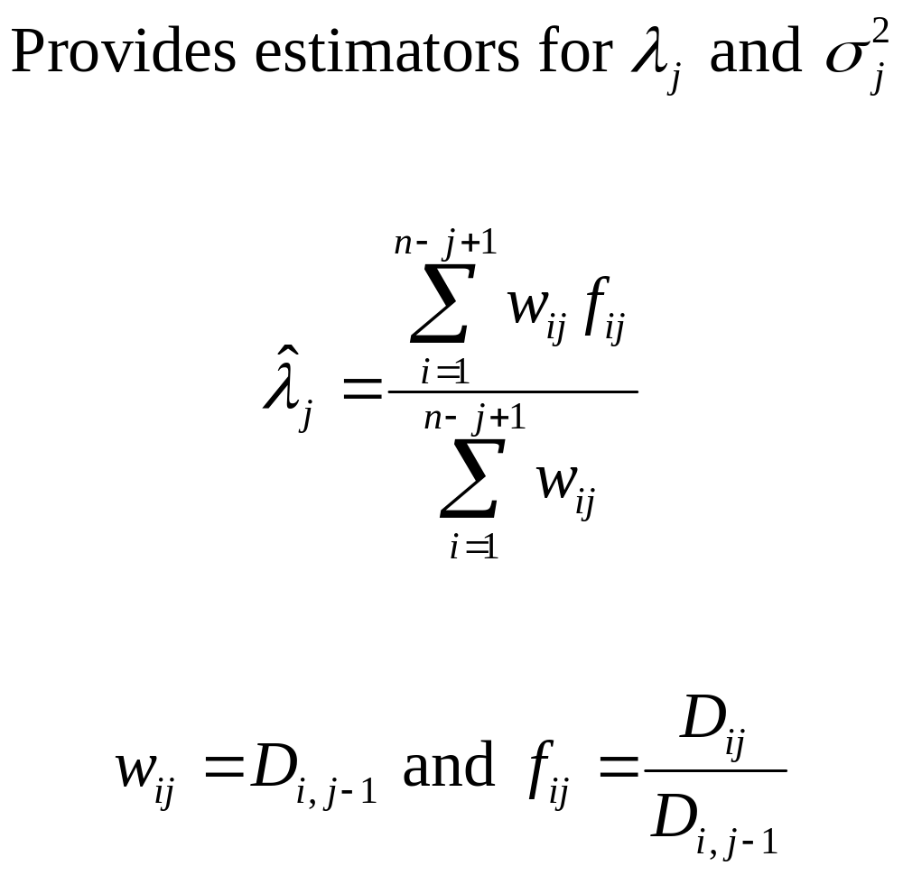
Mack’s Model

Slide 42
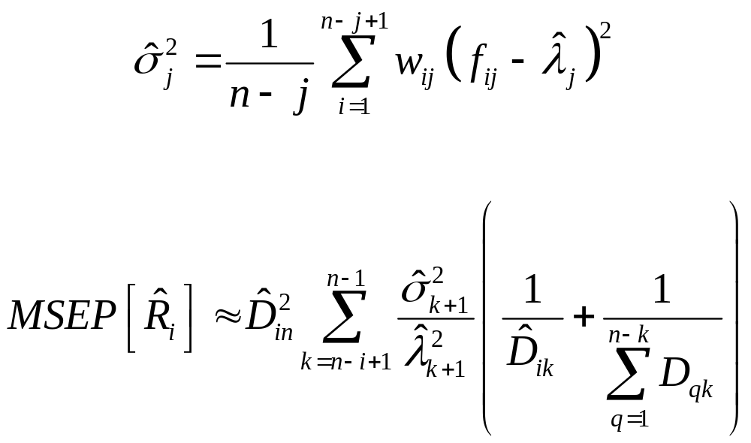
Mack’s Model

Slide 43
Comparison
The Over-dispersed Poisson and Negative Binomial models are different representations of the same thing
The Normal approximation to the Negative Binomial and Mack’s model are essentially the same

Slide 44
The Bornhuetter-Ferguson Method
Useful when the data are unstable
First get an initial estimate of ultimate
Estimate chain-ladder development factors
Apply these to the initial estimate of ultimate to get an estimate of outstanding claims

Slide 45
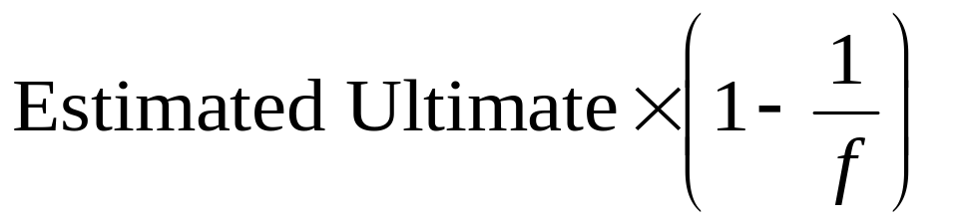
Estimates of outstanding claims
To estimate ultimate claims using the chain ladder technique, you would multiply the latest cumulative claims in each row by f, a product of development factors .
Hence, an estimate of what the latest cumulative claims should be is obtained by dividing the estimate of ultimate by f. Subtracting this from the estimate of ultimate gives an estimate of outstanding claims:

Slide 46
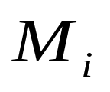
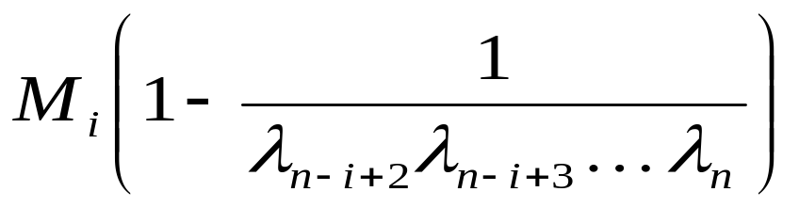
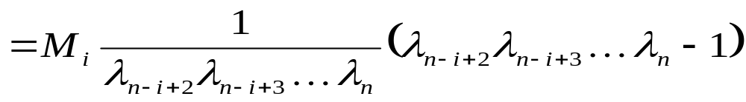
The Bornhuetter-Ferguson Method
Let the initial estimate of ultimate claims for accident year i be
The estimate of outstanding claims for accident year i is

Slide 47
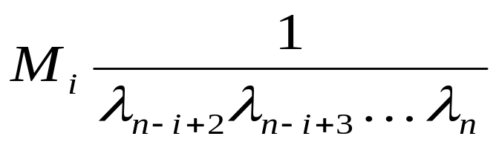
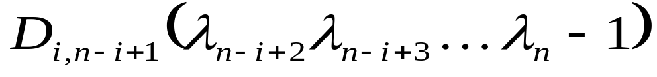
Comparison with Chain-ladder
replaces the latest cumulative claims for accident year i, to which the usual chain-ladder parameters are applied to obtain the estimate of outstanding claims. For the chain-ladder technique, the estimate of outstanding claims is

Slide 48
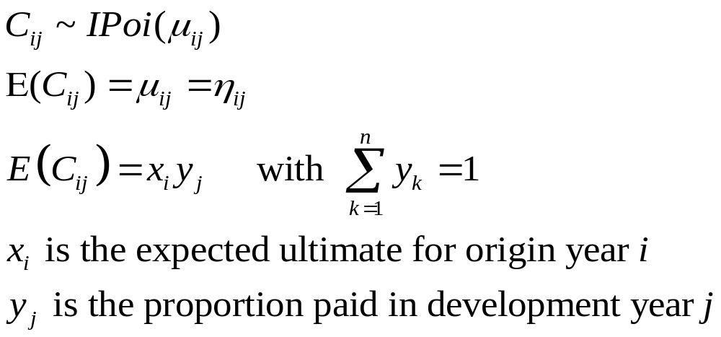
Multiplicative Model for Chain-Ladder

Slide 49
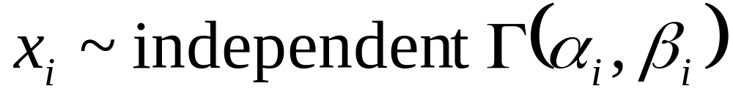
BF as a Bayesian Model
Put a prior distribution on the row parameters.
The Bornhuetter-Ferguson method assumes there is prior knowledge about these parameters, and therefore uses a Bayesian approach. The prior information could be summarised as the following prior distributions for the row parameters:

Slide 50
BF as a Bayesian Model
Using a perfect prior (very small variance) gives results analogous to the BF method
Using a vague prior (very large variance) gives results analogous to the standard chain ladder model
In a Bayesian context, uncertainty associated with a BF prior can be incorporated

Slide 51
Stochastic Reserving and Bayesian Modelling
Other reserving models can be fitted in a Bayesian framework
When fitted using simulation methods, a predictive distribution of reserves is automatically obtained, taking account of process and estimation error
This is very powerful, and obviates the need to calculate prediction errors analytically

Slide 52
Limitations
Like traditional methods, different stochastic methods will give different results
Stochastic models will not be suitable for all data sets
The model results rely on underlying assumptions
If a considerable level of judgement is required, stochastic methods are unlikely to be suitable
All models are wrong, but some are useful!

Slide 53
References
England, PD and Verrall, RJ (2002) Stochastic Claims Reserving in General Insurance, British Actuarial Journal Volume 8 Part II (to appear).
Verrall, RJ (2000) An investigation into stochastic claims reserving models and the chain ladder technique, Insurance: Mathematics and Economics, 26, 91-99.
Also see list of references in the first paper.

