Slide 1
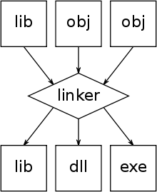
Linking and the ELF Format
By Colin Heinzmann

Slide 2
Roadmap
Problem discussion
How code is linked together to create useful programs
What is an ELF file and why is it useful?

Slide 3
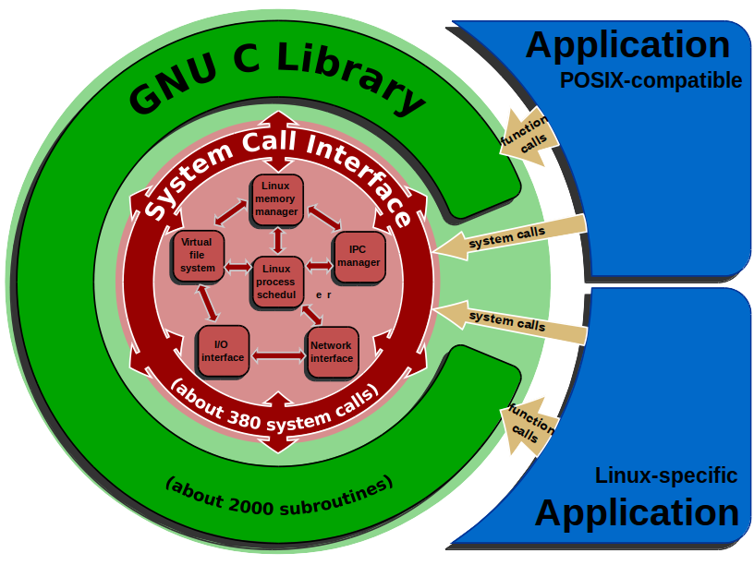
The Problem
I want to create a library that helps make developers' lives easier.
I want to make it easy to use and set up.
I want to minimize resources required to allow users to use library

Slide 4
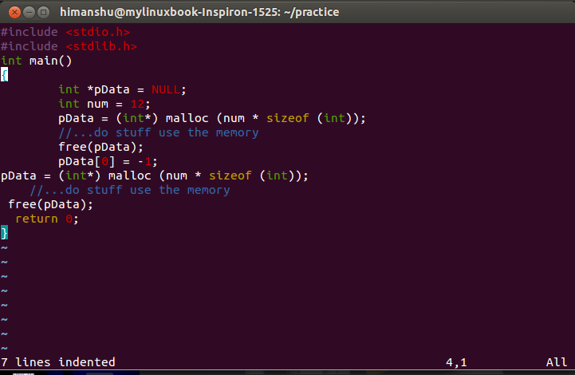
Original Solution: Share Code
Provide the source code to be built into program
Strengths
  Extremely simple, just compiler needed
Weaknesses
  Developer must share source code
  Extra time spent compiling the library
  Copy of library in every program

Slide 5

Solutions: Static Libraries
Prebuild code, provide mechanism for user to plug that code into your program
First implemented with COBOL language in 1959
Strengths
  Simple, linker needed but no kernel support
  Don't have to share source code
Weaknesses
  Copy of library functions in each program

Slide 6

Solution: Dynamic Libraries
Used in IBM products starting in mid-1960's
Implemented in UNIX in early 1980's
Strengths
  Single library code for all programs
  Don't have to share source code
Disadvantages
  More complex, requires kernel support
  Requires special compilation

Slide 7
ELF: Introduction
Executable and Link format
  Common spec for object files and executables
  Part of System V ABI
Container for code, symbols, debugging information, relocation information
  Architecture and OS identification information
First appeared in Solaris 2.0 (1991)

Slide 8
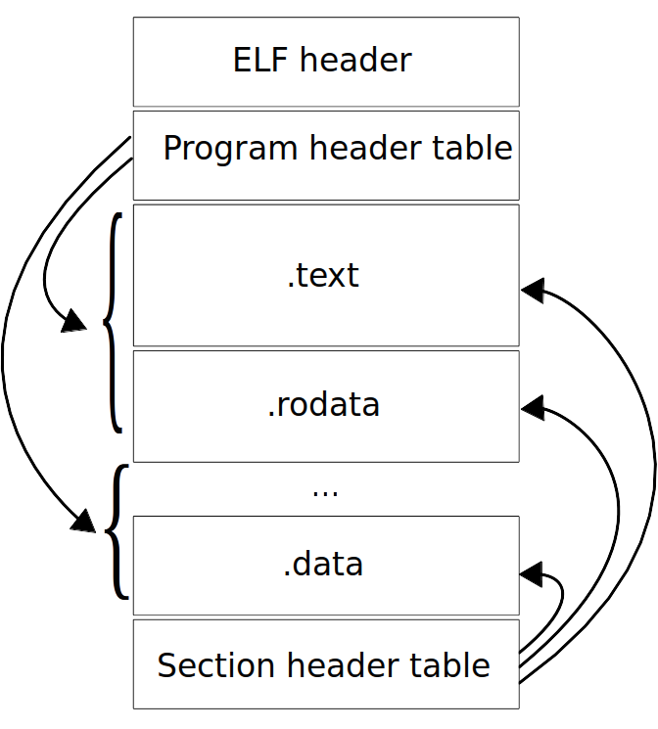
ELF: Structure
Table with sections of various information
  .text: binary code
  .data: initialized global variables
  .rodata: read only data
  .symtab: symbol table

Slide 9
ELF and Linking
Same segments of different object files get stitched together
  Identifier resolution
Code, address relocation
  .rel.data and .rel.text
  Offset
  Target symbol
  Type of addressing

Slide 10

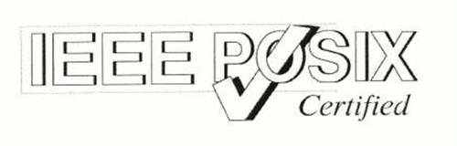
Why ELF is Good
Consistent format for object files, static libs, dynamic libs
Consistent format for all UNIX-like systems
  Reuse of compilation, linking applications
Flexible

