Slide 1

Javascript: The Language of the Web
By Colin Heinzmann

Slide 2


History
1995: Developed at Netscape over 10 days
1997: ECMA standardization
2005: Ajax revolution
2009: JSON, 2nd browser war, Node.js

Slide 3
What is Javascript Good For?
Language of the Web
Rapid prototyping
Event-driven programming
  Networking
  User Interfaces
Cross-platform development

Slide 4
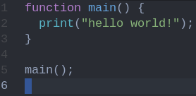
Features
C-esque language
Dynamic, duck typing
Everything is an object… but no classes!
Events and callbacks

Slide 5
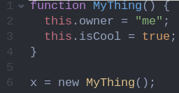
No classes, you must be crazy!?
Prototyping!
“this” is really a scope reference

Slide 6
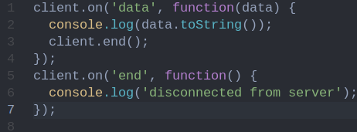
Events

Slide 7
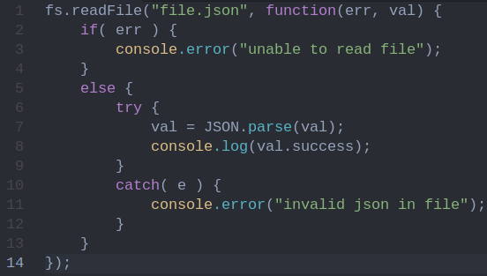
Callbacks

Slide 8
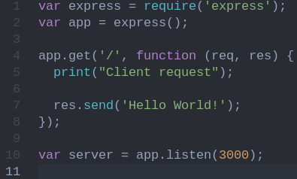
Putting this to Work

Slide 9
















Why Should You Care?
Flexible, powerful, popular
  Lots of libraries
  Powers lots of things

