Slide 1
Compiler Security:
The Ken Thompson Hack
By Colin Heinzmann

Slide 2
Roadmap
What is a self-replicating program?
What is a backdoor and how can it be a problem for compilers?
Can backdoors be put in modern compilers?
Can we trust those who are building our programs?
Should we be concerned?

Slide 3
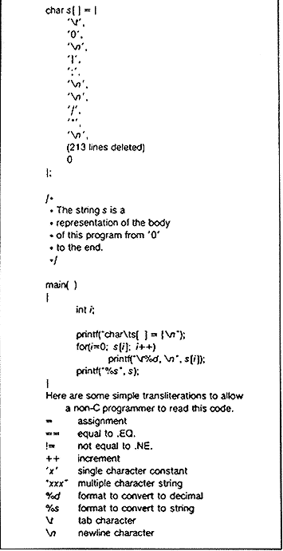
Self-Replicating Program
A program meant to produce itself as output

Slide 4
Implicit Understanding in Compilers
How does a compiler know what character '\n' maps to?
  Different locales have different meaning for '\n'
How do you create new meanings?
  Use intermediary compiler

Slide 5
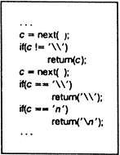
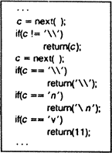
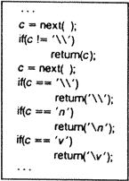
Implicit Understanding in Compilers
Initial Program
Stage I
Stage II

Slide 6
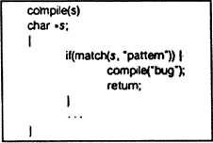
The Ken Thompson Hack
If compiling a specific program, like “login”, or “ssh”, insert a bug
Problem: keeping it secret
Solution: backdoor for the backdoor, self-replicate the backdoor so it becomes an implicit understanding and no longer in source

Slide 7

Can it Actually Happen?
August 2009, determined that this type of Trojan existed in Delphi 4 through 7
Replaced a statically linked code segment
More than 3,000 programs infected including banking software
The virus, Win32.Induc, didn't do anything, possibly exists to prove a point

Slide 8





Trusted Package Maintainers
Arch Linux has 35 core maintainers
  1 person maintains Linux kernel, DOS FS utilities, NFS utilities, 3 bootloaders
4 maintainers of Debian/Ubuntu kernel binary
  March 2014, Ubuntu claimed 22,000,000 users
Can we really trust them?

Slide 9
The Reality
Effective countermeasures to The Ken Thompson Hack exist
  Suggests no hack in GCC
You determine your own security
  Can build own packages
  Can build GCC with third party compiler
Deeper-rooted backdoors in firmware
  Independent user implemented proof-of-concept exploit of hard drive firmware
  Why not the Intel / AMD processors themselves?

