Slide 1

URL's and Templates
SoftUni Team
Technical Trainers
Software University
https://softuni.bg

Slide 2
Table of Contents
Creating a New Project
URLs in Django
Function-Based Views
Writing Dynamic Views
URL Reversing
2

Slide 3
Have a Question?
sli.do
#python-web

Slide 4

Creating a Project
Review

Slide 5
Creating a Project in PyCharm
Start a new project
Set up a database
Create a new app called employees
Include the app in the project
Create an url.py file in the app
Include the app/url.py module in the project/url.py

Slide 6

URLs in Django
Design with No Framework Limitations

Slide 7
Processing an HTTP request
Django finds the root URL configuration module and loads it
Looks for the urlpatterns variable
Runs through each URL pattern and stops at the first matching pattern
Calls the given view and pass it an instance of the class HttpRequest
path('employees/marketing/', views.marketing_department)

Slide 8
Creating Multiple URL Patterns
One way to create more pages in a website is by adding additional paths and views
Note: in some cases, this could be a lot of extra work
urlpatterns = [
path('employees/marketing/', views.marketing_department),
path('employees/hr/', views.hr_department),
path('employees/production/', views.production_department),
path('employees/accounting/', views.accounting_department),
path('employees/r&d/', views.r&d_department),
]

Slide 9
Dynamic Path Segments
Set one dynamic URL pattern for all departments
Optionally, can include converter type (otherwise, it is converted to a string)
The value name is passed as an argument to the view
path('employees/<department>/', views.employees_by_department)
path('employees/<int:department_id>/', views.employees_by_department_id)
def employees_by_department_id(request, department_id):
...

Slide 10
Default Path Converters
str – matches any non-empty string, excluding "/"
int – matches zero or any positive integer
slug – matches any slug string consisting of ASCII letters, numbers, hyphen and underscore characters
path - matches any non-empty string, including "/"
Allows you to match a complete URL path
uuid – matches a formatted UUID

Slide 11
RegEx in URLs
Use re_path() instead of path()
Makes the matching limited
Each captured argument is sent to the view as a string
Using unnamed RegEx groups isn't recommended
When both styles are mixed, any unnamed groups are ignored and only named groups are passed to the view function
re_path(r'^employees/(?P<department_id>[1-5])/$', views.year_archive)

Slide 12
Including URL modules
At any point, you can include other URL modules
It chops off the part of the matched URL ("employees/") and sends the remaining string to the included url.py file for further processing
from django.urls import include, path
urlpatterns = [
...
path('employees/', include('departments.urls')),
]

Slide 13
Including URLpatterns List
Removes redundancy from URL configuration modules where a single pattern prefix is used repeatedly
urlpatterns = [
path('<page_name>-<page_id>/', include([
path('add/', views.add),
path('edit/', views.edit),
path('delete/', views.delete),
path('details/', views.details),
])),
]

Slide 14

Function-Based Views
Returning HttpResponse

Slide 15
Views in Django
Each view receives
HttpRequest object as its first argument (typically named request)
*args - matches from no named groups in the URL pattern
**kwargs - matches from named parts in the URL pattern
Each view returns
HttpResponse object

Slide 16
Views
The view function doesn't have to be named in a certain way
from django.http import HttpResponse
def employees_by_department_id(request, department_id):
employee = None
if department_id == 1:
employee = "Peter Smith"
elif department_id == 2:
employee = "Mariya Brown"
html = "<html><body><h1>Employee: %s, " \
"Department: %s</h1></body></html>" \
% (employee, department_id)
return HttpResponse(html)

Slide 17
Returning Errors
Instead of a normal HttpResponse object, a view can return an HTTP status code
Using HttpResponse subclasses
Passing an HTTP status code to the HttpResponse class
Raising Http404 exception

Slide 18
Using HttpResponse Subclasses
There are list of HttpResponse subclasses for several common HTTP status codes that can be returned to signify an error
from django.http import HttpResponse, HttpResponseNotFound
def employees_by_department_id(request, department_id):
if ...:
...
return HttpResponse(html)
else:
return HttpResponseNotFound('Department was not found')

Slide 19
Passing an HTTP Status Code
If there is no subclass for specific status code, you could create a return class for any status code
from django.http import HttpResponse
def employees_by_department_id(request, department_id):
if ...:
...
return HttpResponse(html)
else:
return HttpResponse(status=501)

Slide 20
Raising Http404 Exception
Unlike HttpResponseNotFound, it is an exception
It returns an application's standard error page and an HTTP 404 status code
Django provides a default 404 page for this exception

Slide 21
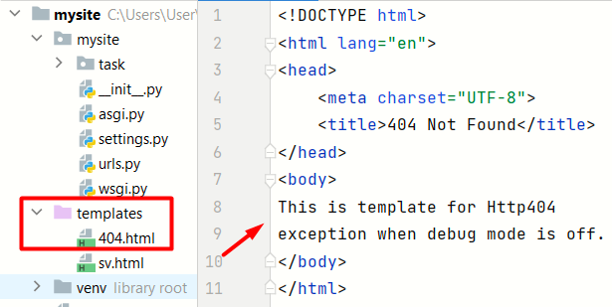
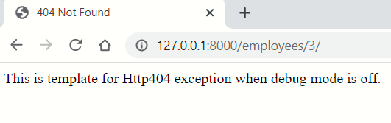
Raising Http404 Exception
To show customized HTML, create a 404.html template
This template will be served when DEBUG is set to False

Slide 22
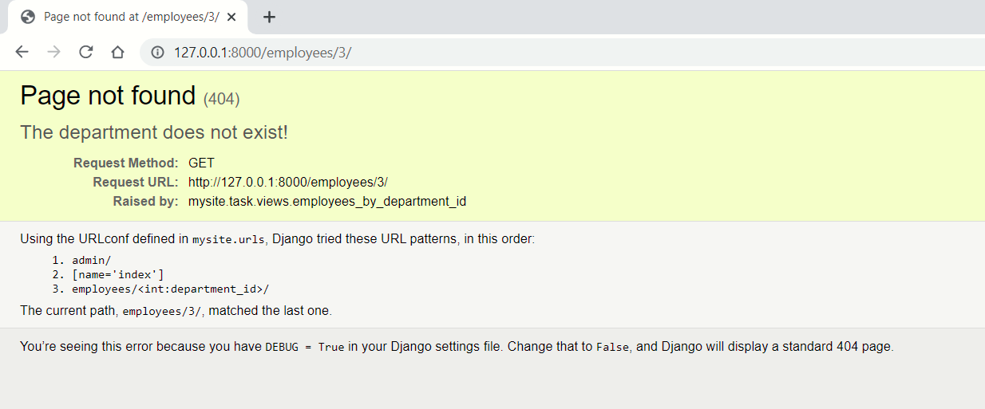
Raising Http404 Exception
When DEBUG is True, the provided message to Http404 will appear in the standard 404 debug template

Slide 23
Writing Dynamic Views
render() and redirect()

Slide 24
Django Shortcut Functions
They are helper functions
Make developing with Django easier
Connect many different levels of the Model-View-Template paradigm
render()
redirect()
get_object_or_404()
get_list_or_404()

Slide 25
render() Function
Combines a template with a context dictionary
Returns an HttpResponse object with the rendered text
Required arguments
request - generating this response
template_name - a full name of a template to use
render(
request=request,
template_name='employees/employees_by_department.html',
)

Slide 26
render() Context
context - optional argument (empty dictionary by default)
A dictionary of values to add to the template context
from django.shortcuts import render
def employees_by_department(request, department_id):
...
context = {"employee": "Peter Smith", "department": "marketing"}
return render(
request=request,
template_name='some_template.html',
context=context,
)

Slide 27
redirect() Function
Use it to redirect the user to the appropriate URL
The function returns an HttpResponseRedirect object
By passing the name of a view and optionally some positional or keyword arguments
By passing a hardcoded URL to redirect to
It returns an HTTP status code 302
redirect(some_view_name, *args, **kwargs)
redirect('/some/url/')

Slide 28
redirect() Example
But it is not much dynamic
from django.shortcuts import render, redirect
def employees_by_department_id(request, department_id):
# find the name of a department by its id
return redirect(
'http://127.0.0.1:8000/employees/' + found_department
)
def employees_by_department(request, department):...

Slide 29

URL Reversing
reverse() and Naming URL Patterns

Slide 30
redirect() Function
To perform URL reversing, use named URL patterns
Helps avoid hardcoding a URL in the view function
Returns a string
path('employees/<str:department>/',
views.employees_by_department,
name='employees-by-department-name')
reverse('employees-by-department-name', args=(found_dep,))
'/employees/marketing/'

Slide 31

Demo
Live Exercise in Class

Slide 32

Summary
The views.py file contains the logic for when a given URL is reached
The urls.py file uses the views.py file to configure the URL's
It is strongly desirable to avoid hard-coding URL patterns

Slide 33
Questions?
Notes:
33

Slide 34











SoftUni Diamond Partners

Slide 35


Educational Partners

Slide 36

License
This course (slides, examples, demos, exercises, homework, documents, videos and other assets) is copyrighted content
Unauthorized copy, reproduction or use is illegal
© SoftUni – https://softuni.org
© Software University – https://softuni.bg
Notes:
36

Slide 37
Trainings @ Software University (SoftUni)
Software University – High-Quality Education, Profession and Job for Software Developers
softuni.bg, softuni.org
Software University Foundation
softuni.foundation
Software University @ Facebook
facebook.com/SoftwareUniversity
Software University Forums
forum.softuni.bg
37
Notes:
37

