Slide 1

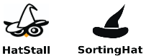
Main System
Anonymization System
Identity Management System
HTTP
HTTP

Slide 2
docker-compose-healthcheck
ping
send ping
incoming request
convert JSON body to DataFrame
anonymizer
processes data
convert DataFrame to JSON body
send response
change_identities
update_identities
forward request to SortingHat
forward response from Sortinghat
show
show-profile
find-profile
find-profiles-by-organization

