Slide 1
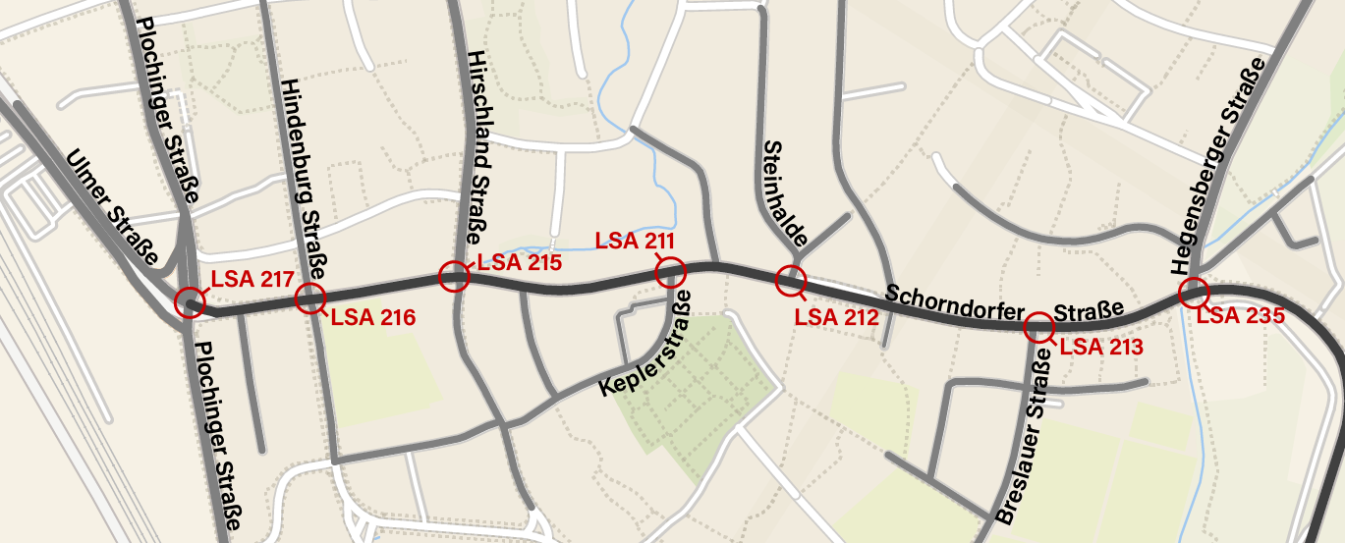
Map of Esslingen

Slide 2
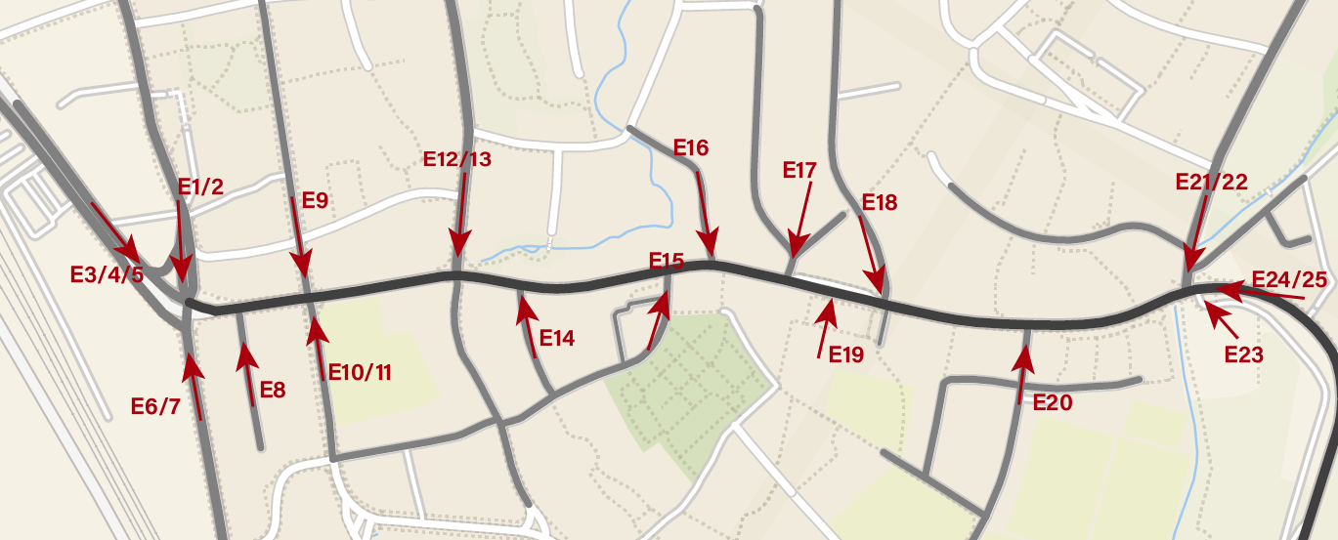
Map of Esslingen - Entry Points

Slide 3
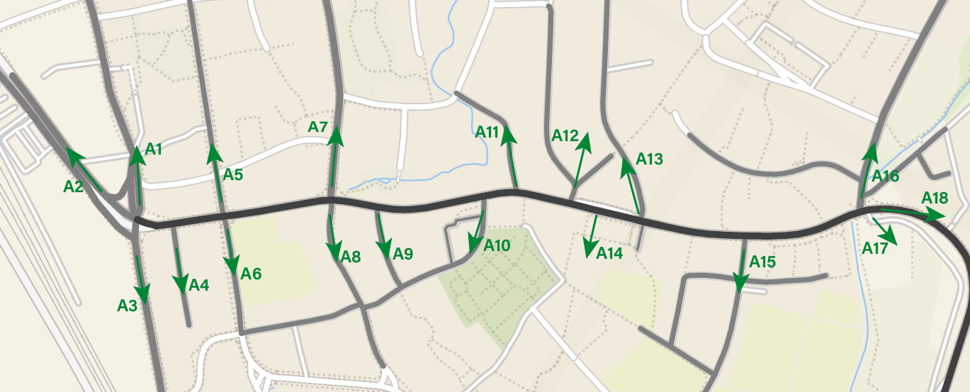
Map of Esslingen – Exit Points

