Slide 1
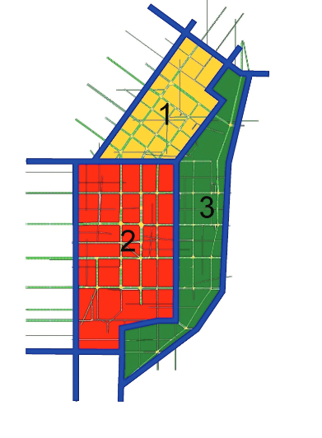
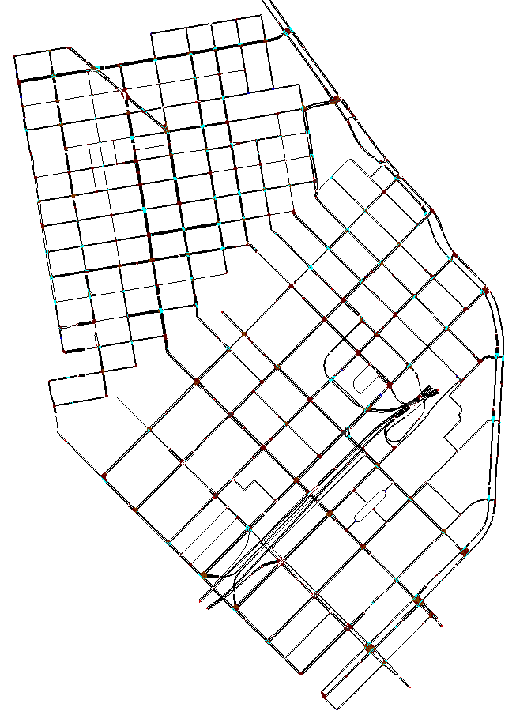
E30,
A30
Entrances and Exits For Vehicle Spawning
(Running Ambühl Simulation)
E29, A29
E31,
A31
A28
E27
E32,
A32
A33
E35,
A35
E26
A34
E36,
A36
A25
E24, A24
E37
A23
E22
A21
A38
E20
E19
E18, A18
E17, A17
E16, A16
A15
E14
A13
E12
A11
A10
A9, E9
E7
E8
A6, E6
A5, E5
A4, E4
A3, E3
A1,
E1
A2,
E2

Slide 2
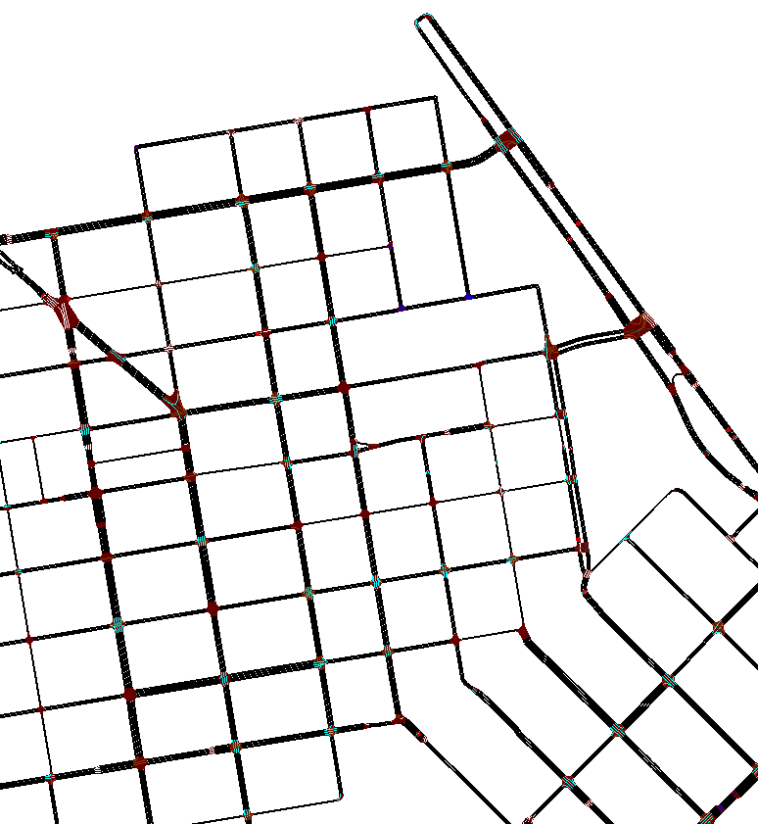
Perimeter 1 Boundary
A33
A34
E35,
A35
E36,
A36
INT4
INT3
INT2
INT1
INT5
INT6
INT7
INT17
INT8
INT9
INT10
INT16
INT11
INT14
INT15
INT12
INT13

Slide 3
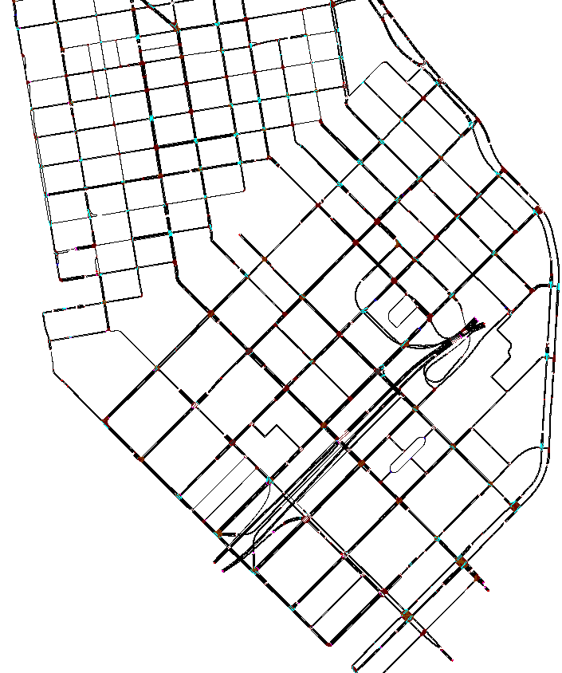
Perimeter 2 Boundary
INT16
INT33
INT32
INT31
INT30
INTZ
INT15
INT28
INT14
INT27(ABC)
INT13
INT26
INT34
INT25
INT23
INT22
INT21
INT20
INT19
INT35
INT24
INT36
INT37
INT38
INT39
INT40
INT41
INT42
INT44
INT45
INT46

Slide 4
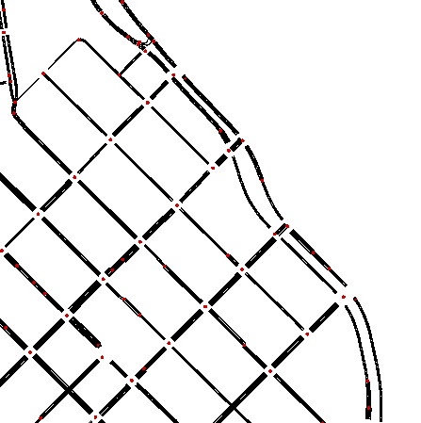
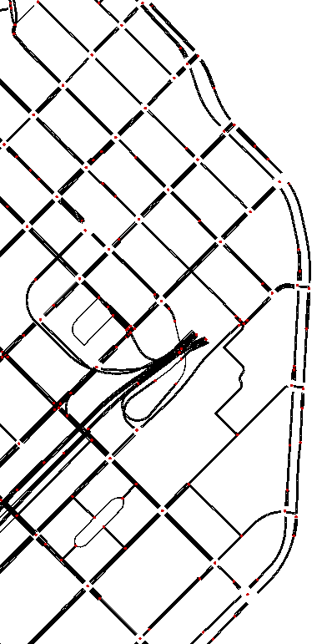
Perimeter 3 Boundary
View 1
View 2
INT33
E36,
A36
INT18
INT32
View 1
INT1
INT31
INT30
INT27 (ABC)
INTZ
INT17
INT25AB
INT26
INT28
INT30
INT29
INT24
INT16
INT23
View 2
INT22
INT21
INT20
INT19
View 3
View 3

