Slide 1















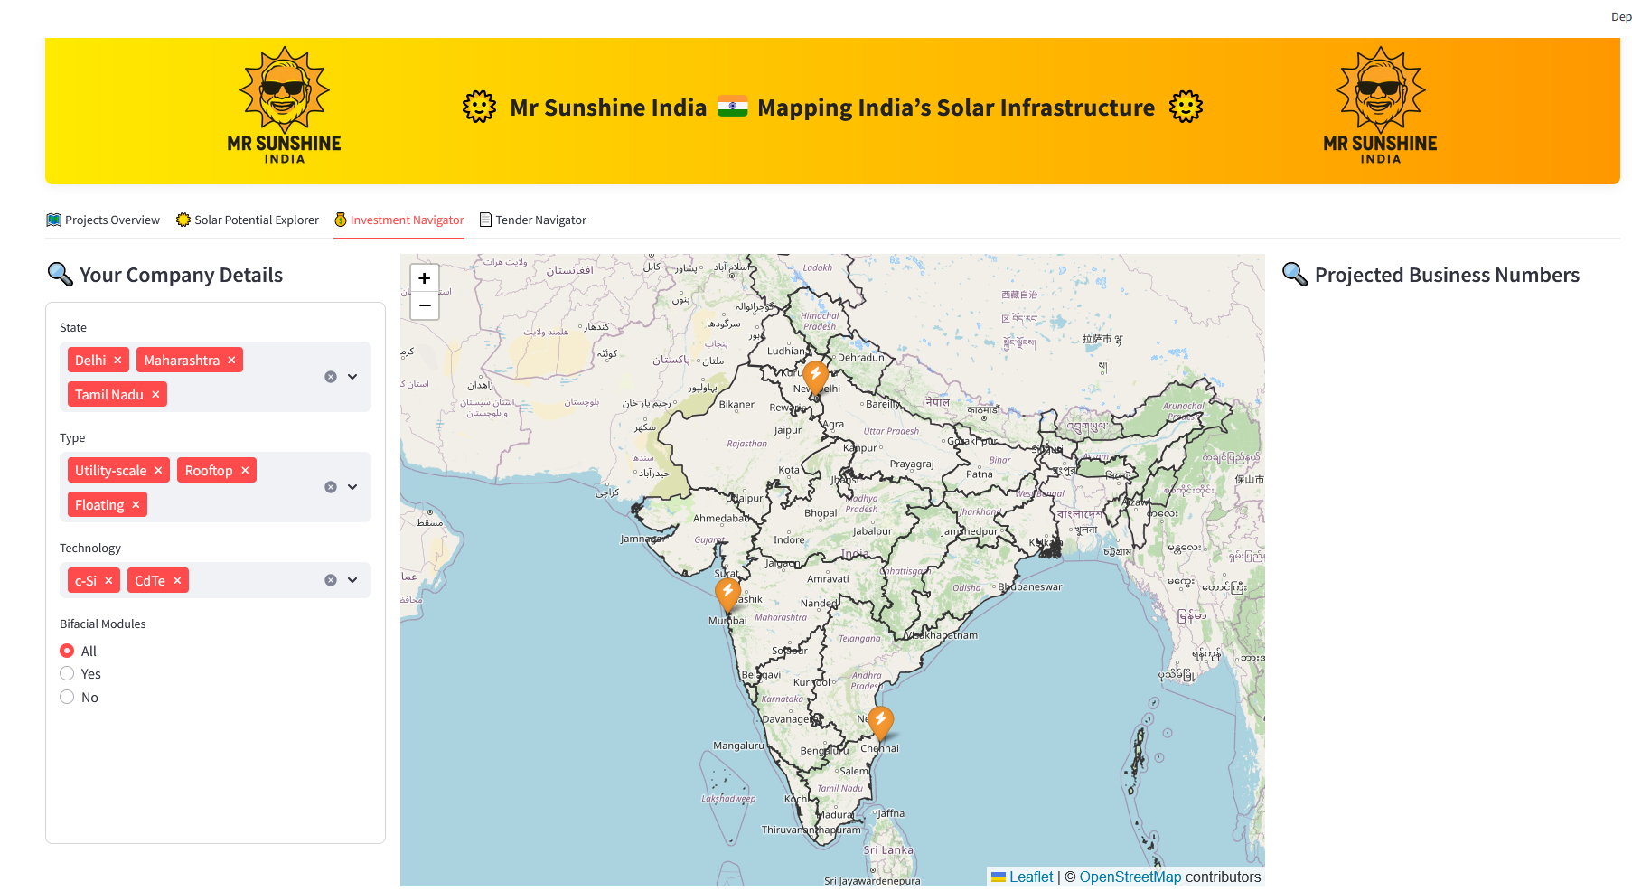




Mr Sunshine India – Mapping India’s Solar Infrastructure
Agentic Scraping Pipeline
Python – For running agentic scrapers
for OCR table extraction from images
For Python-based front end in Browser
Technologies
For HTML parsing
Selenium & Chrome – for browser automation
For Scalable & Fast PostGreSQL
For coordination / location retrieval
Visualization / UI
Government
Public Tender Information
Project Data
Companies
Azure Power
Renew
Tata Power
National Statistics Data
Data Flow
International Organisations
StatisticTimes
INCED
Tender Data
Academia
Geo-Data (UCDavis)
Topography Data
Online Sources
Raw Data Lake
Processed Data
DataBase

Slide 2
Mr Sunshine India – Mapping India’s Solar Infrastructure
Agentic Scraping Pipeline
Python – For running agentic scrapers
for OCR table extraction from images
For Python-based front end in Browser
Technologies
For HTML parsing
Selenium & Chrome – for browser automation
For Scalable & Fast PostGreSQL
For coordination / location retrieval
Visualization / UI
Government
Public Tender Information
Project Data
Companies
Azure Power
Renew
Tata Power
National Statistics Data
Data Flow
International Organisations
StatisticTimes
INCED
Tender Data
Academia
Geo-Data (UCDavis)
Topography Data
Online Sources
Raw Data Lake
Processed Data
DataBase

Slide 3
DELIVERABLES FOR HACKATHON

Slide 4
HACKATHON DELIVERABLES
CRITERIA
Rubric:
- technical quality (33%)
- creativity (33%)
- quality/structure/clarity of the demo (33%)
DELIVERABLES
Word Report
# | Item | Format | Purpose
1 | Project Summary | Text (150–300 words) | High-level pitch for the jury
2 | Demo Video | Link (max 60 sec) | Demonstrate your project
3 | Tech Video | Link (max 60 sec) | Explain how you built it
4 | 1-Page Report | PDF | Structured technical summary
5 | GitHub Repository | Public link | Source code and documentation
6 | Zipped Code | .zip file | Local backup of your project
7 | Dataset (if used or generated) | Link or “N/A” | Raw or processed data
Browser UI
Data Model Scraping Tech
Powerpoint
Github
Polybox

Slide 5
DATA & SCRAPING PIPELINE

Slide 6
DATASOURCES
Selenium
Chrome
Python
Visualization
Government
tenders
Html_files
Tender_data
Csv_files
Companies
Azurepower
Html_files
renew
Csv_files
tatapower
Project_data
International Organizations
Statistic Times INCED
Html_files
PostgreSQL
JPGs of Tables
Excel
Academia
National_statistics_data
Geo-Data (UCDavis)
Geo JSON Files
Scrapers
Online
RawData
ProcessedData
Database

Slide 7
UI & DESIGN

Slide 8
BANNER
Projects Overview
Solar Information Portal
Investment Navigator
Tender Navigator
Users / Stakeholders
Investors
Operators
Planners
Government
Commercial
Suppliers: Manufacturers of Solar Panels
Competitors: Operating Companys
Search for tenders
Search for opportunities
Customer: Energy / Grid Companies
Users / Stakeholders
Competition
Where are current projects
Opportunities
Where are potential tenders
How is the solar potential weather / climate conditions
How is the market potential (demand in the areas, energy prices, …)
Potential customers (grid companies)

Slide 9
BANNER
Projects Overview
Regional Investment Potential
Tender Navigator
Filter
MAPS
Bar Chart / Plots About Energy Produced
Markers
Colors = Companies

Slide 10
BANNER
Projects Overview
Solar Information Portal
Tender Navigator
Filter
Potential Score
Climate Factors
MAPS
Radiation Sunshine
Shapes
Temperature
Cloud / Air Pollution
Economic Factors
Energy Prices
Demand
Supply / Competition

Slide 11
BANNER
Projects Overview
Investment Navigator
Tender Navigator
Filter
CALC
COST & BENEFIT BREAKDOWN
POTENTIAL PROFIT
Potential Score
Climate Factors
MAPS
Radiation Sunshine
Shapes
Temperature
Cloud / Air Pollution
Economic Factors
Energy Prices
Demand
Supply / Competition

Slide 12
BANNER
Projects Overview
Regional Investment Potential
Tender Navigator
Search Filter
Results
MAPS
Markers

