Slide 1








Mr Sunshine India – Mapping India’s Solar Infrastructure
Agentic Scraping Pipeline
Grindelwald AI (Kevin Riehl, Shaimaa El Baklish)

Slide 2









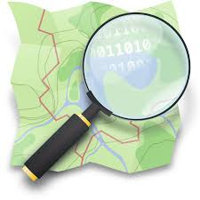



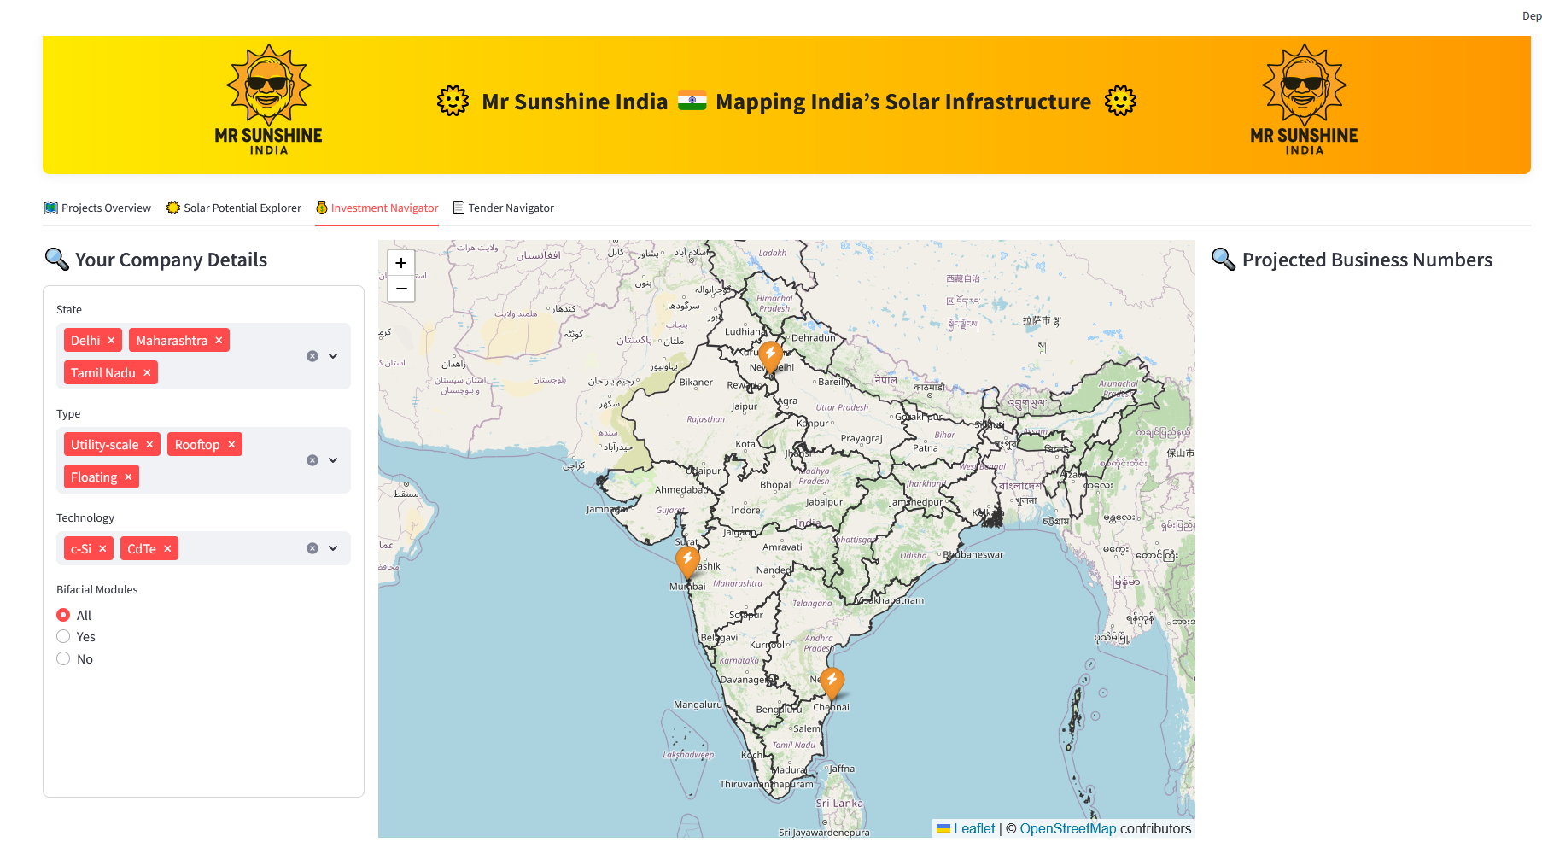




Mr Sunshine India – Mapping India’s Solar Infrastructure
Agentic Scraping Pipeline
Python – For running agentic scrapers
for OCR table extraction from images
For Python-based front end in Browser
Technologies
For HTML parsing
Selenium & Chrome – for browser automation
For Scalable & Fast PostGreSQL
For coordination / location retrieval
Visualization / UI
Government
Public Tender Information
Project Data
Companies
Azure Power
Renew
Tata Power
National Statistics Data
Data Flow
International Organisations
StatisticTimes
INCED
Tender Data
Academia
Geo-Data (UCDavis)
Topography Data
Online Sources
Raw Data Lake
Processed Data
DataBase

Slide 3
GET EXCITED FOR THE LIVE DEMO

Slide 4
Mr Sunshine India – Mapping India’s Solar Infrastructure
Agentic Scraping Pipeline
Python – For running agentic scrapers
for OCR table extraction from images
For Python-based front end in Browser
Technologies
For HTML parsing
Selenium & Chrome – for browser automation
For Scalable & Fast PostGreSQL
For coordination / location retrieval
Visualization / UI
Government
Public Tender Information
Project Data
Companies
Azure Power
Renew
Tata Power
National Statistics Data
Data Flow
International Organisations
StatisticTimes
INCED
Tender Data
Academia
Geo-Data (UCDavis)
Topography Data
Online Sources
Raw Data Lake
Processed Data
DataBase

