Slide 1
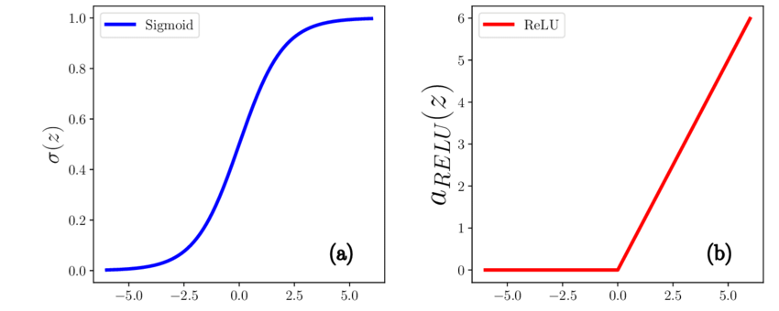
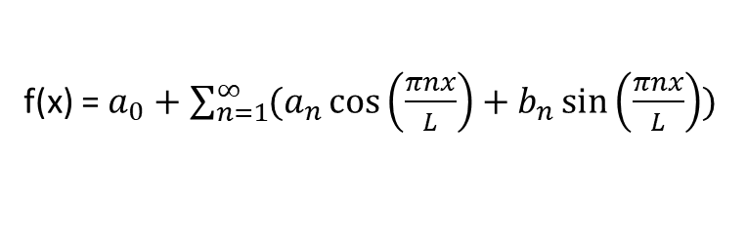
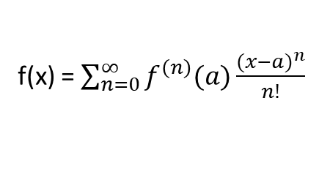
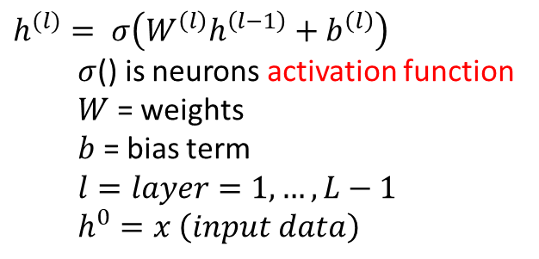

Neural Networks are powerful function approximators
under some assumptions... you can approximate with Taylor Approximation (as sum of polynomials)
f(x) = $\sum_{n=0}^{∞}{f^{\left(n\right)}(a)\frac{{(x−a)}^{n}}{n!}}$
under some assumptions... you can approximate with Fourier Approximation (as sum of sines and cosines)
f(x) = $a_{0}+\sum_{n=1}^{∞}{(a_{n}\cos\left(\frac{πnx}{L}\right)+b_{n}\sin\left(\frac{πnx}{L}\right)) }$
under some assumptions... you can approximate with Multi Layer Perceptrons
(as weighted sum of layers of neurons with same activation function, like sigmoid or ReLu)
f(x) = $W^{(L)}h^{(L−1)}+b^{(L)}$
Universal Approximation Theorem
(Cybenko 1989, Hornik 1991)
$$h^{(l)}= σ\left(W^{\left(l\right)}h^{\left(l−1\right)}+b^{\left(l\right)}\right)$$
  $σ$() is neurons activation function
  $W$ = weights
  $b$ = bias term
  $$l=layer=1, …, L−1$$
  $$h^{0}=x \left(input data\right)$$

Slide 2
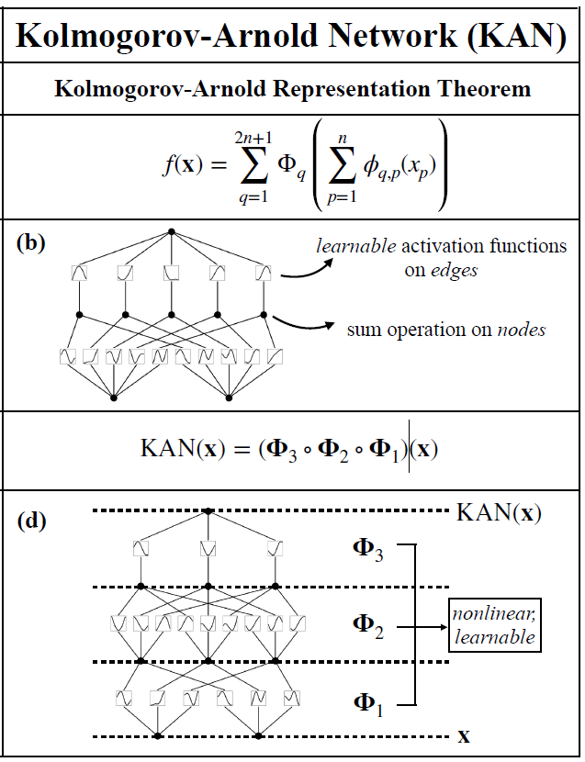
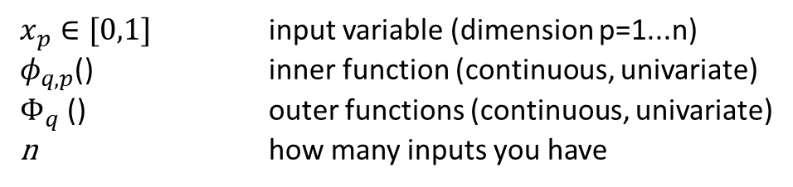
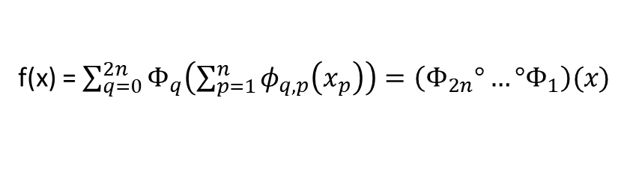
Kolmogorov-Arnold representation theorem for function approximation (Superstition Theorem)
under some assumptions... you can approximate with two layer KAN network
  (first layer = inner layer, vector to vector mapping)
  (second layer = outer layer, vector to scalar mapping)
f(x) = $\sum_{q=0}^{2n}{Φ_{q}\left(\sum_{p=1}^{n}{φ_{q,p}\left(x_{p}\right)}\right)=\left(Φ_{2n}°…°Φ_{1}\right)(x)}$
$x_{p}∈[0,1]$ input variable (dimension p=1...n)
$φ_{q,p}$() inner function (continuous, univariate)
$Φ_{q}$ () outer functions (continuous, univariate)
n how many inputs you have
practically, more than two-layers used for better approximation,
easier functions, and easier training

Slide 3
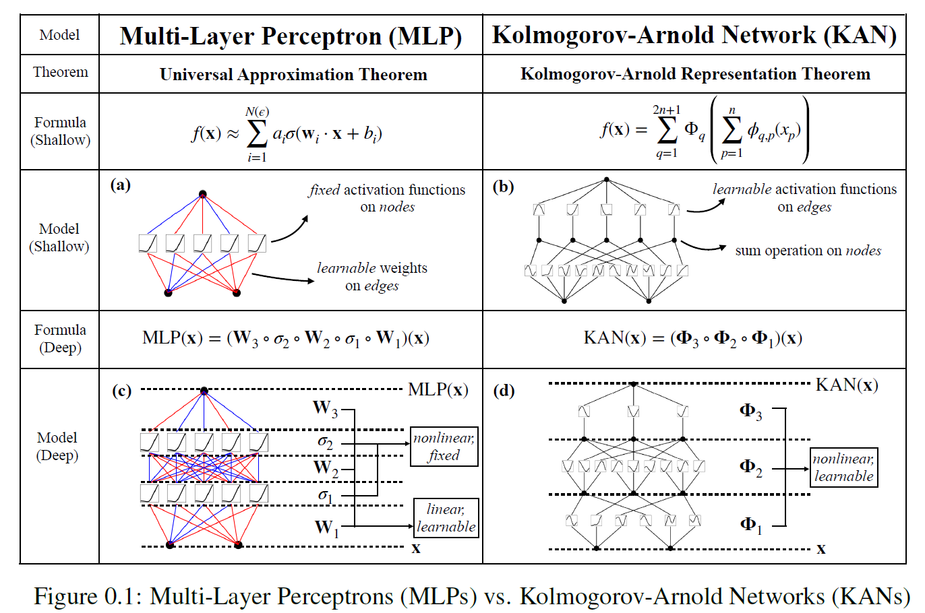
Kolmogorov-Arnold Training is Hard (Computationally + Instability / Dependency to Initialization)
and depends on the edge functions
Kolmogorov-Arnold Networks (KANs) vs. MLPs

Slide 4
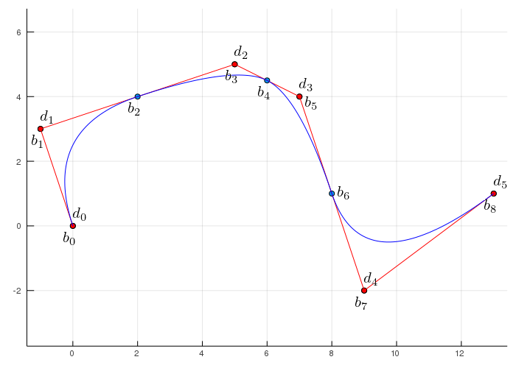
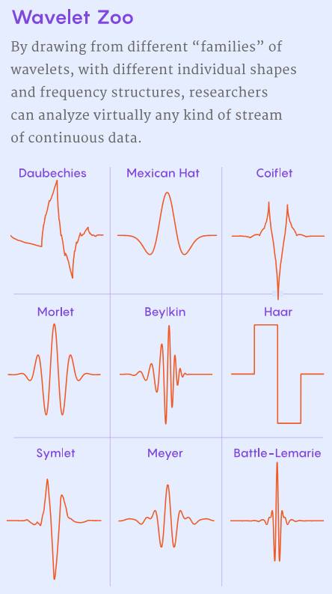
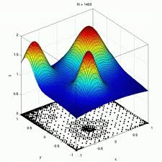
Kolmogorov-Arnold Training Approaches (depends on edge function class)
1) Gradient-Descent-Based Training. B-SPLINES (Liu et al. 2024)
2) Basis Function Variation.
Wavelet Wav-Kan (Bozorgasl et al. 2024)
Radial-Base Functions RBF (Ta et al. 2024)

