Slide 1


Quantum Computing
By Michael Needleman
Notes:
Third in a series of videos exploring modern cryptography and the effect of quantum computers.
In this video I will be going over the basics of quantum computers and the mathematical foundations they are built upon.

Slide 2
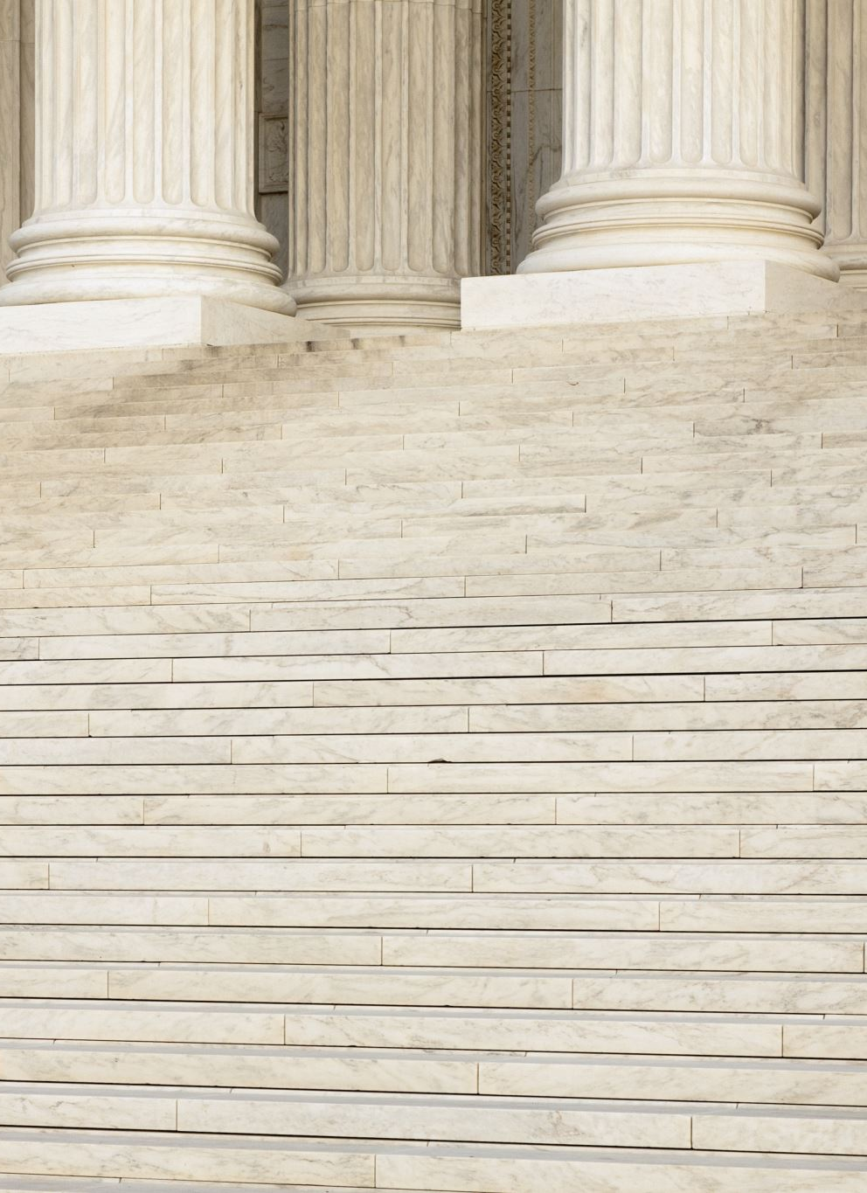

Classical Representations
Bits are either 0 or 1
P(0) = 0% or 100%, P(1) = 1-P(0)
Represented as vectors:
$\left|0\right\rangle =\left[\begin{aligned}1 \\ 0\end{aligned}\right], \left|1\right\rangle =\left[\begin{aligned}0 \\ 1\end{aligned}\right]$
First element is P(0), second is P(1)
Notes:
While it’s not normally meaningful to think about classical systems in terms of probability, it helps to bridge the gap between classical and quantum.
In classical systems, there are only ever two possible values a single bit can take
By describing bits in terms of the probability of being a certain value, we can examine the limitations of classical computers

Slide 3

Sidebar: Dirac Notation
The “ket” $|a⟩$ describes a column vector
The “bra” $\left\langle b\right|$ describes a row vector
The “bra-ket” $\left\langle b | a\right\rangle$describes an inner product
Common symbols:
$\left|0\right\rangle =\left[\begin{aligned}1 \\ 0\end{aligned}\right], \left|1\right\rangle =\left[\begin{aligned}0 \\ 1\end{aligned}\right], \left|+\right\rangle =\frac{1}{\sqrt{2}}\left[\begin{aligned}1 \\ 1\end{aligned}\right], \left|−\right\rangle =\frac{1}{\sqrt{2}}\left[\begin{aligned}1 \\ −1\end{aligned}\right]$
$\left|ψ\right\rangle , \left|q\right\rangle , |x⟩$ are common variable names for quantum states
Notes:
Because quantum computing uses the vectors a lot, it’s often written in the shorthand bra-ket, aka Dirac, notation
To be specific, bra is the complex conjugate of ket

Slide 4


Statevectors
$\left|0\right\rangle$ and $|1⟩$ form an orthonormal basis
By ignoring the “all or nothing” restriction, we can expand into other values
Quantum bits are just linear combinations of $|0⟩$ and $|1⟩$
Notes:
The two values of 0 ket and 1 ket form an orthonormal basis
Because of this, quantum bits are easily expressed as linear combinations of the two values

Slide 5

Meaning of Complex States
If P(0) and P(1) are no longer restricted, there needs to be a meaningful way of measuring
Because it’s a probability, the sum must always be 1
The probability of measuring a state $|ψ⟩$ in the state $|x⟩$
$P\left(|x⟩\right)={\left|⟨x|ψ⟩\right|}^{2}$

Slide 6

Example
Given state: $\left|q_{o}\right\rangle =\frac{1}{\sqrt{2}}\left|0\right\rangle +\frac{i}{\sqrt{2}}\left|1\right\rangle$
Find $P(|0⟩)$
$\left\langle 0 | q_{0}\right\rangle =\frac{1}{\sqrt{2}}\left\langle 0 | 0\right\rangle +\frac{i}{\sqrt{2}}\left\langle 0 | 1\right\rangle =\frac{1}{\sqrt{2}}\left(1\right)+\frac{i}{\sqrt{2}}\left(0\right)=\frac{1}{\sqrt{2}}$
${\left|\left\langle 0 | q_{0}\right\rangle \right|}^{2}=\frac{1}{2}$
Notes:
To find the probability of q0 resulting in 0, we take advantage of two facts:
The inner product of a state and its complex conjugate is 1
The inner product of a state and a linearly independent state is 0
This means that 0 bra 0 ket equals 1 and 0 bra and 1 ket equals 0
As a result, q0 has a 50% chance of resulting in 0 and a 50% chance of resulting in 1

Slide 7

Normalization Constraint
Amplitudes are directly related to probabilities
Statevectors must always be normalized
$\left\langle ψ | ψ\right\rangle =1$
$\left|ψ\right\rangle =α\left|0\right\rangle +β\left|1\right\rangle$
$\sqrt{{\left|α\right|}^{2}+{\left|β\right|}^{2}}=1$
Notes:
You might have noticed that so far all of the values have been normalized. For quantum computers, this will always be the case.

Slide 8

Global Phase and Measurement
Ex. $\left[\begin{aligned}0 \\ i\end{aligned}\right]=i|1⟩$
${\left|\left\langle x | \left(i | 1\right\rangle \right)\right|}^{2}={\left|i\left\langle x | 1\right\rangle \right|}^{2}={\left|\left\langle x | 1\right\rangle \right|}^{2}$
The global phase of $i$ disappears
Implications:
$i\left|1\right\rangle ==\left|1\right\rangle$
Measurement ignores global phase, so states that differ in global phase are physically indistinguishable
Notes:
Global phase is an interesting phenomenon in this system of computation.
Here we can see how the global phase cancels out from measurement.
It’s important to note that global phase is different from relative phase, which is the phase difference between terms in a superposition.

Slide 9


Measurement is an Operation
What if Schrödinger’s box had a double slit?
Much like quantum physics, observing (measuring) the state of a qubit changes it
Often referred to as “collapsing” the state
Once a qubit is measured to be a state $|x⟩$, its state IS $|x⟩$

Slide 10
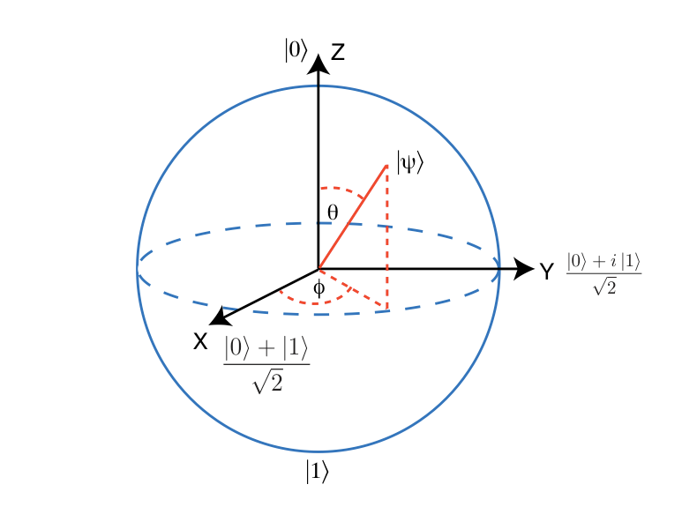

The Bloch Sphere
Define $\left|q\right\rangle =α\left|0\right\rangle +β\left|1\right\rangle ;α,β∈ℂ$
Taking advantage of global phase:
$\left|q\right\rangle =α\left|0\right\rangle +e^{iφ}β\left|1\right\rangle ;α,β,φ∈ℝ$
Recall: $\sqrt{α^{2}+β^{2}}=1$
Use the trig identity:
$\sqrt{\sin^{2}{x}+\cos^{2}{x}}=1$
$α=\cos{\frac{θ}{2}, β=\sin{\frac{θ}{2}}}$
Now we can define any qubit using $φ$ and $θ$
$\left|q\right\rangle =\cos{\frac{θ}{2}\left|0\right\rangle +e^{iφ}\sin{\frac{θ}{2}|1⟩}}$
Notes:
The Bloch sphere is serves as the geometric representation of a single qubit. By re-defining qubits in terms of phi and theta, they can be represented by a vector in 3d space.
One benefit of normalization is that the vector will always be unit length.

Slide 11
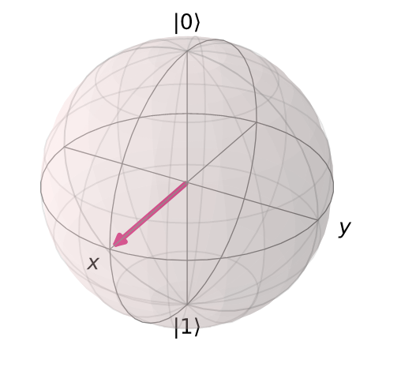



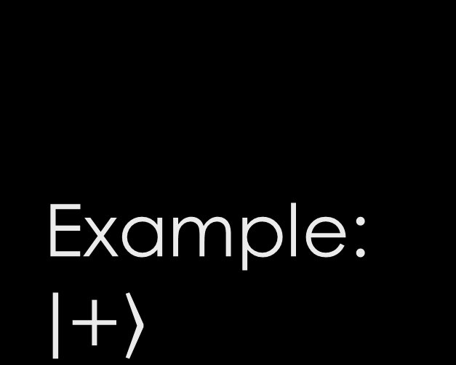

Example: $|+⟩$
$$\left|+\right\rangle =\cos{\frac{π}{4}\left|0\right\rangle +e^{i0}\sin{\frac{π}{4}\left|1\right\rangle , θ=\frac{π}{2}}, φ=0}$$
Notes:
Here we can see how putting a qubit into superposition moves it from 0 to positive X. If we had started with 1 instead, the state would be negative x.

Slide 12
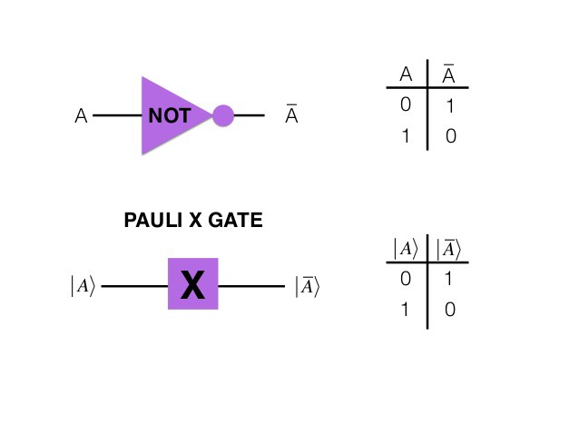

1-Bit Classical Operations (Gates)
Exactly one operation for one bit: Logical NOT
!0=1, !1=0
This makes sense given the restrictions of probabilities
If the only allowable options are $|0⟩$ and $|1⟩$, then the only thing you can do is move between them

Slide 13

1-Qubit Quantum Gates
Hadamard: $H=\frac{1}{\sqrt{2}}\left[\begin{matrix}1 & 1 \\ 1 & −1\end{matrix}\right]$
Puts a qubit into superposition
Pauli-X: X$=\left[\begin{matrix}0 & 1 \\ 1 & 0\end{matrix}\right]$
Equivalent to Boolean NOT
Pauli-Y: $Y=\left[\begin{matrix}0 & −i \\ i & 0\end{matrix}\right]$
Pauli-Z: Z $=\left[\begin{matrix}1 & 0 \\ 0 & −1\end{matrix}\right]$
Note: If $|\left.q\right\rangle =|\left.0\right\rangle$ then nothing happens.
All 4 of these gates are rotations by $π$ around an axis on the Bloch sphere
Notes:
There are 4 major 1 qubit gates: the Hadamard, the Pauli-X, Pauli-Y, and Pauli-Z
Each of these gates is analogous to a rotation on the Bloch sphere.

Slide 14

2-Qubit Quantum Gates
Operations on multiple qubits can be described by a tensor product
Ex: $H\left(q_{0}\right) and X\left(q_{1}\right)$
$X\left|q_{1}\right\rangle ⊗H\left|q_{0}\right\rangle =\left(X⊗H\right)|q_{1}q_{0}⟩$
Controlled-NOT: CNOT-Gate
If the control is 1, flip the target
Notes:
There are many other kinds of controlled gates, and they are vital for many quantum algorithms.

Slide 15
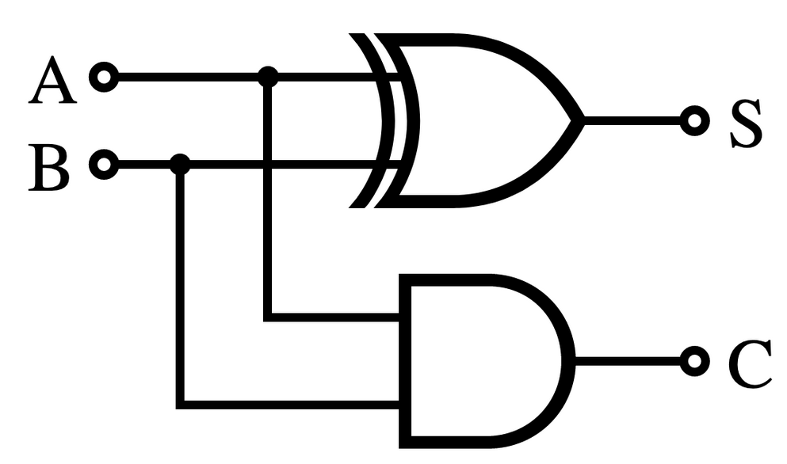
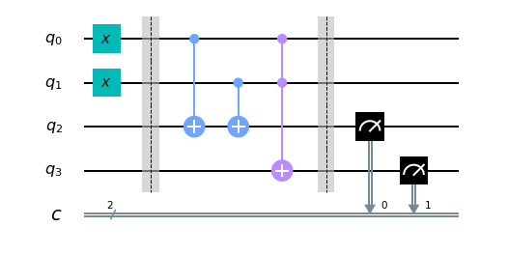

Quantum Circuitry
Classical circuits are drawn with combinations of inputs leading to gates
Quantum circuits must preserve inputs and outputs, so conventions are slightly different
$q_{0},q_{1},q_{2},q_{3}$ represent quantum bits
$c$ represents classical bits used for recording measured results
Here we see X gates and CNOT gates (and a CCNOT) performing the same operation as the classical circuit
The last two gates perform the measurements

Slide 16
Credits
https://qiskit.org/textbook/

