Slide 1
Shor’s Algorithm
By Michael Needleman
Notes:
This is the fifth in a series of videos exploring modern cryptography and the effects that quantum computers will have.
In this video, we will be taking a look at Shor’s period finding algorithm and its applications for factoring numbers.

Slide 2
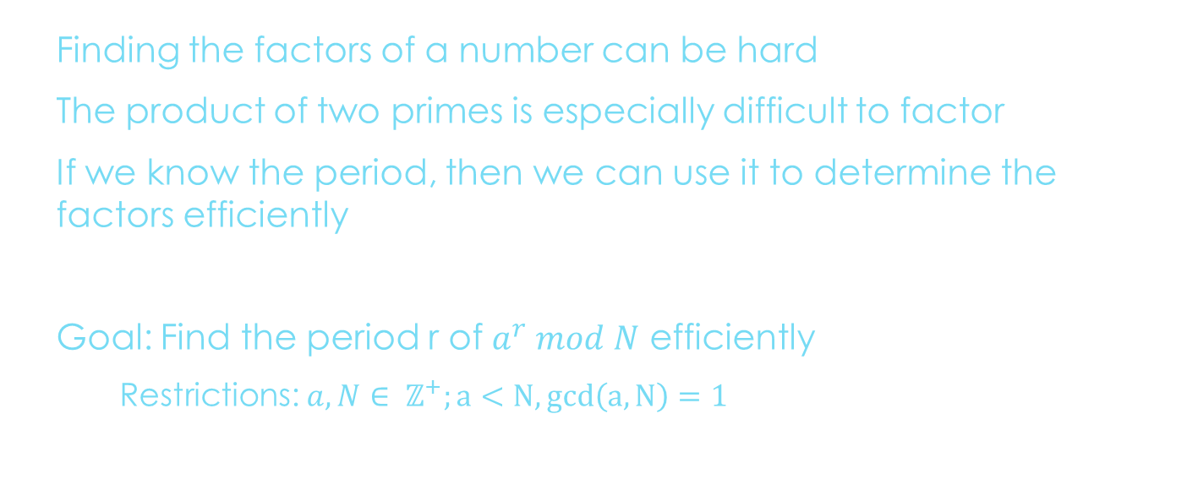
Motivation
Finding the factors of a number can be hard
The product of two primes is especially difficult to factor
If we know the period, then we can use it to determine the factors efficiently
Goal: Find the period r of $a^{r} mod N$ efficiently
Restrictions: $a,N∈ ℤ^{+};a<N, gcd\left(a,N\right)=1$
Notes:
As we discussed in the first video, RSA is based on taking large prime numbers and performing modular operations on them to generate encryption keys.
RSA is considered safe because factoring large numbers takes exponential time with classical computers.
While it’s not very useful to a classical computer, it can be shown that finding the period of the function a to the r mod N can be used to factor efficiently.

Slide 3
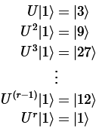
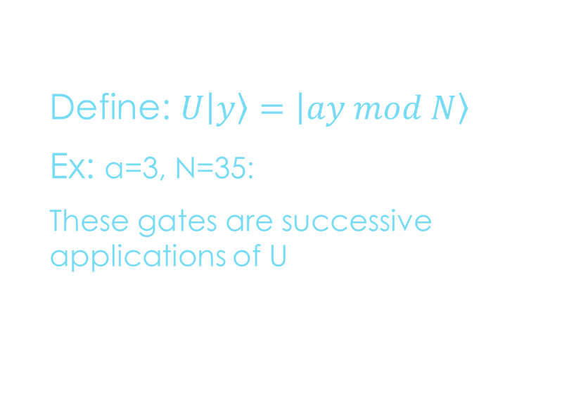
Phase Estimation
Define: $U\left|y\right\rangle =\left|ay mod N\right\rangle$
Ex: a=3, N=35:
These gates are successive applications of U
Notes:
Let’s begin by building an intuition for how the period finding might work on a quantum computer.
We define a unitary operation U that performs a*y mod N for some a, y, and N
Each successive application of U, shown as U to some power, increases the power of a.
As U keeps being applied, eventually we hit 1, and then a. This demonstrates the periodic behavior of the function a to the x mod N, but it doesn’t help us quite yet.

Slide 4
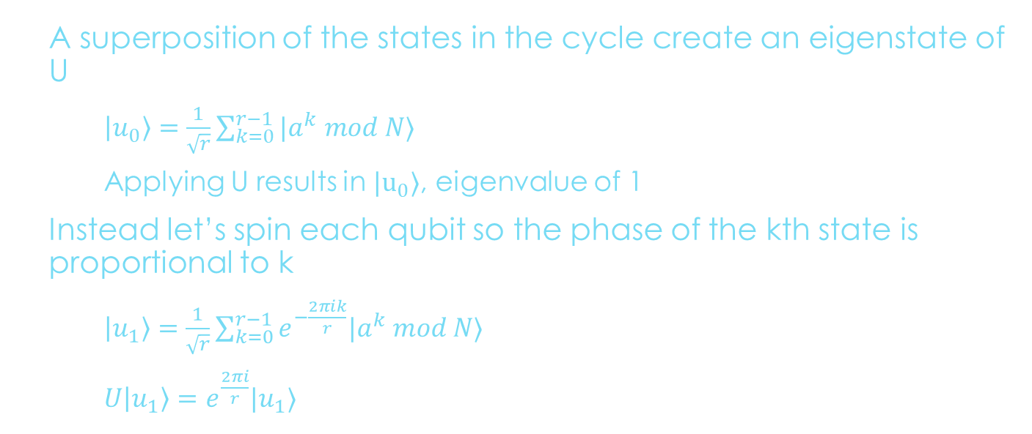
Phase Estimation
A superposition of the states in the cycle create an eigenstate of U
$\left|u_{0}\right\rangle =\frac{1}{\sqrt{r}}\sum_{k=0}^{r−1}{|a^{k} mod N⟩}$
Applying U results in $|u_{0}⟩$, eigenvalue of 1
Instead let’s spin each qubit so the phase of the kth state is proportional to k
$\left|u_{1}\right\rangle =\frac{1}{\sqrt{r}}\sum_{k=0}^{r−1}{e^{−\frac{2πik}{r}}|a^{k} mod N⟩}$
$U\left|u_{1}\right\rangle =e^{\frac{2πi}{r}}|u_{1}⟩$
Notes:
Instead, let’s first put our inputs into superposition.
Repeating the process, we still get the same results, with an eigenstate of U and an eigenvalue of 1.
This time, after applying a superposition, we’ll spin each qubit proportionally to k.
This results in a relative phase proportional to one over the period!

Slide 5
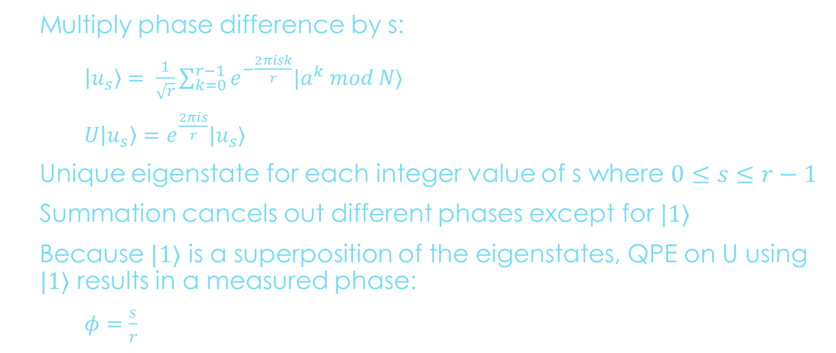
Generalizing to a Useful Eigenstate
Multiply phase difference by s:
$\left|u_{s}\right\rangle = \frac{1}{\sqrt{r}}\sum_{k=0}^{r−1}{e^{−\frac{2πisk}{r}}|a^{k} mod N⟩}$
$U\left|u_{s}\right\rangle =e^{\frac{2πis}{r}}|u_{s}⟩$
Unique eigenstate for each integer value of s where $0≤s≤r−1$
Summation cancels out different phases except for $|1⟩$
Because $|1⟩$ is a superposition of the eigenstates, QPE on U using $|1⟩$ results in a measured phase:
$φ=\frac{s}{r}$
Notes:
By multiplying by a phase difference s, we see several new behaviors emerge.
This achieves a unique eigenstate for each integer value of s, and summation collapses the state to 1.
Because 1 is a superposition of eigenstates, we can recover the phase using quantum phase estimation.
It’s worth noting that phi is s over r, but we can use the continued fractions algorithm to recover r.

Slide 6
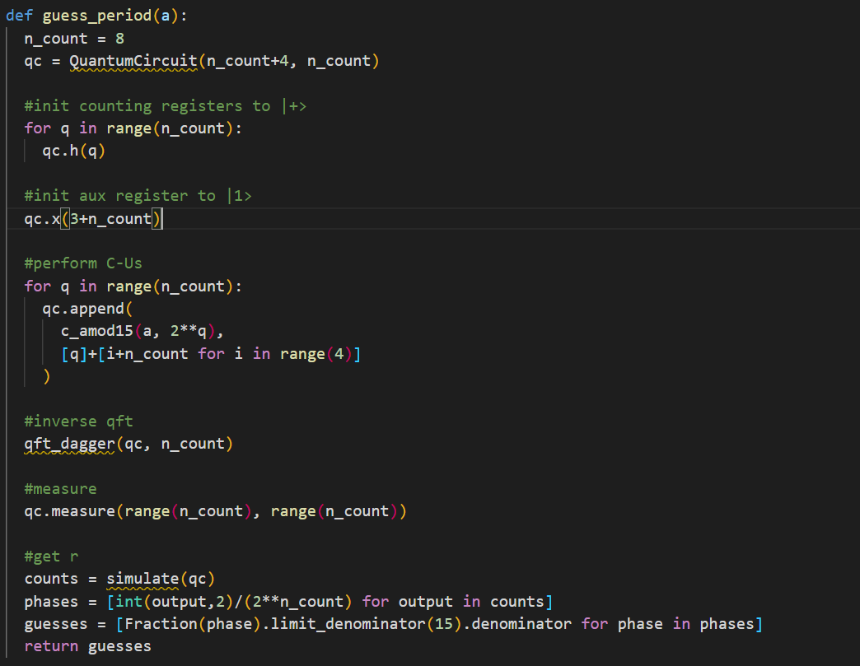
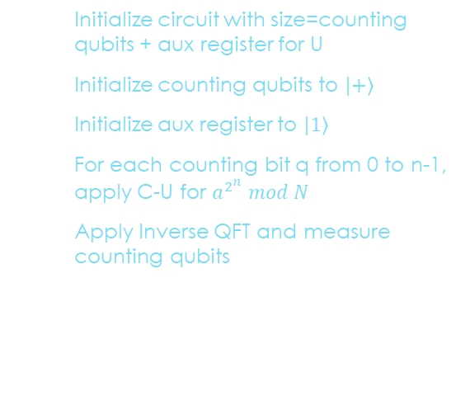
Quantum Period Finding steps
Initialize circuit with size=counting qubits + aux register for U
Initialize counting qubits to $|+⟩$
Initialize aux register to $|1⟩$
For each counting bit q from 0 to n-1, apply C-U for $a^{2^{n}} mod N$
Apply Inverse QFT and measure counting qubits
Notes:
Quantum Period Finding in a nutshell is simply
- taking a state in superposition,
applying a controlled rotation
then converting back from the Fourier basis to a computation basis
The last part of the code is just finding r from the fraction s over r.

Slide 7

Finding Factors of N
If $a^{r} mod N=1$
Then $\left(a^{r}−1\right) mod$ N = 0
N must divide $a^{r}−1$
Assume r is even
$a^{r}−1=\left(a^{\frac{r}{2}}−1\right)\left(a^{\frac{r}{2}}+1\right)$
Results in two probable factors
Notes:
Now that we have the tools to find the period, let’s talk about how we can use it.
We know that a to the r mod N equals 1, therefore subtracting one takes us to zero.
Because N divides a to the r minus one, we can calculate two numbers who share common factors with N.

Slide 8
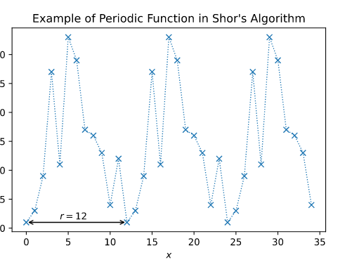
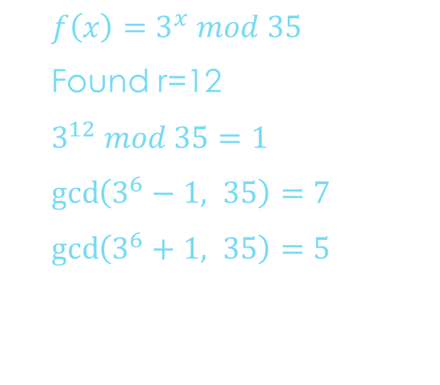

Example: $3^{x} mod 35$
$f\left(x\right)=3^{x} mod 35$
Found r=12
$3^{12} mod 35=1$
$\gcd\left(3^{6}−1, 35\right)=7$
$\gcd\left(3^{6}+1, 35\right)=5$
Notes:
For example, take a to be 3 and N to be 35. This graph shows marks the integer values of function a to the x mod N.
From the lowest points, it’s obvious that the result of the function is 12.
We then take calculate a to the r divided by 2 minus one, and apply the gcd function with N.

Slide 9
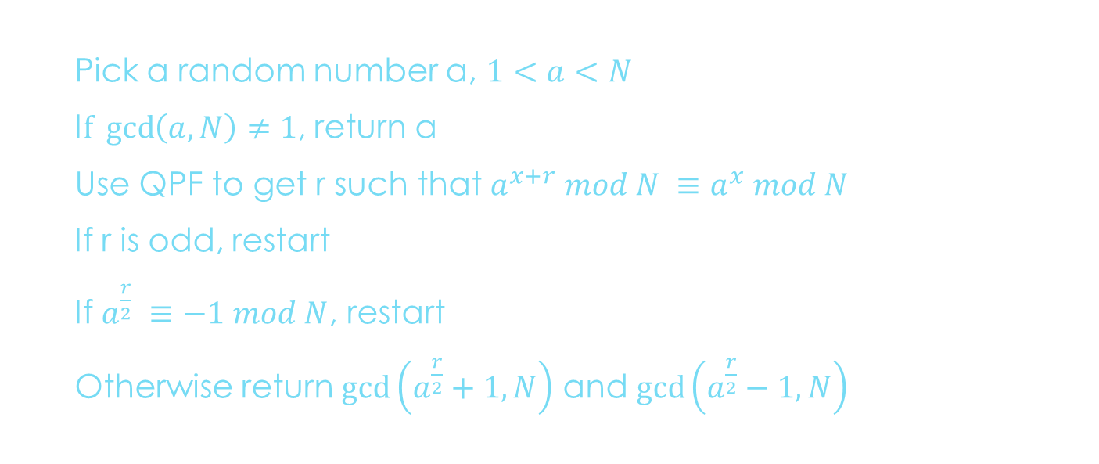
Shor’s algorithm
Pick a random number a, $1<a<N$
I$f \gcd\left(a,N\right)≠1$, return a
Use QPF to get r such that $a^{x+r} mod N ≡a^{x} mod N$
If r is odd, restart
If $a^{\frac{r}{2}} ≡−1 mod N$, restart
Otherwise return $\gcd\left(a^{\frac{r}{2}}+1, N\right)$ and $\gcd\left(a^{\frac{r}{2}}−1, N\right)$
Notes:
We know that if we can find r, we can get the factors of N.
AND we know if we can pick a good value for a, we can get r.
But it turns out that not every number works.
If r is odd, we can’t get an integer value for a to the r divided by 2 reliably.
And if half period a to the r over 2 is congruent to -1 mod N, we’re also in trouble.
Which means that, starting from a, it’s hard to know whether we’ll succeed.

Slide 10
Demo
https://arxiv.org/pdf/quant-ph/0607148.pdf
Notes:
Since Shor’s algorithm is highly random, it’s work taking the time to consider how that randomness might affect the runtime.
Interestingly, it turns out that for N greater than 2 to 11th power, the probability of a random a yielding usable factors is over 90%!
So the only thing stopping quantum computers from making RSA obsolete is the difficulty of working with large numbers of qubits and long circuits.
The largest number ever factored on a quantum computer is 35. RSA is safe, for now.

