Slide 1
GGH and Lattice Cryptography
BY Michael Needleman
Notes:
This is the 6th in a series of videos exploring the effect that quantum computers will have on modern cryptography.
In this video, I will be going over lattice cryptography, the GGH algorithm, and briefly discussing why GGH is considered to be “quantum resistant”.

Slide 2
Cryptography as a “Trapdoor”
Goal: A function that is easy to compute, but hard to invert
Given the correct information about the problem, it should be easy to recover the original inputs
Notes:
One of the more popular metaphors for cryptography is the trapdoor.
Ultimately, the goal is to create a function that will be easy to compute, or “fall through”, but difficult to undo.
Without some key information, it should be very difficult to get back through.

Slide 3
RSA in a Post-Quantum World
Based on modular exponentiation
Shor’s algorithm can theoretically break RSA very quickly
Notes:
As we explored in my previous videos, Shor’s algorithm presents an existential threat to RSA cryptography.
Because Shor’s algorithm can theoretically factor numbers much faster than classical algorithms, it’s only a matter of time before RSA be unable to protect information reliably.

Slide 4
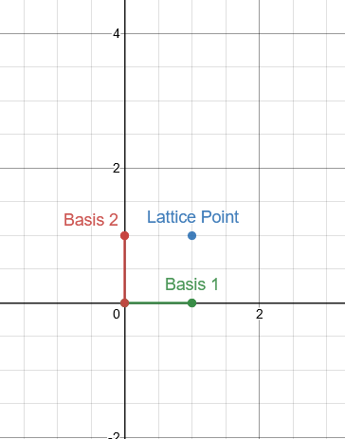

Introducing Lattices
Definition: An infinite set of repeating points in $ℝ^{n}$
Every lattice point in the grid is a linear combination of basic vectors with integer coefficients
Notes:
Because RSA, and all similar methods, aren’t sufficient, there’s a need to explore new kinds of trapdoors.
One such trapdoor function is based on the problems related to lattices.
A lattice is defined as an infinite set of repeating points, where each point is representable by a linear combination of basis vectors.
I

Slide 5
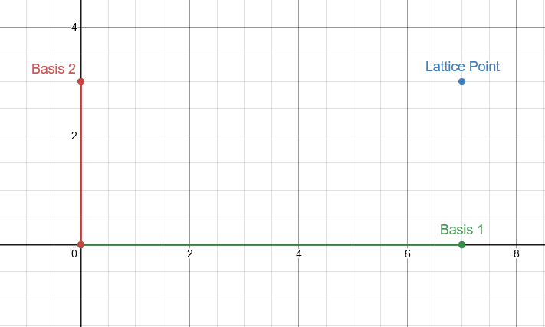
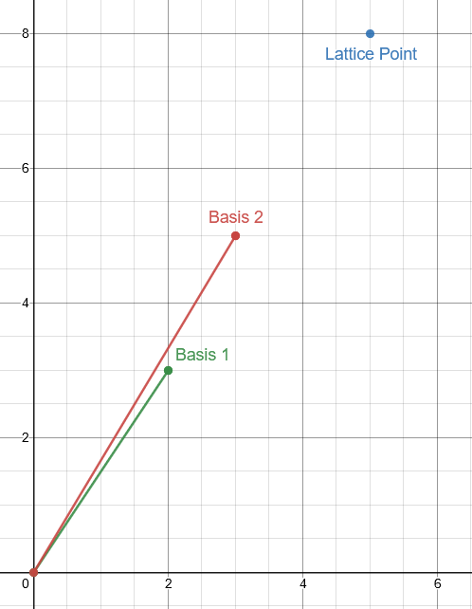

Orthogonality Defect Matters
Orthogonality defect
$D\left(B\right)=\frac{\prod_{i=1}^{n}{\left|\left|b_{i}\right|\right|}}{|\det\left(B\right|}$
Figure 1 (above): A low orthogonality defect lattice defined by $b_{1}=\left[7,0\right],b2=\left[0,3\right]$
Figure 2 (below) : A high orthogonality defect lattice defined by $b_{1}^{′}=\left[2,3\right], b_{2}^{′}=[3,5]$
Notes:
One of the more important attributes of these basis vectors is the orthogonality defect.
As you can see on the top left, the two basis vectors are highly orthogonal, and therefore have a low defect.
On the other hand, the bottom left shows two vectors that have a very high defect.

Slide 6
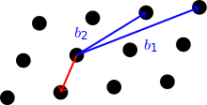
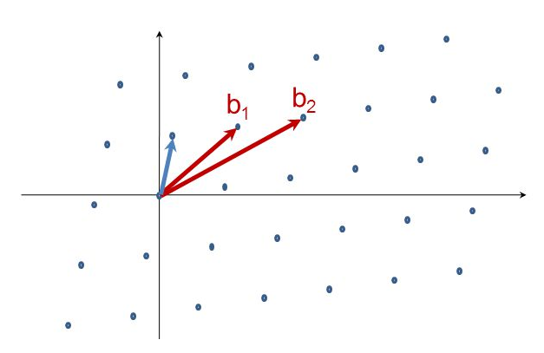
Hard Lattice Problems
Shortest Vector Problem (SVP)
Given a lattice L, find the shortest vector in L (i.e. closest to the origin)
Closest Vector Problem (CVP)
Given a lattice L and a point p, find the vector in L closest to p.
Basis Reduction
Given a lattice L, compute a basis with low orthogonality defect
Notes:
Because any point in the lattice is defined by a linear combination of the basis vectors, with integer coefficients, there are several problems that become very difficult to solve.
These will act as the trapdoor for this new, quantum resistant encryption scheme.
Though these three problems differ, it can be shown that by solving one, the other two become much simpler.

Slide 7
GGH Cryptosystem
CVP acts as a trapdoor
Private key is a low orthogonality defect integer lattice basis
Public key is a high orthogonality defect integer basis of the same lattice
Encryption:
1. Encode as lattice vector
2. Add small error vector
Decryption:
1. Find CVP (efficient with private key)
Notes:
GGH is a lattice-based cryptography scheme where both the public and private keys are sets of basis vectors for the same lattice.
What makes GGH effective is that the public key has a high orthogonality defect, which makes solving the Closest Vector Problem very expensive.
GGH works by encoding the message as a point in the lattice using the public key, with some built-in error.
Then the private key is used to solve the CVP very quickly.

Slide 8

Private Key Generation
Generation parameters $α, β, γ, σ$
Recommended: $α=4, β=\frac{1}{2},γ=α∗ceil\left(1+n^{β}\right), σ=3$
Matrix P has random, integer elements in the range $±α$
$P={\left\{−α,…,α\right\}}^{nxn}$
Private key is just P with $γ$ added to the diagonal entries
$R=P+γI$
Notes:
Like any encryption scheme, key generation is the vital.
GGH has recommended generation parameters of alpha, beta, gamma, and sigma.
Then the private key is built using random elements that follow the parameters.
One key point is that the resulting matrix has diagonal elements that are much higher than the non-diagonal elements.

Slide 9
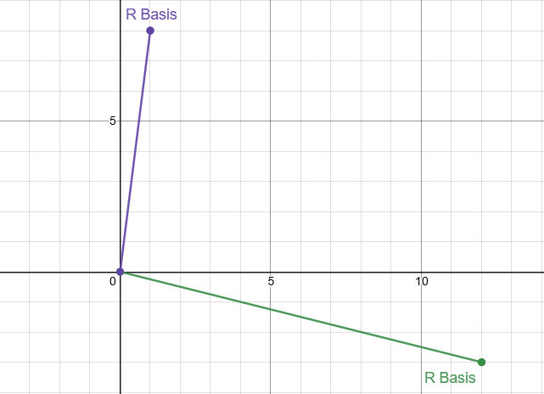

Private Key Example
Parameters:
$α=4,β=\frac{1}{2}$
$γ=α∗ceil\left(1+n^{β}\right)=12, σ=3$
$P= \left[\begin{matrix}0 & −3 \\ 1 & −3\end{matrix}\right]$
$R=P+γI= \left[\begin{matrix}12 & −3 \\ 1 & 8\end{matrix}\right]$
Notes:
Here we can see how the recommended parameters can produce a set of basis vectors that have a very low orthogonality defect.

Slide 10
Public Key Generation
Take R and apply multiple random elementary row operations (recommended 2n)
That way the public key, B, and R will be bases of the same lattice
L(R) = L(B)
Goal is to increase the orthogonality defect of B greatly
D(R) = D(B)
Notes:
Once we have the private key, we just need to modify it to create the public key.
By using elementary row operations, we ensure that the public key is still comprised of basis vectors that generate the exact same lattice.

Slide 11
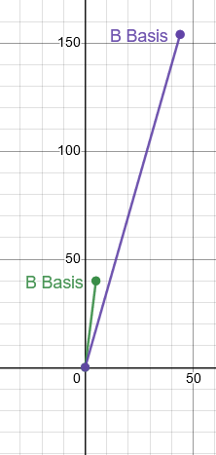

Public Key Example
$R=\left[\begin{matrix}12 & −3 \\ 1 & 8\end{matrix}\right]$
$R_{1}^{′}= \left[\begin{matrix}12 & −3 \\ 5 & 40\end{matrix}\right]$
$R_{2}^{′}=\left[\begin{matrix}22 & 77 \\ 5 & 40\end{matrix}\right]$
$R_{3}^{′}= \left[\begin{matrix}44 & 154 \\ 5 & 40\end{matrix}\right]$
$B=R_{4}^{′}= \left[\begin{matrix}5 & 40 \\ 44 & 154\end{matrix}\right]$
After 4 row operations, $B=\left[\begin{matrix}5 & 40 \\ 44 & 154\end{matrix}\right]$
Notes:
Using the same private key from earlier, and 4 randomly chosen row operations, the public key is generated.
As you can see, the orthogonality defect is drastically higher than the private key.

Slide 12
Comparing Key Orthogonality Defect
Above: The basis vectors of the private key R
Below: The basis vectors of the public key B
Notes:
Side-by-side, it becomes clear how the two keys differ.

Slide 13

Error Vector
Needs to be smaller than the nearest point to allow for a separate instance of the CVP
$e={\left\{±σ\right\}}^{n}$
Notes:
By adding an error vector to the mix, we ensure that the resulting values are not directly on the lattice, but instead are very close.
This error needs to be small, relative to the distance between points in the lattice. Otherwise, decryption will result in incorrect values.

Slide 14

Encryption and Decryption
Vector x is encrypted as a lattice point, plus error
$c=Bx+e$
Inverse of the private key is used with rounding to recover x
$x=R^{−1}×round\left(B^{−1}c\right)$
Notes:
Once the keys are generated, encryption and decryption are quick and simple. The public key is applied to the message, and the error vector is added in.
Then recovery is as simple as applying the inverse and rounding.

Slide 15


Example
Public Key $R=\left[\begin{matrix}12 & −3 \\ 1 & 8\end{matrix}\right]$, inverse $R^{−1}=\left[\begin{matrix}\frac{8}{99} & \frac{1}{33} \\ −\frac{1}{99} & \frac{4}{33}\end{matrix}\right]$
Private Key $B=\left[\begin{matrix}5 & 40 \\ 44 & 154\end{matrix}\right]$, inverse $B^{−1}=\left[\begin{matrix}−\frac{154}{990} & \frac{40}{990} \\ \frac{44}{990} & −\frac{1}{198}\end{matrix}\right]$
$B_{prime}=RB=\left[\begin{matrix}−72 & 18 \\ 357 & 1272\end{matrix}\right]$
Error vector $e=\left[1,−1\right]$
Message $m=\left[35,64\right]$
Encryption:
$c=B_{prime}m+e=\left[20329, 82037\right]$
Decryption:
$m=round\left({cB}^{−1}\right)R^{−1}=\left[35,64\right]$
Notes:
Here we can see how the same keys we generated earlier, along with their inverses, are used to encrypt and decrypt an example message.

Slide 16
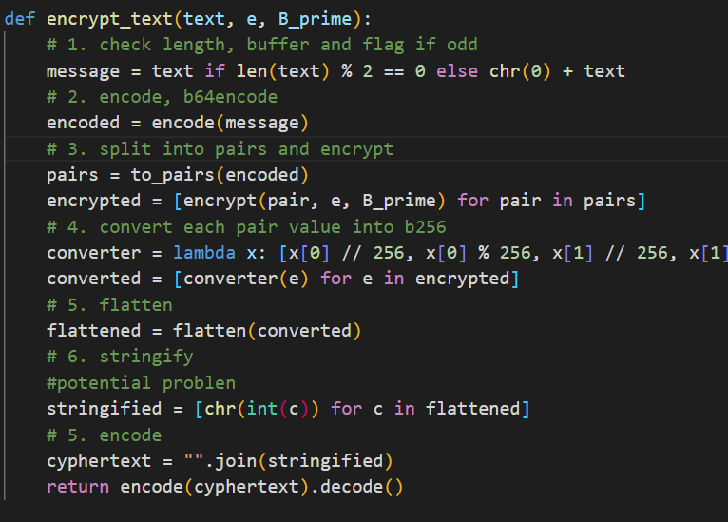
Bringing It All Together: Encoding
Many strategies for converting text to integer vectors and back
Need to consider how to convert large encrypted values to ascii values
Strategy:
Pad odd-length strings with null character
Encode in base 64 and encrypt ascii values
Split encrypted values into set number of digits in base 256
Convert to string
Notes:
As always, there is no real encryption without an encoding strategy. For this algorithm, I chose to split in the message into vectors the same size as my lattice dimensions.
With this method, there are some small steps that need to be taken to prepare the message, such as padding and encoding.

Slide 17

Demo

