Slide 1

Quantum Fast Fourier Transform
By MiCHAEL nEEDLEMAN
Notes:
This is the fourth in a series of videos exploring modern cryptography and the effects that quantum computers will have.
In this presentation we will look at the quantum version of the classical Fast Fourier Transform.
This is vital for understanding phase estimation, which is used in many quantum algorithms.

Slide 2

FFT Overview
In vector form: $y_{k}=\frac{1}{\sqrt{N}}\sum_{j=0}^{N−1}{x_{j}ω_{N}^{jk}}$
$ω_{N}^{jk}=e^{\frac{2πijk}{N}}$
Applied to a qubit:$|\left.x\right\rangle =\frac{1}{\sqrt{N}}\sum_{j=0}^{N−1}{x_{j}ω_{N}^{xy}|\left.y\right\rangle }$
In other words:
$|\left.State in Computational Basis\right\rangle \underset{→}{QFT} |\left.State in Fourier Basis\right\rangle$
Notes:
By normalizing the FFT, we can convert it into a vector form. This allows us to apply it to qubit states.

Slide 3

Counting in the Fourier Basis
$$QFT|\left.x\right\rangle =|\left.\tilde{x}\right\rangle$$
Notes:
TOP: Counting in binary
Bottom: Counting in Fourier basis
Note the frequency changes. Least significant qubit, qubit 0, has the smallest rotations and requires 16 rotations to complete a full circle. The most significant qubit, qubit 3, needs only 2

Slide 4

Implementation Gates
$I= \left[\begin{matrix}1 & 0 \\ 0 & 1\end{matrix}\right]$
$UROT_{k}= \left[\begin{matrix}1 & 0 \\ 0 & e^{\frac{2πi}{2^{k}}}\end{matrix}\right]$
$CROT_{k}= \left[\begin{matrix}I & 0 \\ 0 & UROT_{k}\end{matrix}\right]$
$CROT_{k}|\left.0x_{j}\right\rangle =|\left.0x_{j}\right\rangle$
$CROT_{k}|\left.1x_{j}\right\rangle =e^{\frac{2πi}{2^{k}}}x_{j}|\left.1x_{j}\right\rangle$
Notes:
Here are 3 important gates that are used in the quantum FFT.
The UROTk and CROTk gates perform the rotations necessary for each of k complex kth roots of units.

Slide 5
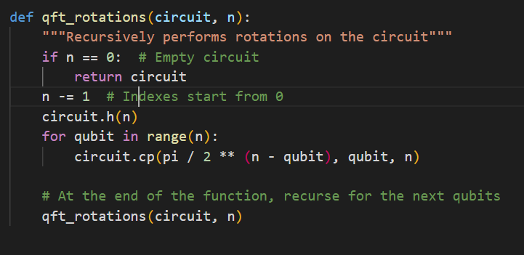
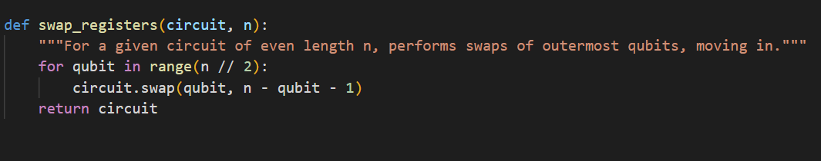
QFT Implementation in qiskit
Each qubit needs to be rotated to the correct position
Then pairs of least and most significant qubits need to be swapped
Because all quantum circuits are invertible, the inverse of the qft is as simple as ```qc.inverse()```
The complex conjugate transpose of any given gate is its own inverse
Notes:
For a quantum computer, the Fast Fourier Transform can be described in relatively few steps.
One of the major features of the quantum FFT is that the reversed circuit performs the inverse

Slide 6

Quantum phase estimation
Vital to many important quantum algorithms
Given the unary operator U, estimates $θ$ in $U\left|ψ\right\rangle =e^{2πiθ}|ψ⟩$
$|ψ⟩$ is an eigenvector and $e^{2πiθ}$ is the corresponding eigenvalue
Uses phase kickback to write the phase in the Fourier basis, then the inverse QFT to convert to a computational basis
Notes:
Quantum phase estimation is key to many quantum algorithms. It takes advantage of phase kickback, where performing controlled rotations in superposition applies a phase relative to the size of the rotation.
Because this phase is in the Fourier basis, the inverse QFT converts it back to a computational basis. This is akin to estimating the value of theta.

Slide 7
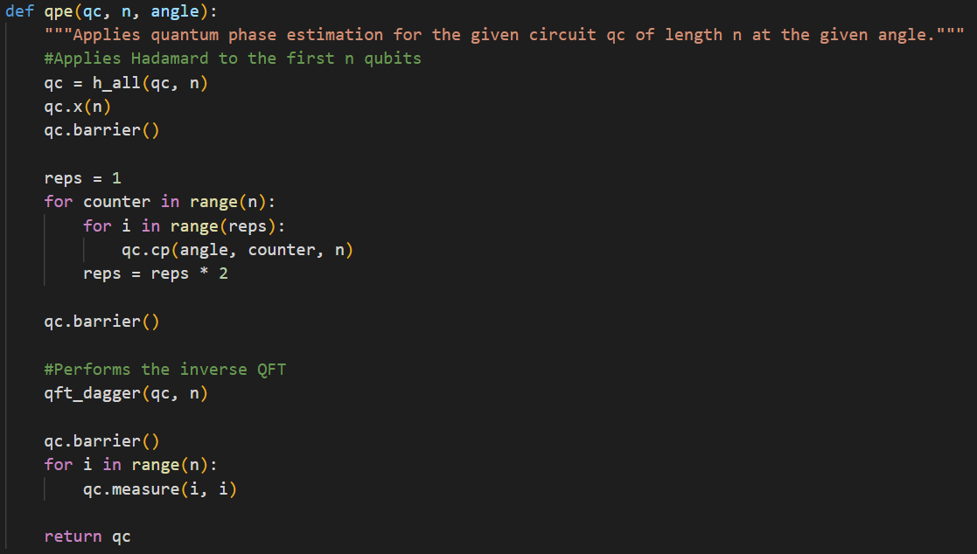

QPE Steps
1. $|ψ⟩$ is the input set of qubit registers. Additional n counting qubits needed to store $2^{n}θ$
$ψ_{0}={\left|0\right\rangle }^{⨂n}|ψ⟩$
2. Apply n-bit Hadamard on counting register
$ψ_{1}=\frac{1}{2^{\frac{n}{2}}}{\left(\left|0\right\rangle +\left|1\right\rangle \right)}^{⨂n}|ψ⟩$
3. Controlled Unitary C-U applies U to target only if control bit is $\left|1\right\rangle$
$ψ_{2}=\frac{1}{2^{\frac{n}{2}}}\sum_{k=0}^{2^{n}−1}{e^{2πiθk}|k⟩⨂|ψ⟩}$
4. Apply Inverse QFT and Measure
Notes:
By using the building blocks described earlier, the phase estimation algorithm takes just a handful of steps.
First we apply the input,
Then we put the inputs in superposition.
Then, after applying a series of controlled rotations to the auxiliary registers, the inverse QFT is applied to the counting registers and the phase is measured.

Slide 8

Example: T-gate
$T\left|1\right\rangle = \left[\begin{matrix}1 & 0 \\ 0 & e^{\frac{iπ}{4}}\end{matrix}\right]\left[\begin{aligned}0 \\ 1\end{aligned}\right]=e^{\frac{iπ}{4}}\left|1\right\rangle$
We expect $θ=\frac{1}{8}$ for $T\left|1\right\rangle =e^{2iπθ}|1⟩$

