Slide 1

RSA Cryptography
Michael Needleman
Notes:
First of several
Talking about the basic principles of cryptography
What is RSA and why does it work
How is it done

Slide 2
Principles for cryptosystems
Encryption
An encrypted body of text needs to be different from the original text
Authentication
Authorship of a body of text must be provable
Integrity
Given the correct information, the original text must be recoverable and unaltered
Non-Repudiation
Authenticity must not be deniable
Notes:
- 4 principles that define cryptography
- As we’ll see later on, steps 2 and 3 are where quantum attacks are focused

Slide 3

Evaluation of Cryptosystems
Key size
For a given text size n, how large is the key?
Vulnerability to known attacks
How expensive is it to break the system?
Computation time
How long does it take to generate the key(s) and encrypt/decrypt?
Flexibility
What kinds of data can the system work with?
Notes:
- How do we evaluate a cryptosystem?

Slide 4
Rsa as a public key cryptosystem
Inputs: 2 prime numbers
Outputs: public key P, secret key S, mod value n
Usage:
Encrypt: y = x^P mod n
Decrypt: x = y^S mod n
Notes:
As a public key cryptosystem, RSA generates both a public and secret key
We can encrypt using either the public or the secret key. If you use public to encrypt, then use secret to decrypt

Slide 5
Why Prime number inputs
Mod value n is composed of p and q
Integer factorization is very slow
For sufficiently large p and q, the time required is exponentially large

Slide 6
How does RSA Measure up?
Key Size
For a given p and q of equivalent size (Ex: 1024 bits), the resulting mod value n is 2x (Ex: 2048 bits)
The size of the public and secret keys, P and S, can vary
Vulnerability
Breaking RSA depends on factoring the semiprime mod value n
The largest semiprime factored (RSA-250, a 829-bit number) took ~2700 core-years of computation time
Neither the existence nor absence of an algorithm that can factor a b-bit number n in O(b^k) for some constant k has been proved
Classed NP, but not NP-complete
Computation Time
Key generation takes O(nlogn)
Encryption takes O(n^2)
Most time spent on key generation and encoding
Flexibility
Any data representable as integers

Slide 7
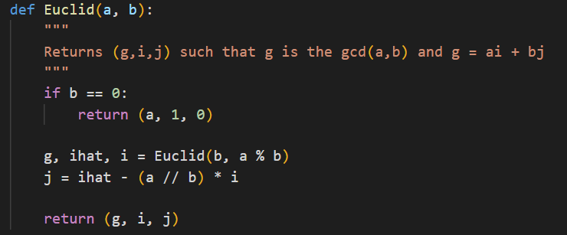
Implementation aids
We can use Euclid’s extended algorithm to look for relative primes

Slide 8
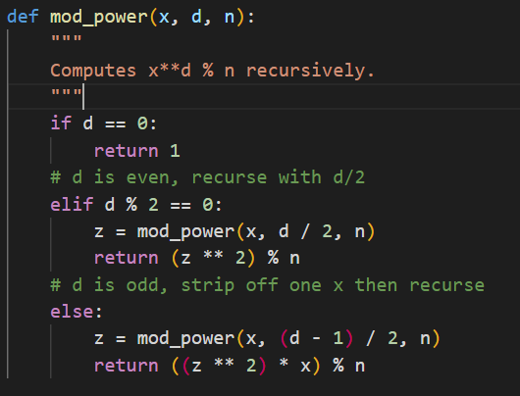
Implementation Aids (Cont’d)
Exponentiation is very expensive for large numbers
We can take advantage of properties of modular arithmetic

Slide 9
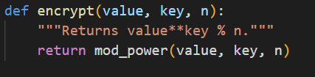
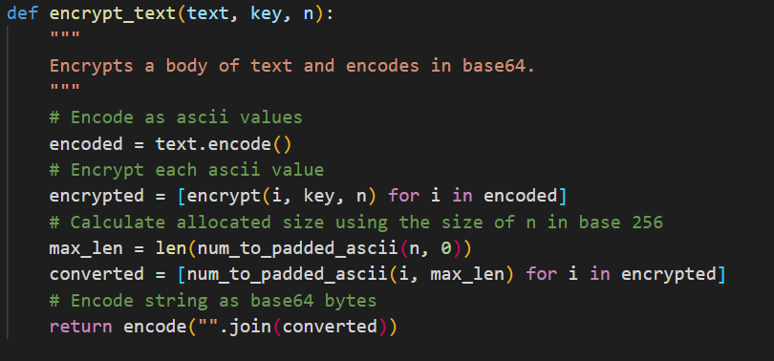
Implementation Aids (Cont’d)
Top: the actual encryption step
Bottom: encoding each character in a body of text and encrypting it

Slide 10
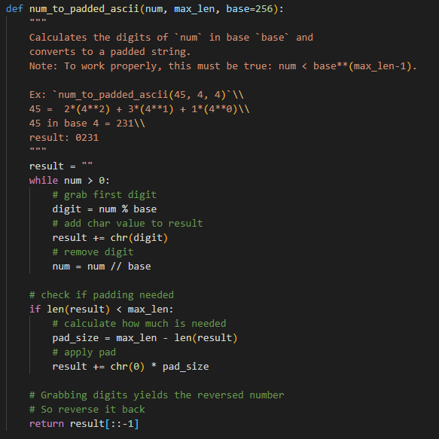
Implementation Aids (Cont’d)
ASCII values range from 0 to 256
Encrypted ASCII values will be MUCH bigger, so we need to encode them as evenly sized words

Slide 11
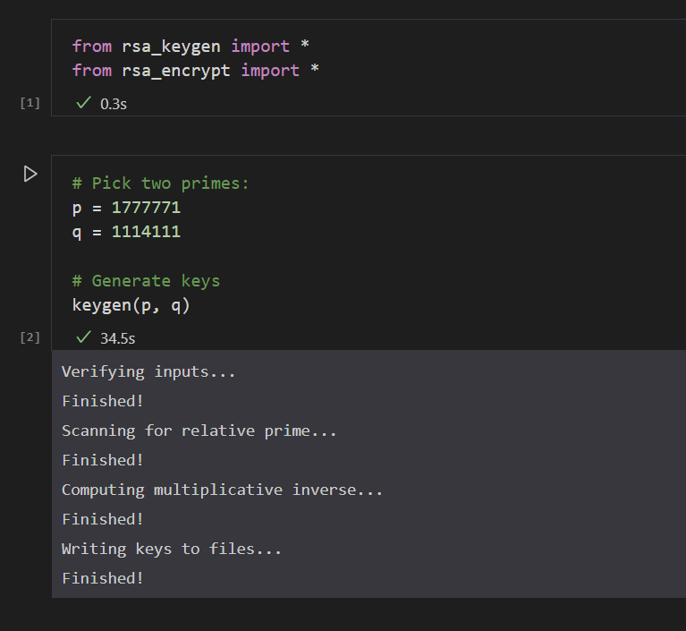
Example
1. Pick two primes as inputs to the key generation
2. Key generation verifies, then performs the RSA keygen algorithm to find a P, S, and N such that
FP(x,n) = x^P mod n
FS(x,n) = x^S mod n
FP( FS(x,n), n) = x

Slide 12
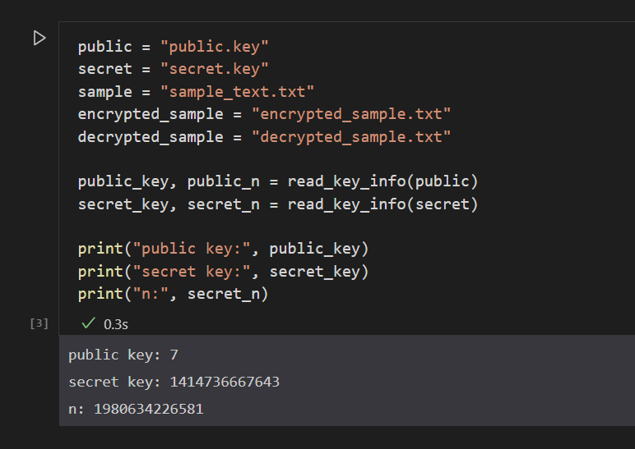
Example (Cont’d)
By opening the key files, we can see the current values of the public and secret keys
Both the public key and the secret key save the same value of n

Slide 13
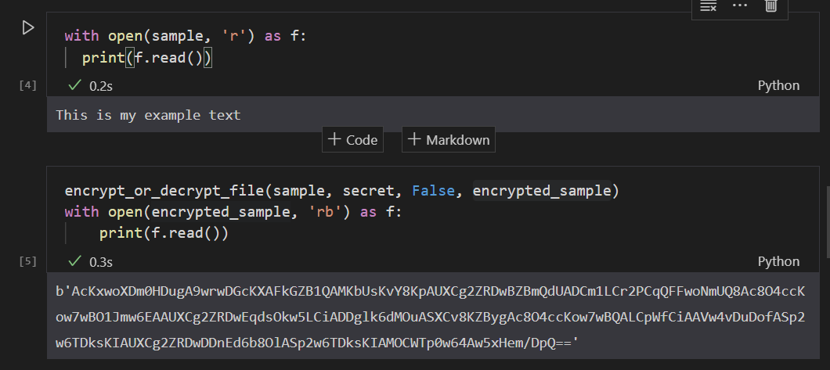
Example (Cont’d)
The first block shows the contents of the sample file
The second shows the encrypted version
Results are much larger than the original
Text must be converted to ASCII (0-255)
Encrypted ASCII is well outside the range

Slide 14
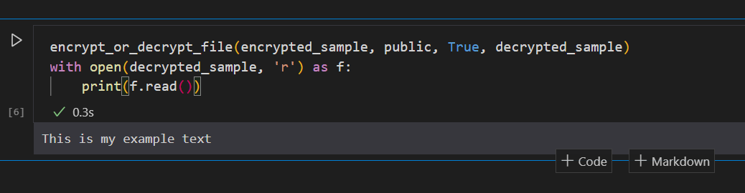
Example (Cont’d)
Regardless of how garbled the resulting encrypted file is, decrypting yields the original text

