Slide 1
    Apache Kafka
Dawid Marcinkowski

Slide 2
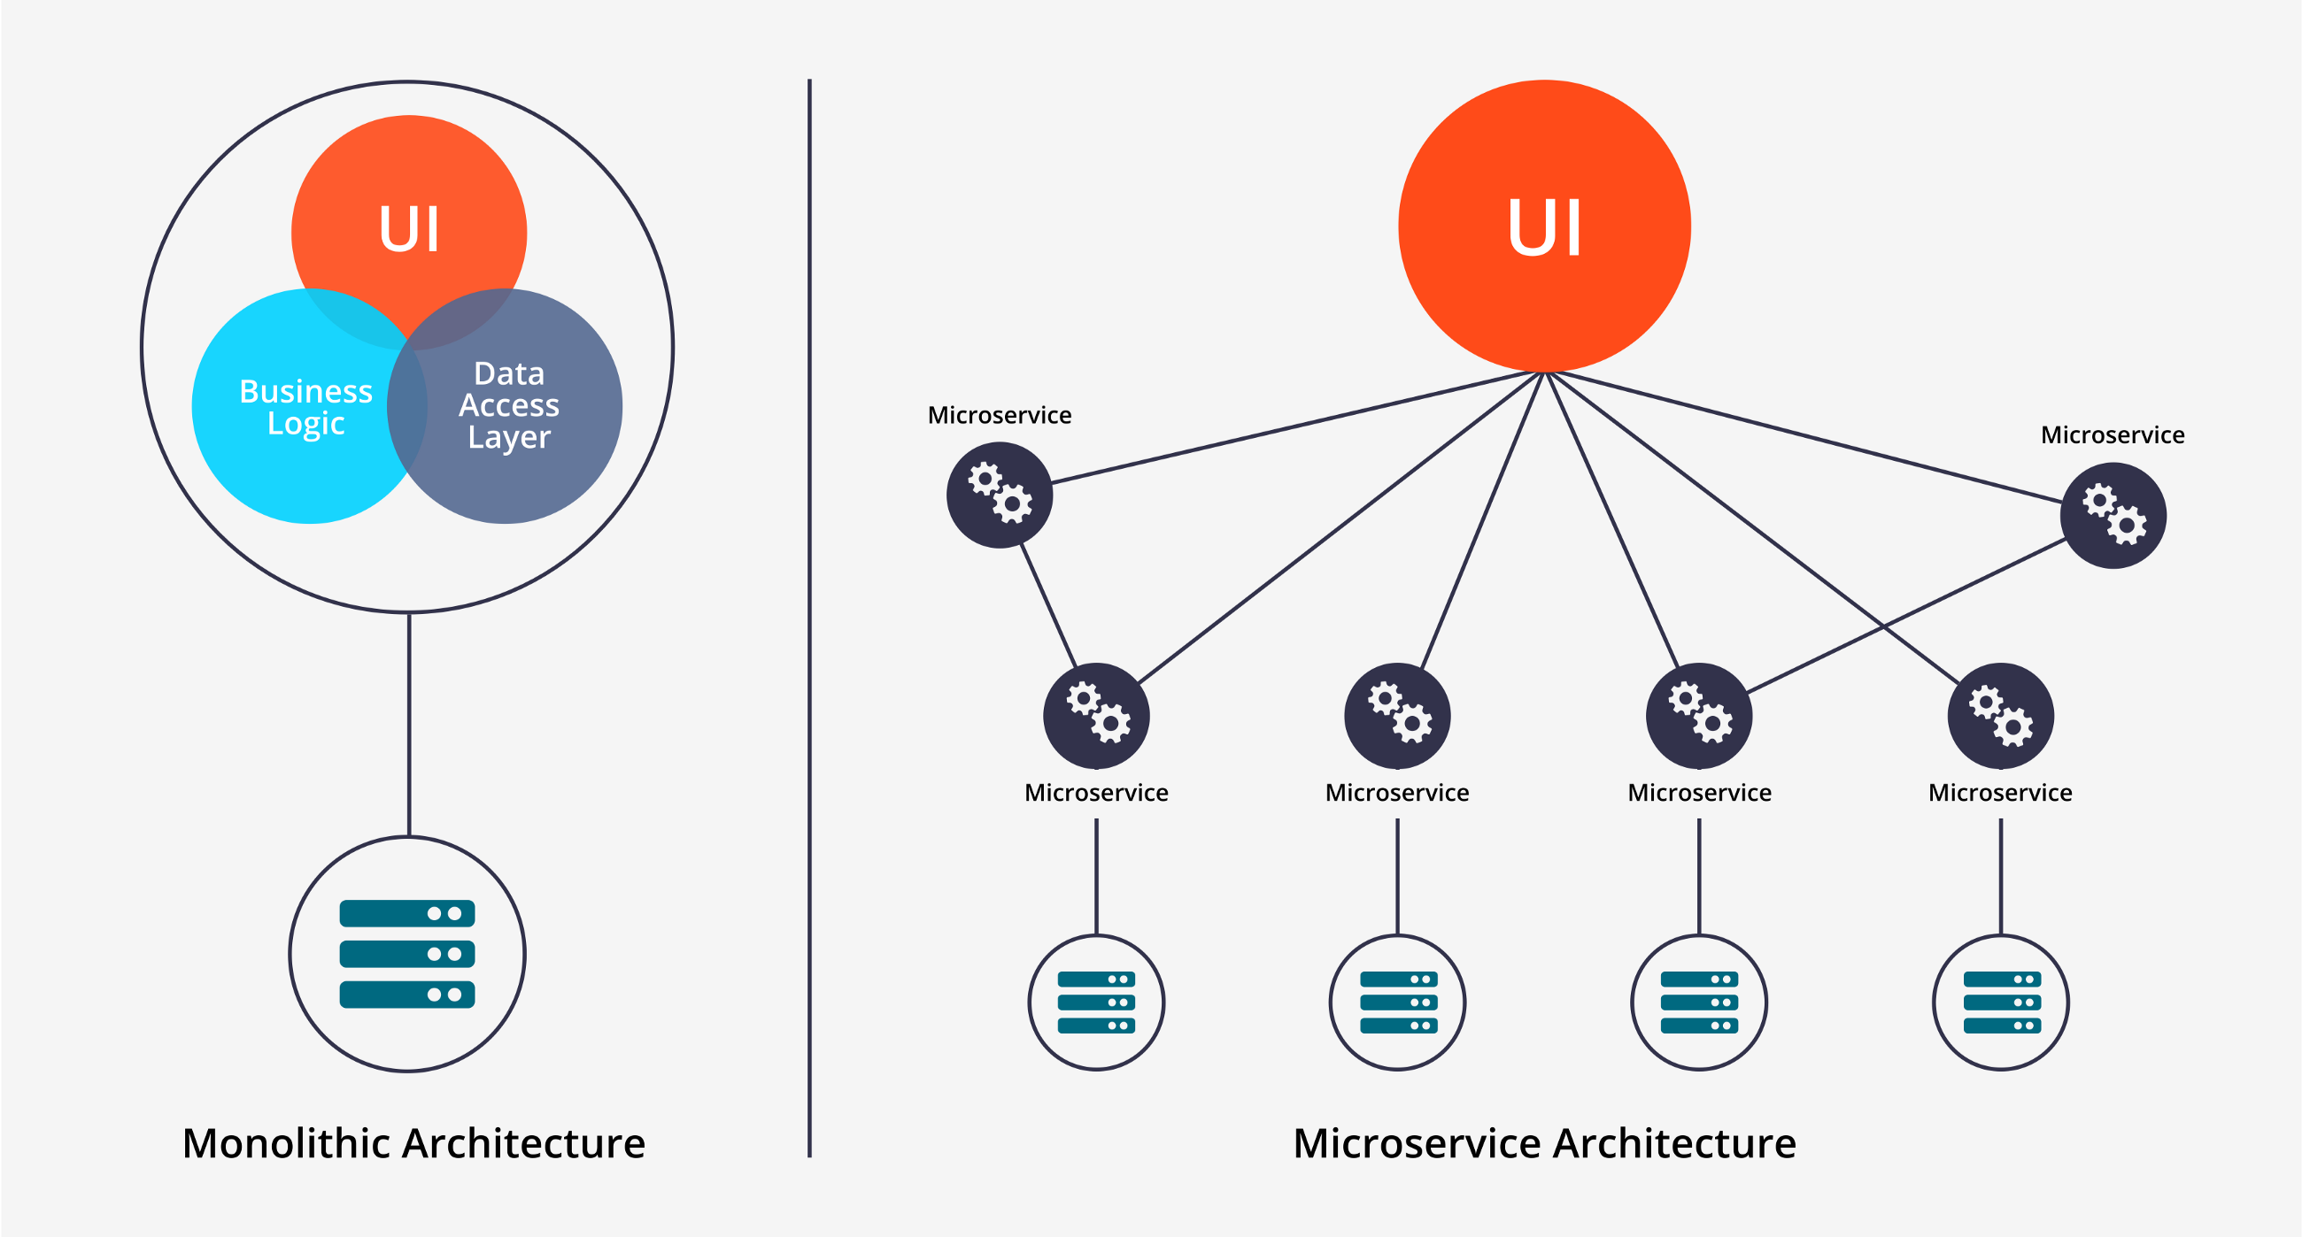
Microservice architecture

Slide 3
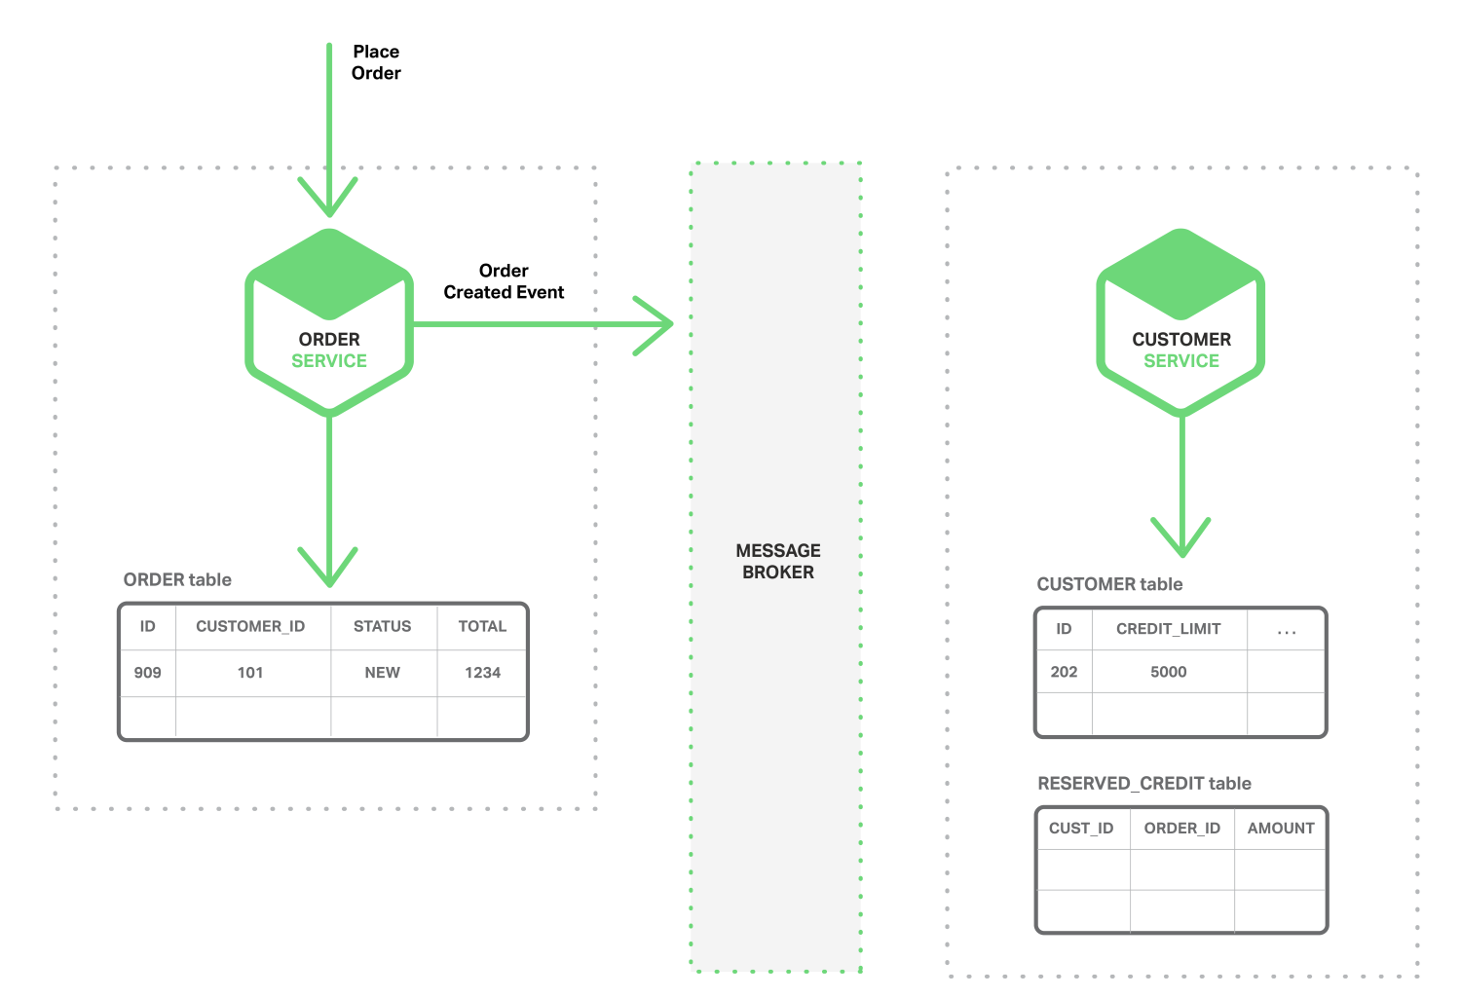
Event driven architecture

Slide 4

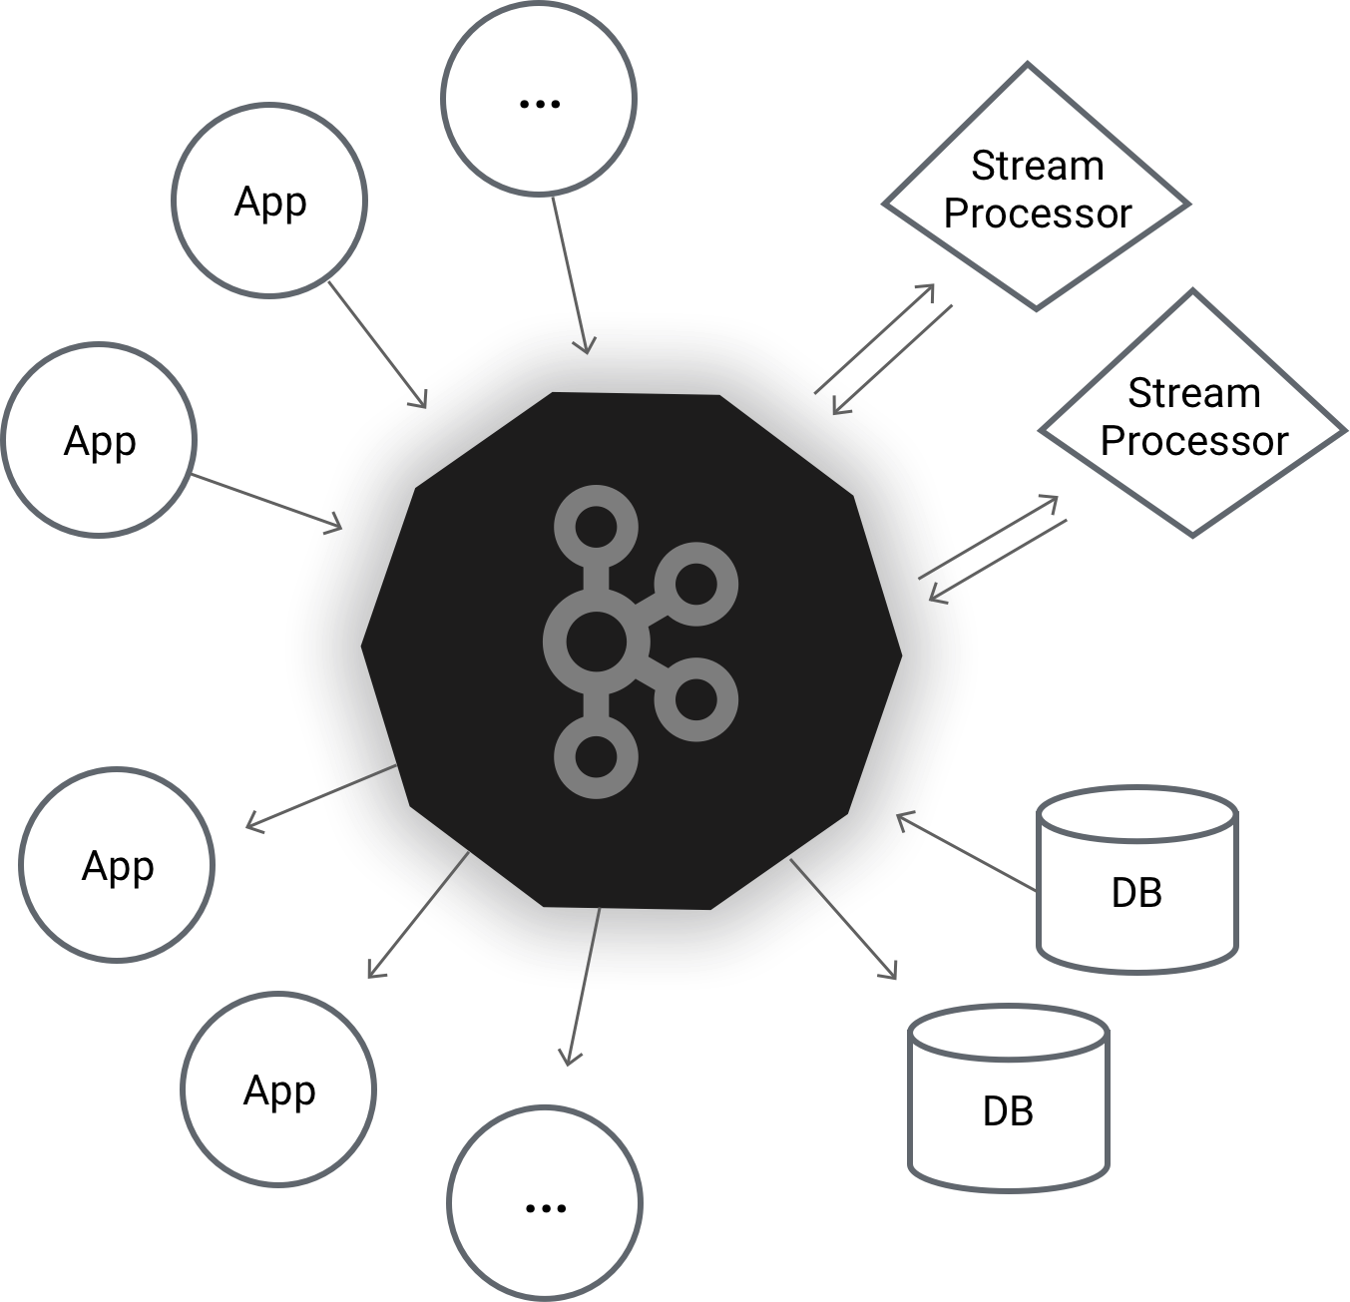
Apache Kafka is a distributed streaming platform

Slide 5




Eventual Consistency

Slide 6
Benefits
Distributed
Fault tolerance
Scalability
Performance
Kafka persists all data to the disk

Slide 7
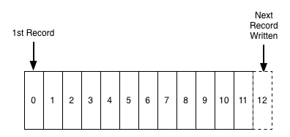
Commit log

Slide 8
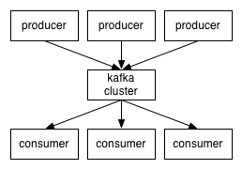
How does it work?

Slide 9
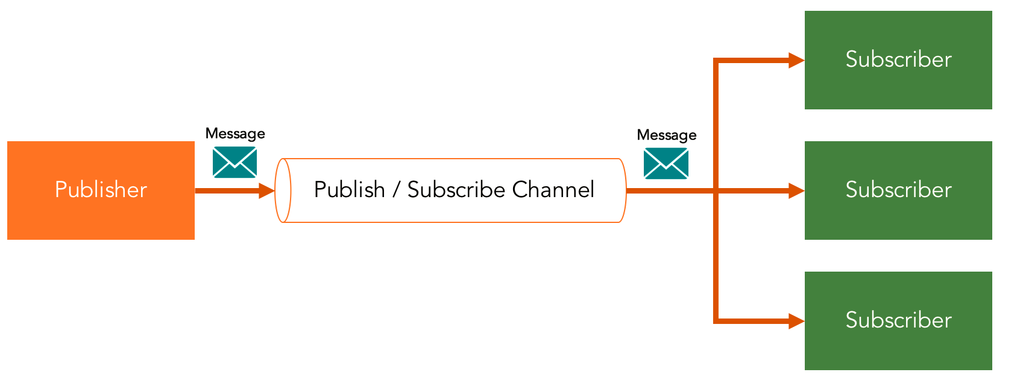
Publish-subscribe pattern
Consumers subscribe to topics to receive new messages

Slide 10

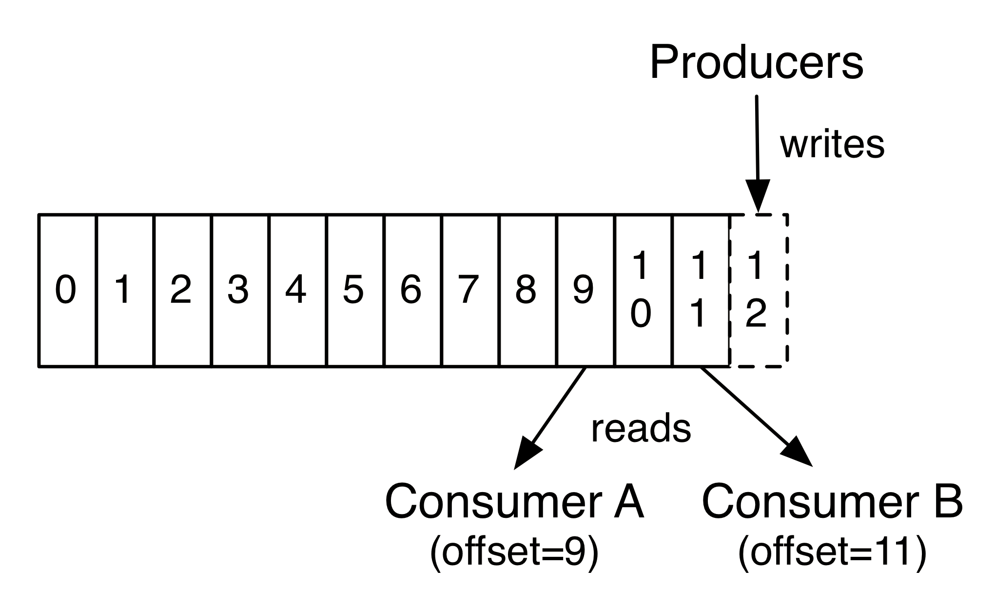
Topics and partitions
Topics are split into partitions.
Specific messages are distinguished by an offset.

Slide 11
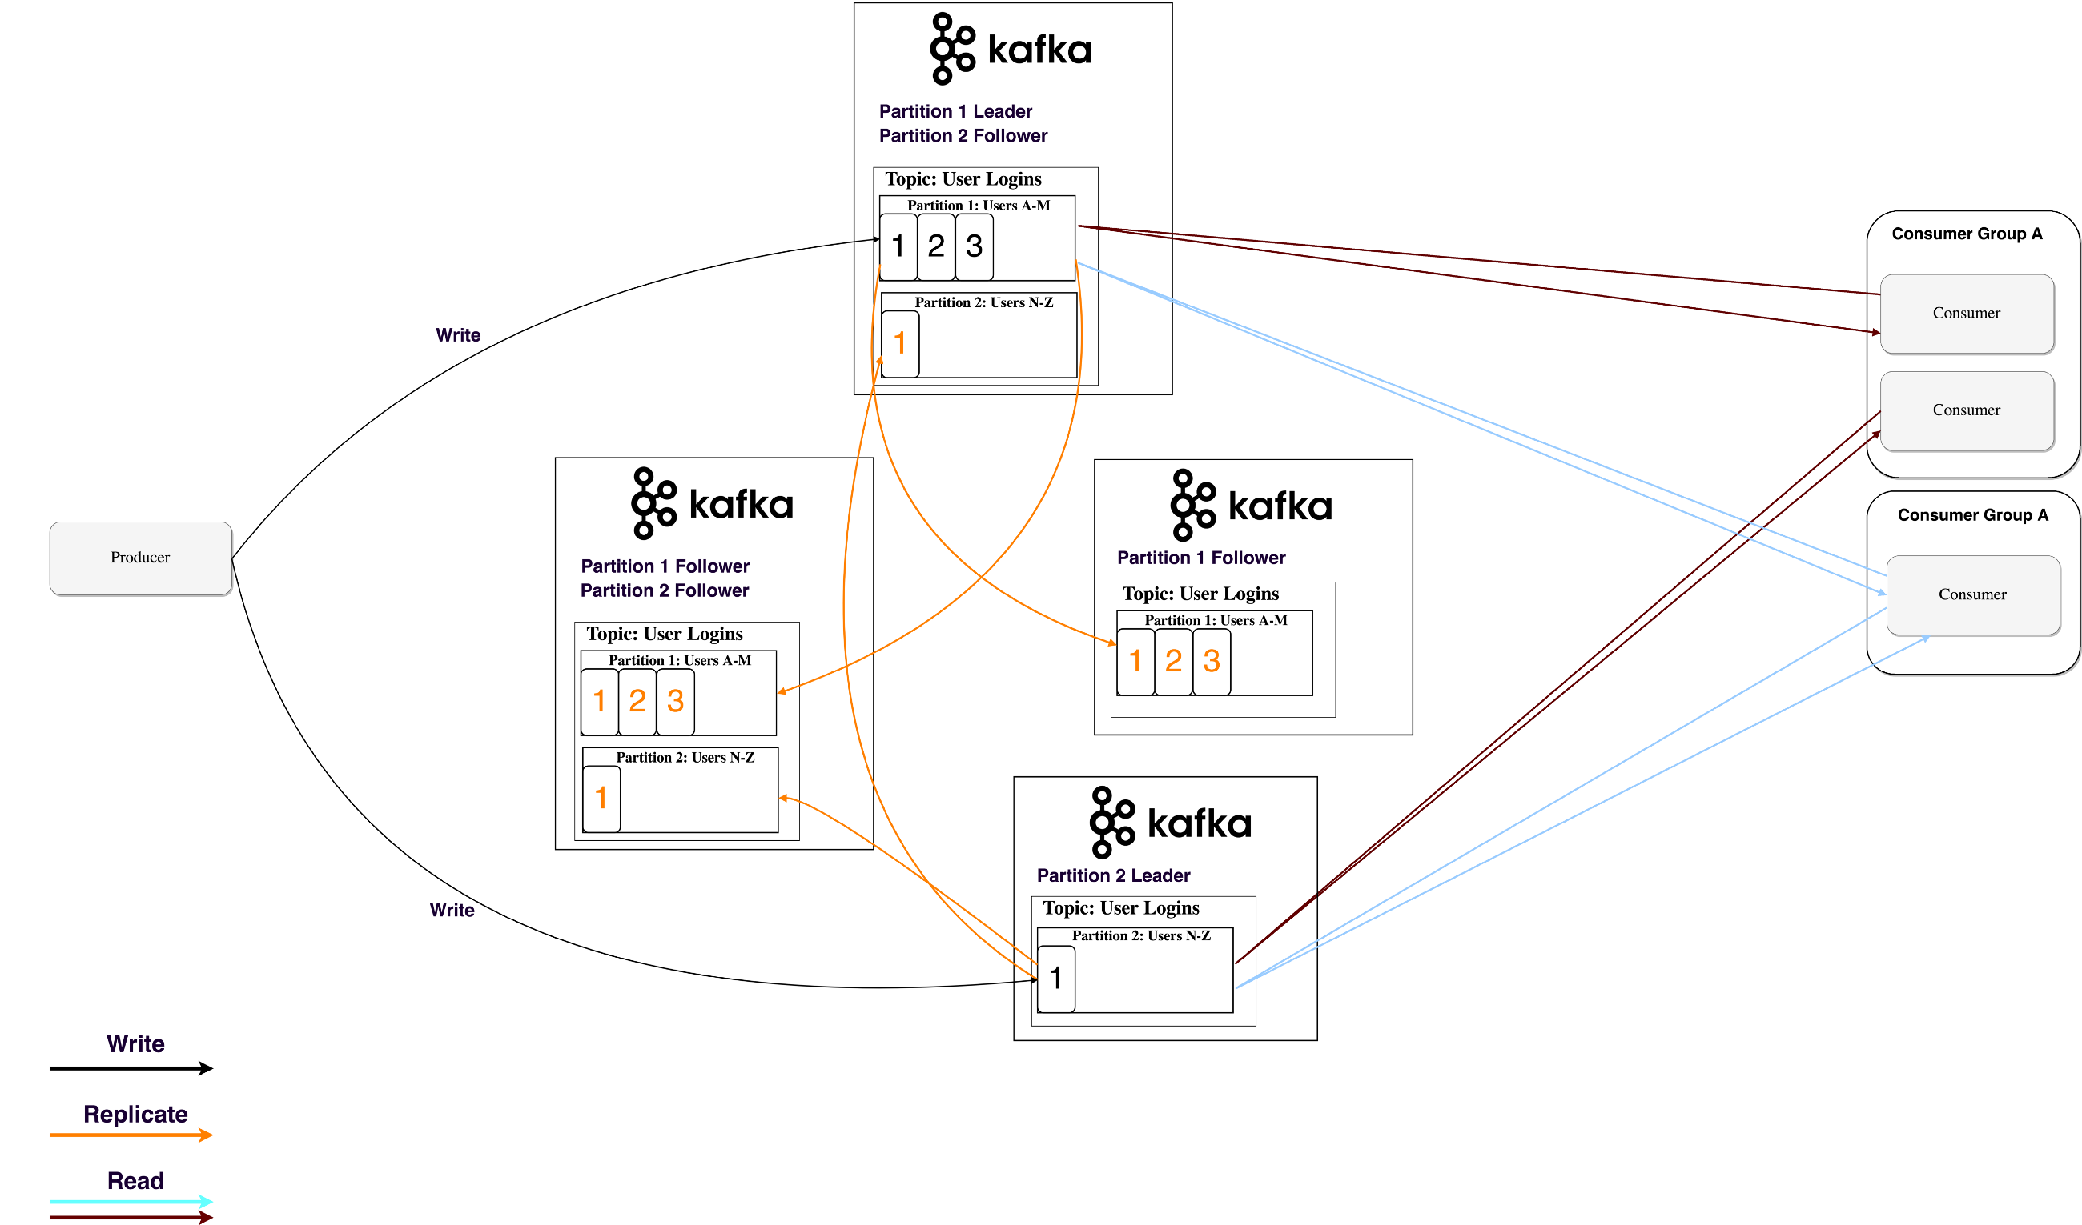
Data replication

Slide 12
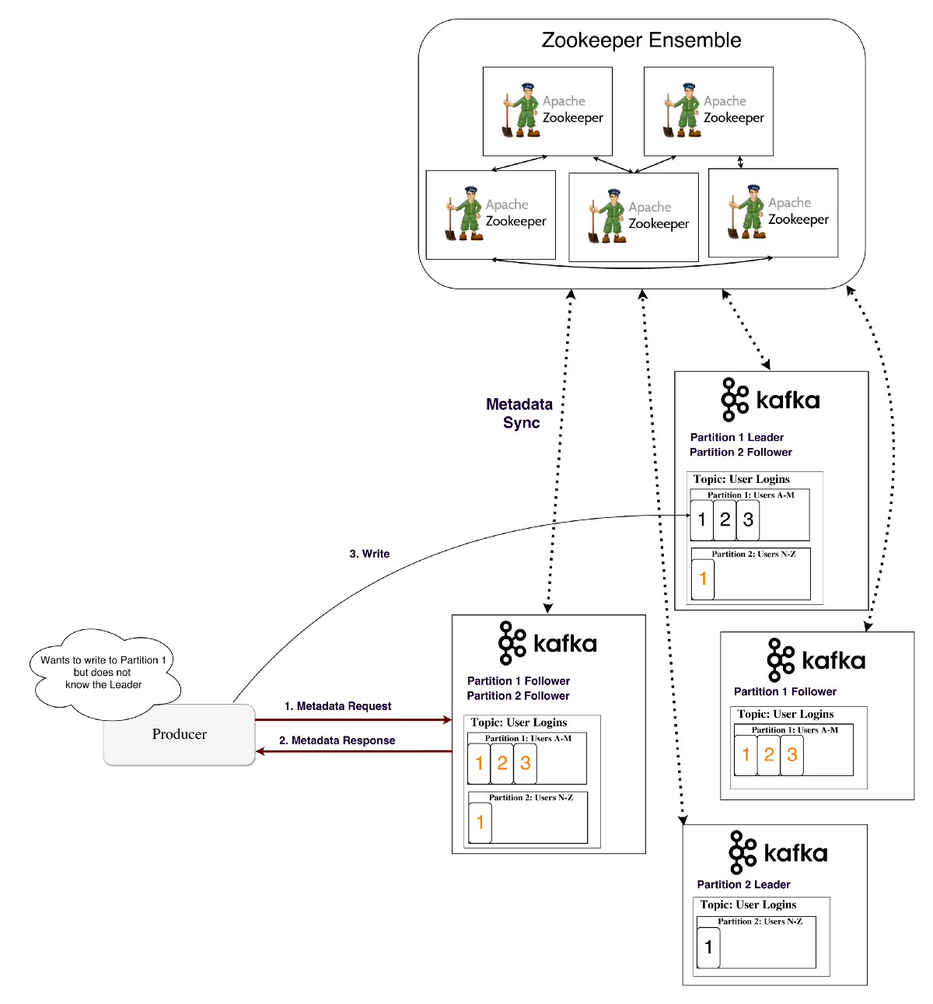

Slide 13
Message delivery guarantees
At-most-once
At-least-once
Exactly-once
Kafka
Producer
Consumer

Slide 14
At-most-once delivery
Restart at last saved offset on failure.
Messages are lost.
A
A
B
B
C
D
D
E
Save offset
Save offset
C has not been processed
Process
Failure
Process
Switch processes

Slide 15
At-least-once delivery
Messages are never lost but may be redelivered.
Producer
Leader
(X,Y)
(A,B)
(A,B)
Send (X,Y)
Append (X,Y)
ACK FAILED
Append (A,B)
Send (A,B)
ACK
Log
Produces retries – this can introduce duplicates

Slide 16
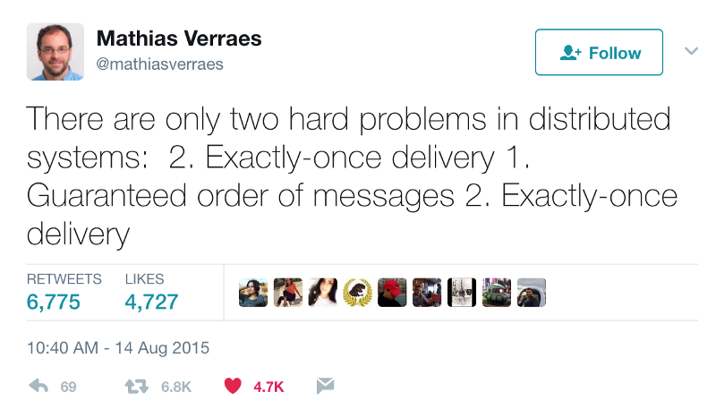

Slide 17
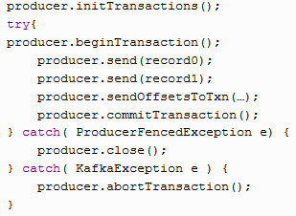
Exactly-once delivery
Idempotent producers
An idempotent operation is an operation that can be performed many times without causing a different effect than if the operation was only performed once.
Atomic transactions

Slide 18
Consumer isolation levels
Consumers can have either of two isolation levels:
read_commited
read_uncommited

Slide 19
Idempotent producer
Messages are never lost or redelivered.
Producer
Leader
(X,Y)
(A,B)
Send (X,Y)
Seq - 0
PID = 100
Append (X,Y)
Seq – 0
PID = 100
ACK FAILED
Append (A,B)
Seq – 1
PID = 100
ACK DUPLICATE
Send (A,B)
Seq - 1
PID = 200
ACK
Log
Message repeated, don’t append

Slide 20
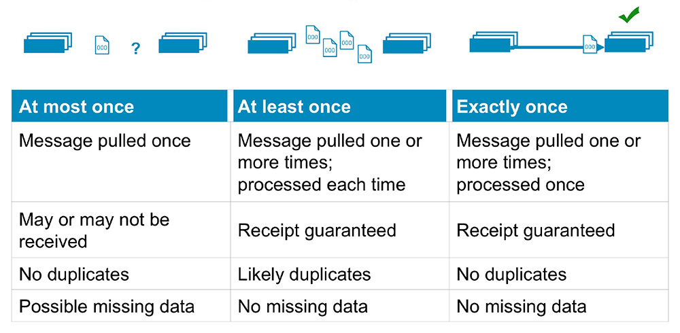
Message delivery semantics summary

Slide 21
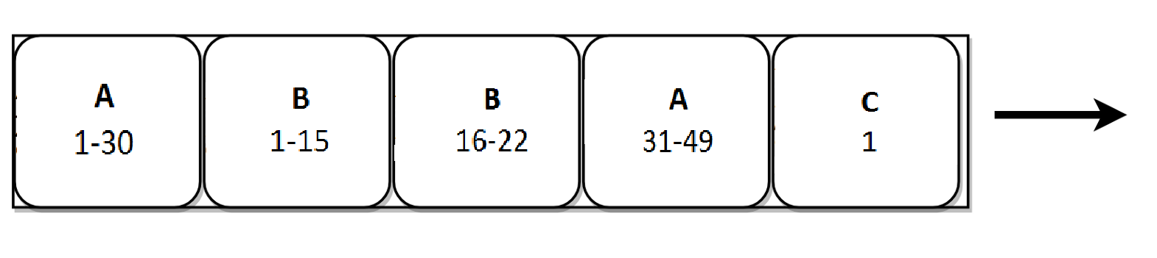
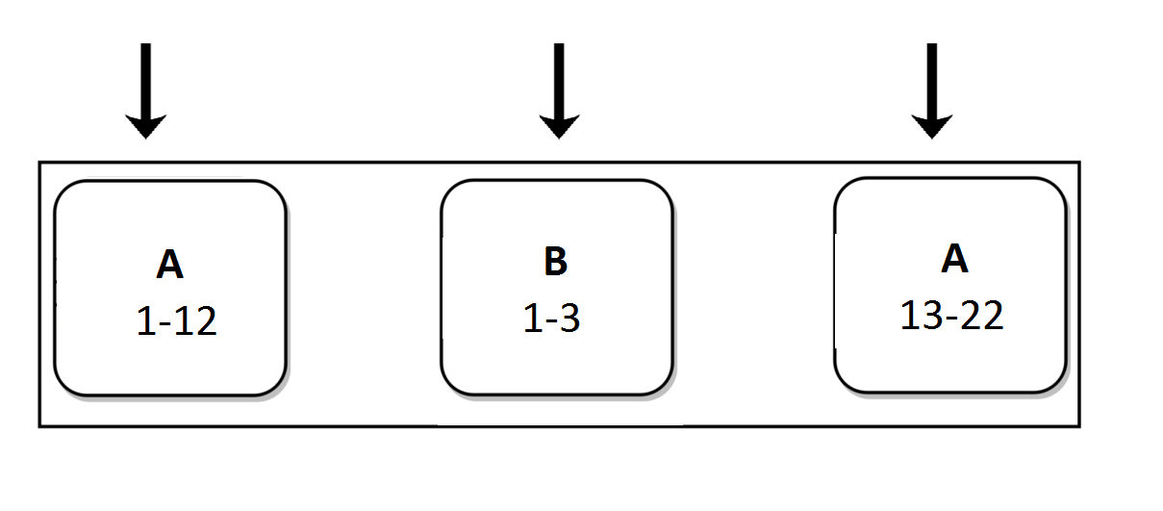
Kafka Streams
Stream can be interpreted as a table and vice versa.
Name | Size
A | 49
B | 22
C | 1
PUT( B, 3)
PUT( A, 10)
PUT( A, 12)
Name | Size
A | 12
B | 3
Name | Size
A | 22
B | 3
Name | Size
A | 12

Slide 22

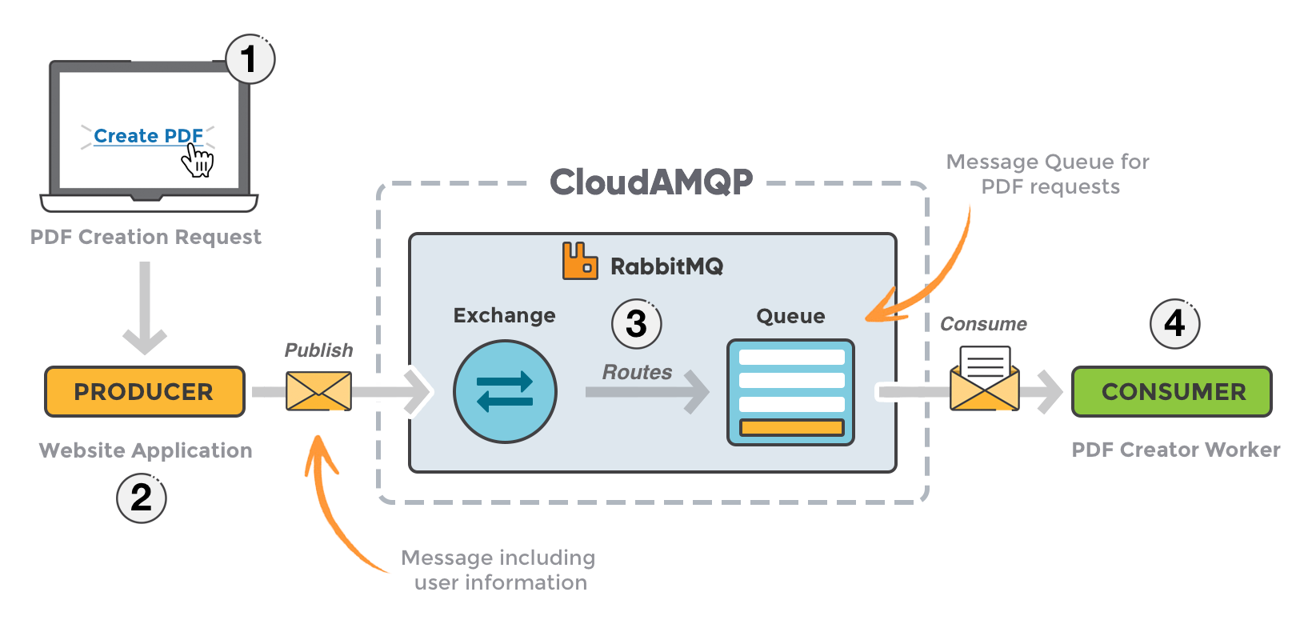
RabbitMQ
Message broker

Slide 23

Kafka vs RabbitMQ
Kafka | RabbitMQ
Dumb broker, smart consumer | Smart broker, dumb consumer
Kafka | RabbitMQ
Dumb broker, smart consumer | Smart broker, dumb consumer
Retains large amounts of data with very little overhead | Fastest when they’re empty (Lazy Queues)
Kafka | RabbitMQ
Kafka | RabbitMQ
Dumb broker, smart consumer | Smart broker, dumb consumer
Retains large amounts of data with very little overhead | Fastest when they’re empty (Lazy Queues)
Durable | Messages removed
Kafka | RabbitMQ
Dumb broker, smart consumer | Smart broker, dumb consumer
Retains large amounts of data with very little overhead | Fastest when they’re empty (Lazy Queues)
Durable | Messages removed
Multiple consumers on the same date | Single consumer at a time for a single queue
Low latency | Complex routing to customers
Only ships Java, but adapter SDK allows you to build your own system integration | Officially supports Java, Spring, .NET and many others (+community plugins)
Kafka | RabbitMQ
Dumb broker, smart consumer | Smart broker, dumb consumer
Retains large amounts of data with very little overhead | Fastest when they’re empty (Lazy Queues)
Durable | Messages removed
Multiple consumers on the same data | Single consumer at a time for a single queue
Kafka | RabbitMQ
Dumb broker, smart consumer | Smart broker, dumb consumer
Retains large amounts of data with very little overhead | Fastest when they’re empty (Lazy Queues)
Durable | Messages removed
Multiple consumers on the same data | Single consumer at a time for a single queue
Low latency | Complex routing to customers

Slide 24
Which one is “better”?

