Slide 1
Cybersecurity Incident Monitoring
and Threat Analytics Dashboard
A database-driven mini Security Operations Center
Python / MySQL / MongoDB / Streamlit
Adwaiy Gupta 25070126018
Aashi Agrawala 25070126003
Adrika Gupta 25070126016
Aditi Chitnis 25070126012
Symbiosis Institute of Technology, Pune
Department of Artificial Intelligence and Machine Learning
DCDSL project presentation
01
Notes:
Project evidence at commit 4bee733: https://github.com/DereFX/cybersecurity-incident-monitoring-dashboard
Files: README.md; output/report/Cybersecurity_Incident_Monitoring_Project_Report.docx

Slide 2
The cyber office problem
Two log exports arrive at the start of a shift.
Scattered evidence
Unclear ownership
Login failures and network flows sit in separate CSVs. Analysts search and copy records manually.
A suspicious event needs a case, an assigned analyst and a response history.
Duplicate investigations
The required outcome
Reimporting a file must not open the same incident again.
One traceable path from a source event to an alert, incident and documented response.
Illustrative office scenario
02
Notes:
Project evidence at commit 4bee733: https://github.com/DereFX/cybersecurity-incident-monitoring-dashboard
Files: Report chapter 2
The office story is an illustrative problem scenario, not a claim about an actual incident. SDG definitions: https://sdgs.un.org/goals/goal9 and https://sdgs.un.org/goals/goal16.

Slide 3
Datasets and provenance
Supplied quickstart CSV | Rows | Fields | Main evidence
Authentication events | 5,000 | 14 | User, time, IP, device, login result
Network flows | 4,444 | 40 | Packets, bytes, protocol, timing and flow counts
Representative development data
The supplied files follow RBA and UNSW-NB15 field concepts. They are not verbatim official benchmark records.
Authentication and network sources represent different environments. Matching IPs, users or times do not establish a shared organisation.
Source: docs/DATA_DICTIONARY.md and supplied dataset archive
03
Notes:
Project evidence at commit 4bee733: https://github.com/DereFX/cybersecurity-incident-monitoring-dashboard
Files: docs/DATA_DICTIONARY.md; config/dataset_mappings.py

Slide 4
System architecture and data flow
Stage | Python responsibility | Persistent result
1 Validate CSV | Detect schema, check identifiers and timestamps | Validated rows with source provenance
2 Store evidence | Normalise UTC times and preserve source fields | MongoDB security_events
3 Run detection | Authentication rules and network model inference | Standardised Python alerts
4 Persist alerts | Upsert by detection key | MongoDB security_alerts
5 Create cases | Map category and deduplicate incidents | MySQL incidents and audit entries
6 Respond | Assign, investigate, record actions and resolve | MySQL assignments and case history
Streamlit reads both databases. detection_key, source_dataset and event references link the evidence.
Source: etl/pipeline.py and database repositories
04
Notes:
Project evidence at commit 4bee733: https://github.com/DereFX/cybersecurity-incident-monitoring-dashboard
Files: etl/pipeline.py; database/mongo_repository.py; incidents/incident_service.py
MongoDB and MySQL do not share one transaction. Stable keys support retry-based recovery.

Slide 5
Why MySQL and MongoDB work together
MySQL
MongoDB
Stable operational records
Users, systems, incidents and assignments
Foreign keys and integrity constraints
Transactions for case and audit updates
Variable security evidence
Raw rows and normalised event envelopes
Nested alert evidence and event references
Per-file import history and aggregations
Trade-off: flexible evidence storage adds cross-store consistency work. There is no distributed commit.
Source: schema.sql, mongo_connection.py and repository code
05
Notes:
Project evidence at commit 4bee733: https://github.com/DereFX/cybersecurity-incident-monitoring-dashboard
Files: database/schema.sql; database/mongo_connection.py; database/mongo_repository.py
SQL can also store JSON logs. MongoDB is a modelling choice. MySQL relational constraints: https://dev.mysql.com/doc/refman/8.0/en/create-table-foreign-keys.html. MongoDB document modelling: https://www.mongodb.com/docs/manual/data-modeling/embedding/.

Slide 6
Relational schema and integrity
Table | Primary key | Relationship or integrity rule
users | user_id | Unique source and external user ID
systems | system_id | Optional owner FK and source-local endpoint ID
analysts | analyst_id | Active analyst flag and team
threat_categories | category_id | Unique category name and valid severity
incidents | incident_id | Nullable user/system FKs and unique detection_key
assignments | assignment_id | Incident and analyst FKs with response history
incident_audit_log | audit_id | Incident FK and chronological case actions
The design separates reusable entities and response history. A network endpoint is observed context, not confirmed internal ownership.
Source: database/schema.sql
06
Notes:
Project evidence at commit 4bee733: https://github.com/DereFX/cybersecurity-incident-monitoring-dashboard
Files: database/schema.sql
The schema has seven InnoDB tables. External identity uniqueness includes source_dataset. Network incidents can retain nullable user/system links.

Slide 7
MongoDB documents and file tracking
Synthetic event envelope
Events and alerts
{
"event_id": "SYN-DEMO-1",
"timestamp": "2026-10-24T09:00:00Z",
"source_dataset": "synthetic_demo",
"event_type": "authentication",
"user_id": "SYN-USER",
"authentication_result": "failure",
"raw_event": { ... },
"original_labels": { ... }
}
security_events preserves raw context. security_alerts stores generated evidence separately.
Upload registry
Filename plus SHA-256 identifies a file. ingestion_runs stores each attempt and its outcome.
Source inclusion
Exclude any legacy source or new CSV from charts and queries. Stored records remain intact.
Source: etl/models.py, upload_history.py and existing_sources.py
07
Notes:
Project evidence at commit 4bee733: https://github.com/DereFX/cybersecurity-incident-monitoring-dashboard
Files: etl/models.py; etl/upload_history.py; etl/existing_sources.py; ui/visibility.py
The JSON shown is an explicitly synthetic schema illustration, not a claimed real event. Inclusion switches filter analytics without deleting data.

Slide 8
Detection logic and incident creation
Detector | Default condition | Alert evidence
Repeated login failures | At least 5 failures in 5 minutes for one source-local user | High severity with the triggering events
Suspicious access | 3 IP/device combinations in 10 minutes of successful logins | Medium severity with origin and time context
Network classifier | Random forest score at or above 0.88 | Model version, probability and flow values
Every alert carries a stable detection key.
MongoDB and MySQL unique keys prevent repeat imports from creating duplicate alerts or cases. Dataset labels support evaluation rather than triggering detections.
Source: detection modules and IncidentService
08
Notes:
Project evidence at commit 4bee733: https://github.com/DereFX/cybersecurity-incident-monitoring-dashboard
Files: detection/failed_login.py; detection/suspicious_access.py; detection/ml_network.py; incidents/incident_service.py
The multi-origin rule counts IP/device combinations for successful logins. It emits at most one alert per source/user in a batch. Windows do not persist across uploads. Model probability threshold uses validation selection rather than a calibrated probability model.

Slide 9
Network recall improves on the supplied test split
Recall on 889 held-out rows
Test result | Rules | Model
True positives | 113 | 751
False negatives | 676 | 38
False positives | 16 | 0
True negatives | 84 | 100
95.18% recall
97.53% F1 score
38 attacks remain missed. These scores do not establish real-world generalisation or zero future false positives.
Source: models/network_classifier_metrics.json
09
Notes:
Project evidence at commit 4bee733: https://github.com/DereFX/cybersecurity-incident-monitoring-dashboard
Files: models/network_classifier_metrics.json; models/overfitting_audit.json
Same 889-row held-out quickstart split. Model features exclude label, attack_cat, IDs, timestamps and IPs. Rule baseline calculates statistical thresholds on the test batch. Saved RF metrics: {"rows":889,"true_positives":751,"false_positives":0,"false_negatives":38,"true_negatives":100,"accuracy":0.9572553430821147,"precision":1,"recall":0.9518377693282636,"f1":0.9753246753246754}. This is representative generated data. Development-only recall is 94.89% after overlap removal, using the same prototype generator.

Slide 10
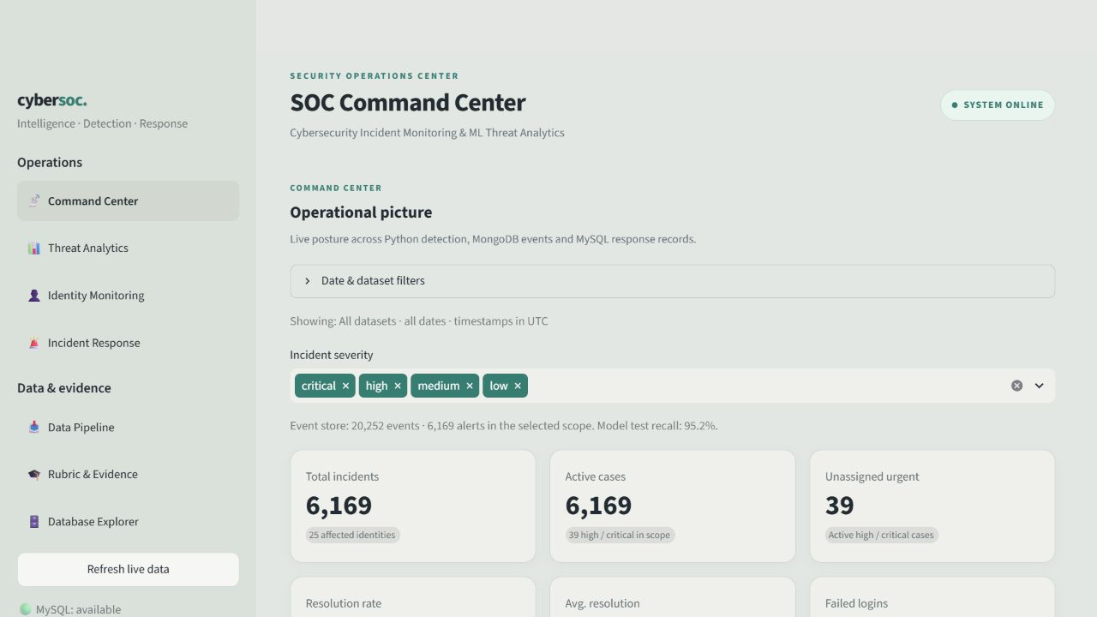
Dashboard monitoring and response
Seven views connect the case workflow.
Command Center
Threat Analytics
Identity Monitoring
Incident Response
Data Pipeline
Rubric and Evidence
Database Explorer
Case status, assignments and actions persist in MySQL. Source evidence remains retrievable from MongoDB.
Actual local dashboard screenshot, 24 October 2026
10
Notes:
Project evidence at commit 4bee733: https://github.com/DereFX/cybersecurity-incident-monitoring-dashboard
Files: app.py; pages/1_Threat_Analytics.py; pages/2_User_Device_Monitoring.py; pages/3_Incident_Management.py
Screenshot: tmp/report_build/dashboard.png. Captured all-source snapshot contained 20,252 events and 6,169 incidents including historical rule and newer model cases. Counts are not model test metrics.

Slide 11
ACID checks and Codd rule coverage
Observed transaction results
# | Relational principle | Project evidence or gap
0 | Relational foundation | MySQL case data through SQL
1 | Information in tables | Seven relational tables
2 | Guaranteed access | PK and column lookup checked
3 | Systematic NULL handling | Unknown user/system tested
4 | Queryable online catalogue | INFORMATION_SCHEMA queried
5 | Comprehensive data language | SQL DDL/DML/transactions only*
6 | Updatable views | Not demonstrated
7 | Set-level data changes | Set-based assignment updates
8 | Physical independence | Engine capability, not tested
9 | Logical independence | Not demonstrated
10 | Integrity independence | DB constraints reject bad writes
11 | Distribution independence | Not demonstrated
12 | No lower-level bypass | Direct SQL checks only*
A Atomicity
Injected failure before commit
Case stays open
0 assignments and 0 audit rows
C Consistency
Database rejects invalid severity 3819
Invalid foreign key 1216
Duplicate detection key 1062
I Isolation
Session B sees the old open status
FOR UPDATE NOWAIT returns 3572
Session A rollback releases the lock
D Durability check
Commit, close and reconnect
Assigned case, 1 assignment, 1 audit
flush_at_commit = 1; no crash test
MySQL 8.0.46, InnoDB
REPEATABLE READ, sync_binlog = 1
Synthetic fixture removed after verification
* Partial evidence. Full Codd compliance and crash recovery are not established.
Live synthetic MySQL proof on 24 October 2026. Scope excludes cross-store atomicity.
11
Notes:
Project evidence at commit 4bee733: https://github.com/DereFX/cybersecurity-incident-monitoring-dashboard
Files: tmp/ppt_build/verify_acid.py; tmp/ppt_build/acid_evidence.json; database/mysql_connection.py; incidents/assignment_service.py
Actual checks: {
"checked_at_utc": "2026-10-24T15:23:29.974678+00:00",
"source_dataset": "synthetic_acid_proof_07ad96061a8f401d85ed75bf26114a70",
"scope": "MySQL only; synthetic fixture; no server restart or cross-store atomicity test",
"checks": {
"atomicity": {
"passed": true,
"case_status": "open",
"assignments_after_rollback": 0,
"audits_after_rollback": 0
},
"consistency": {
"passed": true,
"rejected_error_codes": {
"check": 3819,
"foreign_key": 1216,
"unique": 1062
}
},
"isolation": {
"passed": true,
"second_session_read": "open",
"conflicting_lock_error": 3572
},
"durability": {
"passed": true,
"new_connection_status": "assigned",
"assignment_count": 1,
"audit_count": 1,
"flush_at_commit": 1,
"limit": "Commit survives connection close and reopen. Crash/power-loss recovery was not tested."
},
"codd_evidence": {
"pk_access": true,
"systematic_nulls": {
"unknown_user": 1,
"unknown_system": 1
},
"catalog_relations": 3,
"constraints_independent_of_python": {
"check": 3819,
"foreign_key": 1216,
"unique": 1062
}
}
},
"fixture_incident_id": 6189,
"server": {
"version": "8.0.46",
"isolation_level": "REPEATABLE-READ",
"flush_at_commit": 1,
"sync_binlog": 1
},
"engine": [
{
"TABLE_NAME": "assignments",
"ENGINE": "InnoDB"
},
{
"TABLE_NAME": "incident_audit_log",
"ENGINE": "InnoDB"
},
{
"TABLE_NAME": "incidents",
"ENGINE": "InnoDB"
}
],
"cleanup": {
"synthetic_incidents_remaining": 0
}
}
Reproduce from repository root with .\.venv\Scripts\python.exe tmp/ppt_build/verify_acid.py. The script creates and cleans only uniquely marked synthetic rows. It never restarts a database service.
ACID implementation references: https://dev.mysql.com/doc/refman/8.0/en/mysql-acid.html and https://dev.mysql.com/doc/refman/8.0/en/innodb-parameters.html. NOWAIT: https://dev.mysql.com/doc/refman/8.0/en/select.html.
Codd original 1985 rules reprint: https://reldb.org/c/index.php/twelve-rules/. This is project-level evidence, not certification of MySQL as a fully relational DBMS. Rule 5 includes view definition and authorization in its full definition, not established here. Rule 12 requires low-level non-subversion, beyond the direct SQL check demonstrated.
Full runnable proof source:
"""Isolated live MySQL transaction demonstration for the project presentation.
Creates uniquely marked synthetic rows, checks the real transaction wrapper,
and deletes only rows created by this run. Never restarts database services.
"""
from pathlib import Path
from uuid import uuid4
from datetime import datetime, timezone
import hashlib
import json
import sys
ROOT=Path(__file__).resolve().parents[2]
sys.path.insert(0,str(ROOT/'ml_version'))
from config.settings import Settings
from database.mysql_connection import MySQLDatabase
from incidents.assignment_service import AssignmentService
from mysql.connector import Error
db=MySQLDatabase(Settings.from_env(),pool_size=4)
source='synthetic_acid_proof_'+uuid4().hex
key=hashlib.sha256(source.encode()).hexdigest()
incident_id=analyst_id=None
result={'checked_at_utc':datetime.now(timezone.utc).isoformat(),'source_dataset':source,
'scope':'MySQL only; synthetic fixture; no server restart or cross-store atomicity test', 'checks':{}}
def query(sql,params=()):
with db.connection() as connection:
cursor=connection.cursor(dictionary=True)
try:
cursor.execute(sql,params)
return cursor.fetchall()
finally:
connection.rollback();cursor.close()
class InjectedFailure(RuntimeError):pass
try:
with db.transaction() as connection:
cursor=connection.cursor()
cursor.execute("SELECT category_id FROM threat_categories ORDER BY category_id LIMIT 1")
category=cursor.fetchone()[0]
cursor.execute("INSERT INTO analysts(name,role,team) VALUES(%s,'demonstration','synthetic ACID proof')",(source,))
analyst_id=cursor.lastrowid
cursor.execute("""INSERT INTO incidents(category_id,incident_time,severity,description,status,detected_by,
source_dataset,detection_key) VALUES(%s,UTC_TIMESTAMP(6),'high','SYNTHETIC ACID DEMONSTRATION',
'open','synthetic_acid_proof',%s,%s)""",(category,source,key))
incident_id=cursor.lastrowid
cursor.close()
result['fixture_incident_id']=incident_id
result['server']=query("SELECT @@version AS version, @@transaction_isolation AS isolation_level, @@innodb_flush_log_at_trx_commit AS flush_at_commit, @@sync_binlog AS sync_binlog")[0]
engines=query("SELECT table_name,engine FROM information_schema.tables WHERE table_schema=DATABASE() AND table_name IN ('incidents','assignments','incident_audit_log')")
assert len(engines)==3 and all(row['ENGINE']=='InnoDB' for row in engines)
result['engine']=engines
# A: real service writes a case update, assignment and audit. Inject failure
# before the wrapper's commit and verify every write disappears together.
from contextlib import contextmanager
class FaultDatabase:
@contextmanager
def transaction(self):
with db.transaction() as connection:
yield connection
raise InjectedFailure('Synthetic failure before commit')
try:
AssignmentService(FaultDatabase()).assign(incident_id,analyst_id,'SYNTHETIC rollback proof')
raise AssertionError('Injected failure did not run')
except InjectedFailure:pass
state=query("SELECT status FROM incidents WHERE incident_id=%s",(incident_id,))[0]['status']
assignments=query("SELECT COUNT(*) AS n FROM assignments WHERE incident_id=%s",(incident_id,))[0]['n']
audits=query("SELECT COUNT(*) AS n FROM incident_audit_log WHERE incident_id=%s",(incident_id,))[0]['n']
assert state=='open' and assignments==0 and audits==0
result['checks']['atomicity']={'passed':True,'case_status':state,'assignments_after_rollback':assignments,'audits_after_rollback':audits}
# C: exercise database constraints directly, bypassing Python validation.
invalid=[('check',"UPDATE incidents SET severity='invalid' WHERE incident_id=%s",(incident_id,),3819),
('foreign_key',"INSERT INTO assignments(incident_id,analyst_id) VALUES(%s,0)",(incident_id,),1452),
('unique',"""INSERT INTO incidents(category_id,incident_time,severity,description,detected_by,source_dataset,detection_key)
VALUES(%s,UTC_TIMESTAMP(6),'high','synthetic duplicate','synthetic_acid_proof',%s,%s)""",(category,source,key),1062)]
codes={}
for label,sql,params,expected in invalid:
try:
with db.transaction() as connection:
cursor=connection.cursor()
try:cursor.execute(sql,params)
finally:cursor.close()
raise AssertionError('Constraint failed to reject '+label)
except Error as error:
assert error.errno in ({1216,1452} if label=='foreign_key' else {expected}),(label,error.errno)
codes[label]=error.errno
result['checks']['consistency']={'passed':True,'rejected_error_codes':codes}
# I: a second real connection cannot see uncommitted state or acquire its lock.
with db.connection() as first,db.connection() as second:
first.start_transaction();second.start_transaction()
c1=first.cursor();c2=second.cursor()
try:
c1.execute("UPDATE incidents SET status='assigned' WHERE incident_id=%s",(incident_id,))
c2.execute("SELECT status FROM incidents WHERE incident_id=%s",(incident_id,))
reader=c2.fetchone()[0]
assert reader=='open'
try:
c2.execute("SELECT status FROM incidents WHERE incident_id=%s FOR UPDATE NOWAIT",(incident_id,))
c2.fetchall()
raise AssertionError('Second writer unexpectedly acquired lock')
except Error as error:
assert error.errno==3572,error.errno
lock_code=error.errno
finally:
second.rollback();first.rollback();c1.close();c2.close()
result['checks']['isolation']={'passed':True,'second_session_read':reader,'conflicting_lock_error':lock_code}
# D: commit through the actual service, close the connection, reconnect and read.
assignment_id=AssignmentService(db).assign(incident_id,analyst_id,'SYNTHETIC commit proof')
committed=query("SELECT status FROM incidents WHERE incident_id=%s",(incident_id,))[0]['status']
assignment=query("SELECT COUNT(*) AS n FROM assignments WHERE incident_id=%s",(incident_id,))[0]['n']
audit=query("SELECT COUNT(*) AS n FROM incident_audit_log WHERE incident_id=%s",(incident_id,))[0]['n']
assert committed=='assigned' and assignment==1 and audit==1
result['checks']['durability']={'passed':True,'new_connection_status':committed,'assignment_count':assignment,
'audit_count':audit,'flush_at_commit':result['server']['flush_at_commit'],
'limit':'Commit survives connection close and reopen. Crash/power-loss recovery was not tested.'}
result['checks']['codd_evidence']={'pk_access':len(query("SELECT severity FROM incidents WHERE incident_id=%s",(incident_id,)))==1,
'systematic_nulls':query("SELECT user_id IS NULL AS unknown_user,system_id IS NULL AS unknown_system FROM incidents WHERE incident_id=%s",(incident_id,))[0],
'catalog_relations':len(engines),'constraints_independent_of_python':codes}
finally:
if incident_id is not None or analyst_id is not None:
with db.transaction() as connection:
cursor=connection.cursor()
if incident_id is not None:
cursor.execute("DELETE FROM incidents WHERE incident_id=%s AND source_dataset=%s",(incident_id,source))
if analyst_id is not None:
cursor.execute("DELETE FROM analysts WHERE analyst_id=%s AND name=%s",(analyst_id,source))
cursor.close()
leftovers=query("SELECT COUNT(*) AS n FROM incidents WHERE source_dataset=%s",(source,))[0]['n']
result['cleanup']={'synthetic_incidents_remaining':leftovers}
assert leftovers==0
(ROOT/'tmp/ppt_build/acid_evidence.json').write_text(json.dumps(result,indent=2,default=str))
print(json.dumps(result,indent=2,default=str))

Slide 12
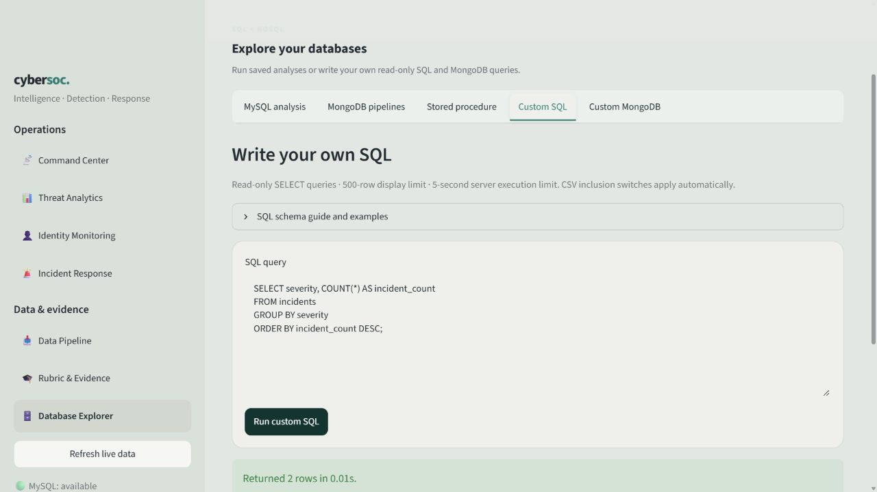
Advanced queries and database exploration
10 SQL analyses
6 MongoDB pipelines
2 procedure definitions
Joins, nested queries, HAVING
and cumulative window totals
MongoDB grouping and time trends
Editable read-only query tabs
SELECT severity, COUNT(*) AS cases
FROM incidents
GROUP BY severity;
Source: analytics modules and Database Explorer
12
Notes:
Project evidence at commit 4bee733: https://github.com/DereFX/cybersecurity-incident-monitoring-dashboard
Files: analytics/sql_queries.py; analytics/mongo_aggregations.py; analytics/custom_queries.py; pages/6_Database_Explorer.py
Screenshot: tmp/report_build/queries.png. The SQL and MongoDB editors enforce source exclusion before aggregation, validate read-only scope and cap execution/results.

Slide 13
Testing, validation and security boundaries
97
2
unit and UI tests passed
live integration tests passed
Check area | What the project verifies
Input validation | Required fields, timestamps, identifiers and duplicates
Response workflow | Assignment, action notes, resolution and reopening
Query safety | Writes and unsafe operators blocked, scoped results
Service failures | Rollback and meaningful errors without credentials
Current limits: no production login/RBAC, no cross-store transaction, and no durable rolling window across uploads.
Source: dated verification reports and live ACID evidence
13
Notes:
Project evidence at commit 4bee733: https://github.com/DereFX/cybersecurity-incident-monitoring-dashboard
Files: reports/verification.json; reports/response_integration.json; tests/test_custom_queries.py; tmp/ppt_build/acid_evidence.json
97 unit/UI checks and 2 live integration checks are saved pytest results. The separate ACID demonstration is not counted as additional pytest tests. UI tests use controlled doubles. No production authentication/RBAC layer is implemented.

Slide 14
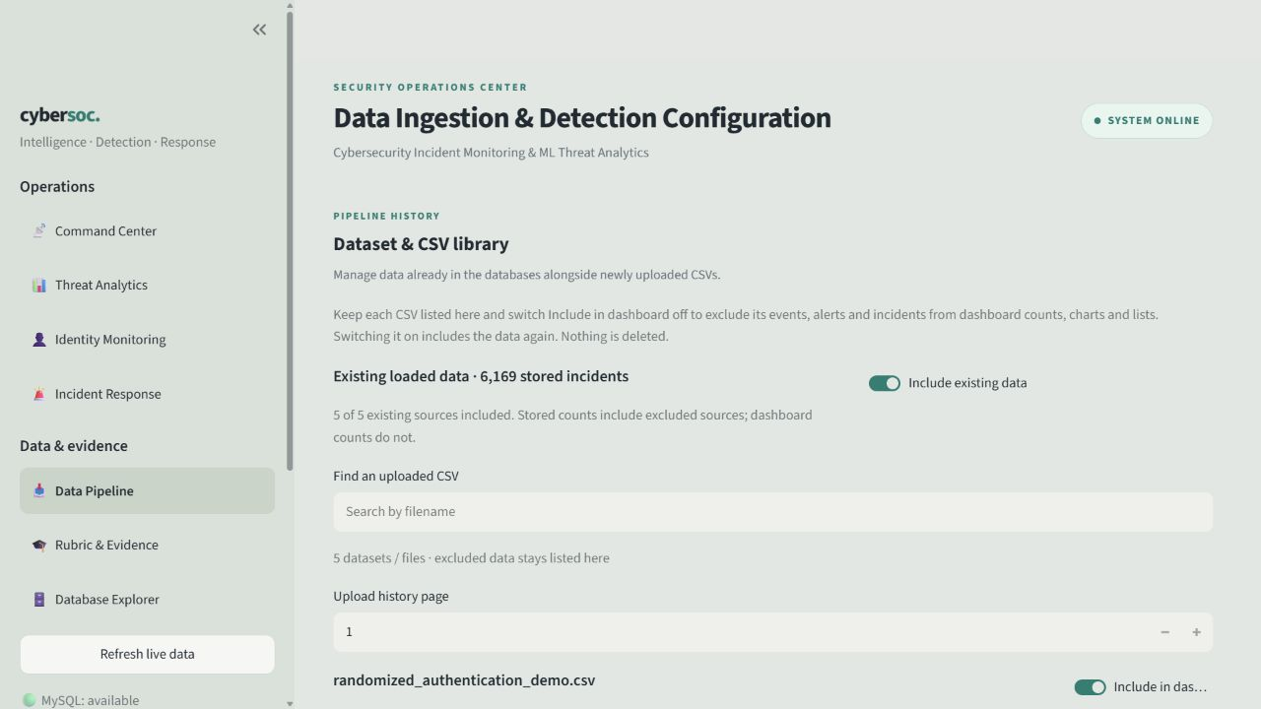
Live demonstration sequence
1 Download a fresh synthetic CSV
2 Validate and import 12 events
3 Inspect MongoDB events and alerts
4 Open the two expected SQL cases
5 Assign, respond and resolve
6 Exclude the CSV and compare totals
Repeat the same import to show duplicates.
Inclusion controls never delete stored data.
Expected synthetic fixture outcome at default thresholds
14
Notes:
Project evidence at commit 4bee733: https://github.com/DereFX/cybersecurity-incident-monitoring-dashboard
Files: etl/demo_data.py; pages/4_Data_Ingestion.py; tests/test_response_integration.py
Screenshot: tmp/report_build/pipeline.png. The built-in generator creates 12 explicitly synthetic authentication events: 5 failed logins, 3 successful origins, and a 4-failure negative control. Expected outcome is 2 alerts and 2 incidents. Verify the actual import summary during the live demo.

Slide 15
Project outcomes and evaluation coverage
Evaluation area | Marks | Demonstrable evidence
Application design and functionality | 2 | Import, detect and handle a persistent case
Python implementation | 2 | Typed modules, validation and services
SQL and NoSQL integration | 2 | Normalised workflow plus document evidence
Advanced querying | 2 | SQL analyses, MongoDB pipelines and procedures
Code quality, documentation and UI | 1 | Seven views, setup guide and project report
Testing, validation and error handling | 1 | 99 saved passing checks plus ACID evidence
Next priorities
Production access control, cross-store recovery and validation on independent network traffic.
Questions
SDGs 9 and 16: digital resilience and accountable response
15
Notes:
Project evidence at commit 4bee733: https://github.com/DereFX/cybersecurity-incident-monitoring-dashboard
Files: docs/RUBRIC_MAPPING.md; supplied DCDSL evaluation rubric; report chapter 9
Rubric marks: 2 application, 2 Python, 2 SQL/NoSQL integration, 2 advanced retrieval, 1 quality/UI, 1 tests/validation. No grade is guaranteed. SDGs: https://sdgs.un.org/goals/goal9 and https://sdgs.un.org/goals/goal16. References for the deck also include scikit-learn RandomForestClassifier documentation https://scikit-learn.org/stable/modules/generated/sklearn.ensemble.RandomForestClassifier.html and Streamlit https://docs.streamlit.io/.

