Slide 1
Preliminary Design Review
Global Package Courier Tracking
BitRunners (Team #5)
Ismael Alonso, Dereje Arega, Chris Hubbard, Ashlesh Gawande, Matthew Longley,
Stephen Moo-Young

Slide 2
Agenda
Overview the assignment
Outline intended use
Blueprint for our design

Slide 3
Abstract
We have been tasked to design a simulation for global packaging at the Memphis airport by Fedex. Once the simulation has run its course, the consumer has requested specific data to be reported from the results.

Slide 4
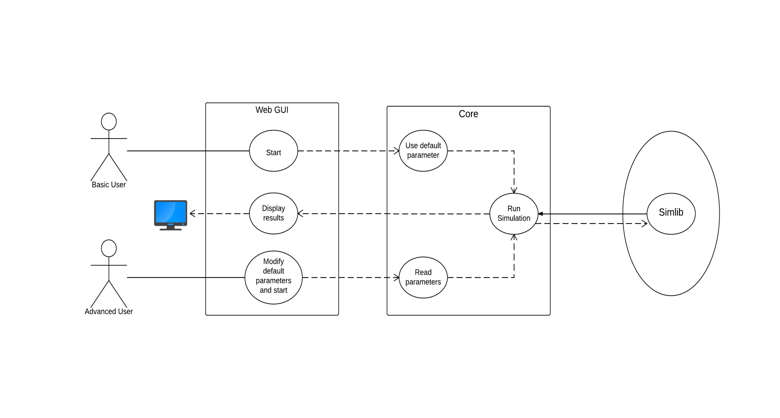
Use Case Diagram

Slide 5
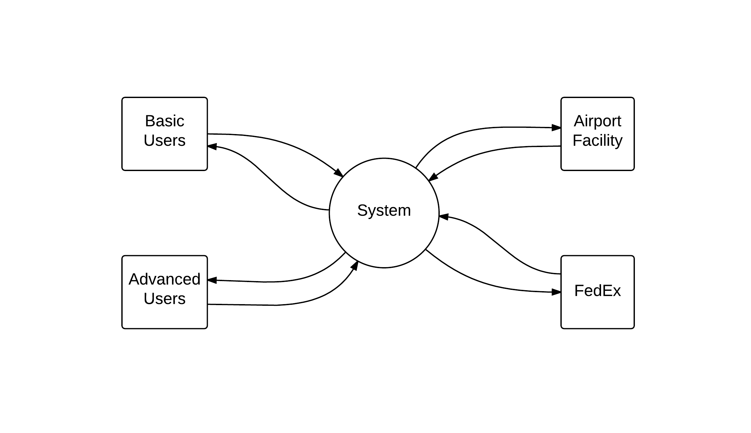
Context Diagram

Slide 6
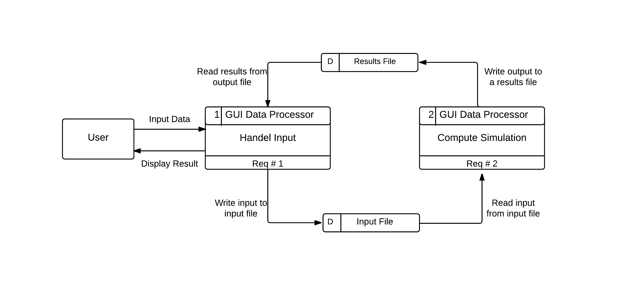
Data Flow Diagram (Level 0)

Slide 7
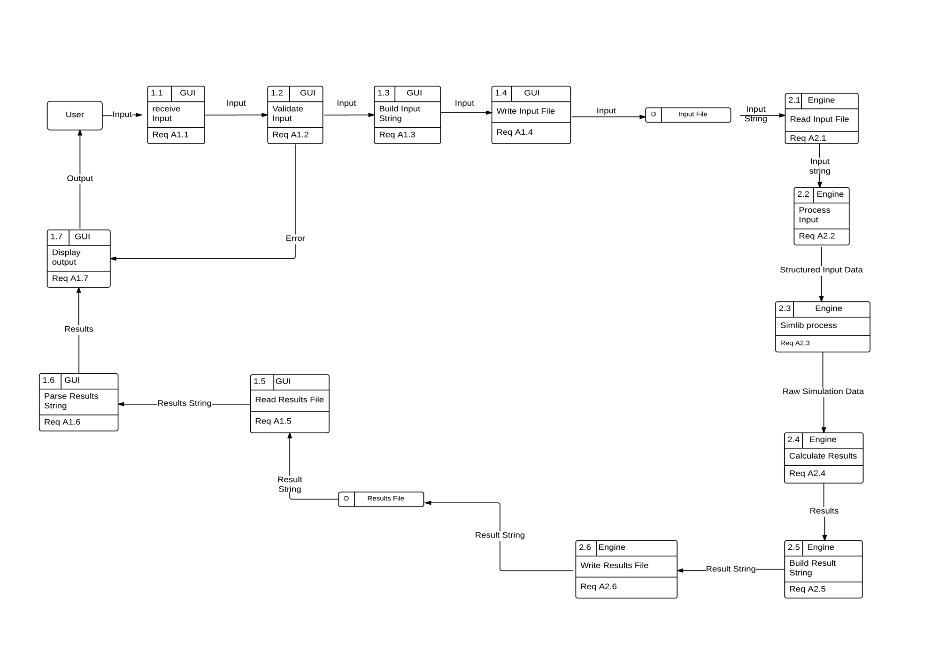
Data Flow Diagram (Level 1)

Slide 8
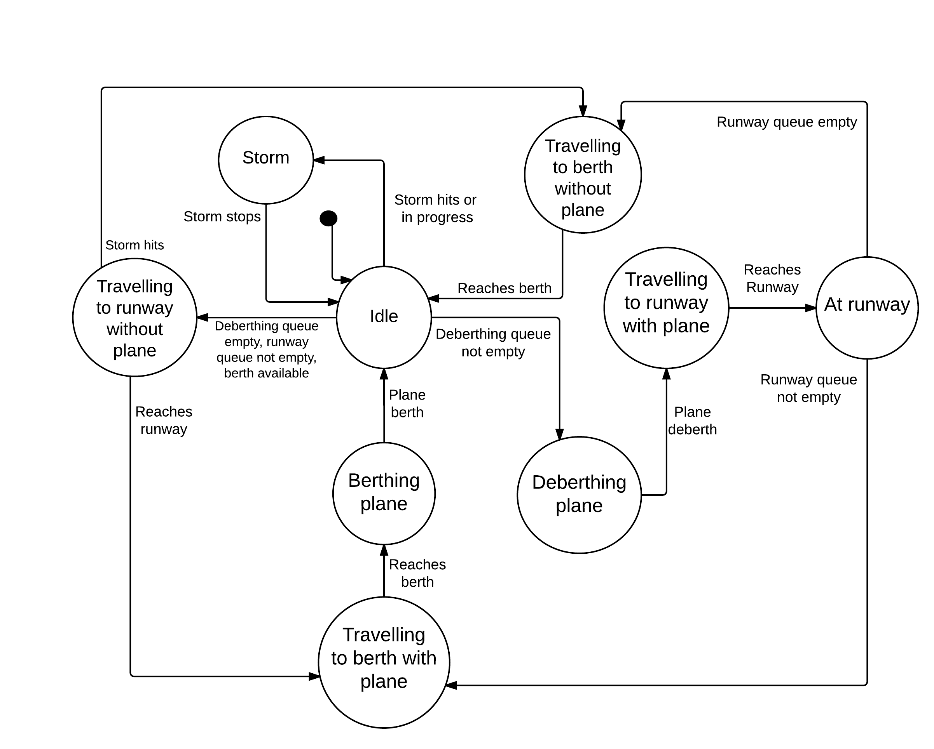
Single-Taxi State Transition Diagram

Slide 9
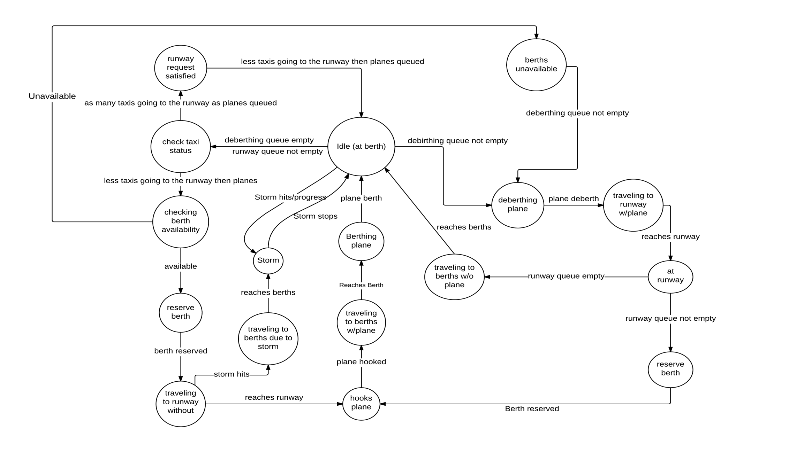
Multi-Taxi State Transition Diagram

