Slide 1
Customer Design Review
Global Package Courier Tracking
BitRunners (Team #5)
Ismael Alonso, Dereje Arega, Chris Hubbard, Ashlesh Gawande, Matthew Longley,
Stephen Moo-Young

Slide 2
Agenda
Overview the assignment
Outline intended use
Blueprint for our design

Slide 3
Abstract
We have been tasked to design a simulation for global packaging at the Memphis airport by Fedex. Once the simulation has run its course, the consumer has requested specific data to be reported from the results.

Slide 4
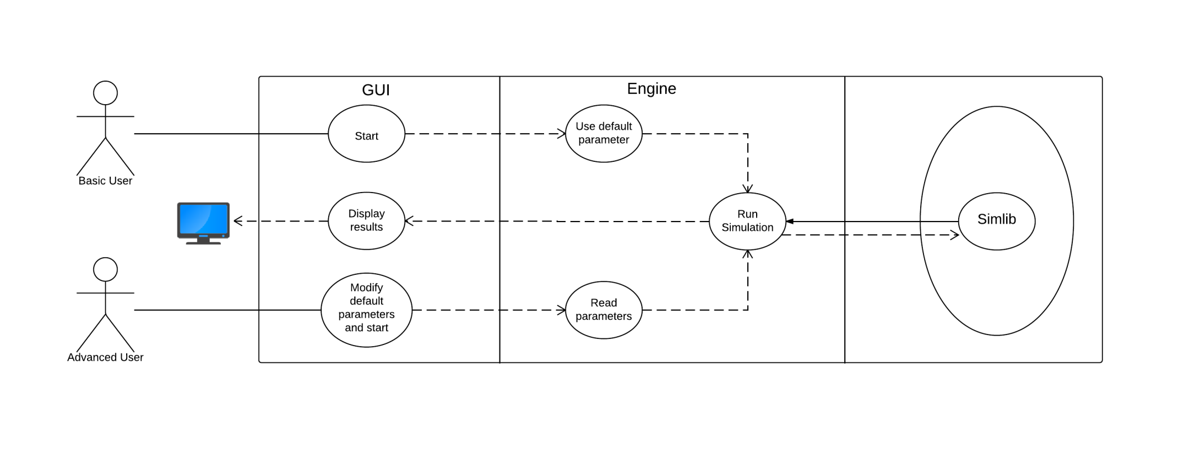
Use Case Diagram

Slide 5
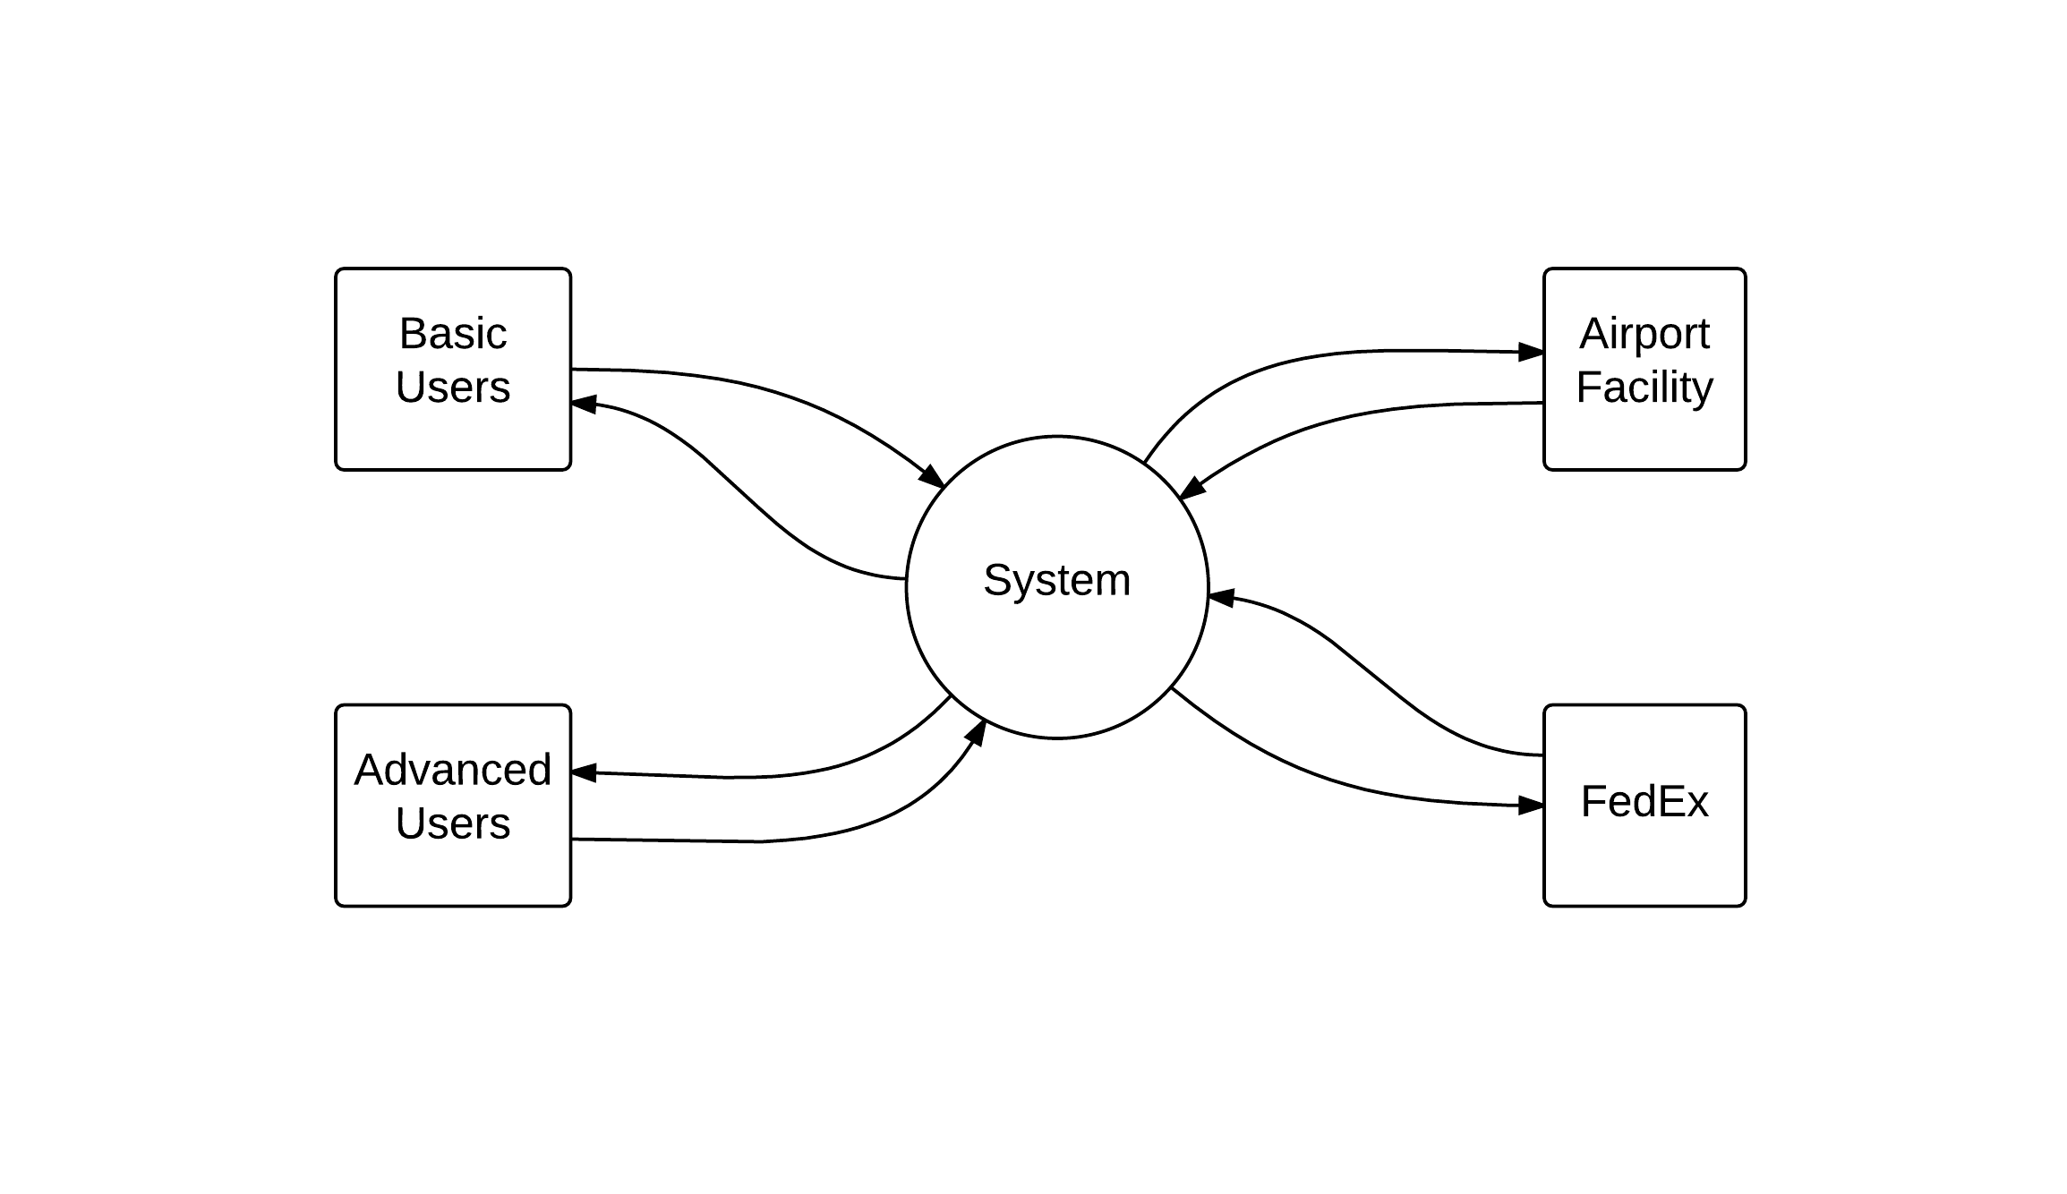
Context Diagram

Slide 6
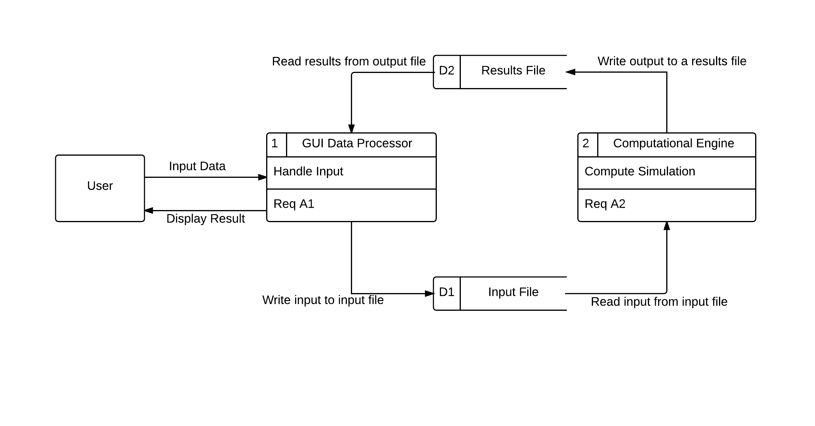
Data Flow Diagram Level 0

Slide 7
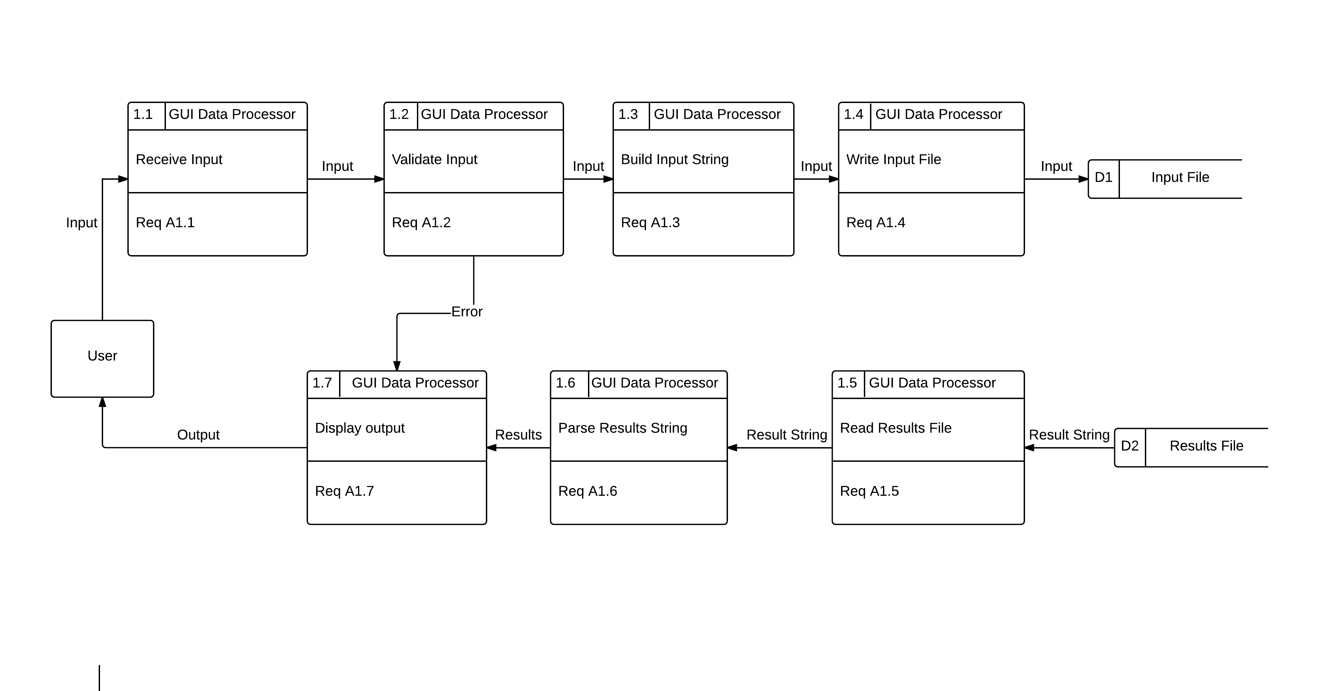
Data Flow Diagram Level 1(1.n)

Slide 8
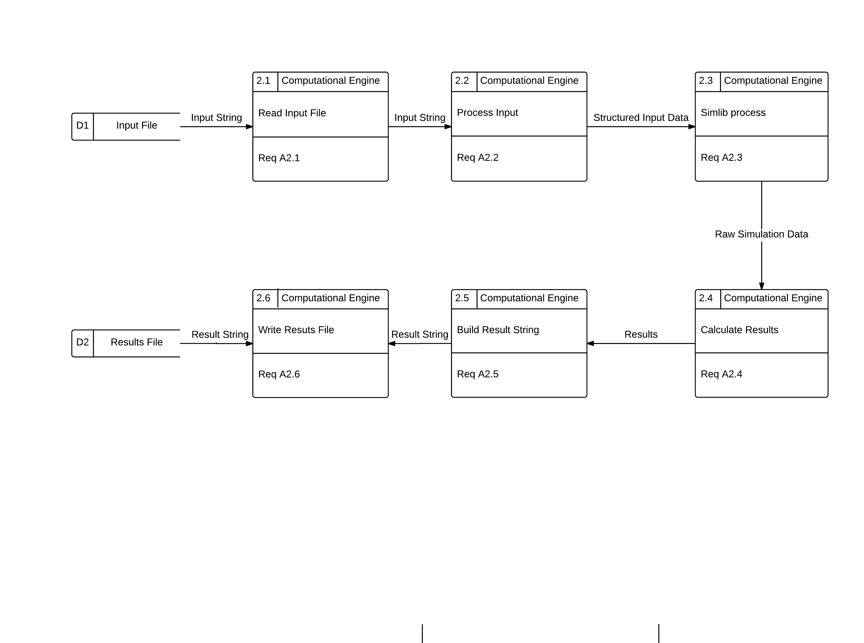
Data Flow Diagram Level 1(2.n)

Slide 9
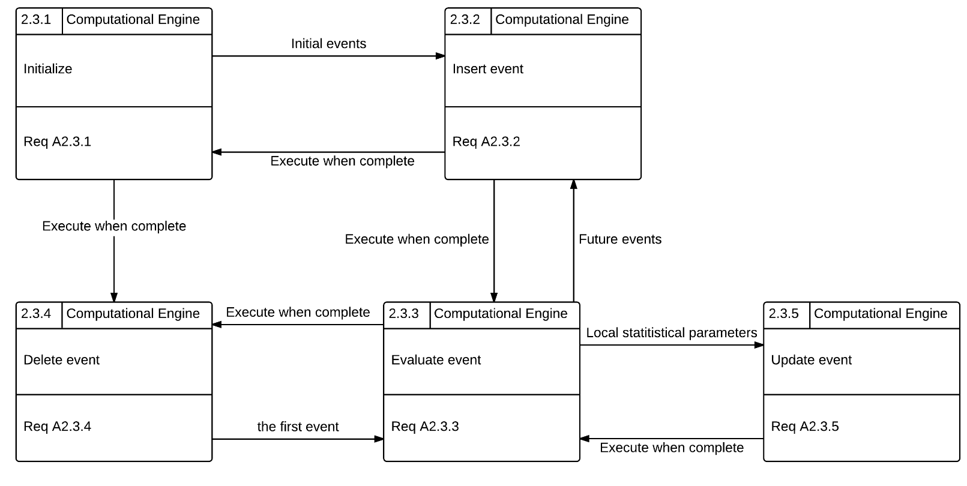
Data Flow Diagram Level 2(2.3.n)

Slide 10
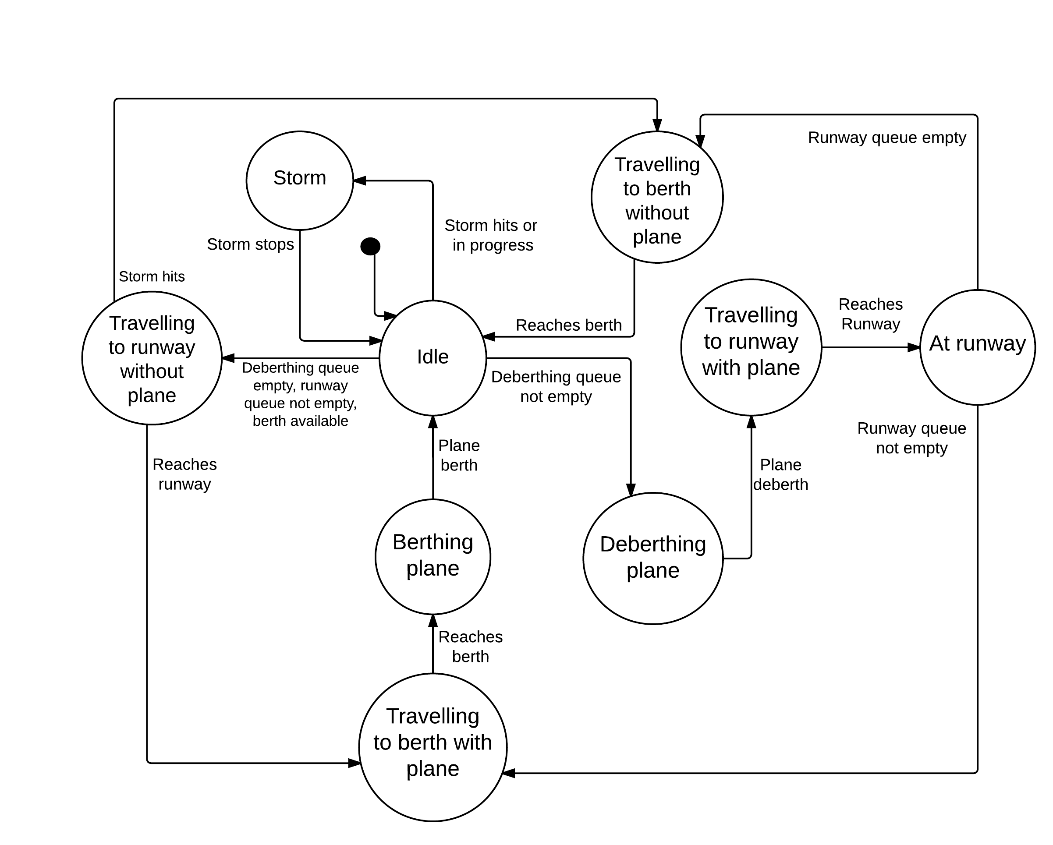
Single-Taxi State Transition Diagram

Slide 11
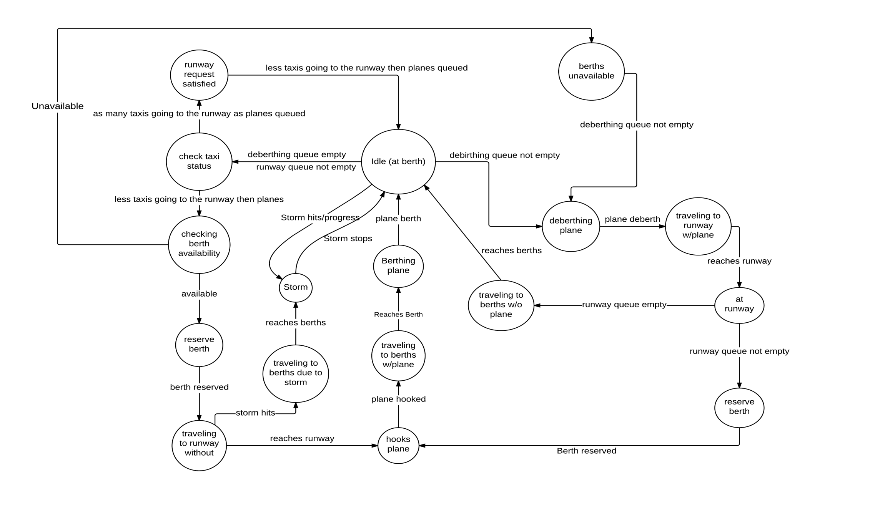
Multi-Taxi State Transition Diagram

