Slide 1
Global Package Courier Tracking Demo
Team 5: Bitrunners
Stephen Moo-Young
Chris Hubbard
Ismael Alonso
Dereje Arega
Ashelsh Gawande
Matthew Longley

Slide 2
Agenda
Traceability Approach
RTM
Test Cases (6)

Slide 3
Traceability Approach
Identify project need
Specify appropriate requirements
Identify testing method for each requirement
Develop RTM
Test modules against assigned requirements

Slide 4
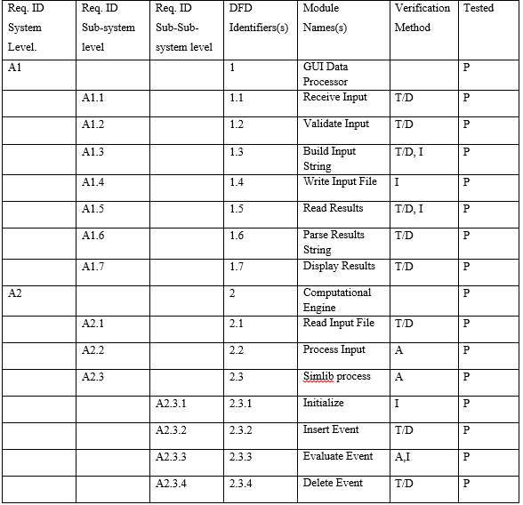

Slide 5
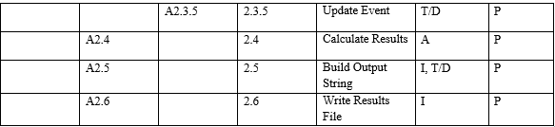

Slide 6
TCS01
Event: Simulation is run with default parameters.
Stimulus: User hits start simulation.
Activity: GPCT runs to completion
Response: Results are displayed on GUI.
Effect: Verifying that GPCT runs correctly

Slide 7
TCS02
Event: Simulation is run with specified parameters.
Stimulus: User hits start simulation.
Activity: GPCT runs to completion
Response: Results are displayed on GUI.
Effect: Verifying that GPCT runs correctly

Slide 8
TCS03
Event: The engine will run in the terminal.
Stimulus: User hits start simulation.
Activity: The terminal log each event sequentially.
Response: Results are displayed on GUI.
Effect: Verifying that events occur as expected.

Slide 9
TCS04
Event: Simulation is run without engine.
Stimulus: User hits start simulation.
Activity: Input file is not consumed.
Response: Inputs are displayed on the input file.
Effect: Verifying that input file is written correctly.

Slide 10
TCS05
Event: Simulation is run.
Stimulus: User hits start simulation.
Activity: Results file is generated.
Response: Results are displayed.
Effect: Verifying that results file and results GUI match.

Slide 11
TCS06
Event: Simulation is run with incorrect parameters.
Stimulus: User hits start simulation.
Activity: GPCT tries to run with incorrect parameters.
Response: GUI prevents simulation from running.
Effect: Verifying that GPCT won’t run with incorrect parameters.

Slide 12
Comments/Concerns

