Slide 1
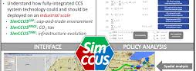



FantasticSIM4
Group members:
LaQuandria Murry
Kyanie Waters
Reggie Kelley
Derek Morris Jr.

Slide 2
Project Problem
Develop wed-based mapping functionality that includes adding and editing layers of georeferenced data.
Create selectable subsets of the layer data to enable the development of specific SimCCS problem scenarios by users.
Demonstrate the capability for integrating new georeferenced data for potential SimCCS users across the US, China and Australia

Slide 3
Project Goal
Our general goal was to create a web-based application that uses a map that we created that incorporates a layer of high CO2 emissions.
With that we were to create mapping functionalities that will allow users to select any region and obtain general information about each Address point.

Slide 4

Methodology
First, we used leaflet to learn how to create a web-based map. Then, we used those resources to find out how to plot points on the map. Once the plots were added we learned how to create some type of graphing lines (sinks) on the map. After, we figured out how to access the data file given to us and used it to be called upon by the user once clicked on a data point.

Slide 5
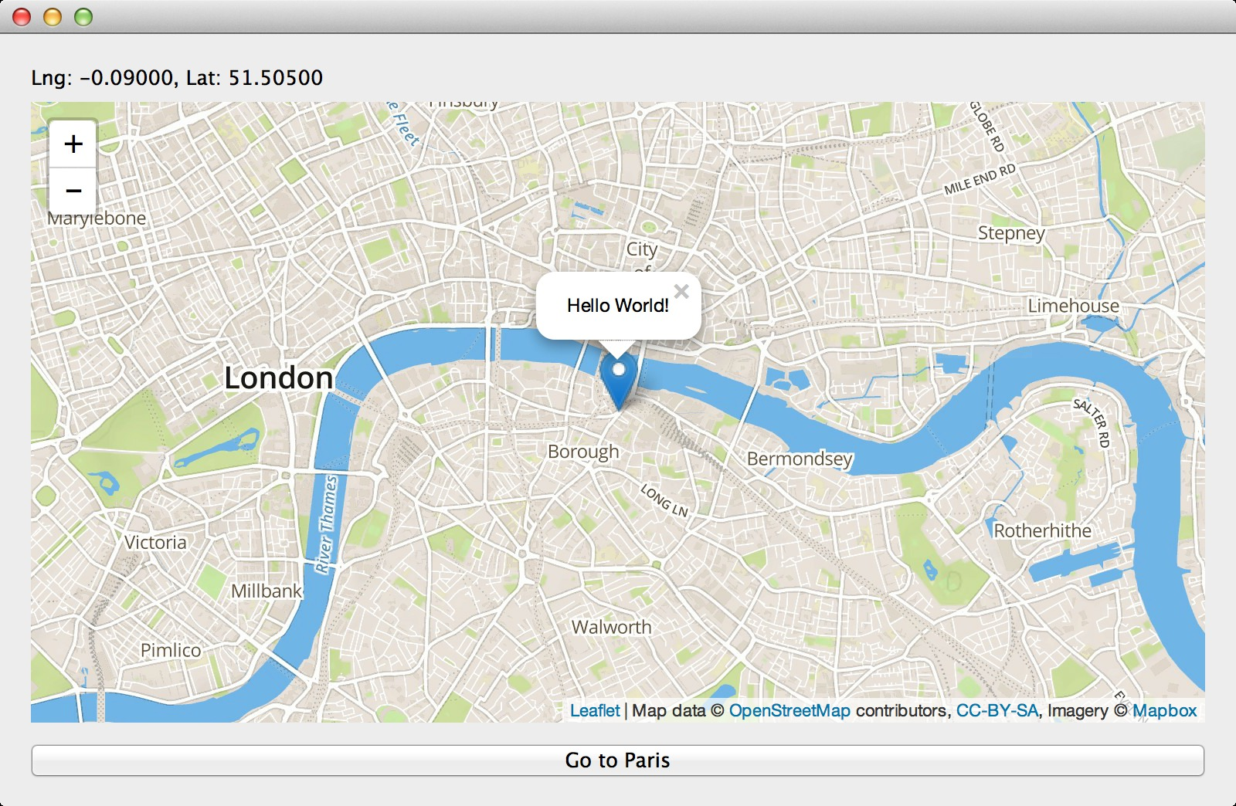
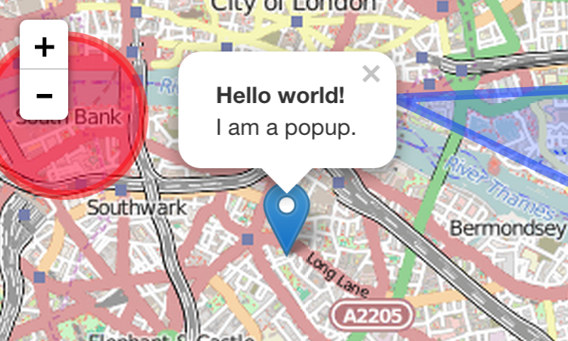
Before

Slide 6
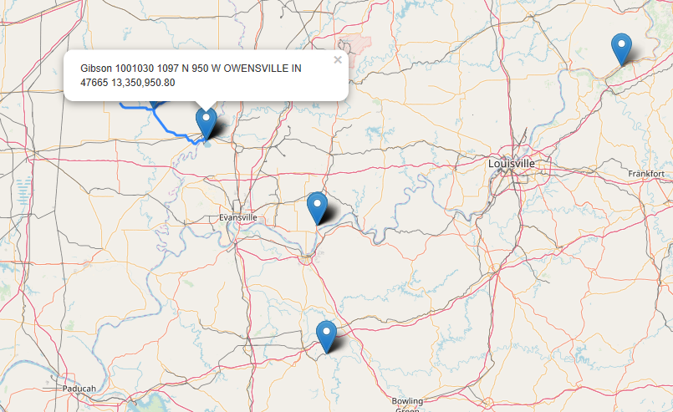
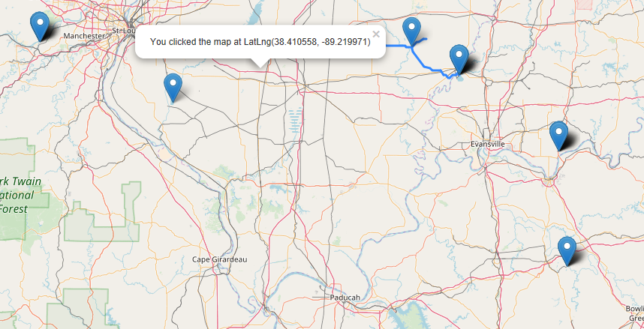
After

Slide 7
Future Work
Be able to include more data
1
Incorporate better widgets for user use
2
Be able to use the map globally
3
Be able to incorporate the algorithm to load all of the sinks and determine the most cost efficient scenarios.
4

Slide 8

Questions

