Slide 1






Exploring Programming Patterns Through Game Development
12-13 November, 2019
Derek Briggs

Slide 2
About me and this talk
Essentially a giant while loop

Slide 3
What is this talk?

Slide 4
What is LibGDX?
Game Framework based on Java
FOSS
Targets Android, Desktop, IOS, and HTML
Supports Kotlin with a little configuring
LibKTX – Optional 3rd party extensions

Slide 5
What is Kotlin?
JVM Language by Jetbrains
Full Interoperability with Java
Syntactically similar to Java
2 Notable differences
  Type Inference
  Mutable vs Immutable “variables”

Slide 6
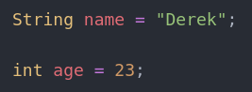
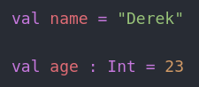
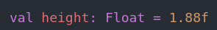
Type Inference
Java
Kotlin

Slide 7
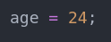
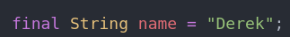
Mutability vs Immutability
Java

Slide 8
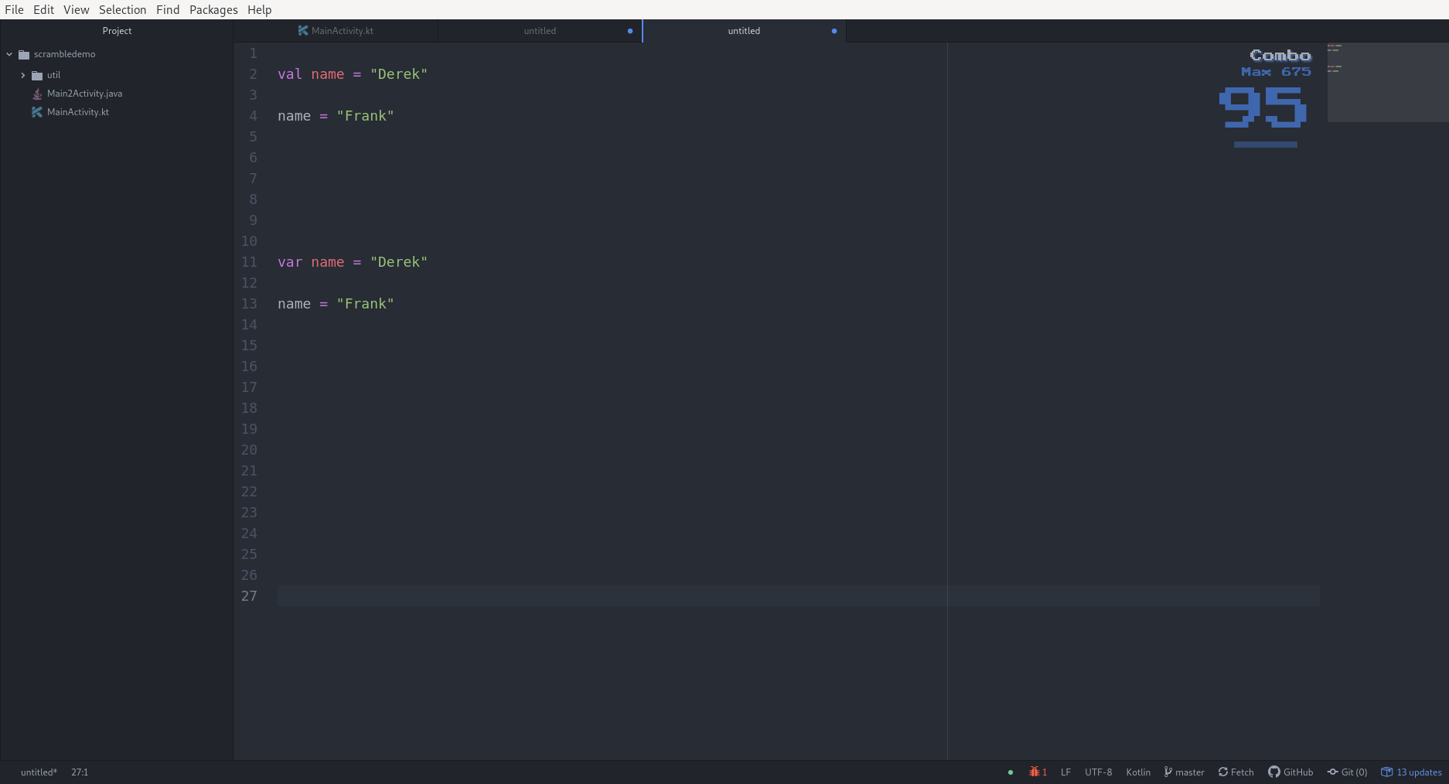
Mutability vs Immutability
Kotlin
Compile time error

Slide 9
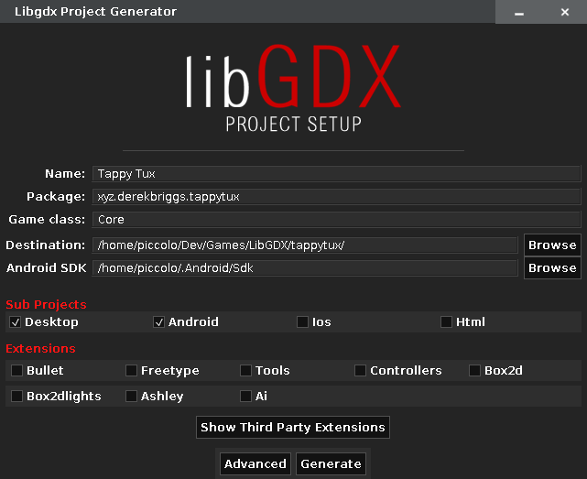
tappytux/
--android/
--desktop/
--core/
----Core.java

Slide 10
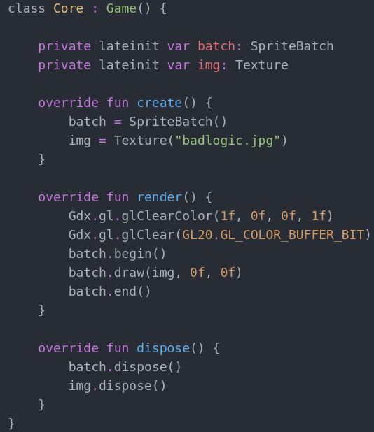

Slide 11
Game Loop

Slide 12
Game Loop

Slide 13
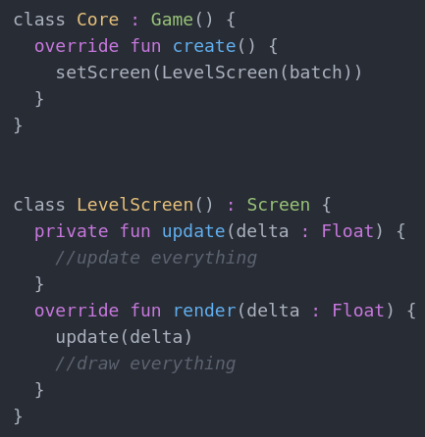
Screen
hide()
show()
render(delta : Float)
pause()
resume()
dispose()

Slide 15
Update Method

Slide 16
Update Method
Delegate

Slide 17
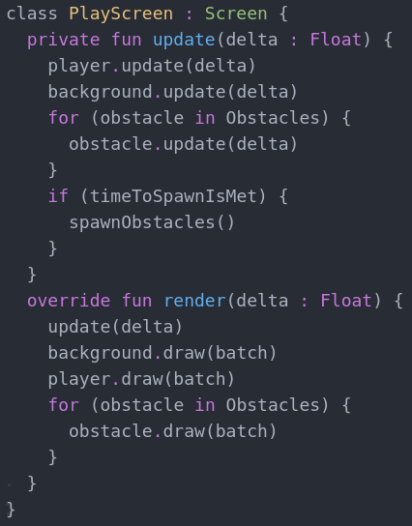

Slide 18
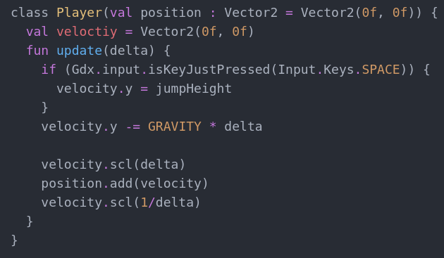

Slide 19
Entity and Actor
Entities, or actors, are dynamic

Slide 20
Finite State Machine

Slide 21
Finite State Machine
Essentially a giant while loop

Slide 22
Game States
Ready
Playing
Pause
GameOver

Slide 23
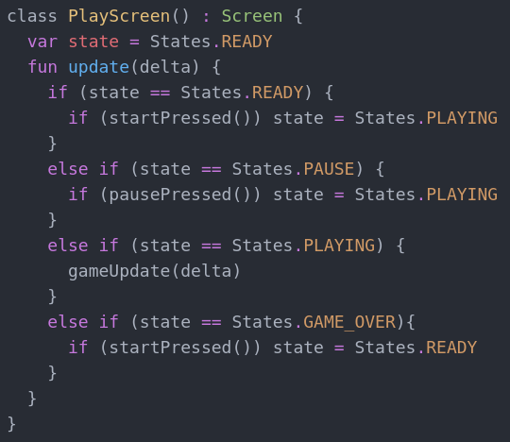
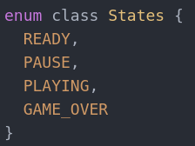

Slide 24
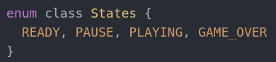
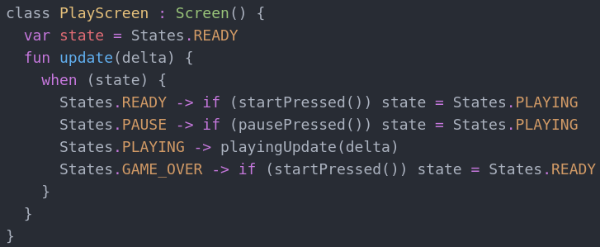

Slide 27
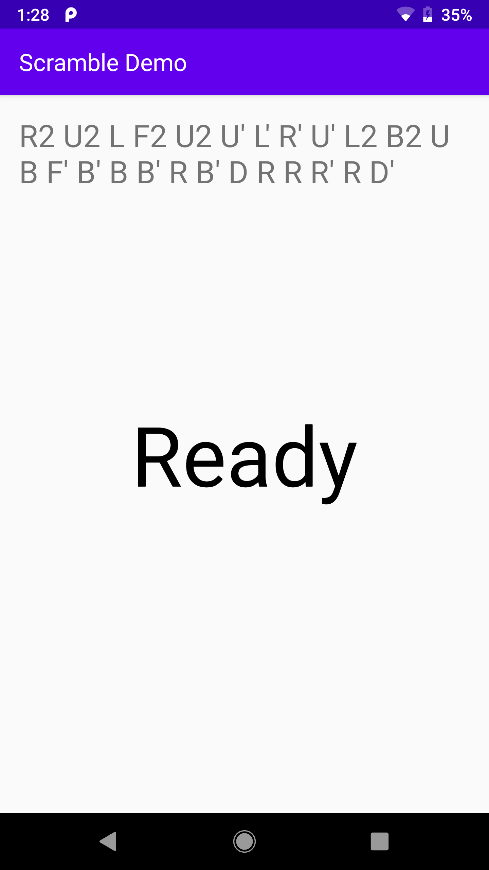
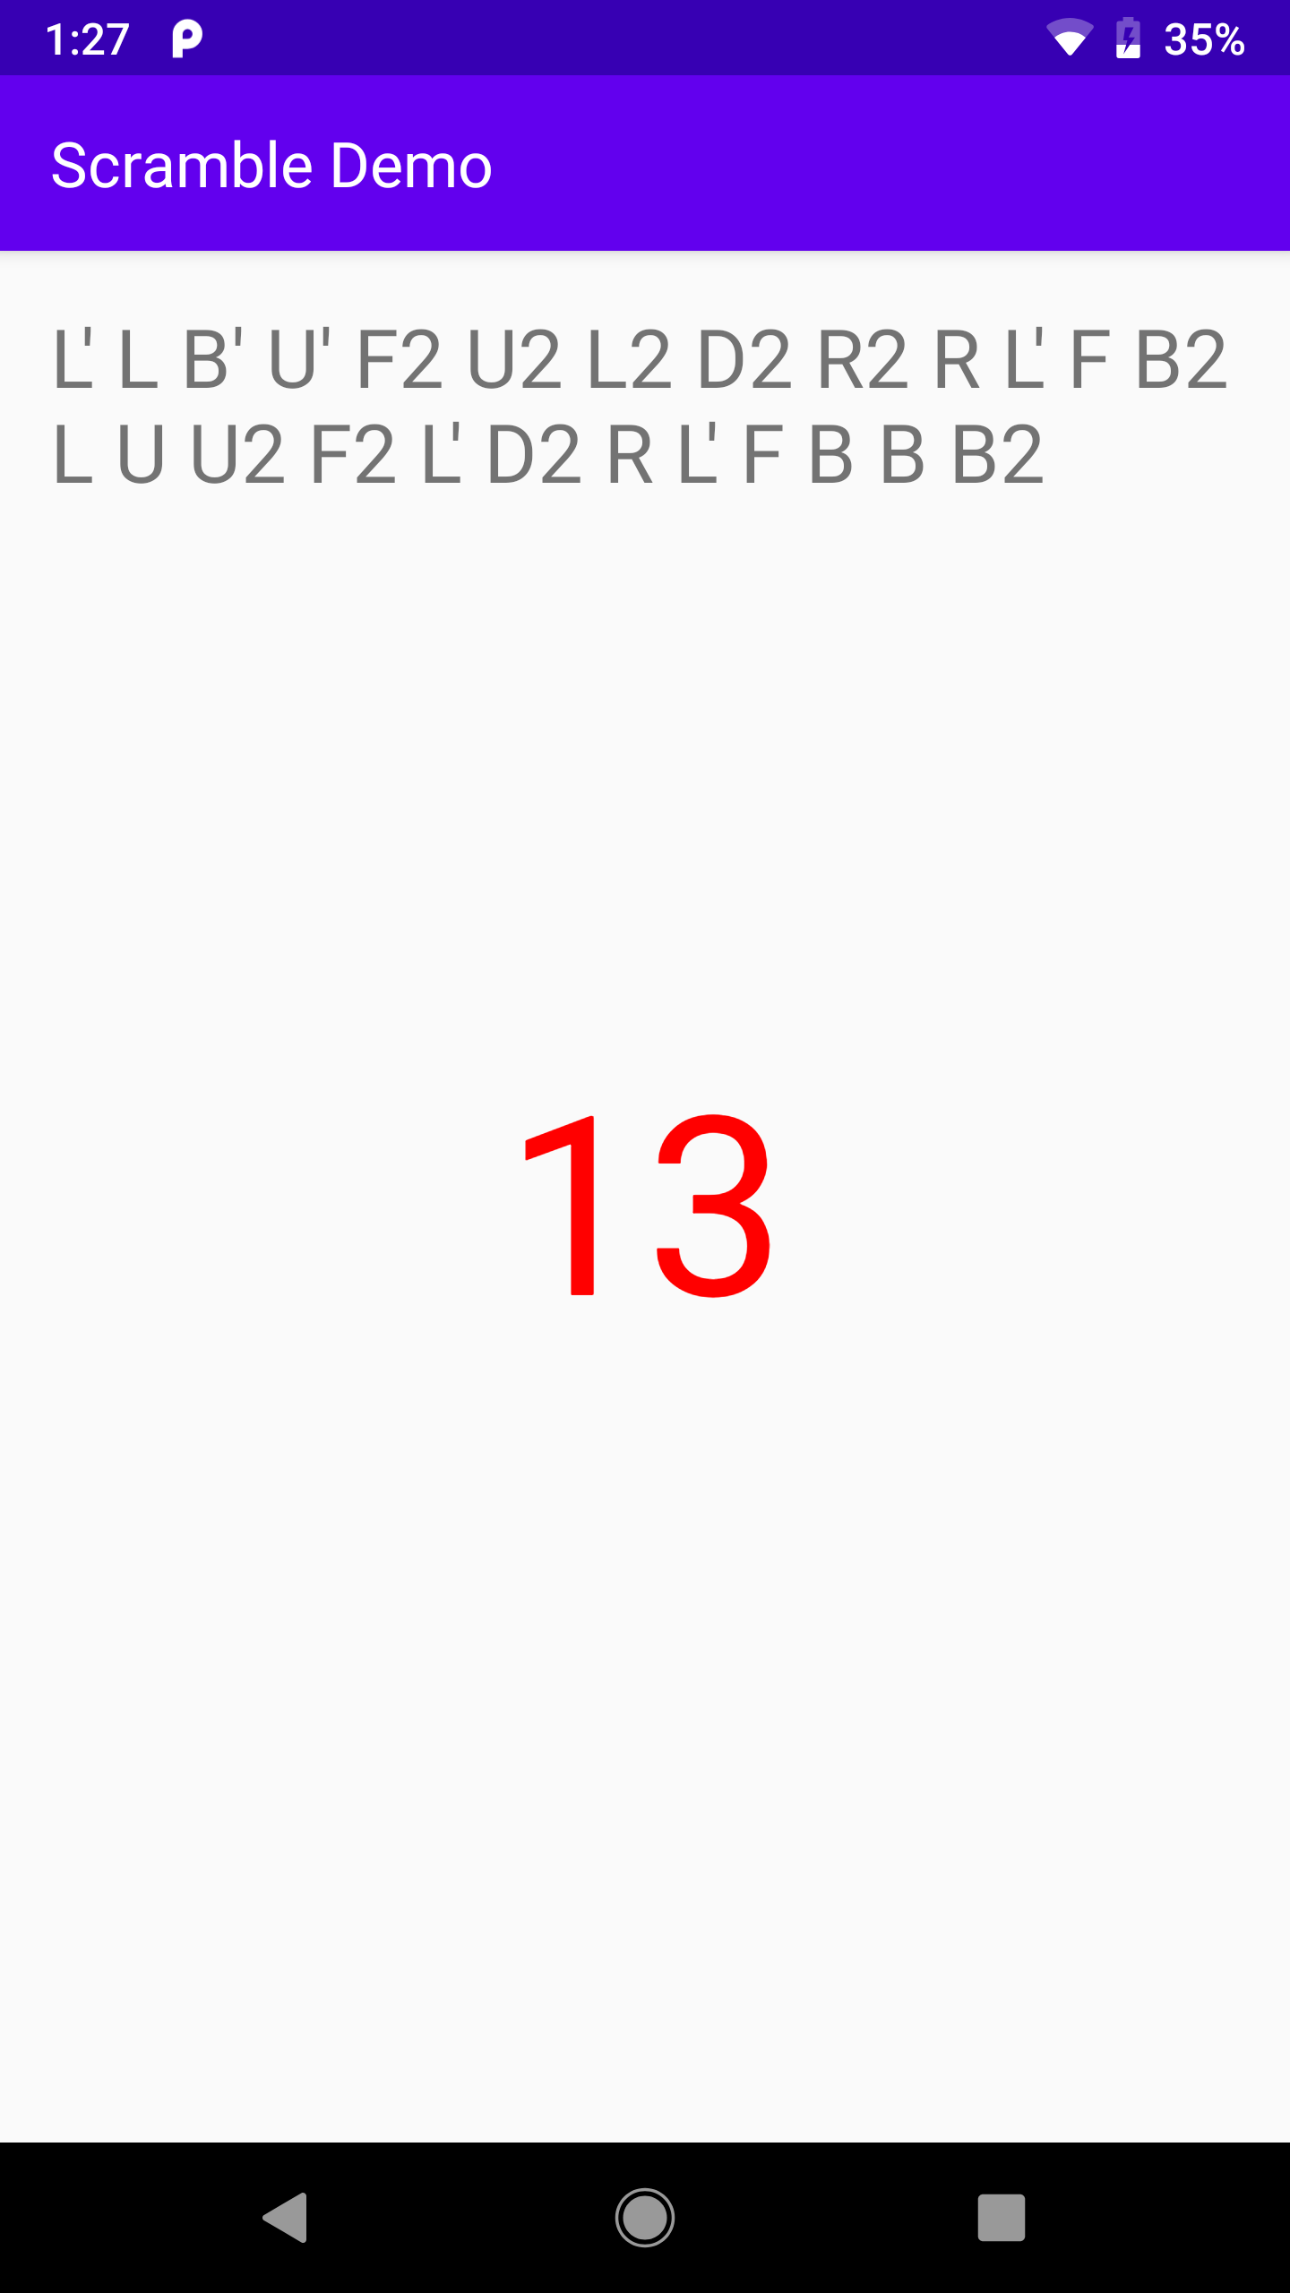
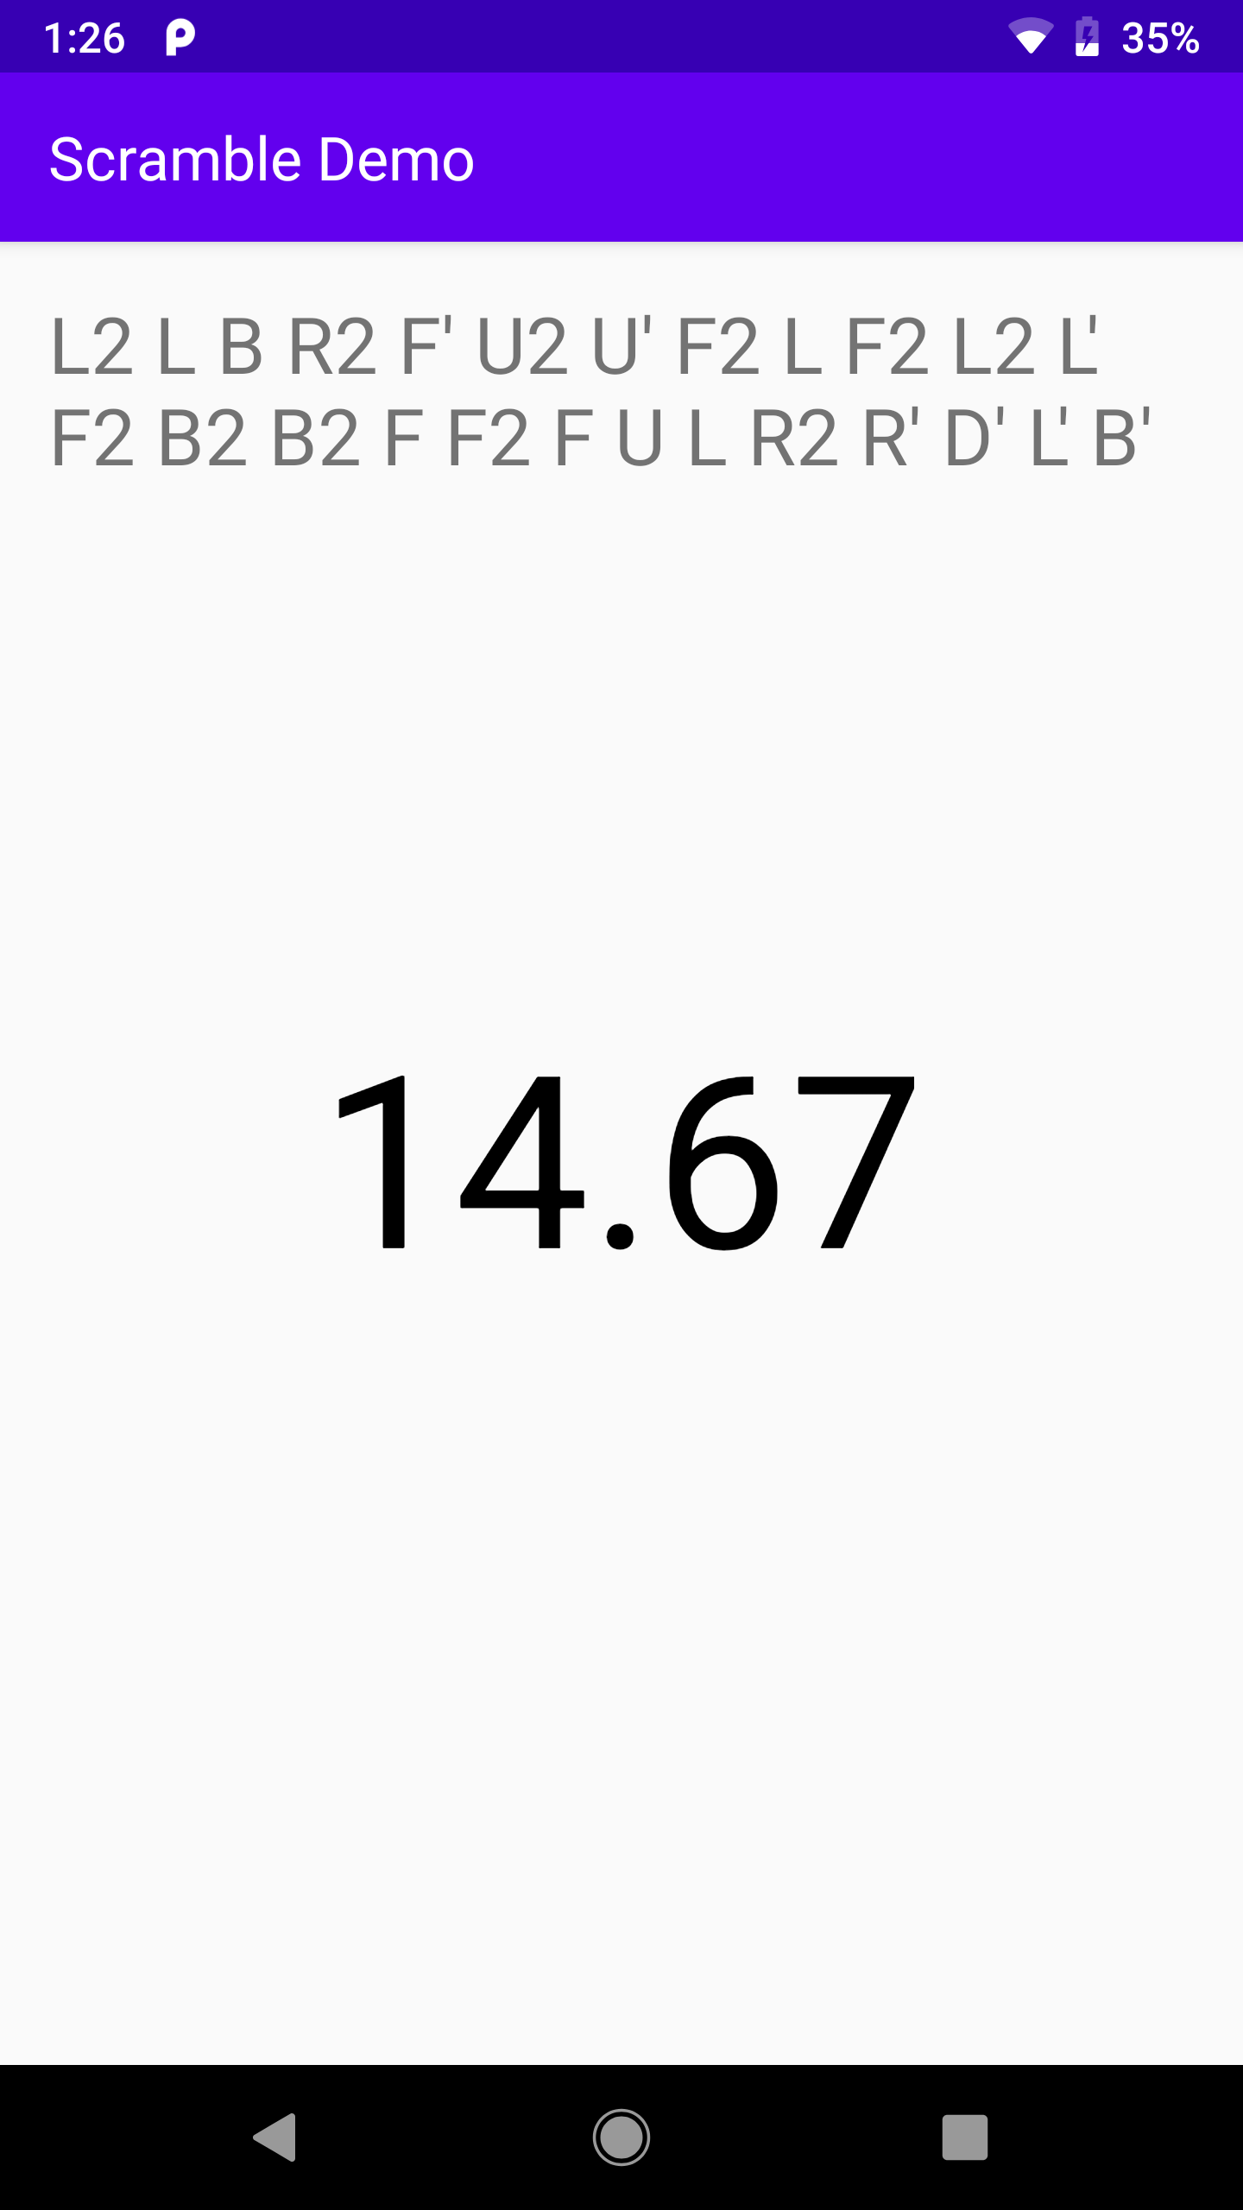
Ready
State
Inspection
State
Solving
State

Slide 28
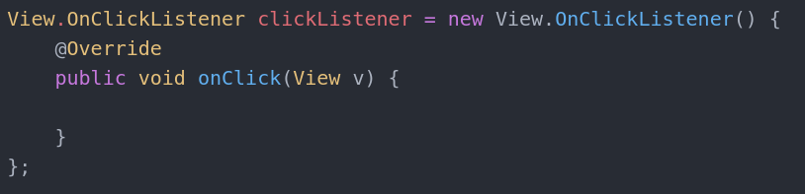
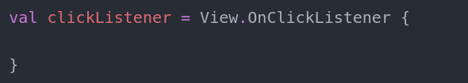
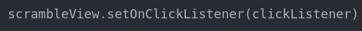
Java
Kotlin

Slide 29
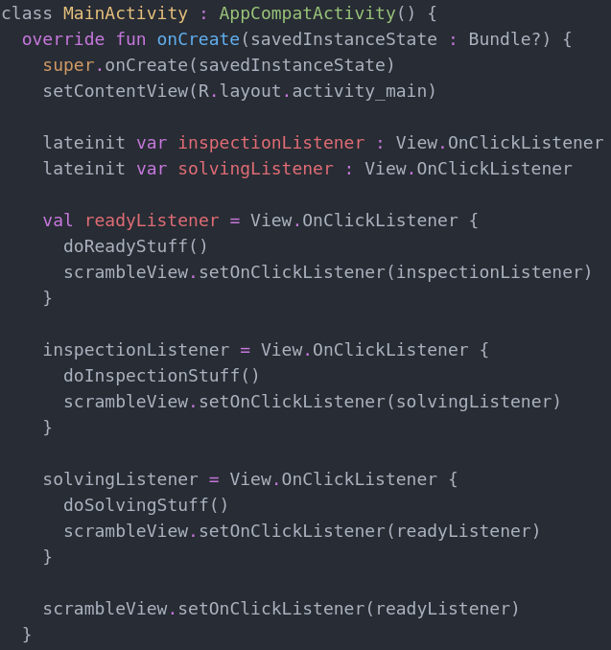

Slide 30
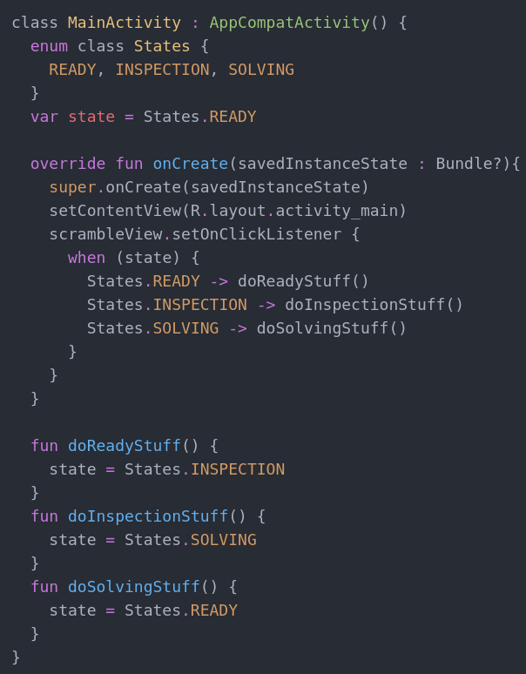

Slide 31
Segues are hard

Slide 32
Entity Component System

Slide 33
Entity Component System
Prefer Composition to Inheritance

Slide 34
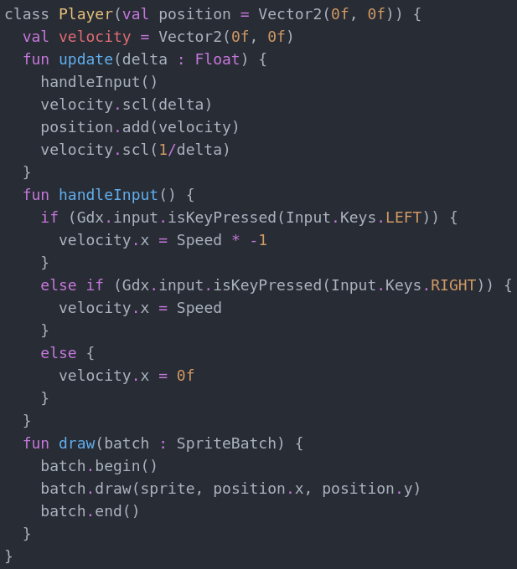
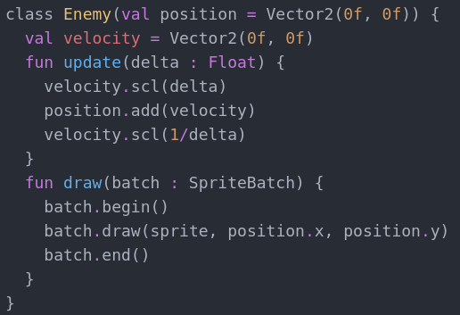
Player
-update()
-handleInput()
-draw()
Enemy
-update()
-draw()

Slide 35
Play Shmup or Llama

Slide 36
Player
Enemy
Brick
SpriteComponent
SpriteComponent
SpriteComponent
PositionComponent
PositionComponent
PositionComponent
VelocityComponent
VelocityComponent
InputComponent
AIComponent

Slide 37
Player
Enemy
SpriteComponent
SpriteComponent
RenderSystem
PositionComponent
PositionComponent
PhysicsSystem
VelocityComponent
VelocityComponent
InputSystem
AiSystem
InputComponent
AIComponent

Slide 38
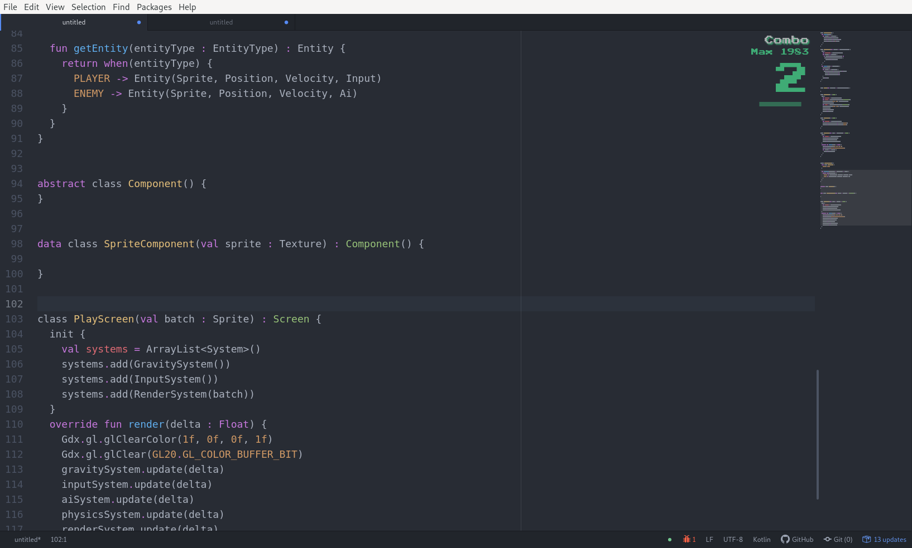
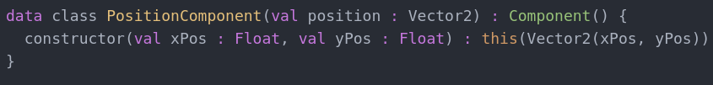
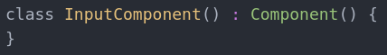

Slide 40
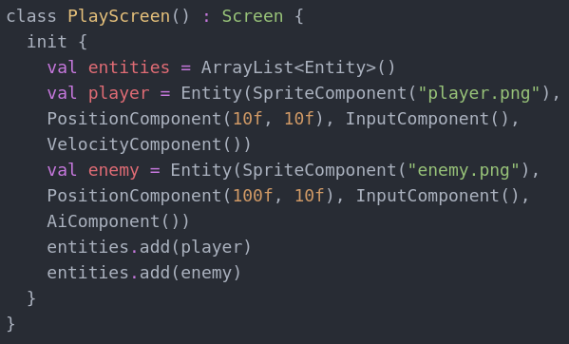
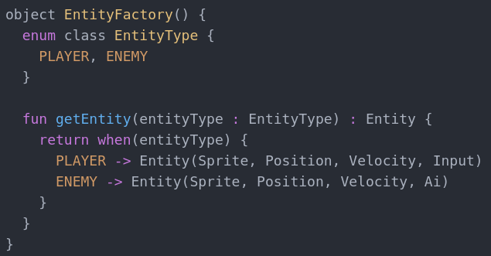
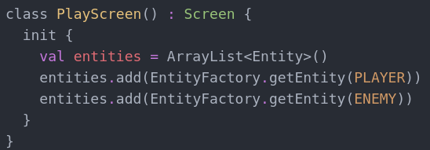

Slide 41
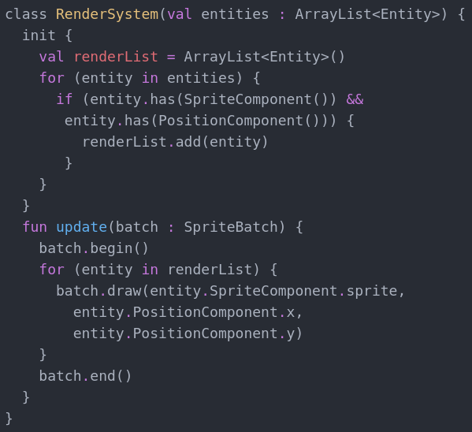
Player
SpriteComponent
PositionComponent
Enemy
SpriteComponent
PositionComponent

Slide 42
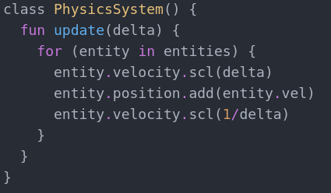
PhysicsSystem
PositionComponent
VelocityComponent

Slide 43
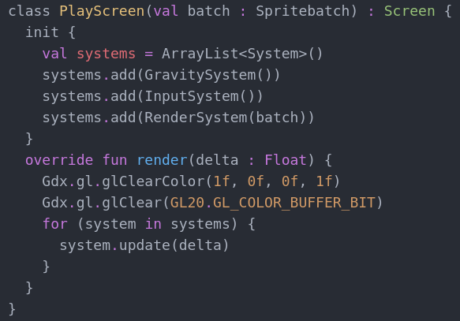
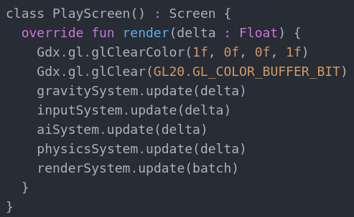

Slide 44
Command

Slide 45
Command
Wrap method calls as objects

Slide 46
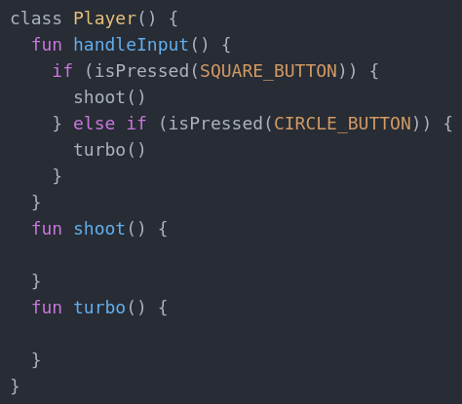

Slide 47
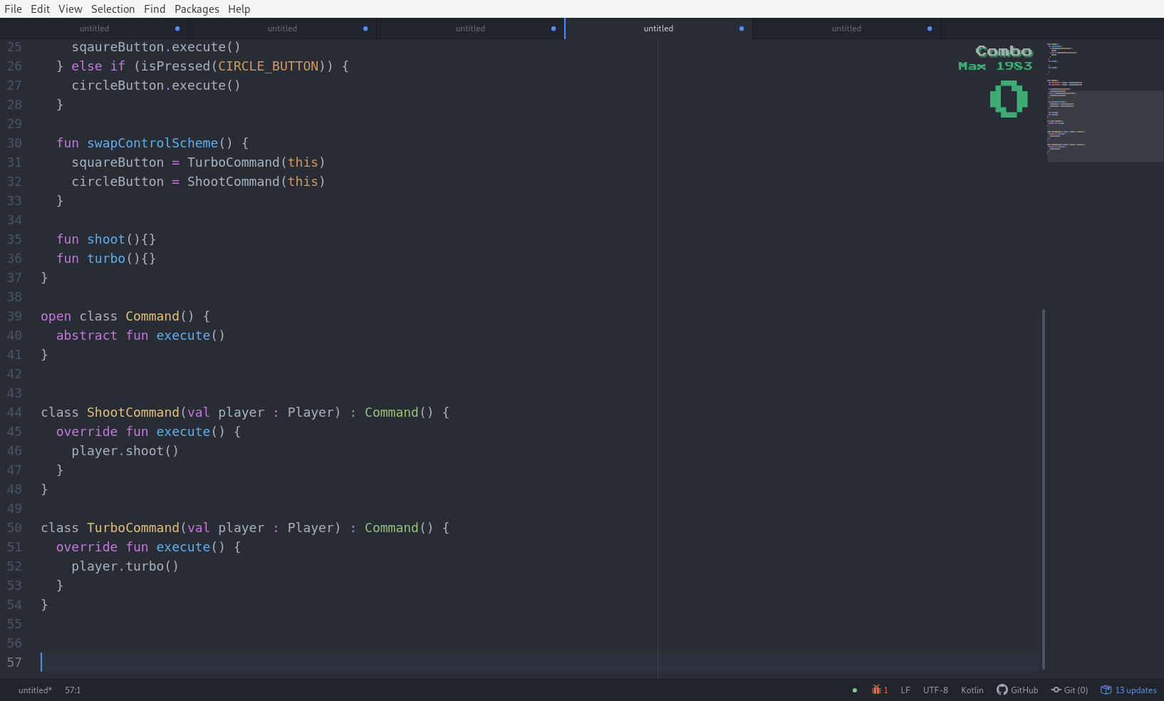

Slide 48
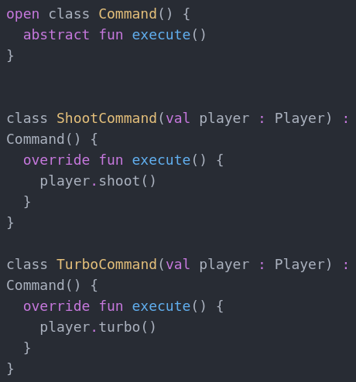
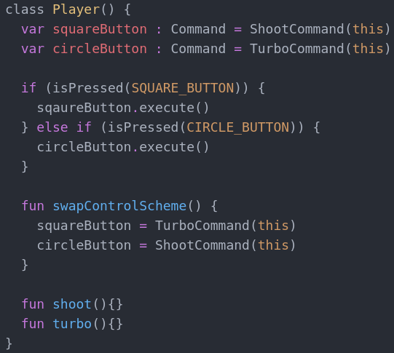

Slide 49
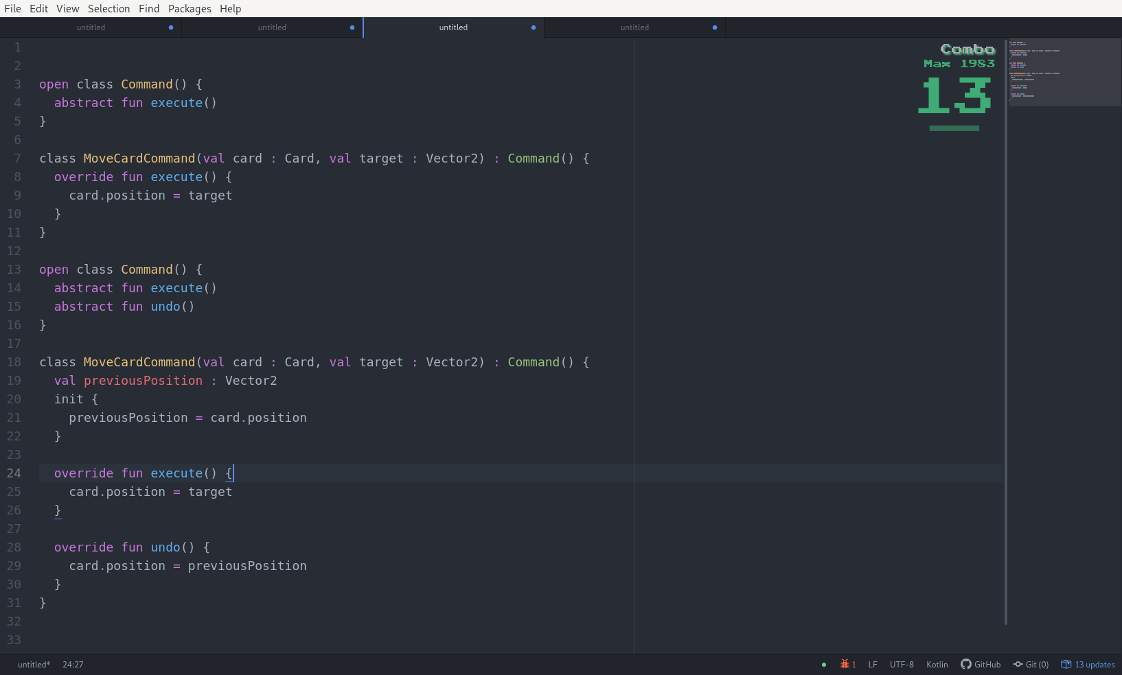
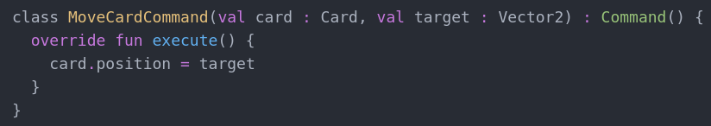

Slide 50
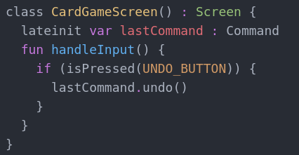

Slide 51
Command
Commands are an object-oriented replacement for callbacks

Slide 52
Define Data As Data

Slide 53


