Slide 1
GREEN PACE – Security Policy Presentation
By: Derek G. Braun
SNHU CS Student – Final Project

Slide 2
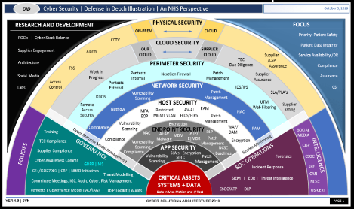
Overview: Defense in Depth
The diagram was provided by SNHU CS405. The diagram gives an overview of the methods of defense I have used for Green Pace security development. This also gives a solid blueprint/plan to secure coding.

Slide 3
THREATS MATRIX
Unlikely Threats are NOT as likely to happen. | Low priority standard with low relevancy.
Threats that are very likely to happen. | Priority Standard with high relevancy.
There are certain levels of vulnerabilities with secure coding which I have outlined in the table above. Each standard/level also has a specific measure of impact.

Slide 4
The 10 Principles
Validate Input Data
Heed Compiler Warnings
Architect and Design for Security Policies
Keep it simple
Default/deny
Adhere to the principle of least privilege
Sanitize data sent to other systems
Practice defense in depth
Use effective QA
Adopt/use secure coding standards

Slide 5
Coding Standards
Do not attempt to create std::string from a null pointer
Do not store already owned pointer value in an unrelated smart pointer
Do not cast to an out-of-range enumeration value
Use valid pointers, iterators and references
Use a static assertion to test the value of a constant expression
Deallocate dynamically allocated resources
Handle exceptions thrown before main()
Do not alternately input and output from a file stream without an intervening positioning call
Do not invoke virtual functions from constructors or destructors
Value returning function must return a value from exit paths

Slide 6
Encryption Policies
Encryption at flight: On-the-fly encryption is encryption that still converts information from one form to another, but it requires no intervention from the user. The data is only encrypted while it is being transmitted to provide protection. Whereas in some applications such as remote replication, data may be unencrypted while it is at rest on drive arrays.
Encryption in rest: Designed to prevent the attacker from accessing the unencrypted data by ensuring the data is encrypted on disk. If an attacker obtains a hard drive with encrypted data but not the encryption keys, the attacker must defeat the encryption.
Encryption in Use: Compromising data in use enables access to encrypted data at rest and data also in motion. Hackers with access to random access memory can parse that memory to locate the encryption key for data at rest. Once they have obtained that encryption key, they can decrypt encrypted data at rest.

Slide 7
TRIPLE-A Policies
Authentication: Authentication is the process where the user is being confirmed as someone who has access to the system. This can include user login and password information for the user to be able to access parts of the system. In my current job we use 2-step authentication where another smart card is required to login.
Authorization: Authorization is the level of access that a user has within the system. Often used in database engineering, there are user accounts and admin accounts which have access to everything and can change everything. Whereas other user accounts can only view and change specific things.
Accounting: Accounting is the process of monitoring what a user is doing with their level of access to the system. This will keep track of what databases are accessed, what was done when it was accessed and what user accessed the system. In some cases, there are even time stamps etc...

Slide 8
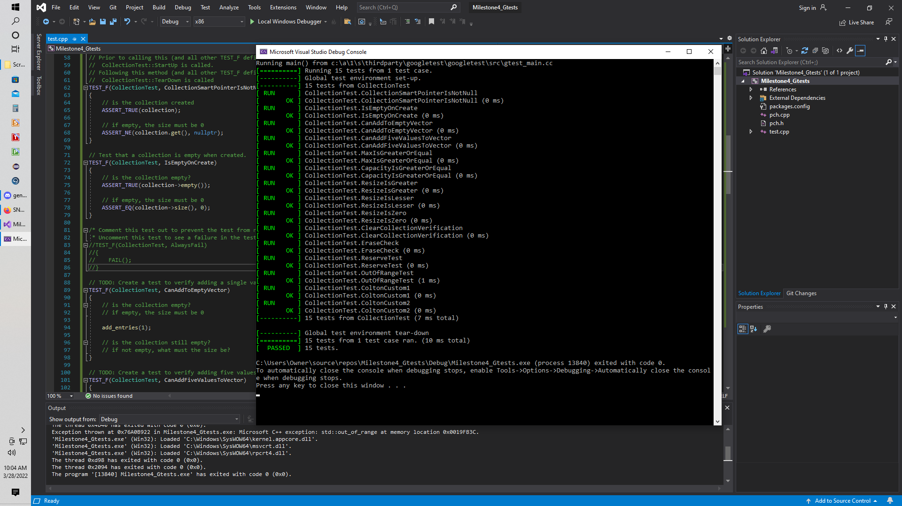
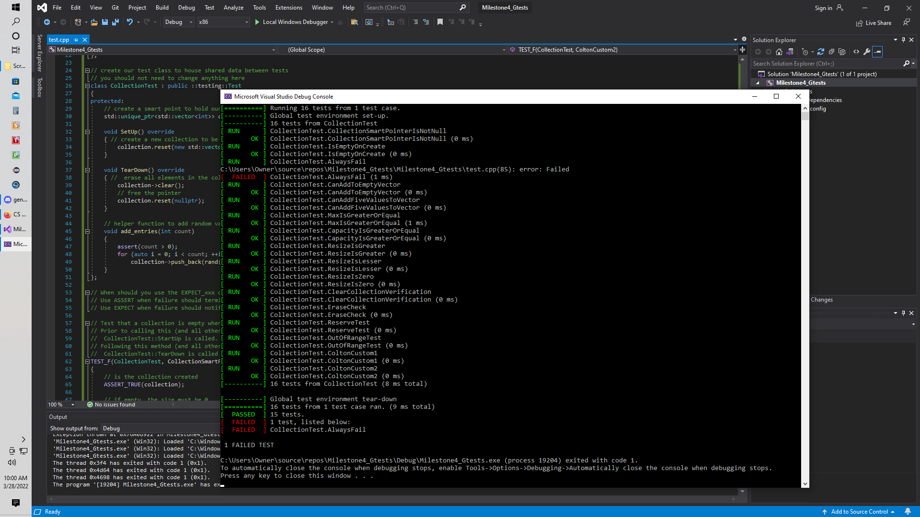
Unit Tests
It's always a good practice to run Unit Tests early and often while developing a new system or code. Below is an example for limiting the number of characters within a user input string to prevent a buffer overflow.

Slide 9
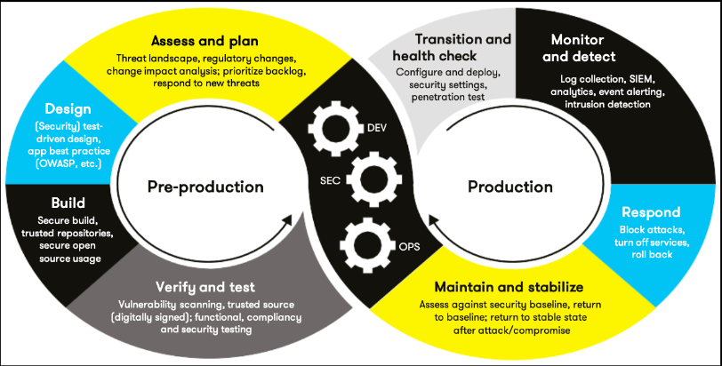
AUTOMATION

Slide 10
Automation - Tools
Always be mindful of defense in depth.
Test early and often to detect vulnerabilities, warnings, errors early. The earlier we can catch these things, the better.
THE TOOL: The DevSecOps pipeline is a secure coding tool that has a full circle approach to enforcing a policy that has an infrastructure built on efficiency and keeping code secure.

Slide 11
RISKS and BENEFITS
I have not heard of anything being 100% secure. There is always a way to find weaknesses and vulnerabilities. We need to always assume there are threats.
Constantly update, renew, and improve your security.
Keep up to date with current technology and methods.
Secure coding and following defense in depth is highly critical to the success of this policy.

Slide 12
RECOMMENDATIONS
Testing early, often and effective.
Following these recommended procedures will help keep us on track.
Following secure coding and defense in depth practices.
Keeping up with all security threats, technology, and trends.
Do not become complacent, staying on top of security maintenance.
Keep everything simple and effective.
Implement a ZERO-TRUST policy when it comes to accessing things inside and outside the company.

Slide 13
Conclusion
We have covered standards, principles, policies and best practices. Our conclusion is to follow our plan/policy to create and maintain a secure and proficient system.

