Slide 1
Location Scouting in New York State

Slide 2
Location scouting
Contractors want the best location when opening a new business and would review different factors which would affect the state of their business
Many contractors consider local vendors, suppliers, budget constraints, and more when searching for an ideal location
Selecting the best location can help alleviate the potential financial risk for a new business
Others interested in this analysis would be investors, entrepreneurs, and small businesses aiming to promote or expand their business

Slide 3
Data processing
The NYCHA Development Data book was obtained from https://data.cityofnewyork.us/Housing-Development/NYCHA-Development-Data-Book/evjd-dqpz, which contains 323 rows and 51 features
Total number and percentage of households with fixed income
Location (street address and borough)
The cleaned dataset is cleaned of any rows with Nan or null values in the four selected features mentioned above, which contains 313 rows

Slide 4
Location/financial analysis
BOROUGH | TOTAL # OF FIXED INCOME HOUSEHOLD | PERCENT FIXED INCOME HOUSEHOLDS
BRONX | 16361.0 | 32.273
BROOKLYN | 23634.0 | 40.575
MANHATTAN | 23614.0 | 48.497
QUEENS | 6014.0 | 10.433
STATEN ISLAND | 1854.0 | 5.036
We can infer from the table above that the Manhattan and Brooklyn boroughs have a large number and percentage of households with a fixed income. This type of information is useful to understand how much the business can gain profit and the amount of financial risk involved.

Slide 5
Venue analysis
 | LATITUDE | LONGITUDE | NAME | VENUE_LATITUDE | VENUE_LONGITUDE | VENUE_CATEGORY
0 | 40.847028 | -73.898061 | Napoli's Best Pizza | 40.846903 | -73.896335 | Pizza Place
1 | 40.847028 | -73.898061 | 7-Eleven | 40.846679 | -73.902036 | Convenience Store
2 | 40.847028 | -73.898061 | Tremont Park | 40.845145 | -73.895416 | Park
3 | 40.847028 | -73.898061 | Luna Night Club & Lounge | 40.846210 | -73.901241 | Nightclub
4 | 40.847028 | -73.898061 | Dunkin' | 40.844449 | -73.897744 | Donut Shop
The table above displays a portion of venues available in the different boroughs from the dataset. We can use this data to gain a better understanding of the venues located in each borough.

Slide 6
Venue cont.
Venue Category | Count
Pizza Place | 120
Coffee Shop | 119
Korean Restaurant | 102
Bar | 98
Harbor / Marina | 82
… | …
Bubble Tea Shop | 1
Pet Café | 1
Lake | 1
Rental Car Location | 1
Filipino Restaurant | 1
Venue Category | Count
Deli / Bodega | 158
Gym | 113
Café | 97
Wine Shop | 84
Friend Chicken Joint | 78
… | …
Wine Bar | 1
Fruit & Vegetable Store | 1
Mac & Cheese Joint | 1
Snack Place | 1
Community Center | 1
Since the data infers that the Manhattan and Brooklyn boroughs offer the most potential locations financially, we can continue our analysis regarding venues in these boroughs.
It’s clear that in both boroughs, there is a high number of food venues that would offer competition should a contractor start a food business.
Manhattan
Brooklyn

Slide 7
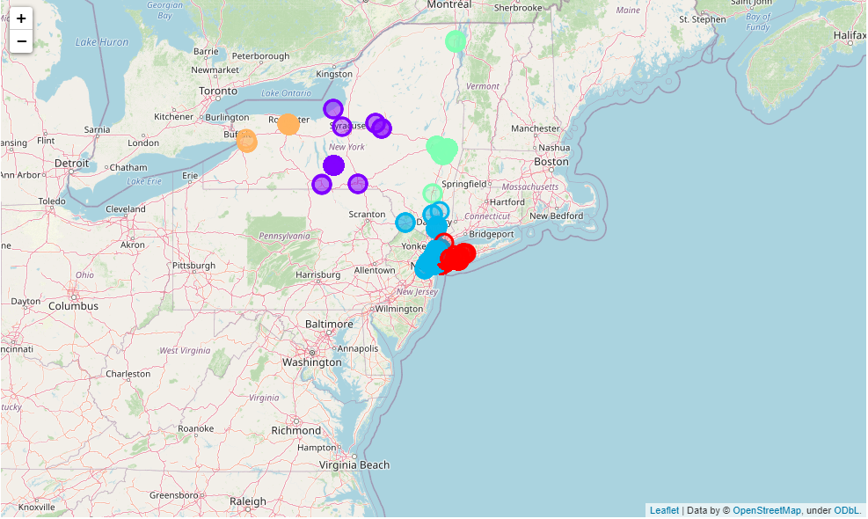
Map
In this image, we can visualize the locations of the different venues in each borough. Both the Manhattan and Brooklyn boroughs, represented as blue and red respectively, have the most clustered venues in an area.

Slide 8
Conclusion
Identify potential locations in the Manhattan and Brooklyn boroughs
Analyze venue and financial data in relation to locations
Analysis can be investigated more with additional features not available with current dataset
Local venues
Expenses
Popular areas for certain businesses

