Slide 1
Location scouting in New York State

Slide 2
Location scouting
Contractors want the best location when opening a new business.
Gain insight on scouting a potential location for new businesses
Others interested in this analysis would be investors, entrepreneurs, and small businesses aiming to promote or expand their business.

Slide 3
Data processing
The NYCHA Development Data book was obtained from https://data.cityofnewyork.us/Housing-Development/NYCHA-Development-Data-Book/evjd-dqpz, which contains 323 rows and 51 features
Total number and percentage of households with fixed income
Location (street address and borough)
The cleaned dataset is cleaned of any rows with Nan or null values in the four selected features mentioned above, which contains 313 rows

Slide 4
Location/financial analysis
BOROUGH | TOTAL # OF FIXED INCOME HOUSEHOLD | PERCENT FIXED INCOME HOUSEHOLDS
BRONX | 16361.0 | 32.273
BROOKLYN | 23634.0 | 40.575
MANHATTAN | 23614.0 | 48.497
QUEENS | 6014.0 | 10.433
STATEN ISLAND | 1854.0 | 5.036

Slide 5
Venue analysis
 | LATITUDE | LONGITUDE | NAME | VENUE_LATITUDE | VENUE_LONGITUDE | VENUE_CATEGORY
0 | 40.847028 | -73.898061 | Napoli's Best Pizza | 40.846903 | -73.896335 | Pizza Place
1 | 40.847028 | -73.898061 | 7-Eleven | 40.846679 | -73.902036 | Convenience Store
2 | 40.847028 | -73.898061 | Tremont Park | 40.845145 | -73.895416 | Park
3 | 40.847028 | -73.898061 | Luna Night Club & Lounge | 40.846210 | -73.901241 | Nightclub
4 | 40.847028 | -73.898061 | Dunkin' | 40.844449 | -73.897744 | Donut Shop

Slide 6
Venue cont.
Venue Category | Count
Pizza Place | 120
Coffee Shop | 119
Korean Restaurant | 102
Bar | 98
Harbor / Marina | 82
… | …
Bubble Tea Shop | 1
Pet Café | 1
Lake | 1
Rental Car Location | 1
Filipino Restaurant | 1
Venue Category | Count
Deli / Bodega | 158
Gym | 113
Café | 97
Wine Shop | 84
Friend Chicken Joint | 78
… | …
Wine Bar | 1
Fruit & Vegetable Store | 1
Mac & Cheese Joint | 1
Snack Place | 1
Community Center | 1
Manhattan
Brooklyn

Slide 7
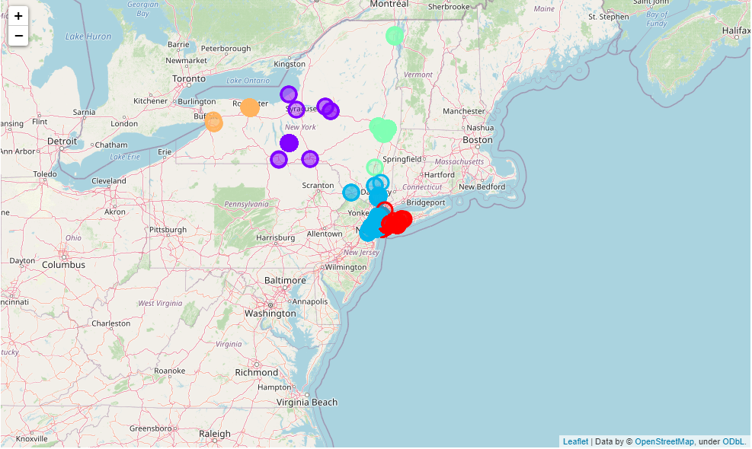
Map

Slide 8
Conclusion
Identify potential locations in different New York boroughs
Analyze venue and financial data in relation to locations
Analysis can be investigated more with additional features not available with current dataset
Local venues
Expenses
Popular areas for certain businesses

