Slide 1
Christ is Superior to Moses
Hebrews Chapter Three

Slide 2
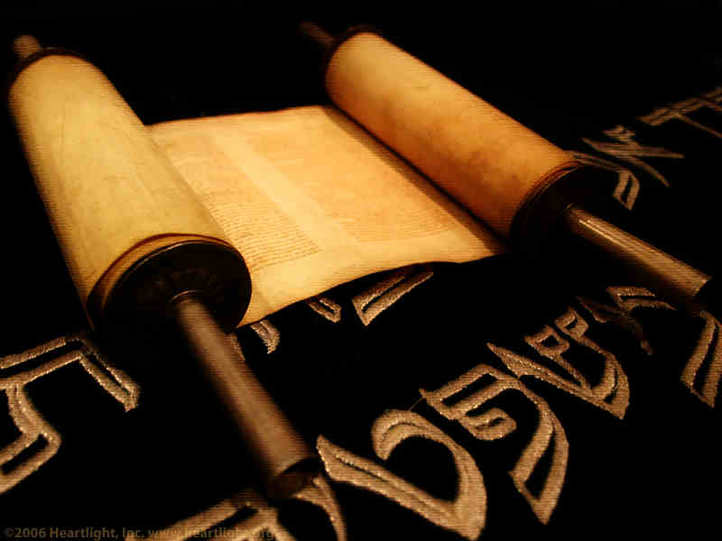
Christ Faith Is Superior to Moses’s v. 1-2

Slide 3

Christian Brotherhood v. 1
The combinations of these two words occur only here in the New Testament.
These Christians had been separated from the world because of Christ’ sacrifice.

Slide 4
Christian Calling v.1
“heavenly calling”
This is an invitation to everyone.

Slide 5
Christian Calling
I. Called from labor to rest (Matt. 11:28)
II. Called from death to life (1 John 3:14)
III. Called from bondage to liberty (Gal 5:13)
IV. Called out of darkness into light (1 Pet. 2:9)
V. Called from bondage to peace (1 Cor. 7:15
VI. Called to the fellowship of His Son (1 Cor. 1:9)
I. We are made sons of God (John 1:12)
II. We are made the children of God (Gal. 3:26)
III. We are made the servants of God (Matt. 25:21)
IV. We are made God’s saints (Col. 1:1)
V. We are made God’s witnesses (I Thess. 2:10)
VI. We are made workers together with God (2 Cor. 6:1)

Slide 6
Christian Example v.1b-2
“our profession”
“apostle and high priest”
“faithful”

Slide 7
Christ Position Is Superior to Moses’s v. 3-6

Slide 8
Jesus built the house and Moses only lived in it.
“worthy of more glory than Moses”
“he that built all things is God”

Slide 9
Jesus is the son of the house and Moses is only a servant
Moses was faithful in his house.
Christ is faithful over his house.
Both are faithful but Christ is better because of his position in his own house.

Slide 10
A Warning to the House of God v. 7-19

Slide 11
The Unbelief of Israel v. 7-15
Wonders of God v.9
Wrath of God v.11
Winners in God v. 14-15

Slide 12
The Penalty of Israel v. 16-19
They did not enter.
  Because of their unbelief.

Slide 13
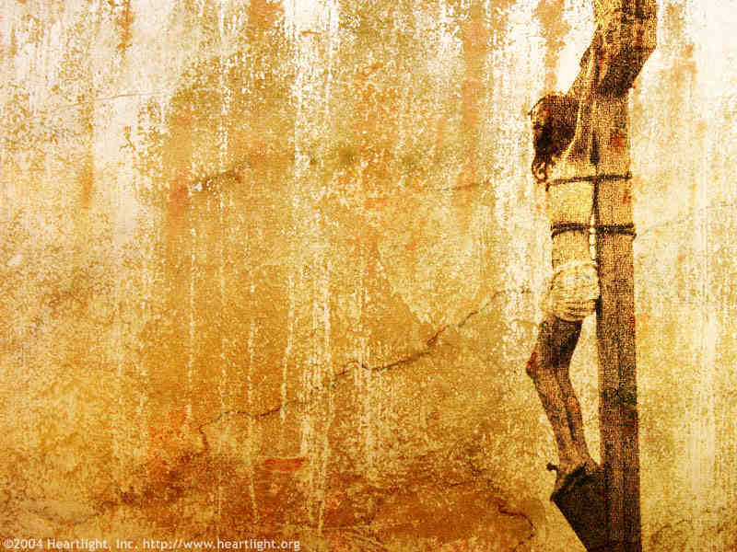
Christ is better than Moses
Christ faith is Superior
Christ Position is Superior
Christ House is Superior
The House of God is encouraged to reach for greater faith.
  Remember your confession
  Beware of unbelief

