Slide 1
Moving Forward to Spiritual Maturity
Hebrews Chapter Six

Slide 2
The Peril of no Progress (vs. 1-8).
Pronouncement (v. 1a).
Plan (vs. 1b-3).
Problem (vs. 4-8)

Slide 3
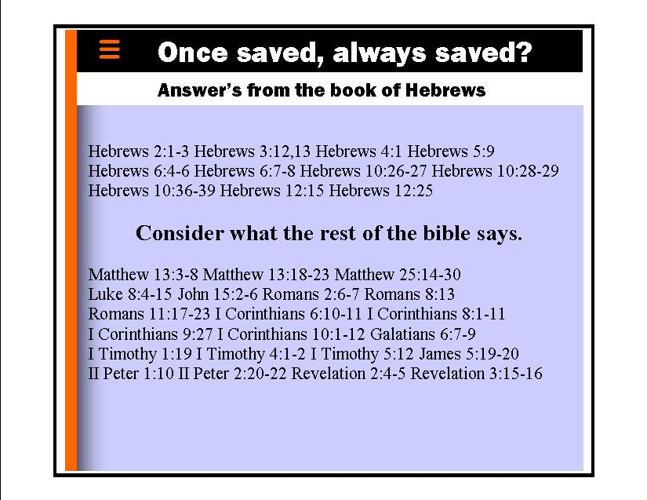

Slide 4
The Promise for Progress (vs. 9-12).
Persuasion (v. 9).
Promise (v. 10).
Perseverance (v. 11).
Patience (v. 12).

Slide 5
The Proof of Progress (vs. 13-20).
Partnership (vs. 13-15).
Pact (vs. 16-18a).
Pledge (vs. 18b-20).

