Slide 1
Tetris System Design
Zhigang Ji

Slide 2
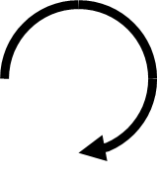
Overall Design
▣
▣
▣
▣
▣
▣
▣
▣
▣
▣
SCORE
▣
▣
▣
▣
▣
▣
▣
▣
▣
▣
▣
▣
▣
▣
▣
▣
▣
▣
▣
▣
▣
▣
▣
▣
▣
▣
▣
▣
▣
▣
▣
▣
▣
▣
▣
▣
▣
▣
▣
▣
SPEED LEVEL
▣
▣
▣
▣
▣
▣
▣
▣
▣
▣
▣
▣
Machine
Screen
Playfield - left side
Background Matrix
Running Piece
Info – right side
Score
Speed Level
Next
Footer Indicators
Keyboard
▣
▣
▣
▣
▣
▣
▣
▣
▣
▣
▣
▣
▣
▣
▣
▣
▣
▣
▣
▣
▣
▣
▣
▣
▣
▣
▣
▣
▣
▣
▣
▣
NEXT
▣
▣
▣
▣
▣
▣
▣
▣
▣
▣
▣
▣
▣
▣
▣
▣
▣
▣
▣
▣
▣
▣
▣
▣
▣
▣
▣
▣
▣
▣
▣
▣
▣
▣
▣
▣
▣
▣
▣
▣
▣
▣
▣
▣
▣
▣
▣
▣
▣
▣
▣
▣
▣
▣
▣
▣
▣
▣
▣
▣
▣
▣
▣
▣
▣
▣
▣
▣
▣
▣
▣
▣
▣
▣
▣
▣
▣
▣
▣
▣
▣
▣
▣
▣
▣
▣
▣
▣
▣
▣
▣
▣
▣
▣
▣
▣
▣
▣
▣
▣
▣
▣
▣
▣
▣
▣
▣
▣
▣
▣
▣
▣
▣
▣
▣
▣
▣
▣
▣
▣
▣
▣
▣
▣
🎵
14: 25
START/PAUSE
ROTATE
🎵
SOUND
LEFT
RIGHT
DROP
RESET

Slide 3
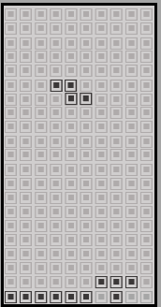
Essential Concepts
Playfield
Piece
Block
▣
▣
▣
▣
▣
▣
▣
▣
A piece in Tetris and similar games is a geometric shape consisting of a set of blocks that is moved as a unit.
▣
A block is the part of a piece that fills one unit of the playfield.

Slide 4
Piece Shapes
▣
▣
▣
T
L
J
Z
S
O
I
▣
▣
▣
▣
▣
▣
▣
▣
▣
▣
▣
▣
▣
▣
▣
▣
▣
▣
▣
▣
▣
▣
▣
▣
▣

Slide 5
Piece Direction
▣
▣
▣
Up
Down
Left
Right
▣
▣
▣
▣
▣
▣
▣
▣
▣
▣
▣
▣
▣

Slide 6
Rotate
Clockwise
Up -> Right -> Down -> Left -> Up
Anti Clockwise
Up -> Left -> Down -> Right -> Up

Slide 7
Coordinate System
0: at the TOP-LEFT corner
0
X
Y

Slide 8
Piece Definitions
▣
▣
▣
▣
4x4 matrix
Keep left (except Shape I)
Keep top (except Shape I)
Hex Code
▣
▣
▣
▣
▣
▣
▣
▣
▣
▣
▣
▣
▣
▣
▣
▣
0 0 0 0
1 1 1 1
0 0 0 0
0 0 0 0
0
F
0
0
▣
▣
▣
▣
1 1 0 0
1 1 0 0
0 0 0 0
0 0 0 0
C
C
0
0
▣
▣
▣
▣
0x 0F00
▣
▣
▣
▣
0x CC00
▣
▣
▣
▣
▣
▣
▣
▣
▣
▣
▣
▣
▣
▣
▣
▣
▣
▣
▣
▣
0 1 0 0
1 1 1 0
0 0 0 0
0 0 0 0
4
E
0
0
▣
▣
▣
▣
1 1 1 0
1 0 0 0
0 0 0 0
0 0 0 0
E
8
0
0
▣
▣
▣
▣
0x 4E00
▣
▣
▣
▣
0x E800
▣
▣
▣
▣
▣
▣
▣
▣
▣
▣
▣
▣
▣
▣
▣
▣
▣
▣
▣
▣
0 1 1 0
1 1 0 0
0 0 0 0
0 0 0 0
6
C
0
0
▣
▣
▣
▣
1 0 0 0
1 1 1 0
0 0 0 0
0 0 0 0
8
E
0
0
▣
▣
▣
▣
0x 6C00
▣
▣
▣
▣
▣
▣
▣
▣
▣
▣
▣
▣
0x 8E00
▣
▣
▣
▣
▣
▣
▣
▣
▣
▣
▣
▣
1 1 0 0
0 1 1 0
0 0 0 0
0 0 0 0
C
6
0
0
▣
▣
▣
▣
0x C600
▣
▣
▣
▣
▣
▣
▣
▣

Slide 9
Piece Position
0
X
Start from 0
(X, Y):
The position of the whole piece in the playfield
(x, y):
The position of a block in the piece
(X, Y) = (3, 5)
x
0
▣
▣
▣
▣
▣
▣
▣
▣
(x, y) = (1, 1)
▣
▣
▣
▣
▣
▣
▣
▣
Y
y

Slide 10
Events/Actions
KEY_LEFT
KEY_RIGHT
KEY_ROTATE_CLOCKWISE
KEY_DOWN
KEY_DROP_TO_END
KEY_START_PAUSE
SET_READY
TICK
KEY_TOGGLE_SOUND
KEY_RESET

Slide 11
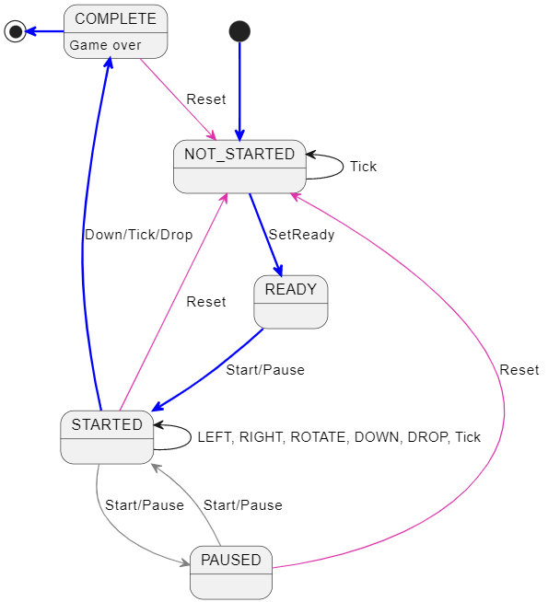
FSM: Finite State Machine
NOT_STARTED
READY
STARTED
PAUSED
COMPLETED
Main transition path
Reset
Toggle Start/Pause
In-state transitions

Slide 12
Collision Detections
Running Piece
Only consider occupied blocks: Piece[x][y] == 1
The running piece is in the playfield
① X + x < W
② X + x >= 0
③ Y + y < H
The piece is not overlapping to the background matrix
④ PlayField[X + x][Y + y] != 1
0
W
X
▣
▣
▣
①
▣
▣
▣
▣
▣
▣
▣
▣
▣
▣
▣
▣
▣
②
▣
▣
▣
▣
▣
▣
▣
▣
▣
▣
▣
▣
▣
▣
▣
▣
④
▣
▣
▣
▣
③
▣
▣
▣
▣
▣
▣
▣
▣
▣
▣
▣
▣
▣
▣
▣
▣
H
▣
▣
▣
▣
▣
▣
▣
▣
▣
▣
▣
▣
Y

Slide 13
Machine
▣
▣
▣
▣
▣
▣
▣
▣
▣
▣
SCORE
▣
▣
▣
▣
▣
▣
▣
▣
▣
▣
▣
▣
▣
▣
▣
▣
▣
▣
▣
▣
▣
▣
▣
▣
▣
▣
▣
▣
▣
▣
▣
▣
▣
▣
▣
▣
▣
▣
▣
Playfield
▣
SPEED LEVEL
▣
▣
▣
▣
▣
▣
▣
▣
▣
▣
▣
▣
Screen
▣
▣
▣
▣
▣
▣
▣
▣
▣
▣
▣
▣
▣
▣
▣
▣
▣
▣
▣
▣
▣
▣
▣
▣
▣
▣
▣
▣
▣
▣
▣
▣
NEXT
▣
▣
▣
▣
▣
▣
▣
▣
▣
▣
▣
▣
▣
▣
▣
▣
▣
▣
▣
▣
▣
▣
▣
▣
▣
▣
▣
▣
▣
▣
▣
▣
▣
▣
▣
▣
▣
▣
▣
▣
▣
▣
▣
▣
▣
▣
▣
▣
▣
▣
▣
▣
▣
▣
▣
▣
▣
▣
▣
▣
▣
▣
▣
▣
▣
▣
▣
▣
▣
▣
▣
▣
▣
▣
▣
▣
▣
▣
▣
▣
▣
▣
▣
▣
▣
▣
▣
▣
▣
▣
▣
▣
▣
▣
▣
▣
▣
▣
▣
▣
▣
▣
▣
▣
▣
▣
▣
▣
▣
▣
▣
▣
▣
▣
▣
▣
▣
▣
▣
▣
▣
▣
▣
▣
🎵
14: 25
START/PAUSE
ROTATE
🎵
Keyboard
SOUND
LEFT
RIGHT
DROP
RESET

